Slide 1
CSE 3400 - Introduction to Computer & Network Security (aka: Introduction to Cybersecurity) Lecture 2 Encryption – Part I
Ghada Almashaqbeh
UConn
From Textbook Slides by Prof. Amir Herzberg
UConn

Slide 2
Outline
Introduction and motivation.
Ancient ciphers.
Kerckhoffs' Principle.
Encryption attacker models.

Slide 3



Encryption
Prevention of exposure of secret information
Earliest and `basic’ tool of cryptology
Related terms:
Cryptography: `secret writing’
Cryptanalysis: `breaking’ encryption
Encryption scheme = Cryptosystem = Cipher
Encrypt
Decrypt

Slide 4
The Encryption World: basic terms
Goal: encrypt plaintext into ciphertext
Only legit-recipient can decrypt ciphertext to plaintext
Adversary cannot learn anything from ciphertext
Idea: decryption uses secret algorithm and/or key
Variants:
Keyed or unkeyed?
Shared key (symmetric) or public/private keys (asymmetric)?
Stateful / stateless ? Randomized ? Input size ?
key
key
plaintext
ciphertext
plaintext
Encrypt
Decrypt
Notes:
4
10/30/11
Asymmetric = public key

Slide 5
Encryption, Decryption, Correctness
Key k
Plaintext
m
Encrypt E
Ciphertext c=E_{k}(m)
Key k
Ciphertext c
Decrypt D
Plaintext m=D_{k}(c)
Key k
Key k
Plaintext
m
Encrypt E
Ciphertext c=E_{k}(m)
Decrypt D
Plaintext D_{k}(c)
Correctness: m=D_{k}(E_{k}(m))

Slide 6
Ancient, Keyless Ciphers
Ancient ciphers were simple, naive
No key: secrecy is in the algorithm
Monoalphabetic ciphers: encrypt/decrypt one character at a time
Plaintext, ciphertext are both single letters
A set {<E,D>} of permutation + inverse: m=D(E(m))

Slide 7
AzBy Cipher
AzBy Cipher
Based on the (Hebrew) At-BaSh, the first documented cipher [Jeremiah]
Substitute the first letter of alphabet by the last… and so on:
Mathematically: Let A be 0, B be 1, …, Z be 25. Let m denote plaintext and c denote ciphertext.
c = Enc(m) = 25 – m
m = Dec(c) = 25 - c
Plaintext:
A | B | C | . | . | . | . | X | Y | Z
Ciphertext:
Z | Y | X | . | . | . | . | C | B | A

Slide 8
(Unkeyed) Caesar Cipher
Used by Julius Caesar
Rotate the 26 letters of the alphabet by 3:
A B C D E F G H I J K L M N O P Q …
A B C D E F G H I J K L M N O P Q …
As formula:
c = E(m) = m+3 (mod 26)
m = D(c) = c-3 (mod 26)
Ceasar and AzBy are trivial to cryptanalyze
No key – algorithm itself is `secret`
‘Security by obscurity’
+3

Slide 9
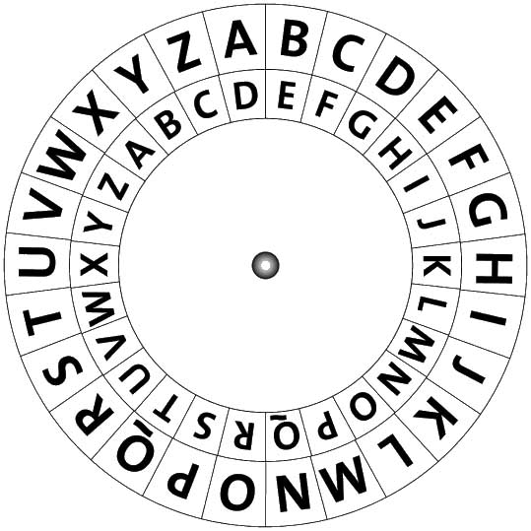
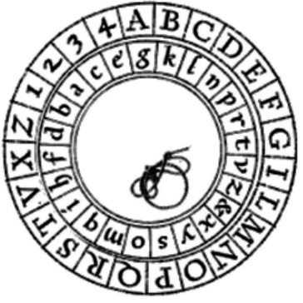
Monoalphabetic Substitution Ciphers
Generalize Caesar and AzBy:
Other permutations of letters
To letters or to other symbols (no real difference)
Keyed: Given key k, cipher E_{k} is a permutation
Or: the ‘key’ is simply the permutation (table)
Classical, `elementary school’ cryptosystem
Examples:
Vulnerable to letter-frequency cryptanalysis

Slide 10
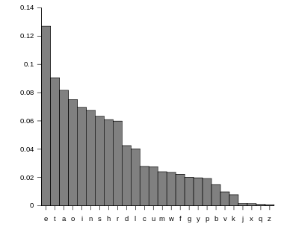
Letter frequencies (in English)
Other useful statistic:
Bigrams, Trigrams…
First/Last letter in words, sentences
Etc…

Slide 11
Example: Frequency Cryptanalysis
Given ciphertext:
UZQSOVUOHXMOPVGPOZPEVSGZWSZOPFPESXUDBMETSXAIZ
VUEPHZHMDZSHZOWSFPAPPDTSVPQUZWYMXUZUHSX
EPYEPOPDZSZUFPOMBZWPFUPZHMDJUDTMOHMQ
Count relative letter frequencies:
A | B | C | D | E | F | G | H | I | J | K | L | M
2 | 2 | 0 | 6 | 6 | 4 | 2 | 7 | 1 | 1 | 0 | 0 | 8
N | O | P | Q | R | S | T | U | V | W | X | Y | Z
0 | 9 | 16 | 3 | 0 | 10 | 3 | 10 | 5 | 4 | 5 | 2 | 14

Slide 12
Example: Frequency Cryptanalysis
Given ciphertext:
UZQSOVUOHXMOPVGPOZPEVSGZWSZOPFPESXUDBMETSXAIZ
VUEPHZHMDZSHZOWSFPAPPDTSVPQUZWYMXUZUHSX
EPYEPOPDZSZUFPOMBZWPFUPZHMDJUDTMOHMQ
Sorted:
P | Z | S | U | O | M | H | D | E | V | X | F | W
16 | 14 | 10 | 10 | 9 | 8 | 7 | 6 | 6 | 5 | 5 | 4 | 4
e | t
Q | T | A | B | G | Y | I | J | C | K | L | N | R
3 | 3 | 2 | 2 | 2 | 2 | 1 | 1 | 0 | 0 | 0 | 0 | 0
Most frequent letter is e, so: P=E(e)
Second frequent is t, so: Z=E(t) … let’s replace…

Slide 13
Example: Frequency Cryptanalysis
Given ciphertext:
UtQSOVUOHXMOeVGeOteEVSGtWStOeFeESXUDBMETSXAIt
VUEeHtHMDtSHtOWSFeAeeDTSVeQUtWYMXUtUHSX
EeYEeOeDtStUFeOMBtWeFUetHMDJUDTMOHMQ
Sorted:
P | Z | S | U | O | M | H | D | E | V | X | F | W
16 | 14 | 10 | 10 | 9 | 8 | 7 | 6 | 6 | 5 | 5 | 4 | 4
e | t
Q | T | A | B | G | Y | I | J | C | K | L | N | R
3 | 3 | 2 | 2 | 2 | 2 | 1 | 1 | 0 | 0 | 0 | 0 | 0
In English texts, `t` is often followed by `h`. Count chars following Z (t):
Twice: W, H, U and O; once: Q, V, D & S.
Pick W, since this gives `the’…

Slide 14
Example: Frequency Cryptanalysis
Given ciphertext:
UtQSOVUOHXMOeVGeOteEVSGthStOeFeESXUDBMETSXAIt
VUEeHtHMDtSHtOhSFeAeeDTSVeQUthYMXUtUHSX
EeYEeOeDtStUFeOMBtheFUetHMDJUDTMOHMQ
Sorted:
P | Z | S | U | O | M | H | D | E | V | X | F | W
16 | 14 | 10 | 10 | 9 | 8 | 7 | 6 | 6 | 5 | 5 | 4 | 4
e | t | a |  |  |  |  |  |  |  |  |  | h
Q | T | A | B | G | Y | I | J | C | K | L | N | R
3 | 3 | 2 | 2 | 2 | 2 | 1 | 1 | 0 | 0 | 0 | 0 | 0
We have thSt with S being third-most common. After e and t, most common letters are: aoinshr (in this order). Only `a` fits, so…

Slide 15
Example: Frequency Cryptanalysis
Given ciphertext:
UtQaOVUOHXMOeVGeOteEVaGthatOeFeEaXUDBMETaXAIt
VUEeHtHMDtaHtOhaFeAeeDTaVeQUthYMXUtUHaX
EeYEeOeDtatUFeOMBtheFUetHMDJUDTMOHMQ
Sorted:
P | Z | S | U | O | M | H | D | E | V | X | F | W
16 | 14 | 10 | 10 | 9 | 8 | 7 | 6 | 6 | 5 | 5 | 4 | 4
e | t | a |  |  |  |  |  |  |  |  |  | h
Q | T | A | B | G | Y | I | J | C | K | L | N | R
3 | 3 | 2 | 2 | 2 | 2 | 1 | 1 | 0 | 0 | 0 | 0 | 0
Next common in ciphertext is U and in English are oinshr (in this order). Few, rare words begin with `ot’ (and not `oth’), but `it` is common, so: U=E(i) !

Slide 16
Example: Frequency Cryptanalysis
Given ciphertext:
itQaOViOHXMOeVGeOteEVaGthatOeFeEaXiDBMETaXAIt
ViEeHtHMDtaHtOhaFeAeeDTaVeQithYMXitiHaX
EeYEeOeDtatiFeOMBtheFietHMDJiDTMOHMQ
Sorted:
P | Z | S | U | O | M | H | D | E | V | X | F | W
16 | 14 | 10 | 10 | 9 | 8 | 7 | 6 | 6 | 5 | 5 | 4 | 4
e | t | a | i |  |  |  |  |  |  |  |  | h
Q | T | A | B | G | Y | I | J | C | K | L | N | R
3 | 3 | 2 | 2 | 2 | 2 | 1 | 1 | 0 | 0 | 0 | 0 | 0
Next common in ciphertext are OMH and in English are onsr (in this order). ‘O’=E(‘o’) is unlikely since it gives `that oeFeEa…` ➔ try ‘M’=E(‘o’)…

Slide 17
Example: Frequency Cryptanalysis
Given ciphertext:
itQaOViOHXoOeVGeOteEVaGthatOeFeEaXiDBoETaXAIt
ViEeHtHoDtaHtOhaFeAeeDTaVeQithYoXitiHaX
EeYEeOeDtatiFeOoBtheFietHoDJiDToOHoQ
Sorted:
P | Z | S | U | O | M | H | D | E | V | X | F | W
16 | 14 | 10 | 10 | 9 | 8 | 7 | 6 | 6 | 5 | 5 | 4 | 4
e | t | a | i |  | o |  |  |  |  |  |  | h
Q | T | A | B | G | Y | I | J | C | K | L | N | R
3 | 3 | 2 | 2 | 2 | 2 | 1 | 1 | 0 | 0 | 0 | 0 | 0
Next common in ciphertext is O and in English is s… go for it: O=E(s)!

Slide 18
Example: Frequency Cryptanalysis
Given ciphertext:
itQasVisHXoseVGesteEVaG that seFeEaXiDBoETaXAIt
ViEeHtHoDtaHtshaFeAeeDTaVeQithYoXitiHaX
EeYEeseDtatiFesoBtheFietHoDJiDTosHoQ
Sorted:
P | Z | S | U | O | M | H | D | E | V | X | F | W
16 | 14 | 10 | 10 | 9 | 8 | 7 | 6 | 6 | 5 | 5 | 4 | 4
e | t | a | i | s | o |  |  |  |  |  |  | h
Q | T | A | B | G | Y | I | J | C | K | L | N | R
3 | 3 | 2 | 2 | 2 | 2 | 1 | 1 | 0 | 0 | 0 | 0 | 0
`that’ is mostly one word. Most common last-letter not assigned yet is `y`, which is not a common word, so: G=E(y)…

Slide 19
Example: Frequency Cryptanalysis
Given ciphertext:
itQasVisHXoseVyesteEVay that seFeEaXiDBoETaXAIt
ViEeHtHoDtaHtshaFeAeeDTaVeQithYoXitiHaX
EeYEeseDtatiFesoBtheFietHoDJiDTosHoQ
Sorted:
P | Z | S | U | O | M | H | D | E | V | X | F | W
16 | 14 | 10 | 10 | 9 | 8 | 7 | 6 | 6 | 5 | 5 | 4 | 4
e | t | a | i | s | o |  |  |  |  |  |  | h
Q | T | A | B | G | Y | I | J | C | K | L | N | R
3 | 3 | 2 | 2 | 2 | 2 | 1 | 1 | 0 | 0 | 0 | 0 | 0
 |  |  |  | y
We now simply recognize the (quite common) word `yesterday’, so:
E=E(r), V=E(d)…

Slide 20
Example: Frequency Cryptanalysis
Given ciphertext:
itQasdisHXosed yesterday that seFeraXiDBorTaXAIt
direHtHoDtaHtshaFeAeeDTadeQithYoXitiHaX
reYreseDtatiFesoBtheFietHoDJiDTosHoQ
Sorted:
P | Z | S | U | O | M | H | D | E | V | X | F | W
16 | 14 | 10 | 10 | 9 | 8 | 7 | 6 | 6 | 5 | 5 | 4 | 4
e | t | a | i | s | o |  |  | r | d |  |  | h
Q | T | A | B | G | Y | I | J | C | K | L | N | R
3 | 3 | 2 | 2 | 2 | 2 | 1 | 1 | 0 | 0 | 0 | 0 | 0
 |  |  |  | y
Next unused common letter is n (by far). But H doesn’t seem to fit… so D=E(n)…

Slide 21
Example: Frequency Cryptanalysis
Given ciphertext:
itQasdisHXosed yesterday that seFeraXinBorTaXAIt
direHtHontaHtshaFeAeenTadeQithYoXitiHaX
reYresentatiFesoBtheFietHonJinTosHoQ
Sorted:
P | Z | S | U | O | M | H | D | E | V | X | F | W
16 | 14 | 10 | 10 | 9 | 8 | 7 | 6 | 6 | 5 | 5 | 4 | 4
e | t | a | i | s | o |  | n | r | d |  |  | h
Q | T | A | B | G | Y | I | J | C | K | L | N | R
3 | 3 | 2 | 2 | 2 | 2 | 1 | 1 | 0 | 0 | 0 | 0 | 0
 |  |  |  | y
Long string with only one cipher-letter, H… only c fits so: H=E(c)…

Slide 22
Example: Frequency Cryptanalysis
Given ciphertext:
itQasdiscXosed yesterday that seFeraXinBorTaXAIt
direct contacts haFeAeenTadeQithYoXiticaX
reYresentatiFesoBtheFietconJinToscoQ
Sorted:
P | Z | S | U | O | M | H | D | E | V | X | F | W
16 | 14 | 10 | 10 | 9 | 8 | 7 | 6 | 6 | 5 | 5 | 4 | 4
e | t | a | i | s | o | c | n | r | d |  |  | h
Q | T | A | B | G | Y | I | J | C | K | L | N | R
3 | 3 | 2 | 2 | 2 | 2 | 1 | 1 | 0 | 0 | 0 | 0 | 0
 |  |  |  | y
Next common cipher-letter is X and plain-letter is l, and it indeed fits: X=E(l) !

Slide 23
Example: Frequency Cryptanalysis
Given ciphertext:
itQas disclosed yesterday that seFeralinBorTalAIt
direct contacts haFeAeenTadeQithYolitical
reYresentatiFesoBtheFietconJinToscoQ
Sorted:
P | Z | S | U | O | M | H | D | E | V | X | F | W
16 | 14 | 10 | 10 | 9 | 8 | 7 | 6 | 6 | 5 | 5 | 4 | 4
e | t | a | i | s | o | c | n | r | d | l |  | h
Q | T | A | B | G | Y | I | J | C | K | L | N | R
3 | 3 | 2 | 2 | 2 | 2 | 1 | 1 | 0 | 0 | 0 | 0 | 0
 |  |  |  | y
Next identify text begins with `it was’ and also two quite common words so : Q=E(w), Y=E(p), F=E(v) !

Slide 24
Example: Frequency Cryptanalysis
Given ciphertext:
it was disclosed yesterday that several inBorTalAIt
direct contacts have AeenTade with political
representatives oBthevietconJinToscow
Sorted:
P | Z | S | U | O | M | H | D | E | V | X | F | W
16 | 14 | 10 | 10 | 9 | 8 | 7 | 6 | 6 | 5 | 5 | 4 | 4
e | t | a | i | s | o | c | n | r | d | l | v | h
Q | T | A | B | G | Y | I | J | C | K | L | N | R
3 | 3 | 2 | 2 | 2 | 2 | 1 | 1 | 0 | 0 | 0 | 0 | 0
w |  |  |  | y | p
Next: `oB’->`of’, ‘Aeen’->been, `Tade’->made, `vietconJ’->Vietcong, ..

Slide 25
Example: Frequency Cryptanalysis
Given ciphertext:
it was disclosed yesterday that several informal bIt
direct contacts have been made with political
representatives of the vietcong in moscow
Sorted:
P | Z | S | U | O | M | H | D | E | V | X | F | W
16 | 14 | 10 | 10 | 9 | 8 | 7 | 6 | 6 | 5 | 5 | 4 | 4
e | t | a | i | s | o | c | n | r | d | l | v | h
Q | T | A | B | G | Y | I | J | C | K | L | N | R
3 | 3 | 2 | 2 | 2 | 2 | 1 | 1 | 0 | 0 | 0 | 0 | 0
w | m | b | f | y | p |  | g
(finally: I=E(u) )

Slide 26
Security-by-Obscurity Ciphers
Previous ciphers’ security relied on obscurity
I.e., hope attacker does not know cipher
Used extensively untill 1883
… but usually cryptanalyzed
… esp. after encryption devices were captured
What happened in 1883??
A conceptual leap in cryptography and security

Slide 27
Kerckhoffs’ Known Design Principle [1883]
Assume adversary knows the design – everything except the secret keys
No `security by obscurity’
Although attacking obscure design is harder
Why assume/use public design ?
No need to replace system once design is exposed
Usually stronger
Establish standards for multiple applications:
Efficiency of production and of test attacks / cryptanalysis
Secrecy is based only on secrecy of key
a
Notes:
27
10/30/11

Slide 28
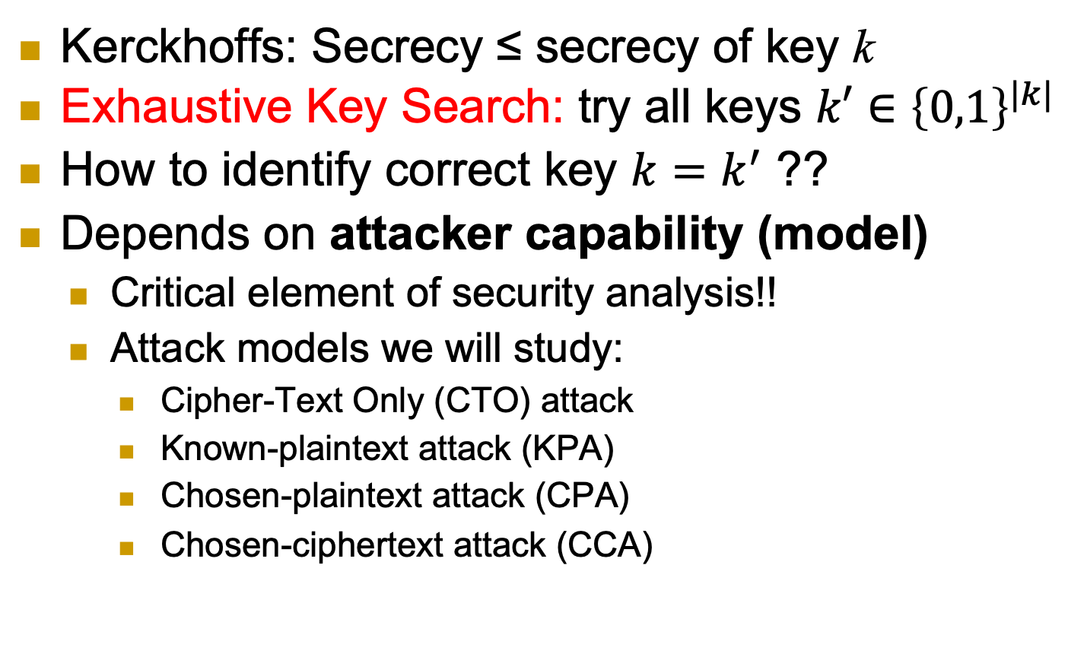
Exhaustive Key Search
Kerckhoffs: Secrecy ≤ secrecy of key k
Exhaustive Key Search: try all keys $k′∈{\left\{0,1\right\}}^{|k|}$
How to identify correct key $k=k^{′}$ ??
Depends on attacker capability (model)
Critical element of security analysis!!
Attack models we will study:
Cipher-Text Only (CTO) attack
Known-plaintext attack (KPA)
Chosen-plaintext attack (CPA)
Chosen-ciphertext attack (CCA)
Notes:
28
10/30/11

Slide 29



Cipher-Text Only (CTO) attack
Adversary have previous knowledge about all possible plaintexts, like their distribution.
Attacker can infer info about the challenge plaintext m* beyond the initial info it has.
This is given only ciphertexts and the plaintext distribution
E_{k}
D_{k}
m*
c₁=E_{k}(m₁), c₂=E_{k}(m₂), … , c*=E_{k}(m*)
m1, m2,…
m_{1,} m_{2,}…
m*
Info about m* (beyond distribution)
a
Notes:
29
10/30/11

Slide 30
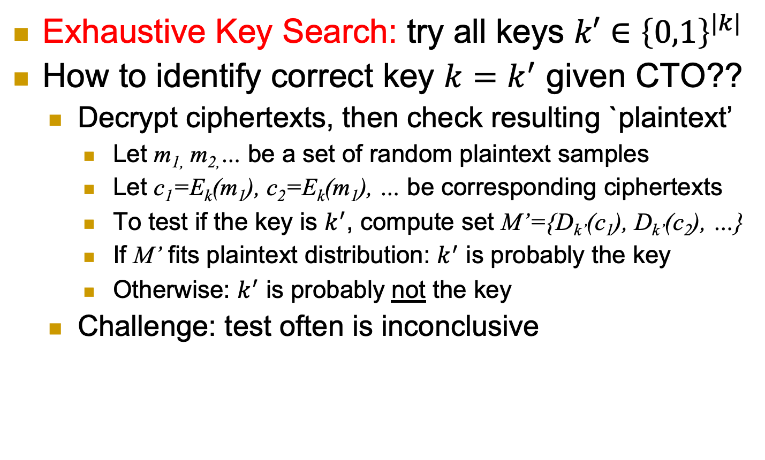
Exhaustive Key Search and CTO
Exhaustive Key Search: try all keys $k′∈{\left\{0,1\right\}}^{|k|}$
How to identify correct key $k=k^{′}$ given CTO??
Decrypt ciphertexts, then check resulting `plaintext’
Let m_{1,} m_{2,}… be a set of random plaintext samples
Let c₁=E_{k}(m₁), c₂=E_{k}(m₁), … be corresponding ciphertexts
To test if the key is $k^{′}$, compute set M’={D_{k’}(c₁), D_{k’}(c₂), …}
If M’ fits plaintext distribution: $k^{′}$ is probably the key
Otherwise: $k^{′}$ is probably not the key
Challenge: test often is inconclusive
Notes:
30
10/30/11

Slide 31
Known Plaintext Attack (KPA)
Sample messages M={m₁, m₂,…} from a given distribution.
Give M and ciphertexts c₁=E(m₁), c₂, … to attacker
E
D
m_{1,} m_{2,}…
c₁=E(m₁), c₂=E(m₂), … , c*=E(m*)
m*
Info about m* (beyond distribution)
a
Notes:
31
10/30/11

Slide 32
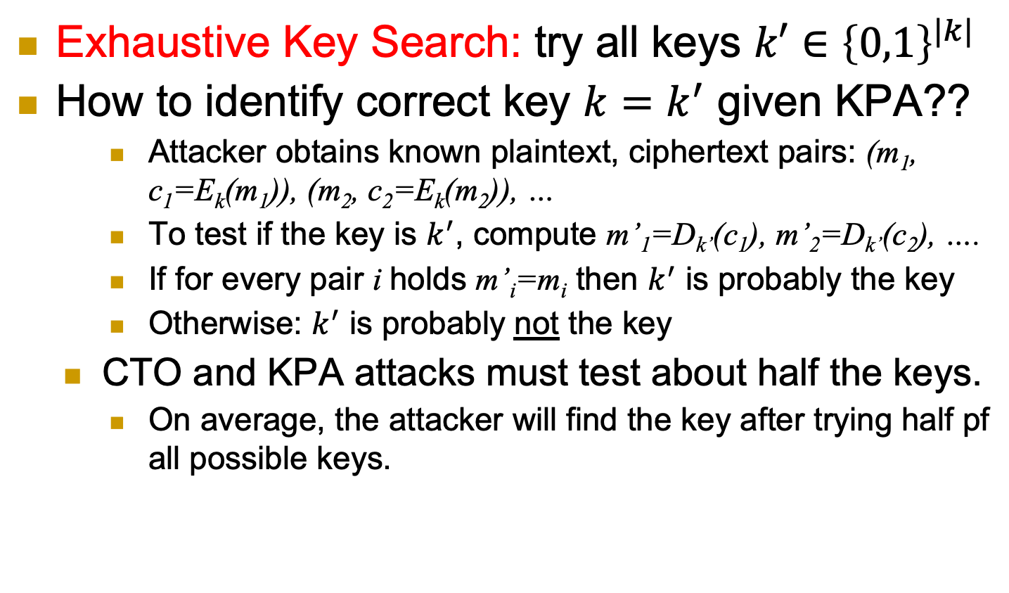
Exhaustive Key Search and KPA
Exhaustive Key Search: try all keys $k′∈{\left\{0,1\right\}}^{|k|}$
How to identify correct key $k=k^{′}$ given KPA??
Attacker obtains known plaintext, ciphertext pairs: (m₁, c₁=E_{k}(m₁)), (m₂, c₂=E_{k}(m₂)), …
To test if the key is $k^{′}$, compute m’₁=D_{k’}(c₁), m’₂=D_{k’}(c₂), ….
If for every pair i holds m’_{i}=m_{i} then $k^{′}$ is probably the key
Otherwise: $k^{′}$ is probably not the key
CTO and KPA attacks must test about half the keys.
On average, the attacker will find the key after trying half pf all possible keys.
a
Notes:
32
10/30/11

Slide 33
Chosen Plaintext Attack (CPA)
Beside the plaintext distribution/initial info, attacker can choose messages m₁, m₂,…
Give ciphertexts of these plaintext messages to attacker.
E
D
m_{1,} m_{2,}…
c₁=E(m₁), c₂=E(m₂), … , c*=E(m*)
m*
Info about m* (beyond distribution)
a
Notes:
33
10/30/11

Slide 34
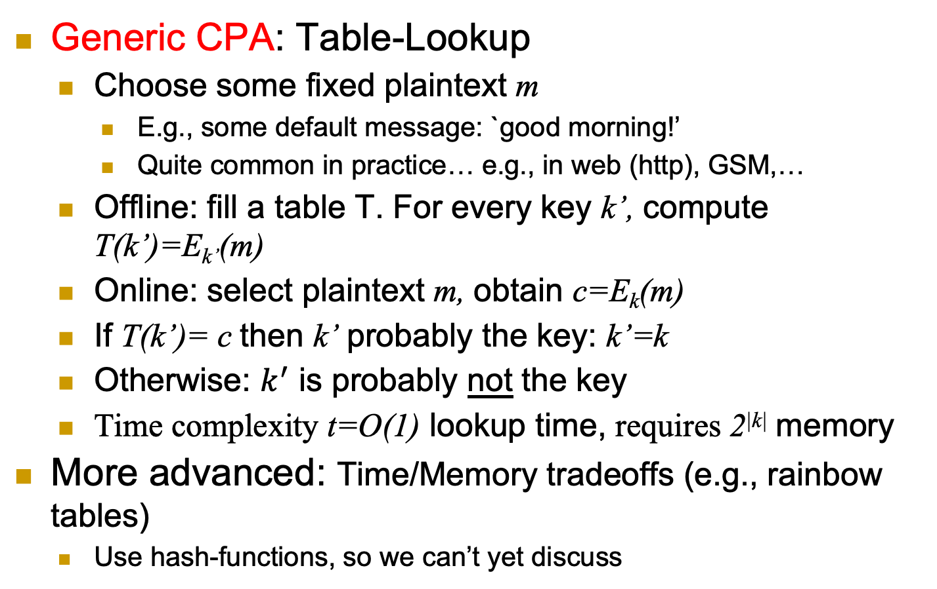
Exhaustive Key Search and CPA
Generic CPA: Table-Lookup
Choose some fixed plaintext m
E.g., some default message: `good morning!’
Quite common in practice… e.g., in web (http), GSM,…
Offline: fill a table T. For every key k’, compute T(k’)=E_{k’}(m)
Online: select plaintext m, obtain c=E_{k}(m)
If T(k’)= c then k’ probably the key: k’=k
Otherwise: $k^{′}$ is probably not the key
Time complexity t=O(1) lookup time, requires 2^{|k|} memory
More advanced: Time/Memory tradeoffs (e.g., rainbow tables)
Use hash-functions, so we can’t yet discuss
a
Notes:
34
10/30/11

Slide 35
Chosen Ciphertext Attack (CCA)
Attacker can select ciphertexts c₁, c₂,…
And receive decryptions:
E
D
m*
c*=E(m*)
c₁, c₂ ,…
m₁=D(c₁), m₂=D(c₂), …
Info about m* (beyond distribution)
a
Notes:
35
10/30/11

Slide 36
The Attack Models Championship
We discussed several attack models:
CTO, KPA, CPA, CCA
Model A is stronger than model B, if a cipher secure against A is also secure against B
Notation: A > B
Example: KPA > CTO [why?]
KPA vs. CPA ?
KPA vs. CCA?
CPA vs. CCA ?

Slide 37
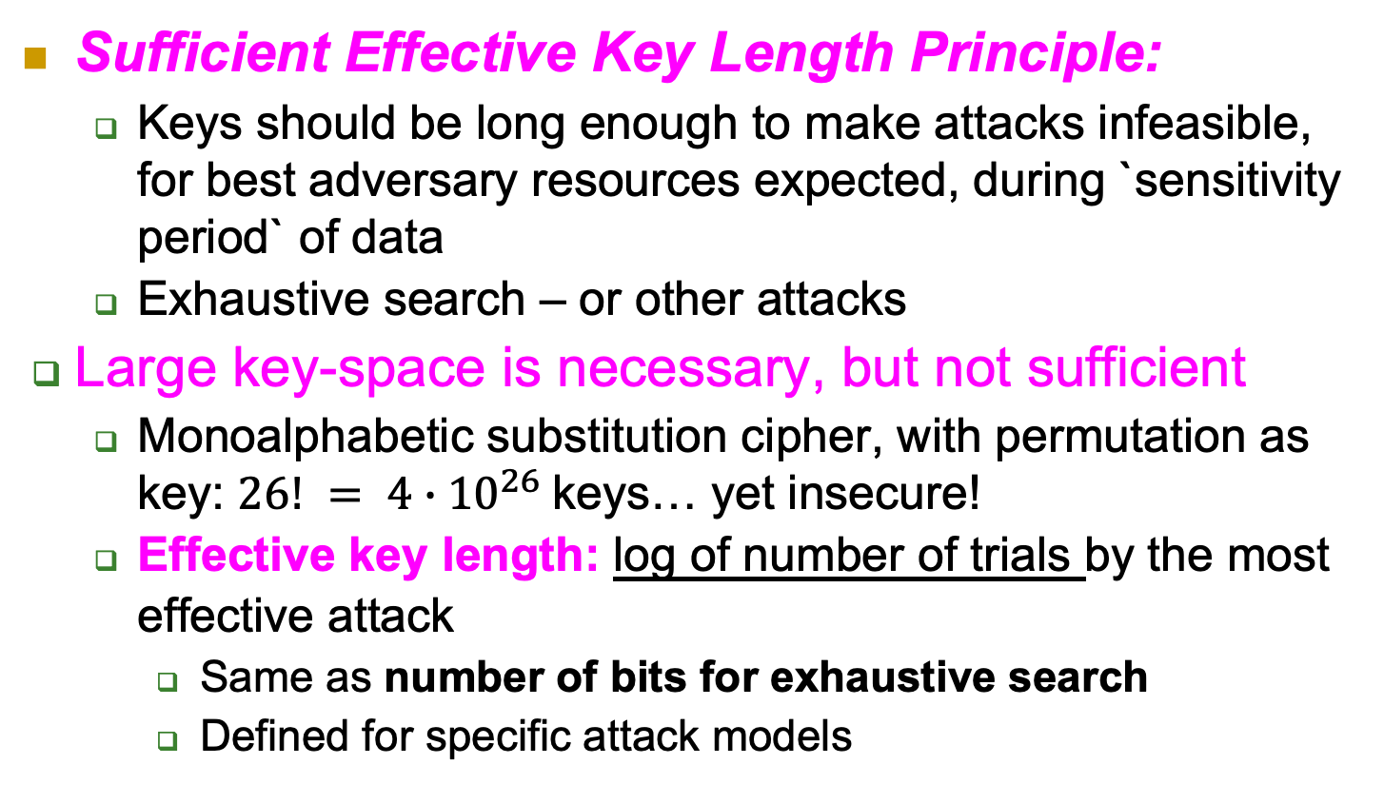
Sufficient Effective Key Length
Sufficient Effective Key Length Principle:
Keys should be long enough to make attacks infeasible, for best adversary resources expected, during `sensitivity period` of data
Exhaustive search – or other attacks
Large key-space is necessary, but not sufficient
Monoalphabetic substitution cipher, with permutation as key: $26! = 4∙{10}^{26}$keys… yet insecure!
Effective key length: log of number of trials by the most effective attack
Same as number of bits for exhaustive search
Defined for specific attack models

Slide 38

Thank You!

