Slide 1







Movie review sentiment analysis
Team members:
Ghadah Mohammad
Rahma Esam

Slide 2
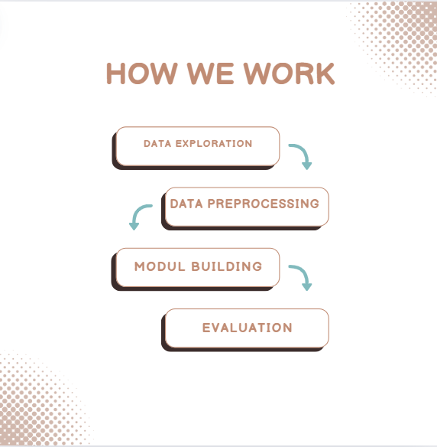
E

Slide 3


About the data
columns:
1.text
2.label
so we can conclude that we have duplicate values

Slide 4

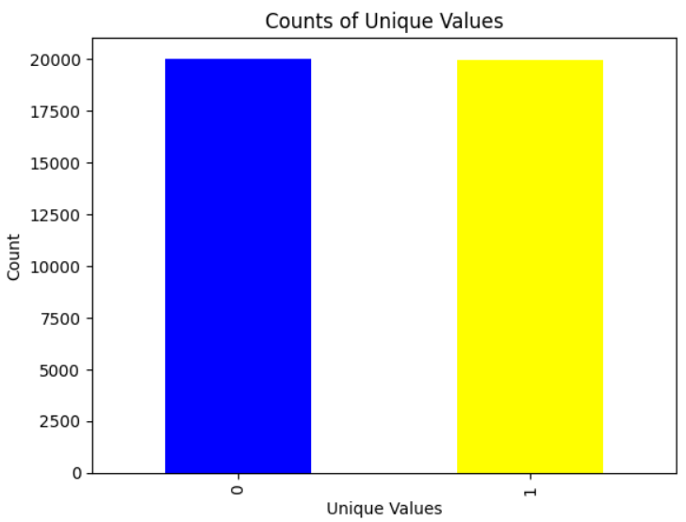

Class distribution plot

Slide 5
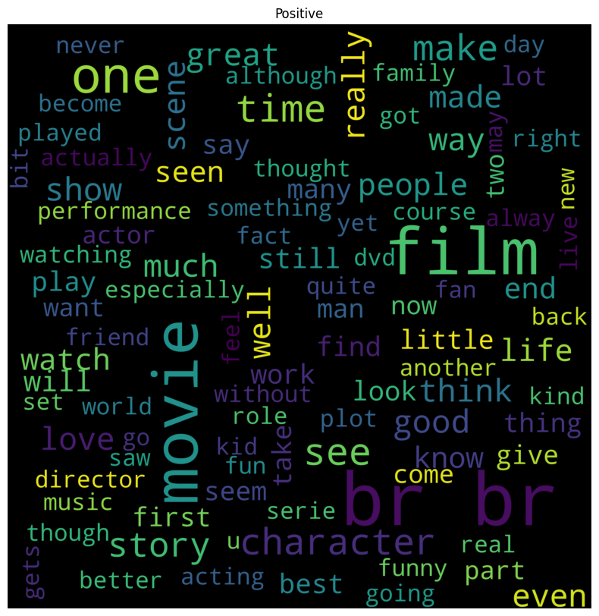
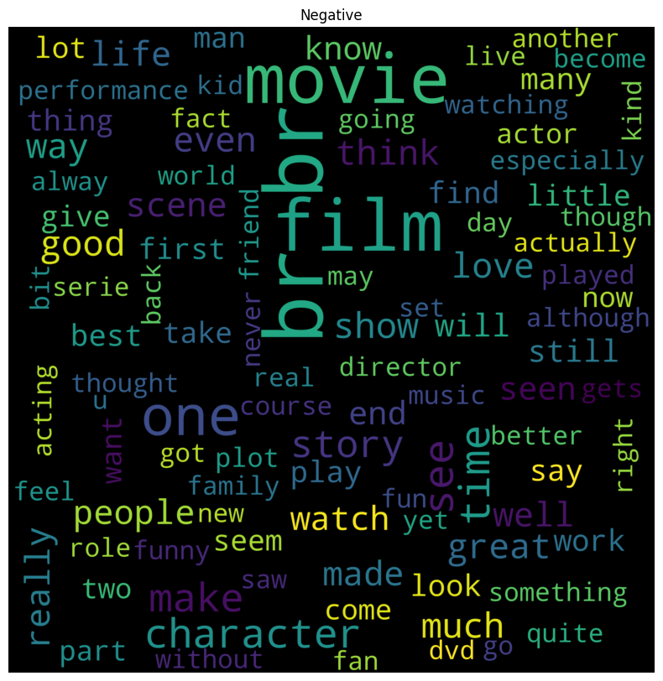
word cloud representation

Slide 6
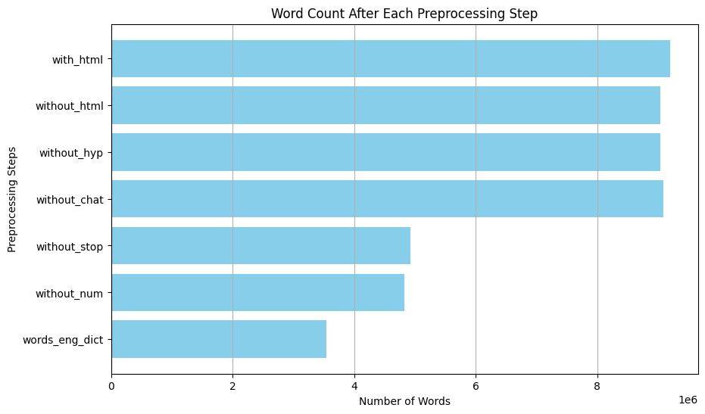
Pipelines
1. Case folding
2. Remove HTML TAGS
3. REMOVE HYPERLINK
4. REPLACE CHAT WORDS
5. REMOVE STOP WORDS
6. REMOVE PUNCTUATION
7. REMOVE NUMBERS
8. REMOVE SINGLE DIGIT
9. FILTER ON DICTIONARY
10. LEMMATIZATION

Slide 7
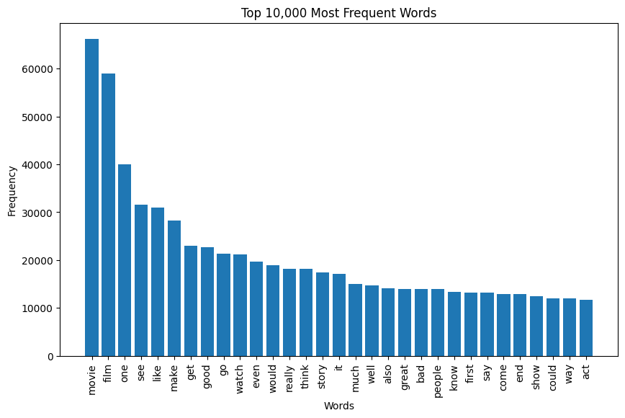
Words frequency after preprocessing
As we can notice from the graph it seems that the most frequently occurring word, unfortunately, does not significantly contribute to sentiment analysis.

Slide 8

E

Slide 9
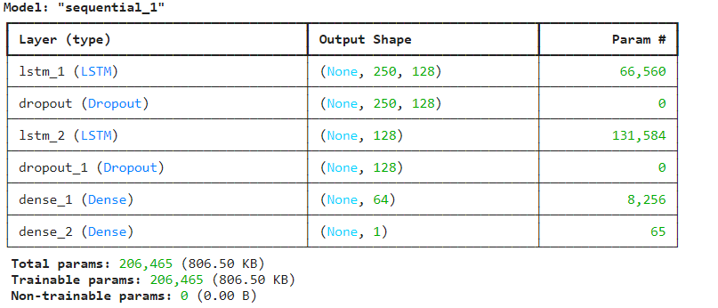
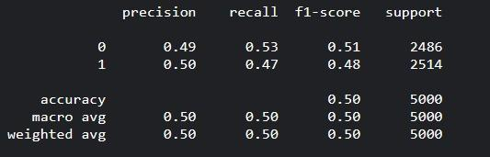
DATA MODELING

Slide 10
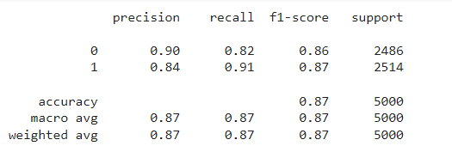
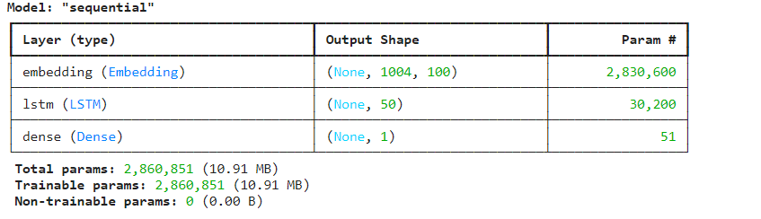
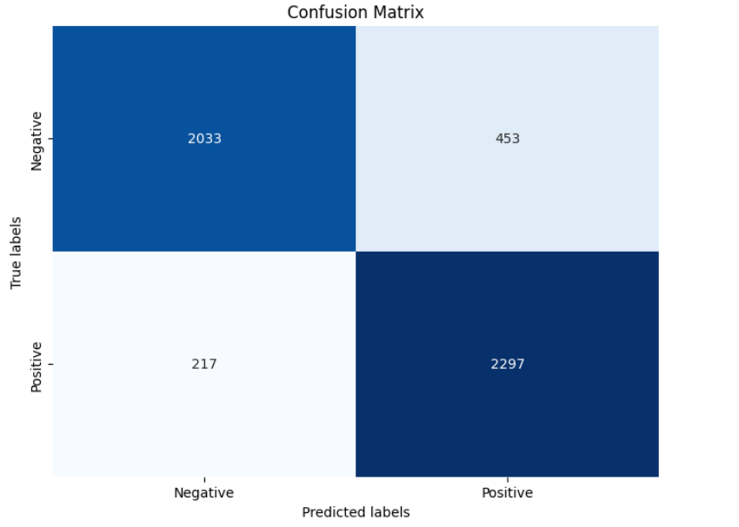
DATA MODELING

Slide 11








5/11/2024
notebook link
rahma
ghada

