Slide 1
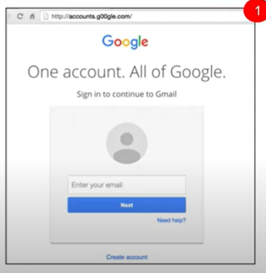
What do you think?
Fake website

Slide 2
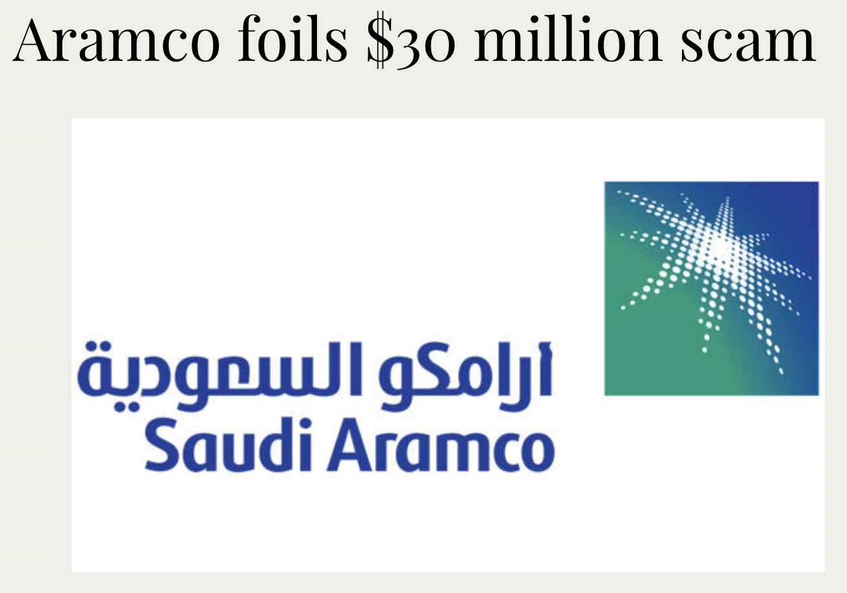


Aramco and ONGC

