Slide 1
Problem formulation :

Slide 2
MiniMax:
MiniMax: is a kind of backtracking algorithm that is used in decision making and game theory to find the optimal move for a player.

Slide 3
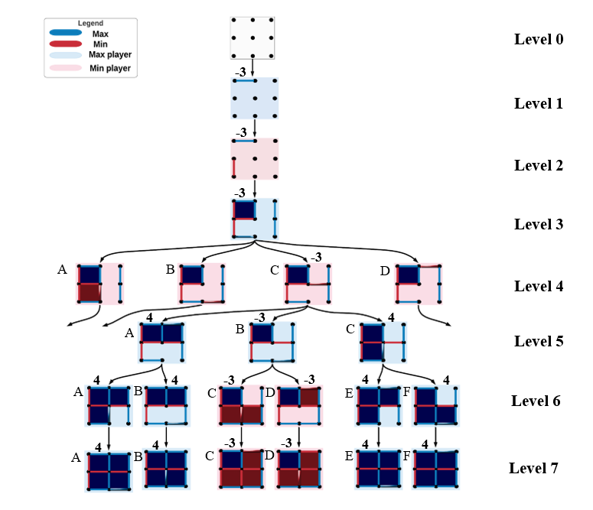
Discussion of results:

Slide 4
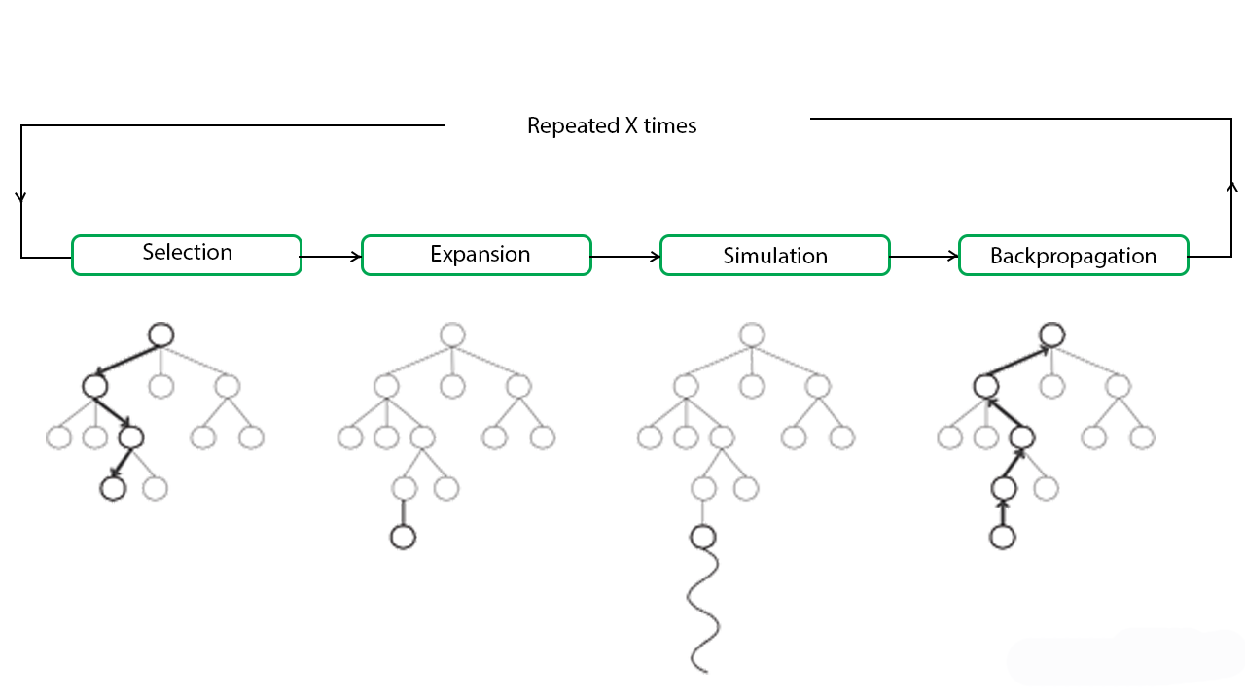
2.1 MCTS Algorithm explanation.
Monte Carlo algorithm is a tree search algorithm that starts from any state and tries to improve it by producing
its successors and choose the one that is more optimal than the current node and the other successors.
It becomes useful as it continues to evaluate other alternatives periodically during the learning phase by executing them,
instead of the current perceived optimal strategy. The process of Monte Carlo Tree Search can be broken down into
four distinct steps, viz., selection, expansion, simulation, and backpropagation. Figure (1) shows each of these steps below:

Slide 5
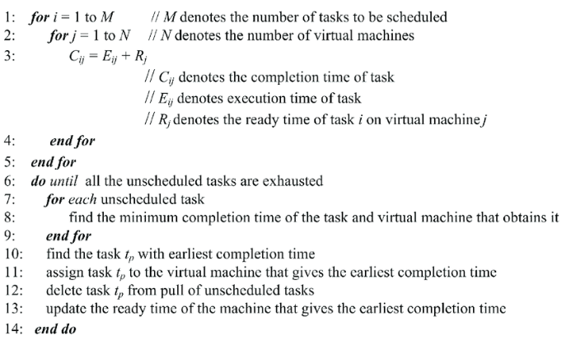
2.1.1 Pseudo Code For MCT algorithm

Slide 6
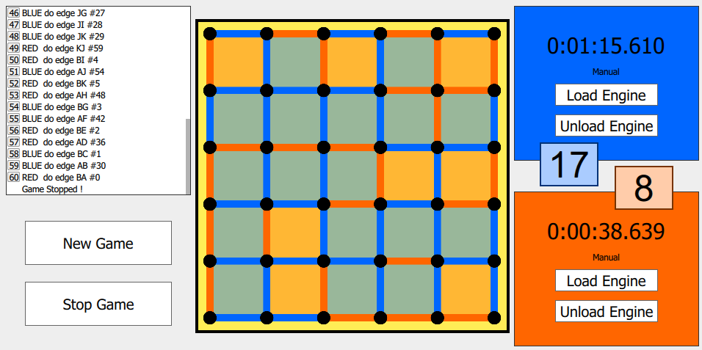
2.2.4 Final output:

Slide 7
2.3 MCTS Algorithm Evaluation
 | MCTS performance
Completeness | Yes
Optimality | No, but it finds the optimal solution in only current state.
Time complexity | O(mkI/C) where mm is the number of random children to consider per search and kk is the number of parallel searches, and II is the number of iterations and CC is the number of cores available.
Space complexity | O(mk) since in each iteration we map mk states over the cluster.

