Slide 1
Problem formulation :

Slide 2
MiniMax:
MiniMax: is a kind of backtracking algorithm that is used in decision making and game theory to find the optimal move for a player.

Slide 3
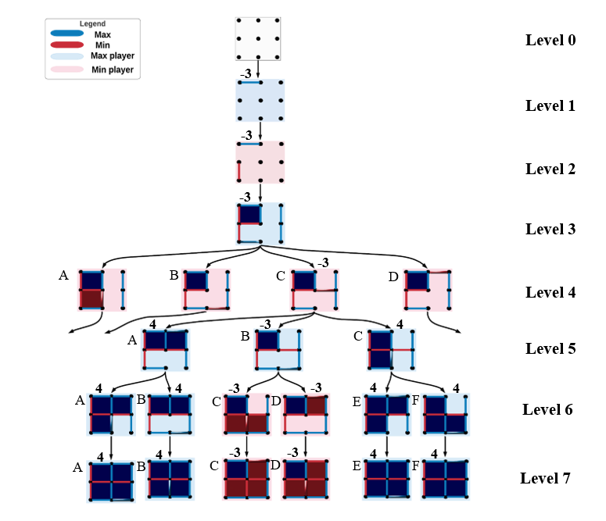
Discussion of results:

