Slide 1
An Ensemble Transfer Learning Approach to (poorly) Classify Renal Ultrasound of Fibrotic Stages in Mice
Ghadi El Hasbani
Danielle Antoun Azar, PhD Lebanese American University, Byblos

Slide 2
Table of contents
Introduction ……………………… 3
Materials & Methods ………….. 4
Results …….…………….………… 7
Limitations & Future Work …...8

Slide 3
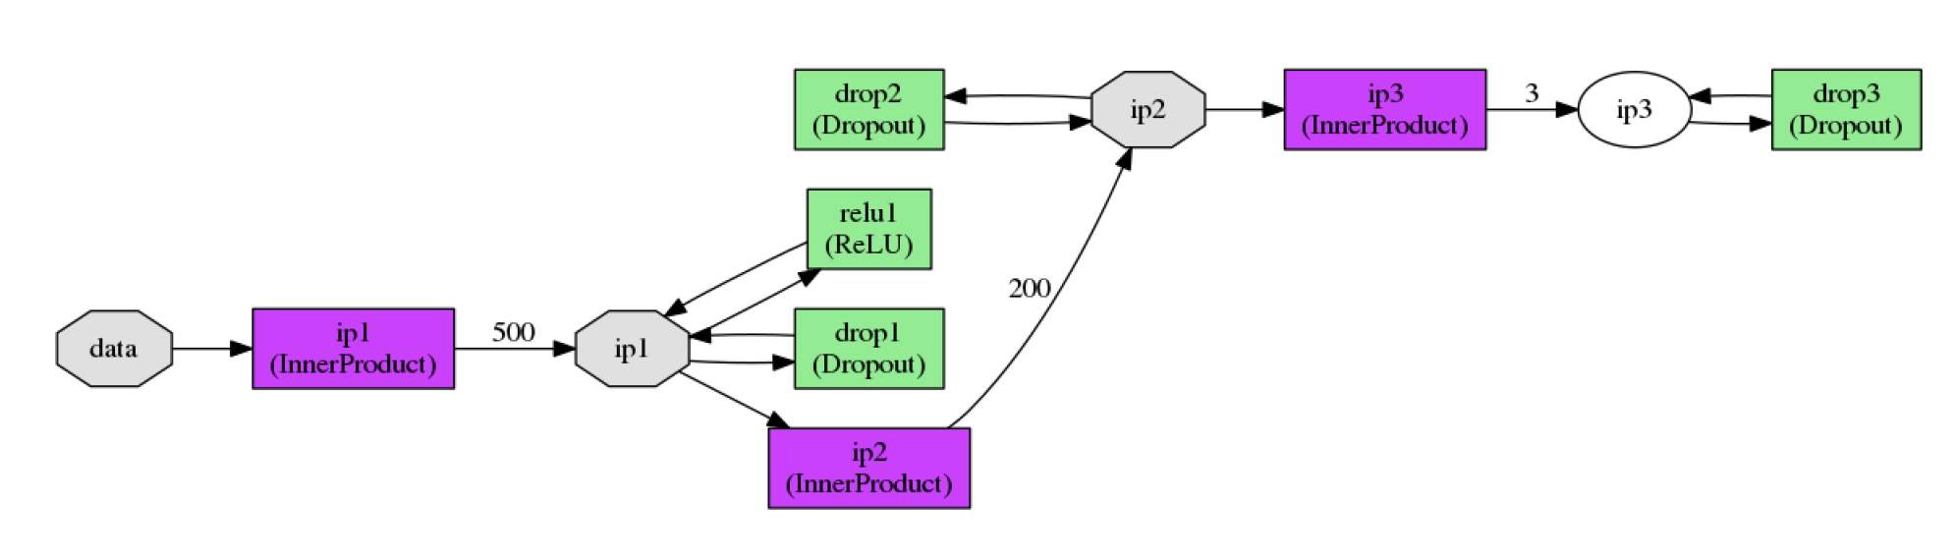
Introduction
-Classical Machine Learning vs. Deep Learning
-Restoration, Segmentation, Classification
-Proposed method: ensemble transfer learning for staged classification
-Fibrosis as biomarker of CKD
-Biopsy vs. Ultrasound
-Issue -> Noise, robustness

Slide 4
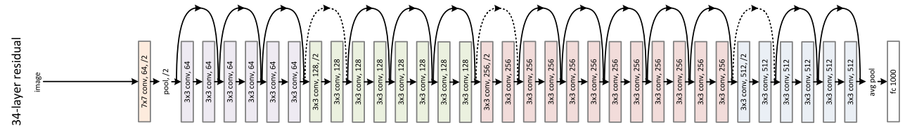
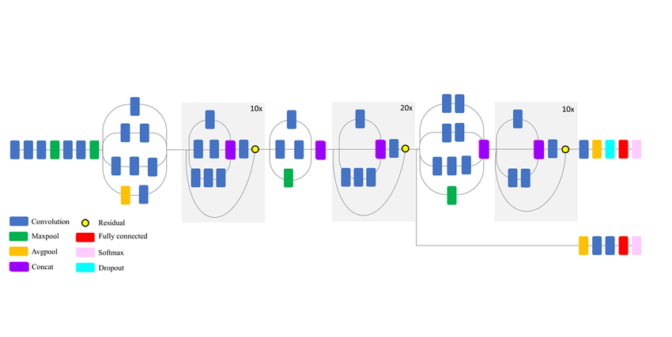
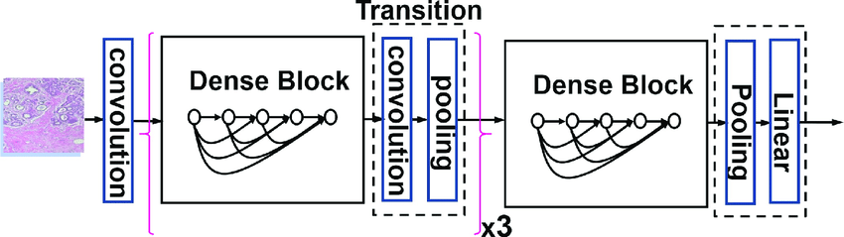
Materials & Methods
-VGG16, ResNet50, InceptionResNetV2, DenseNet121
-Various depths

Slide 5
Materials & Methods
-2/3 training, 1/3 testing
-When FCNet used: training divided into 2/3 for submodels 1/3 for FCNet
VGG16 Inception ResNet DenseNet
-Fine-tuned layers 8 30 20 5
-Fine-tune LR 0.0001 0.0001 0.00001 0.00001
-Fine-tune opt SGD SGD SGD SGD
-Training LR 0.001 0.005 0.005 0.005
-Training opt NAdam NAdam Adamax NAdam
-Epochs 3 10 3 15
-Trial and error was used to determine parameter settings.

Slide 6
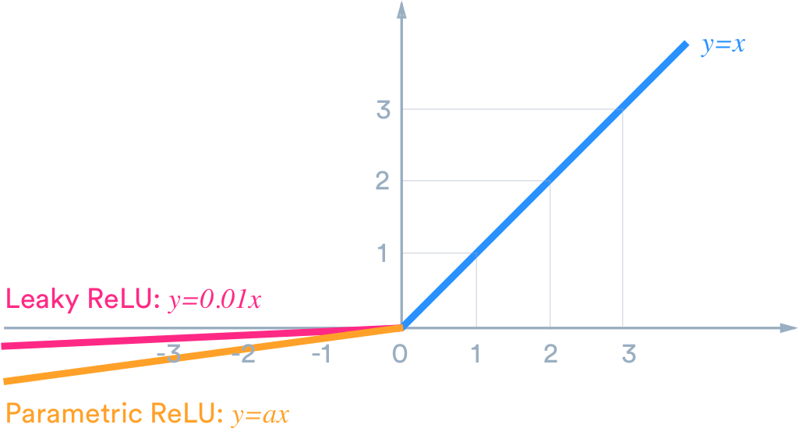
Materials & Methods
-To combat gradient vanishing and dying ReLU problems, PReLU was used in FCNet.
-Dropout: 0.1
-L2: 0.2
-Units: 552
-Layers: 3
-LR: 0.0001
-Opt: NAdam
-Epochs: 10

Slide 7
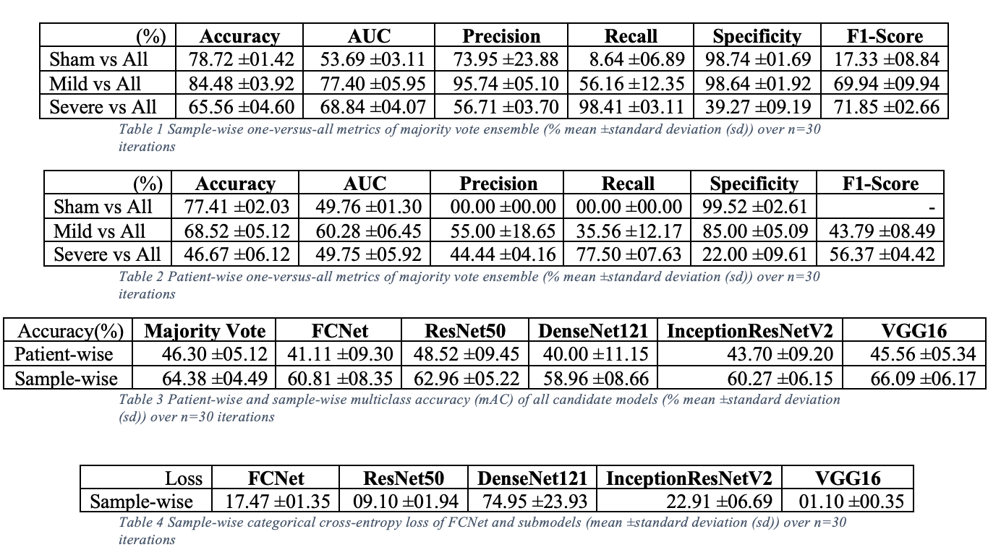
Results

Slide 8
Limitations & Future Work
-Data Augmentation
-Feature extraction using tradition methods like wavelet decomposition to supplement CNN extractors
-Using a ranking approach to further process ensemble representation
-Shallower models and different training procedure for overfitting

Slide 9
Thank you

