Slide 1
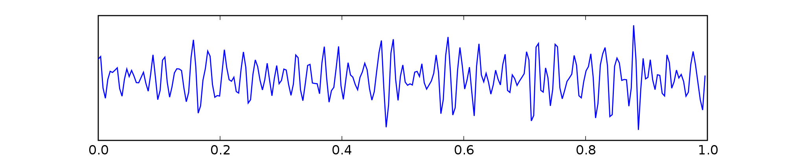
Explainable online ensemble of deep neural network pruning for time series forecasting
Saadallah et al., 2022 Ghadi El Hasbani
Danielle Antoun Azar, PhD Lebanese American University, Byblos

Slide 2
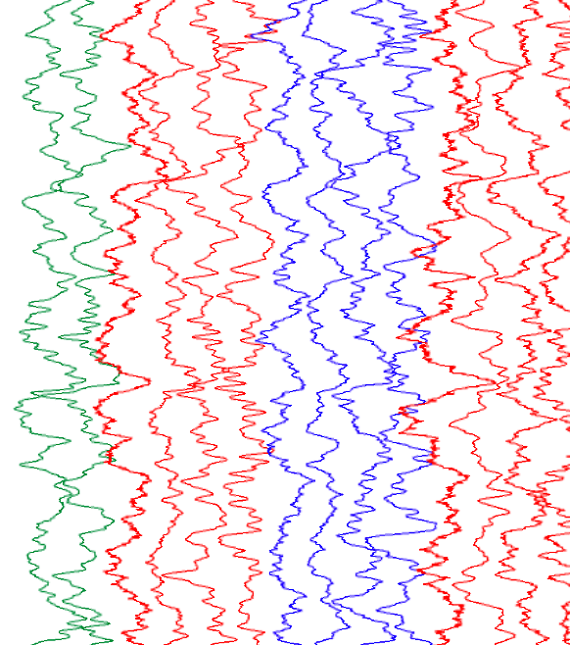
Table of contents
Introduction ……………………… 3
OEP-ROC …………………………. 7
Experiments …………….……….. 12
Results …………………………….. 13
Suggestions ………………………. 16
References ………………………... 18

Slide 3
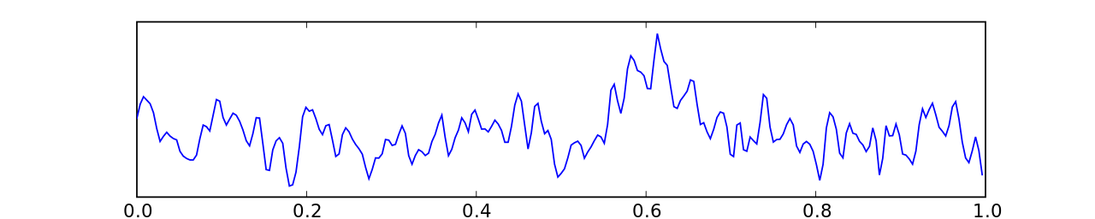
Introduction
ToC
The problem of time-series forecasting:
Function f that gave rise to time-series
→
Train Test
?
-Real-time predictions
-Dynamic and complex
-No Free Lunch
→
slide
→
f(X) window t Y t+f (f=1)

Slide 4
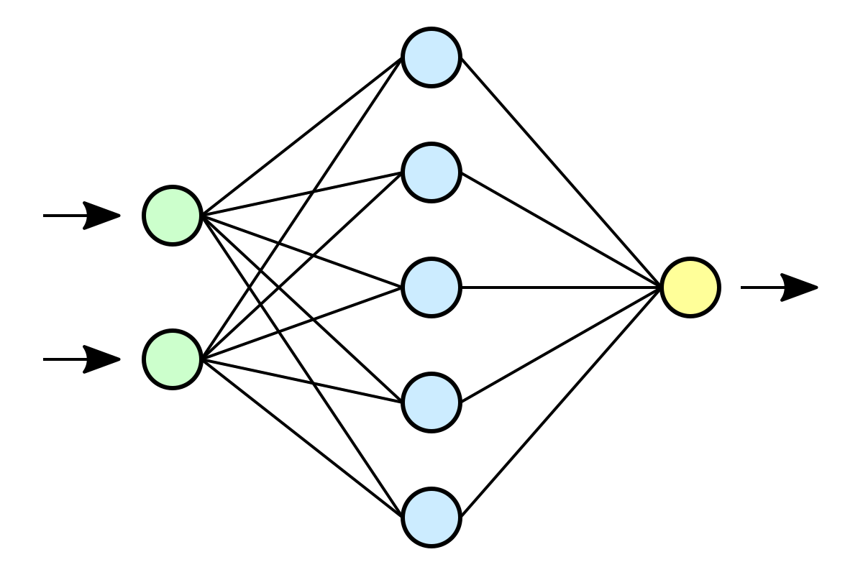
Introduction
ToC
Step 1: Generation
Progress: - DNNs automatically compute enriched feature representations → CNNs and LSTMs used as state-of-the-art forecasting
Ensemble methods lower both bias and variance and have ability to be aware of concept drift
Most research focused on step 3 for this problem
…
Step 2: Pruning
?
High Variance
…
Step 3: Aggregation
→
…
→
→
w_{N}
w₁
→
ŷ

Slide 5
Introduction
ToC
Needs:
Combinatorial search problem → approximate search
Real-time dynamic forecasting → continuous, informed pruning update
Generalization performance of ensemble → performance and diversity of base models
Explainable subensemble → explainable pruning process
Step 2: Pruning
…
?
step 2
Resources consumption
Performance
Dynamicity
→

Slide 6
Introduction
ToC
Background:
Search mechanism: global vs greedy
Selection mechanism:
Ranking-based: metric?
Clustering and representative selection for diversity: similarity measure? Optimal number of clusters?
Optimization-based: time?
Aggregation that can set w_{i} = 0
Repetition: random vs informed
DNNs blackbox: special techniques
Exploiting gradient: efficiency
Explanation mechanism:
Visualization-based: which input needs to be changed least to affect prediction most
Concept-based: is a given concept imbedded in latent space?
Model-based: can a simpler model be extracted that generalizes better?
→ not model-agnostic

Slide 7
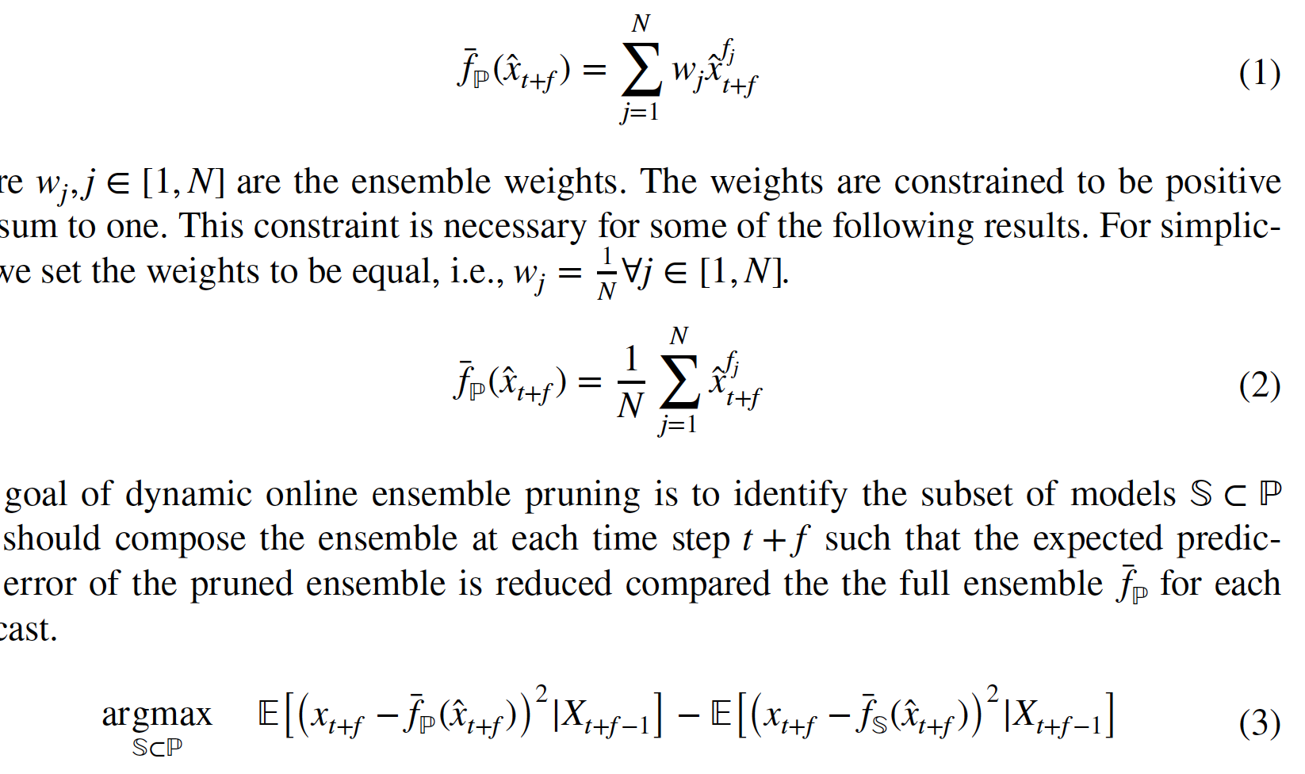
OEP-ROC
ToC
Online Ensemble Pruning using performance saliency maps-based Regions-Of-Competence
Base learners
Input layer: L-lagged time-series
CNN-based: differing number of convolutional layers, differing number of filters
Batch normalization layer
Some with LSTM layer with differing number of units
Output layer: 1 unit for following time value (f=1)
Goal
Training
Ensemble prediction
(weights equal) →
Train Val

Slide 8
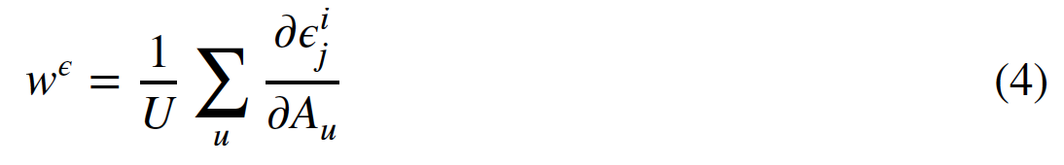

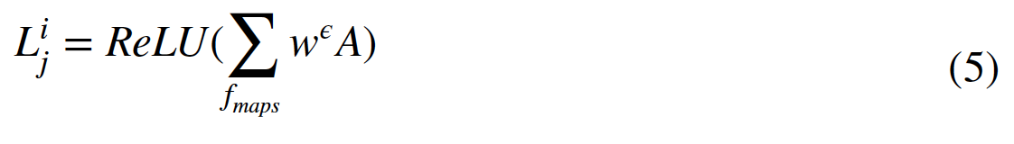
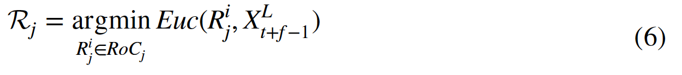

OEP-ROC
ToC
Val
RoC Computation
For each model j at each window in validation set i, do the following using the last feature map activation units:
→
slide Z-1 times
f(X) window t Y t+f (f=1)
→
For each model j:
→
Normalize: [0,1]
→
Buffer RoCs
Clip at 0.1
→
Moving average w=3
→

Slide 9
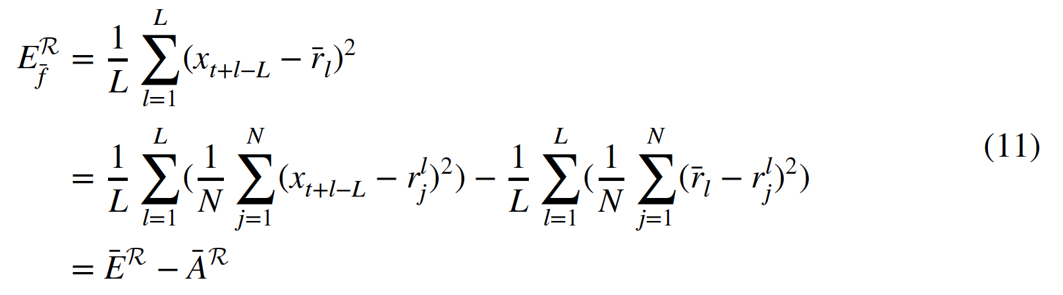

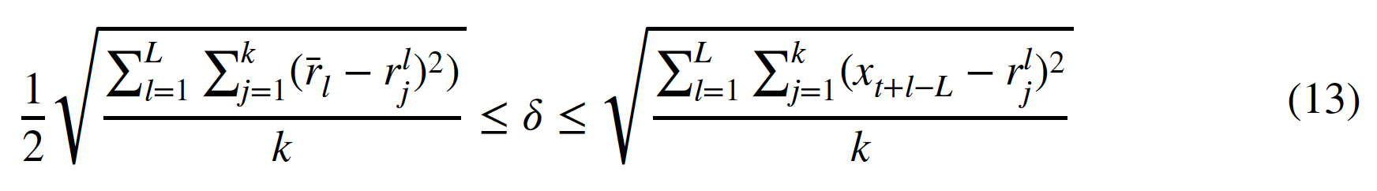
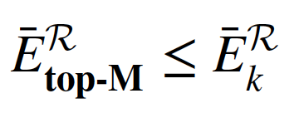
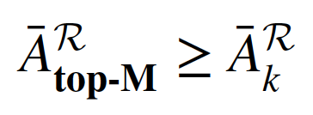
OEP-ROC
ToC
Stage 1: k-Means Clustering
Similarity measure: Euclidean distance
Keep representative of each cluster f_{r}:
Stage 2: top-M selection
Rank using
Use threshold cut-off:
Ensemble Error
Task

Slide 10
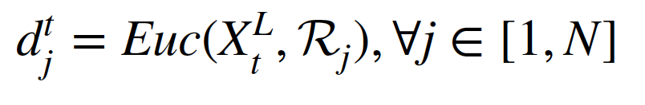
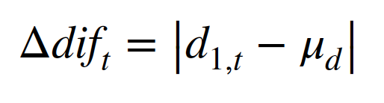

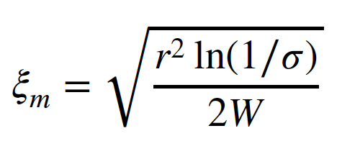
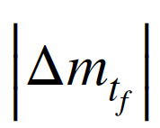



OEP-ROC
ToC
Drift Type II: Performance concept drift
For W independent observations of a variable with range r:
Weak stationary dependence
Set t_{i} = t_{f}, repeat Stage 1 & 2
Drift Type I: Time-series concept drift
For W independent observations of a variable with range r:
Set t = t_{f}, update RoCs,
repeat Stage 1 & 2
with minimum at reference t_{i}
If:
If:
Probability:
Probability:
→
→

Slide 11
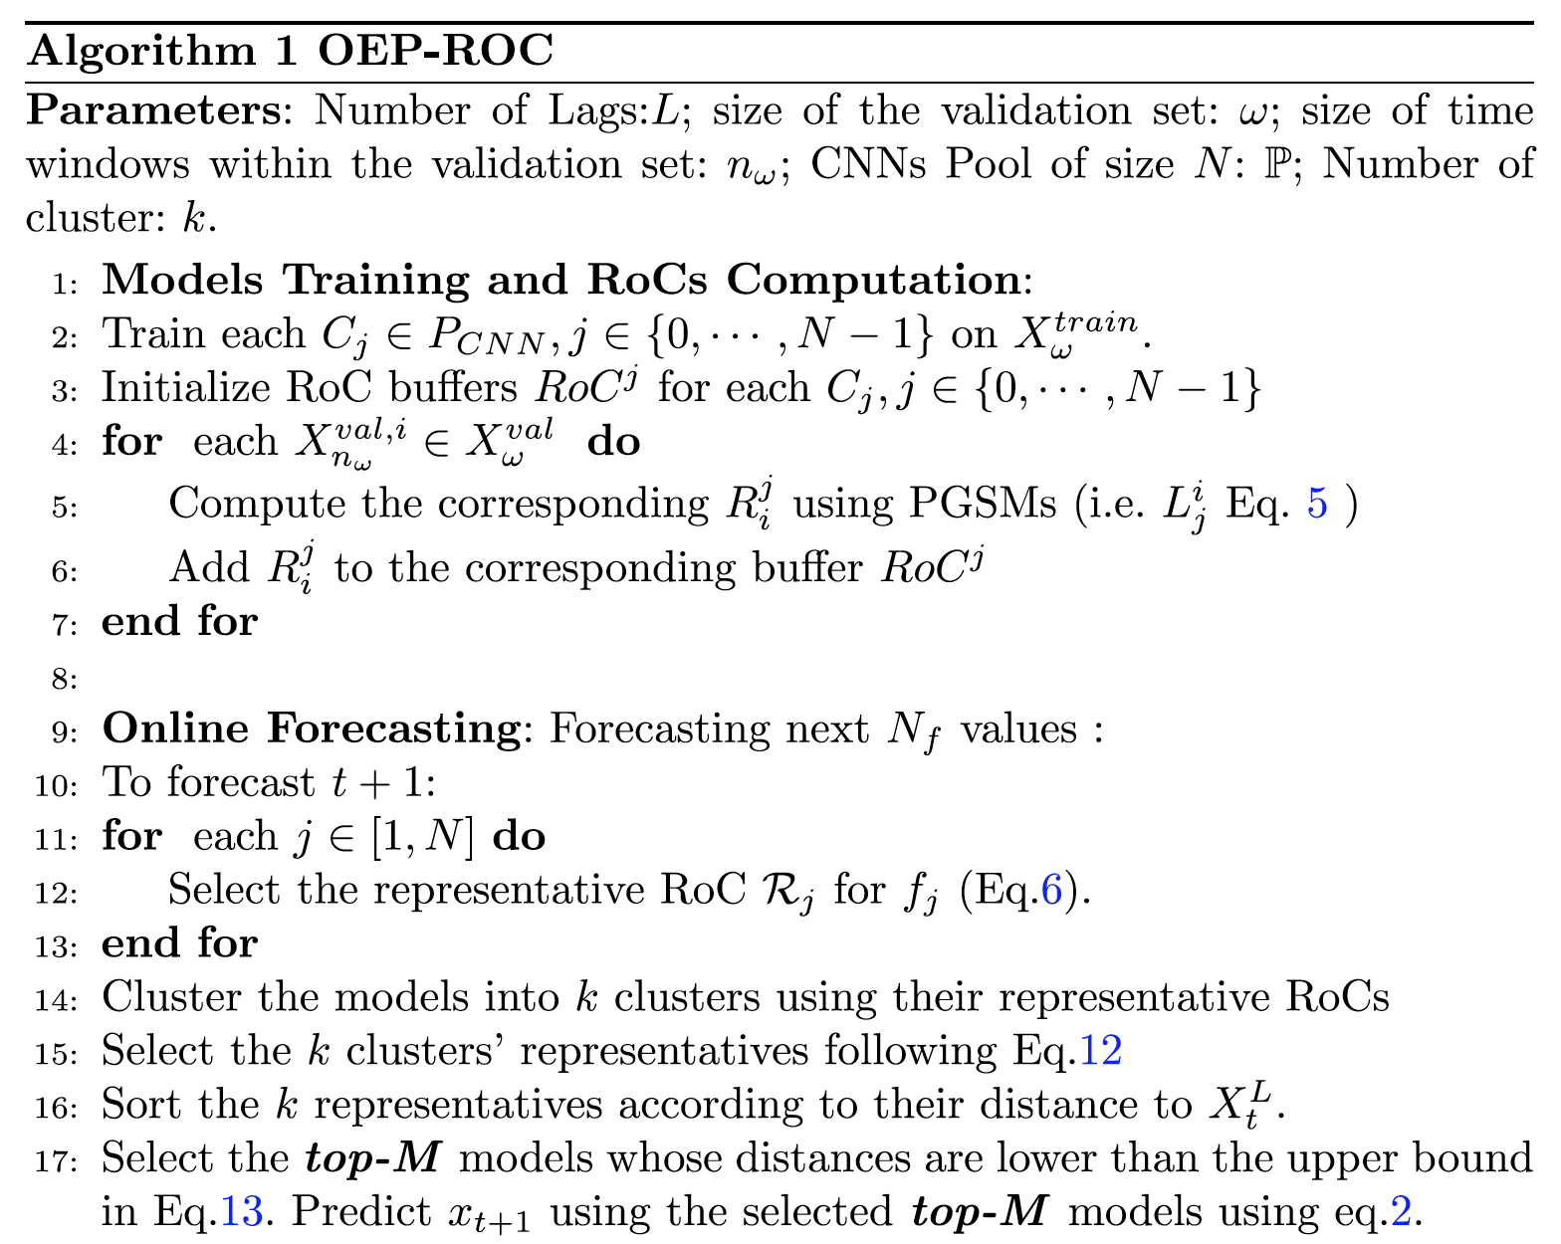
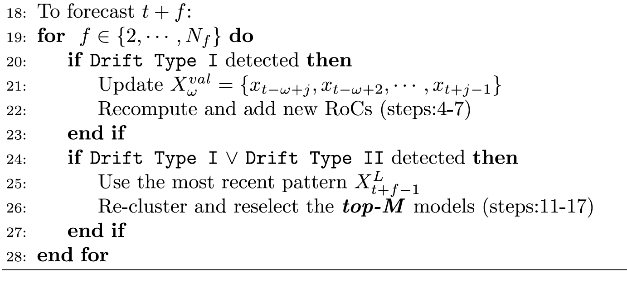
OEP-ROC
ToC

Slide 12
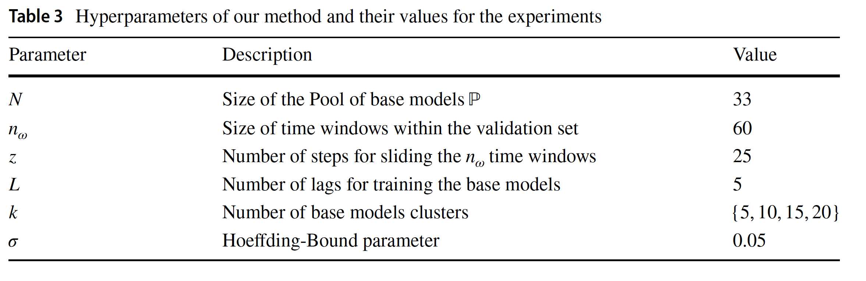
Experiments
ToC
Setup
Metric: RMSE
Comparison: Wilcoxon Signed Rank test
100 real-world datasets
Questions
OEP-ROC vs state-of-the-art forecasting
OEP-ROC vs OEP-ROC variants
Impact of k and δ
Aggregation vs OEP-ROC+aggregation
OEP-ROC time
OEP-ROC informed vs random
How to explain OEP-ROC ensemble selection or performance
50% Train 25% Val 25% Test

Slide 13
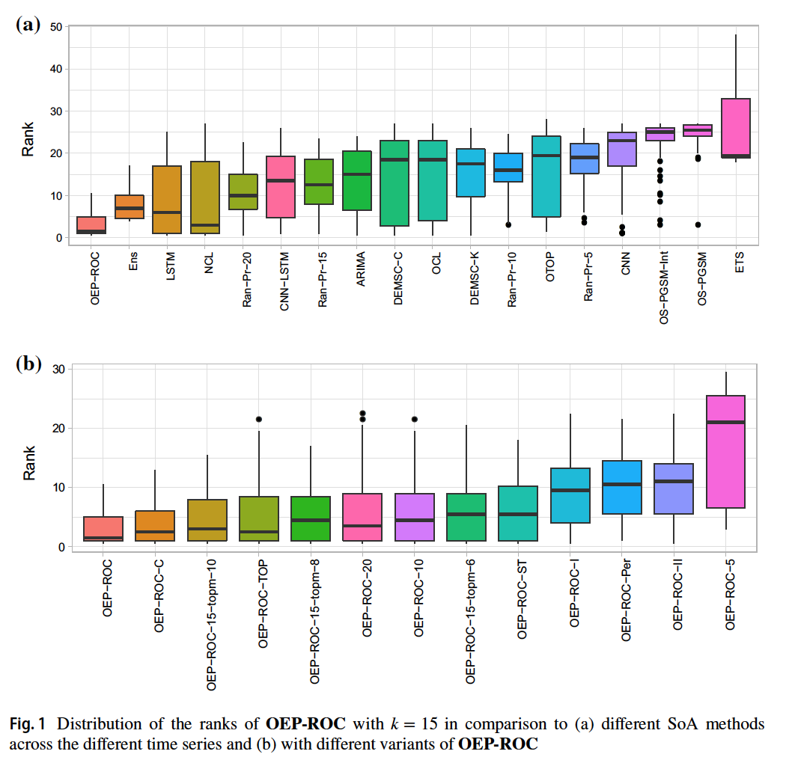
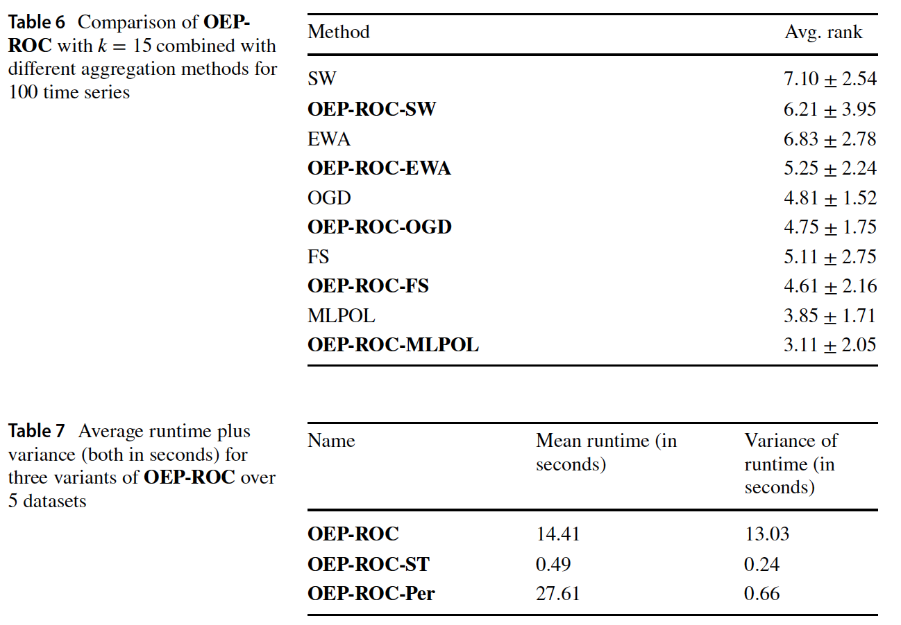
ToC
Results

Slide 14
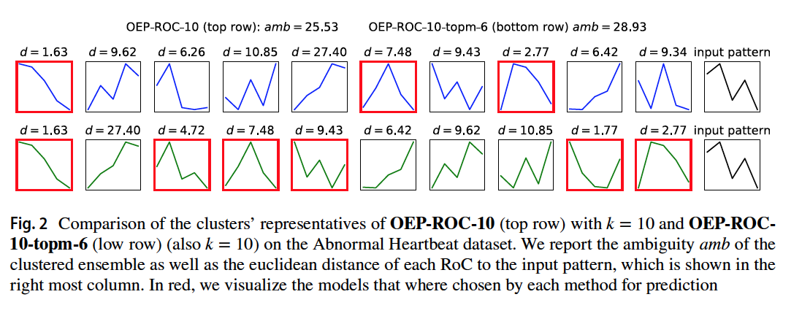
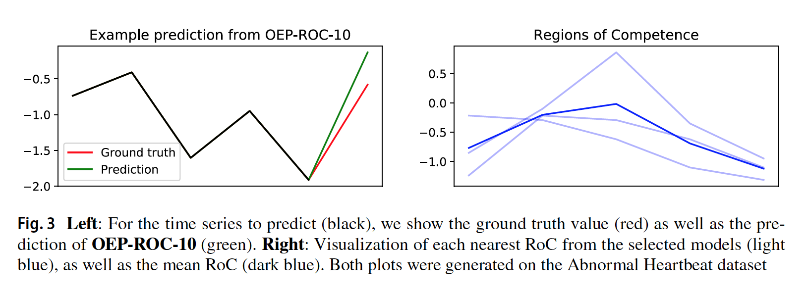
ToC
Results

Slide 15
ToC
Results
- Outperforms most state-of-the-art methods in pairwise comparison
None of the variants which exclude some steps outperform the original method (need for all components including diversity)
The variant that updates randomly does not improve the performance over drift-informed updates even though they trigger more updates → computational efficiency
Model aggregation methods perform better when combined with this model pruning method
Saliency maps are interpretable and can be used to extract reasoning behind choosing one model over the other
Cons
-Not model-agnostic
-Base models can be more explainable or supported by explanation tools
-Runtime of 14 seconds is a lot for real-time forecasting: could be improved by sampling from Val instead of using all of it
-Impact of size of input pattern L should be investigated

Slide 16
Suggestions
ToC
Representational dissimilarity (or similarity) matrix between model input representation and time-series could be used instead of saliency maps to generalize methods to any base model that is designed to output a forecast where feature importance can be extracted
input
input
input
Modified input
Alternatively modified input can be used as a proxy for RoCs directly without similarity matrix computation to save on resources

Slide 17
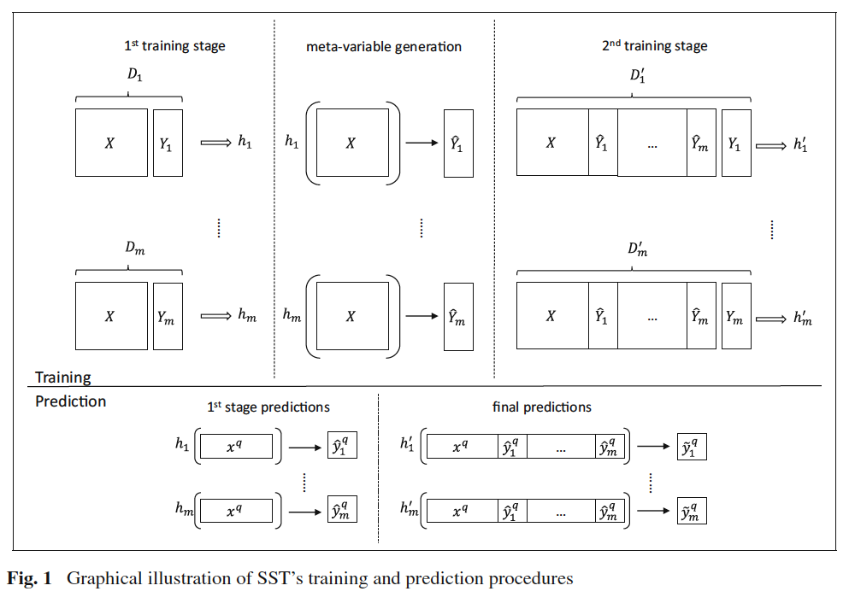
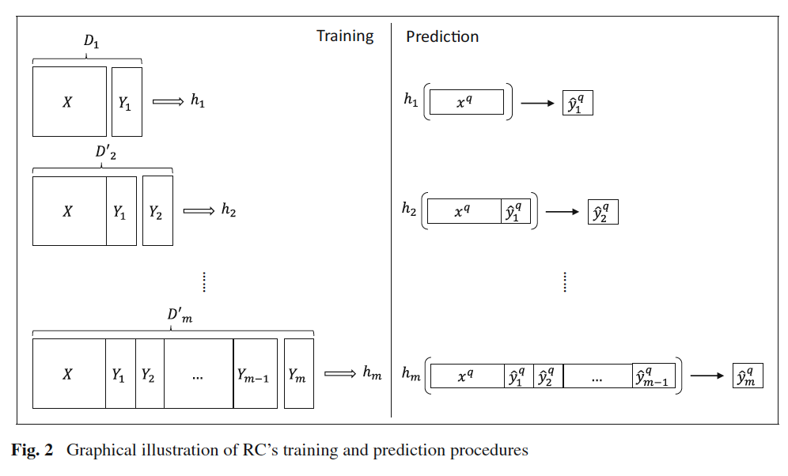
Suggestions
ToC
ANNs can handle multi-target forecasting by increasing output nodes
it would also be useful to have forecasts at previous time-steps be fed back with a recurrent connection to input. This will enable any forecast output at t-1 to influence any forecast output at t.
This is similar to extended Stacked-Single target (eSST) and regressor chains (eRC) described in Spyromitros-Xioufis et al. (2016). With recurrence, there is no need for multi-stage predictions, but dependence of forecast A on forecast B at t is not tested (only t and t-1). To test for this dependence, if eRC is used, this will result in an ensemble of ensembles whereby saliency maps can be averaged for each subensemble since these submodels will be simple input permutations of each other. If eSST is used, final stage models can be used for RoCs.
…

Slide 18
References
ToC
Saadallah, A., Jakobs, M., & Morik, K. (2022). Explainable online ensemble of deep neural network pruning for time series forecasting. Machine Learning, 111(9), 3459-3487.
Spyromitros-Xioufis, E., Tsoumakas, G., Groves, W., & Vlahavas, I. (2016). Multi-target regression via input space expansion: treating targets as inputs. Machine Learning, 104(1), 55-98.

Slide 19
Table of contents
Introduction ……………………… 3
OEP-ROC …………………………. 7
Experiments …………….……….. 12
Results …………………………….. 13
Suggestions ………………………. 16
References ………………………... 18
Any questions?

Slide 20
Thank you

