Slide 1

Applied Electricity (ELNG 103) 3 credit
Electrical and Electronic Engineering
SCHOOL OF ENGINEERING
UENR
Nana Twum Duah
Email: nana.twumduah@yahoo.com
Notes:
Click to add notes

Slide 2
Teaching and Assessment
Electrical and Electronic Engineering
SCHOOL OF ENGINEERING
Lectures:
Tutorials:
Assessment:
One mid- term test
Assignments
Exams

Slide 3
Contents
Electrical and Electronic Engineering
SCHOOL OF ENGINEERING
Fundamentals of electricity
Network Theorems (DC)
Alternating Voltage and Current
A.C. Circuits
Magnetic Circuits

Slide 4
Reference Books
Electrical and Electronic Engineering
SCHOOL OF ENGINEERING
Hughes E. , Electrical and Electronics Technology
Theraja B.L, Theraja R.K, A Text Book of Electrical Technology

Slide 5
Aim and Objective
Electrical and Electronic Engineering
SCHOOL OF ENGINEERING
Understand and apply fundamental network theorems in DC circuits.
Known the basics of AC parameters – single and three phase introduced.
Magnetic Circuits

Slide 6
details- fundamentals of electricity
Electrical and Electronic Engineering
SCHOOL OF ENGINEERING
Fundamentals of electricity
Electricity
Electric Charge
Current
Voltage
Resistance
Power

Slide 7
Introduction
Electrical and Electronic Engineering
SCHOOL OF ENGINEERING
Fundamentals of electricity
Electricity is the flow of electric charges in a circuit
Electric charge Q (coulomb): quantity of electricity passing a given point in a circuit when a current of 1 A is maintained for 1 sec.
Q = I x t
Current I (amperes) : flow rate of electrical charge (1 A = 1 C/s)

Slide 8
Introduction
Electrical and Electronic Engineering
SCHOOL OF ENGINEERING
Voltage V (volts): electrical potential difference - energy absorbed or released per coulomb of charge moving from point to another (1 V = 1 J/C).
Resistance R (ohms Ω): degree to which an electrical component (resistor) opposes the flow of electric current.
Power P (watts): rate of energy flow (1 W = 1 J/s)
Notes:
Lesson descriptions should be brief.

Slide 9
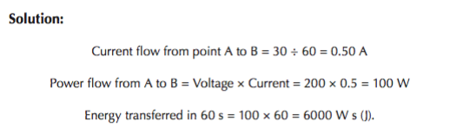
Introduction
Electrical and Electronic Engineering
SCHOOL OF ENGINEERING
e.g.
The electrical potential of point A is 200 V higher than that of point B, and 30 C of charge per minute flows from A to B. Determine the current and power flow from A to B and the energy transferred in 1 min.

Slide 10
Part A.
Electrical and Electronic Engineering
SCHOOL OF ENGINEERING
Basic electric system
Ohms Law
D.C circuit
Kirchoff’s laws
Resistors in series and parallel
Superposition and Reciprocity theorems
Thevenin’s and Norton’s theorems
Delta-star and star-delta transformations

Slide 11
Basic electric system
Electrical and Electronic Engineering
SCHOOL OF ENGINEERING
Source: Provide energy for the electrical system. e.g. battery, generator
Load: absorb electrical energy supplied by the source. e.g. home appliance such as lamps, heaters, TV.
Transmission system: conducts energy from the source to the load. Mostly consist of wire/cable.
Control apparatus: controls the system. e.g. switch

Slide 12
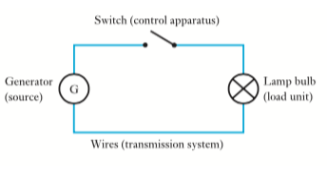
Basic electric system
Electrical and Electronic Engineering
SCHOOL OF ENGINEERING

Slide 13
Ohms Law
Electrical and Electronic Engineering
SCHOOL OF ENGINEERING
The law states that the strength of a current is directly proportional to the voltage and inversely proportional to resistance offered.
If I, V and R be expressed in terms of units,

Slide 14
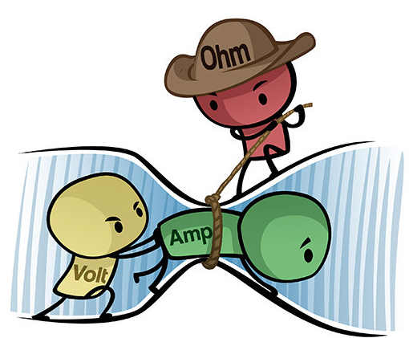
Ohms Law
Electrical and Electronic Engineering
SCHOOL OF ENGINEERING

Slide 15
Ohms Law
Electrical and Electronic Engineering
SCHOOL OF ENGINEERING
R can range from zero to infinity, it is important that we consider the two extreme possible values of R.
Short circuit – when R=0,
i.e. voltage is zero but the current could be anything.
Open Circuit – R = ∞,
i.e. current is zero but the voltage could be
anything
.

Slide 16
Ohms Law
Electrical and Electronic Engineering
SCHOOL OF ENGINEERING
Power
The power dissipated by a resistor can be expressed in terms of R:
The power dissipated in a resistor is a nonlinear function of either current or voltage.
Since R is positive quantities, the power dissipated in a resistor is always positive. Thus, a resistor always absorbs power from the circuit.

Slide 17
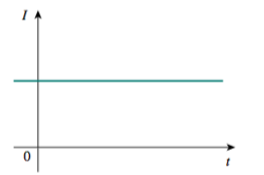
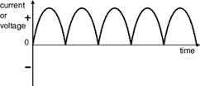
DC circuit
Electrical and Electronic Engineering
SCHOOL OF ENGINEERING
Direct current (DC) is current that flow in unidirectional. Sources - batteries, solar cells
Constant DC b. Variable DC
DC circuit is a circuit that Electric Current flows through in one direction.

Slide 18
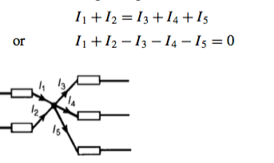
Network Theorems
Electrical and Electronic Engineering
SCHOOL OF ENGINEERING
Kirchhoff’s Laws
Current law: At any junction in an electric circuit the total current flowing towards that junction is equal to the total current flowing away from the junction. i.e.
Notes:
where N is the number of branches connected to the node and I_{n} is the nth current entering (or leaving) the node

Slide 19
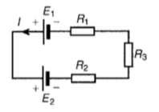

Kirchhoff’s Laws
Electrical and Electronic Engineering
SCHOOL OF ENGINEERING
Voltage Law: In any closed loop in a network, the algebraic sum of the voltage drops taken around the loop is equal to the resultant e.m.f. acting in that loop.

Slide 20
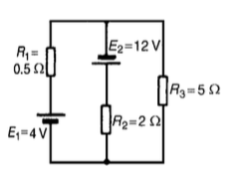
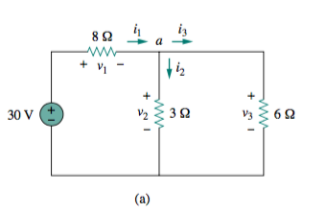
Application of Kirchhoff’s Laws
Electrical and Electronic Engineering
SCHOOL OF ENGINEERING
e.g. find each branch current and voltage drop across each resistor in the network.
a. b.
Notes:
Solution
Current flowing through R₁=6.52A, R₂=6.37A and R₃=0.15A
I₁= 3A, I₂ =1A, V₁ = 24V, V₂ =6V V₃ =6V

Slide 21
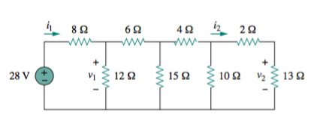
Application of Kirchhoff’s Laws
Electrical and Electronic Engineering
SCHOOL OF ENGINEERING
Try. find each branch current and voltage drop across each resistor in the network

Slide 22
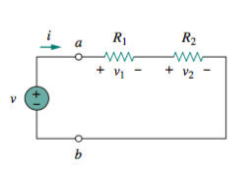
Resistors in series & Voltage division
Electrical and Electronic Engineering
SCHOOL OF ENGINEERING
The two resistors are in series, since the same current i flows in both of them.
Applying ohm’s law
Apply KVL
where

Slide 23
Resistors in series & Voltage division
Electrical and Electronic Engineering
SCHOOL OF ENGINEERING
The equivalent resistance of any number of resistors connected in series is the sum of the individual resistances.
For N resistors in series then,

Slide 24
Resistors in series & Voltage division
Electrical and Electronic Engineering
SCHOOL OF ENGINEERING
Voltage division
Substituting (2) into (1)
In general, if a voltage divider has N resistors (R₁ ^{, R}₂ ^{, . . . , R}_{N} ^{) in}
series with the source voltage v, the nth resistor (R_{n}^{) will have a voltage drop of}

Slide 25
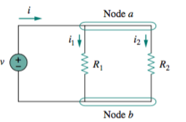
Parallel resistors and current division
Electrical and Electronic Engineering
SCHOOL OF ENGINEERING
When two resistors are connected in parallel – have the same voltage across them.
From ohms,
Rearranging
Applying KCL at node a

Slide 26
Parallel resistors and current division
Electrical and Electronic Engineering
SCHOOL OF ENGINEERING
Substituting (6) into (7)
Therefore,
Notes:
Equation (10) applies only to two resistors in parallel.
If R₁ = R_{2 ,} then, R_{eq}= R₁/2

Slide 27
Parallel resistors and current division
Electrical and Electronic Engineering
SCHOOL OF ENGINEERING
The equivalent resistance of two parallel resistors is equal to the product of their resistances divided by their sum.
For N number of resistors in parallel,

Slide 28
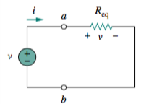
Parallel resistors and current division
Electrical and Electronic Engineering
SCHOOL OF ENGINEERING
Current division
Combining (6) and (11)

Slide 29
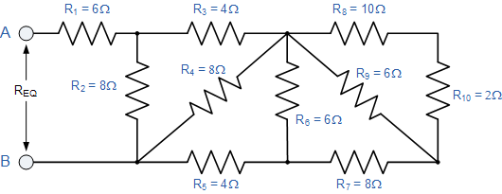
Resistance in series and parallel
Electrical and Electronic Engineering
SCHOOL OF ENGINEERING
Find the total resistance as seen from terminal AB

Slide 30
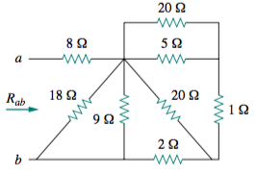
Resistance in series and parallel
Electrical and Electronic Engineering
SCHOOL OF ENGINEERING
Find the total resistance as seen from terminal AB

Slide 31
Superposition theorem
Electrical and Electronic Engineering
SCHOOL OF ENGINEERING
states that the voltage across or current through an element in a linear circuit is the algebraic sum of the voltage across or currents through that element due to each independent source acting alone.

Slide 32
Superposition theorem
Electrical and Electronic Engineering
SCHOOL OF ENGINEERING
Steps to Apply Superposition Principle:
Turn off all independent sources except one source. Find the output (voltage or current) due to that active source.
Repeat step 1 for each of the other independent sources.
Find the total contribution by adding algebraically all the contribution due to the independent sources.

Slide 33
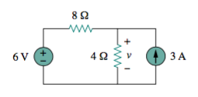
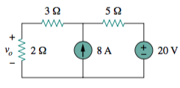
Superposition theorem
Electrical and Electronic Engineering
SCHOOL OF ENGINEERING
e.g. Use the superposition theorem to find v in the circuit in the networks.
a. b.
Notes:
Solution
a. V = 10V
B. V_{O}= 12V

Slide 34
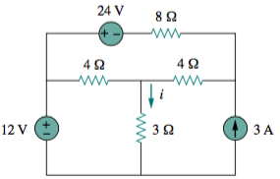
Superposition theorem
Electrical and Electronic Engineering
SCHOOL OF ENGINEERING
Try. Use superposition theorem to find the current i.
Notes:
i = 2A

Slide 35
Reciprocity Theorems
Electrical and Electronic Engineering
SCHOOL OF ENGINEERING
The reciprocity theorem is applicable only to single-source networks and states the following:
The current I in any branch of a network, due to a single voltage source E anywhere in the network, will equal the current through the branch in which the source was originally located if the source is placed in the branch in which the current I was originally measured
The location of the voltage source and the resulting current may be interchanged without a change in current

Slide 36
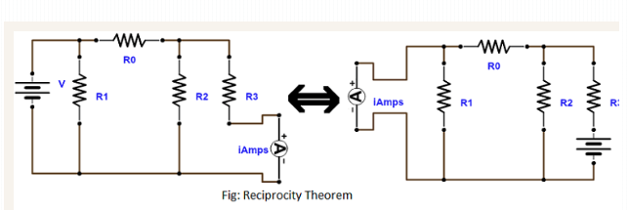
Reciprocity Theorems
Electrical and Electronic Engineering
SCHOOL OF ENGINEERING

Slide 37
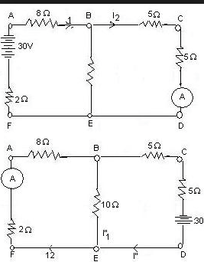
Reciprocity Theorems
Electrical and Electronic Engineering
SCHOOL OF ENGINEERING
E.g. Using reciprocity theorem find the ammeter current.

Slide 38
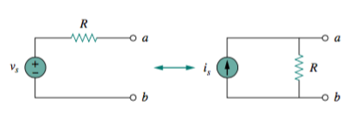

Source transformation
Electrical and Electronic Engineering
SCHOOL OF ENGINEERING
Is a tool for simplifying electric circuits.
A source transformation is the process of replacing a voltage source v_{s} in series with a resistor R by a current source is in parallel with a resistor R, or vice versa.

Slide 39
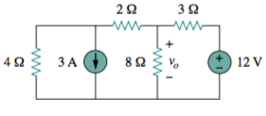
Source transformation
Electrical and Electronic Engineering
SCHOOL OF ENGINEERING
E.g. Use source transformation to find v_{o} in the circuit.
Notes:
Solution
Vo = 3.2V

Slide 40
Thevenin’s theorem
Electrical and Electronic Engineering
SCHOOL OF ENGINEERING
Thevenin’s theorem states that a linear two-terminal circuit can be replaced by an equivalent circuit consisting of a voltage source V_{Th} in series with a resistor R_{Th}, where V_{Th} is the open-circuit voltage at the terminals and R_{Th} is the input or equivalent resistance at the terminals when the independent sources are turned off.

Slide 41
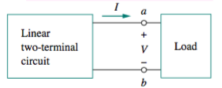
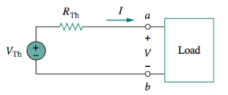
Thevenin’s theorem
Electrical and Electronic Engineering
SCHOOL OF ENGINEERING

Slide 42
Thevenin’s theorem
Electrical and Electronic Engineering
SCHOOL OF ENGINEERING
Procedure
Remove the load resistance from that branch.
Determine the open-circuit voltage, V_{th}, across the break.
Remove each Voltage and current sources and replace them by their internal resistan- ces and then determine the resistance, Rt_{h}, ‘looking-in’ at the break. i.e. replace voltage source with short circuit and current source with open circuit.

Slide 43
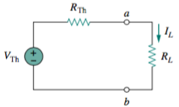

Thevenin’s theorem
Electrical and Electronic Engineering
SCHOOL OF ENGINEERING
4. Obtained the thevenin equivalent circuit

Slide 44
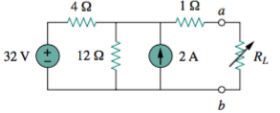
Thevenin’s theorem
Electrical and Electronic Engineering
SCHOOL OF ENGINEERING
e.g. Find the Thevenin equivalent circuit of the circuit shown in to the left of the terminals a-b. Then find the current through RL = 6, 16, and 36 .
Notes:
Solution
R_{th} = 4Ω
Vth = 30V
When R_{L}= 6Ω, 16Ω and 36Ω.
I_{L}=3A, 1.5A, 0.75A respectively

Slide 45
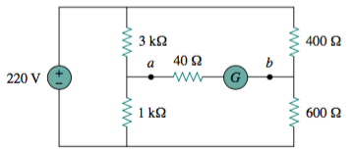
Thevenin’s theorem
Electrical and Electronic Engineering
SCHOOL OF ENGINEERING
e.g. Using Thevenin’s theorem, If the galvano- meter has a resistance of 40Ω , find the current through the galvanometer.
Notes:
Vth = 77V
Rth = 990Ω

Slide 46
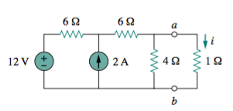
Thevenin’s theorem
Electrical and Electronic Engineering
SCHOOL OF ENGINEERING
Try. Using Thevenin’s theorem, find the equivalent circuit to the left of the
terminals in the circuit. Then find i
Notes:
V_{th}= 6V
R_{th}=3Ω
i = 1.5A

Slide 47
Norton’s Theorem
Electrical and Electronic Engineering
SCHOOL OF ENGINEERING
Norton’s theorem states that a linear two-terminal circuit can be replaced by an equivalent circuit consisting of a current source I_{N} in parallel with a resistor R_{N}, where I_{N} is the short-circuit current through the terminals and R_{N} is the input or equivalent resistance at the terminals when the independent sources are turned off.

Slide 48
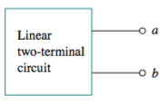
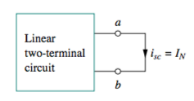
Thevenin’s theorem
Electrical and Electronic Engineering
SCHOOL OF ENGINEERING

Slide 49
Thevenin’s theorem
Electrical and Electronic Engineering
SCHOOL OF ENGINEERING
Procedure
Remove the load resistance from that branch.
Determine the short-circuit current, i_{sc}, flowing from terminal a to b.
Remove each Voltage and current sources and replace them by their internal resistan- ces and then determine the resistance, R_{N}, ‘looking-in’ at the break. i.e. replace voltage source with short circuit and current source with open circuit.

Slide 50
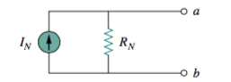
Thevenin’s theorem
Electrical and Electronic Engineering
SCHOOL OF ENGINEERING
4. Obtained the Norton’s equivalent circuit

Slide 51
,.,,

