Slide 1
EDA Google play store
Ghaidaa Khaled

Slide 2
Over view
Today, 1.85 million different apps are available for users to download. Android users have even more from which to choose, with 2.56 million available through the Google Play Store. These apps have come to play a huge role in the way we live our lives today.

Slide 3
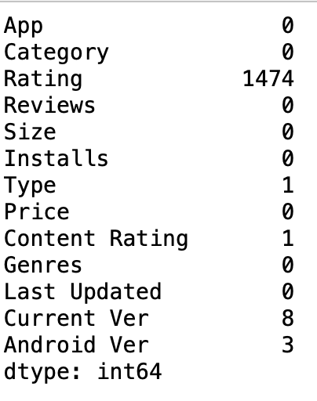
Check missing data

Slide 4
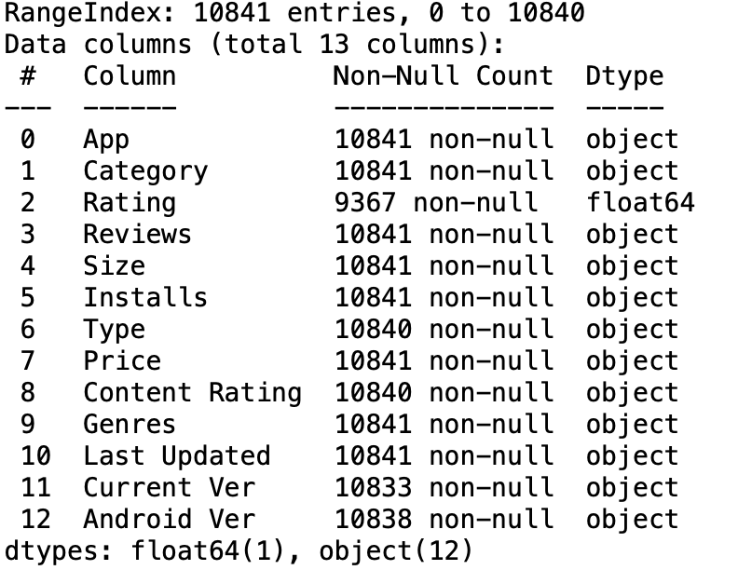

Slide 5
delete data duplicated
Num rows duplicate is 305 the shape of the dataset

Slide 6
Exploratory Data Analysis (EDA)

