Slide 1

Car price predection
By : Ghaida Ali Alaqeel
Instractour : Dr. Mejdal Alqahtani

Slide 2
GOAL
Find the best model can predict the car price
depend of features and how I can improved

Slide 3
Car data set
Target
Dependent column
collected
4395 , 9
features
Independent column
Clean
4123 , 21

Slide 4
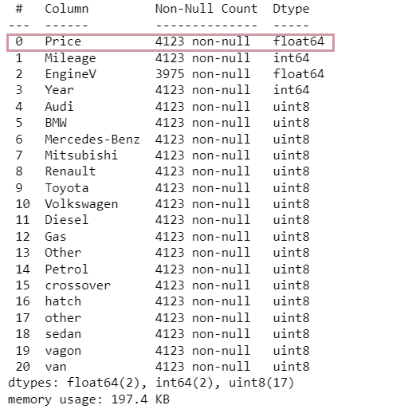
Table of contents
The Target (Price) : Prices of cars
Milleage : Driven cars in Km
Engine V : engine version of Car
Year : year of manufacturing of Car
Car Brands : [5,6,7,8,9,10]
Fuel types : [Diesel , Gas , Other ]
Car Bodies : [15,16,17,18,19,20]

Slide 5
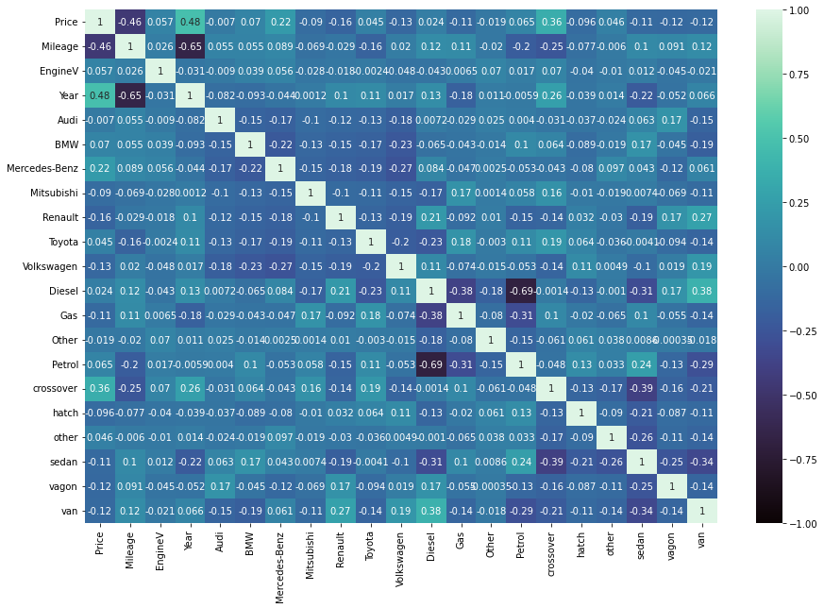
correlations between features and target

Slide 6
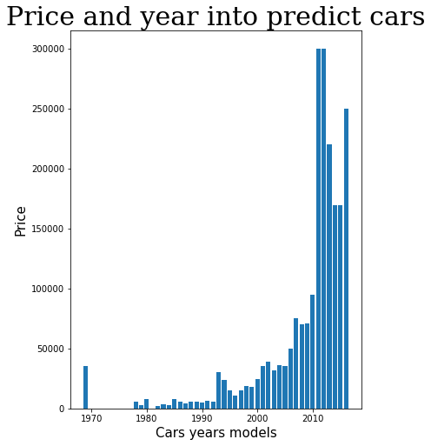
Year price
The price increasing through years
ascending increase
1970 => 2016

Slide 7
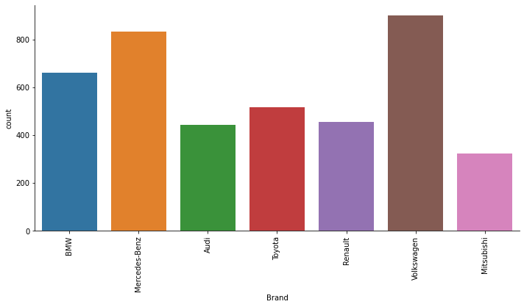
The common Cars brands
1 st
Volkswagen
2 nd
Mercedes-benz
3 rd
bmw
Histogram for count the most car brands selles

Slide 8
01
models
Model | Accuracy
Linear Regression | 0.52%
Lasso Regression | 0.43%
Poly with Ridge Regression | 0.63%
OLS | 0.27%
Elastic Net | 0.52%
RANSA Regressor | 0.10%
Random Forest Regressor | 0.91%

Slide 9

01
models
Model | Accuracy
Linear Regression | 0.52%
Lasso Regression | 0.43%
Poly with Ridge Regression | 0.63%
OLS | 0.27%
Elastic Net | 0.52%
RANSA Regressor | 0.10%
Random Forest Regressor | 0.91%

Slide 10
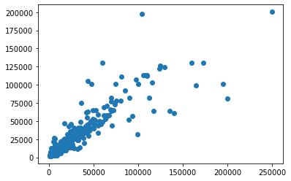
Random Forest Regressor
. Training model accuracy = > 91%
. Testing model accuracy = > 81%
. mean_absolute_error = > 4136.23
. mean_squared_error = > 115726211.51
!
OPPS
OVERFITTING

Slide 11
01
models
Model | Accuracy
Linear Regression | 0.5232
Lasso Regression | 0.4347
Poly with Ridge Regression | 0.6335
OLS | 0.275
Elastic Net | 0.5249
RANSA Regressor | 0.1020
Random Forest Regressor | 0.9116

Slide 12
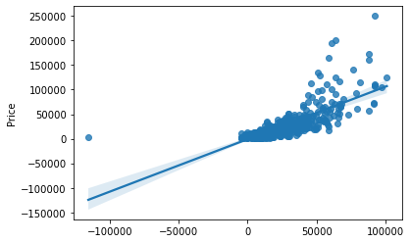
Polynomial and ridge regression
Split
Cross-val = 9
Polynomail feature
Degree = 2
Ridge
alpha=950

Slide 13
Polynomial and ridge regression
. Polynomial degree = > 2
. Alpha = > 950
. Training model accuracy = > 63%
. Testing model accuracy = > 62%
. Mean MAE = > 0.62

Slide 14

Thanks !

