Slide 1

Credit Risk Analysis and Prediction of Loan Defaults using Lending Club Loan dataset
Gashaw Hailemichael
DATA 606 - Capstone Project

Slide 2
Introduction
This project focuses to analyze the credit risk involved in peer-to-peer (P2P) lending system of Lending Club Company.
Machine learning algorithms and preprocessing techniques has been used to explore, analyze and determine the factors.
The dataset used existed in the open source Kaggle website

Slide 3
The Dataset
Lending Club Loan Dataset contain complete loan data for all loans issued through the year 2007 to 2015
Data existed in the open source kaggle website through the link: https://www.kaggle.com/wendykan/lending-club-loan-data
Dataset Size: 2 GB
Number of records: 890 thousand
Number of columns: 75

Slide 4
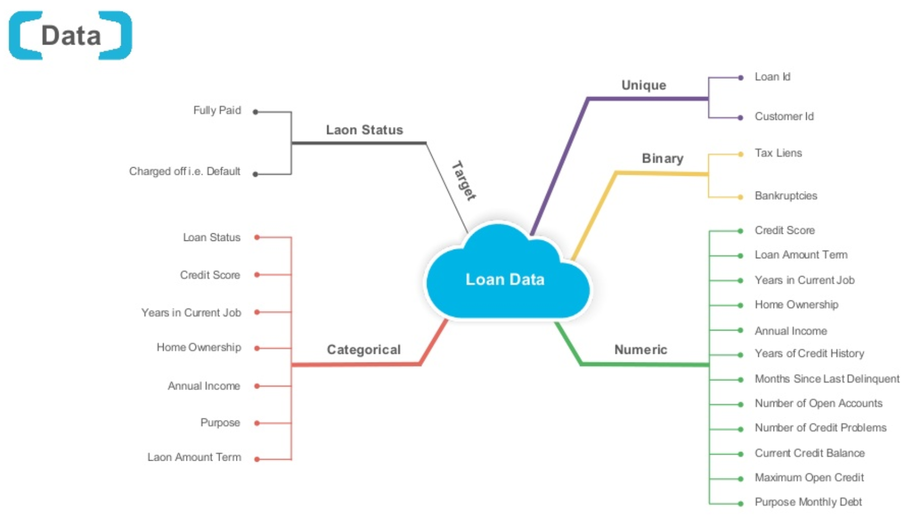
Data Flow
https://www.slideshare.net/AliCloud/loan-default-prediction-with-machine-learning

Slide 5
Statement of the problem
In decision-making process, it is a tough problem for investors to decide whether or not to fund a particular loans. Therefore, it is important for the lending industry to apply risk management by providing investors with comprehensive risk assessment.
This study proposes solutions with the goal at helping potential investors in their decision making process.

Slide 6
Related Work
Emekter et al. (2015), Evaluating credit risk and loan performance in online Peer-to-Peer (P2P) lending.
Findings: Credit Grade, FICO score, Debt-to-Income and Revolving Credit Utilization,
Serrano-Cinca et al. (2015), Determinants of Default in P2P Lending.
Findings: Credit Grade, Annual Income, Loan Purpose, Debt-to-Income, Current Housing Situation, Credit History Length, Revolving Credit Utilization, Recent Inquiries, Deliquency in Past 2 Years, Open Credit Lines

Slide 7
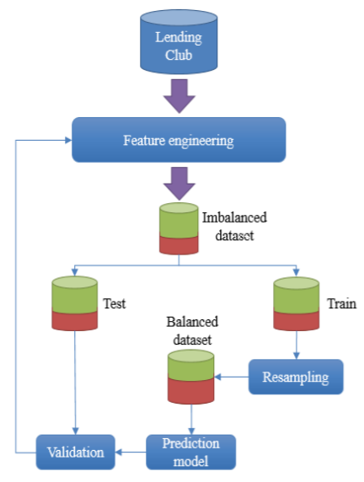
Methodology
https://arxiv.org/ftp/arxiv/papers/1805/1805.00801.pdf

Slide 8
Data Cleaning
Removed the columns which had more than 50% of missing data.
Imputed the remaining attributes of missing data
Removed the columns that has no direct relation to our analysis
Removing Redundant Attributes
Labeled our data based on the features provided in data. “Default", "Charged Off", "Late “ were considered as defaulted loans.

Slide 9
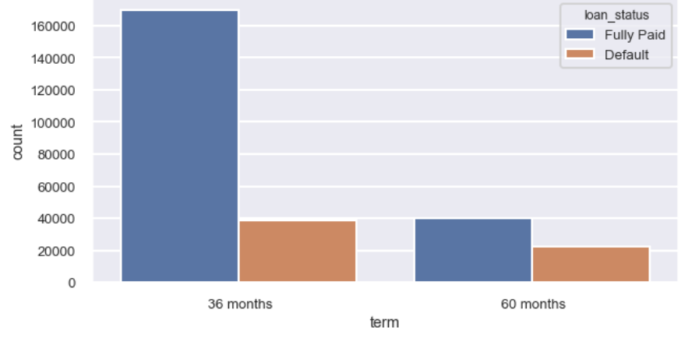
Exploratory Data Analysis :Bivariate Analysis
Loan_status vs Term

Slide 10
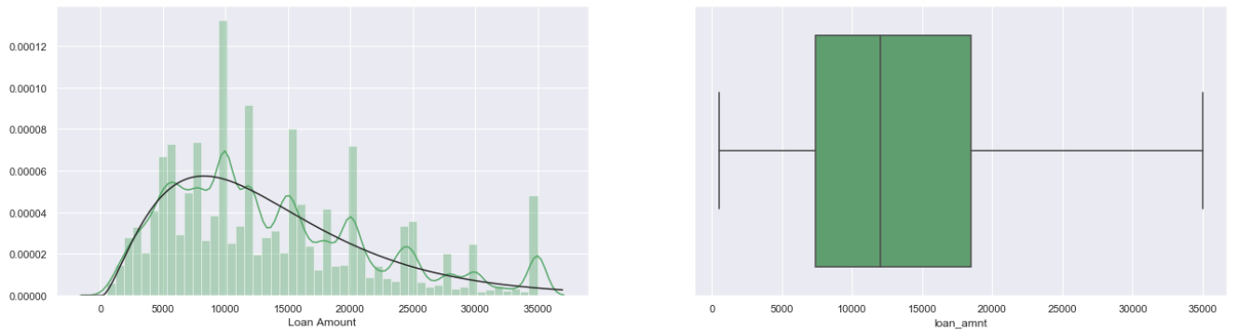
Exploratory Data Analysis:Univariate Analysis
Loan_amount

Slide 11
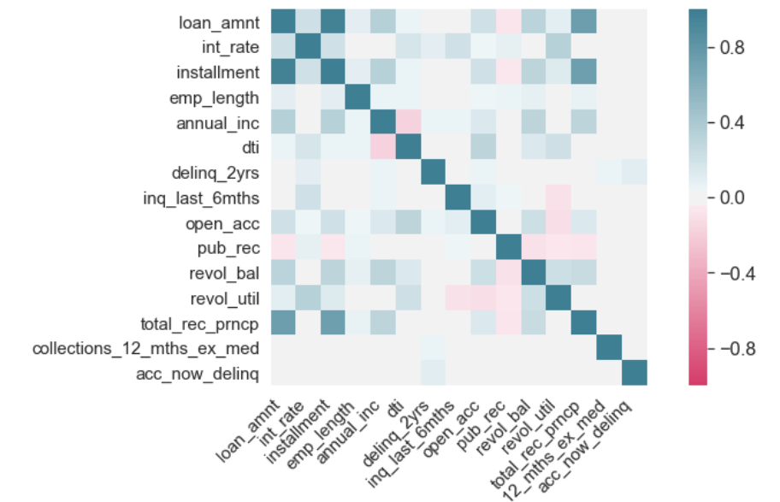
Correlation matrix

Slide 12
Model
Naïve Bayes
Logistic Regression
Random Forest

Slide 13
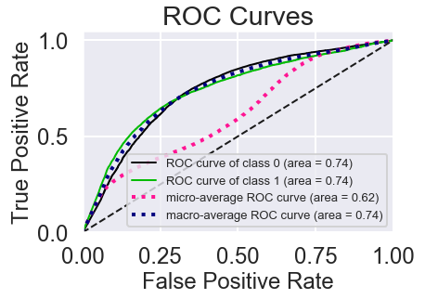
Results
Naïve Bayes
Table 1: Performace Matrix
Naïve Bayes | Precision | Recall | F1 Score | Support
Fully Paid | 0.91 | 0.46 | 0.61 | 41867
Default | 0.31 | 0.84 | 0.46 | 12311
A ‘Default’ recall of 84% and a ‘Fully Paid’ precision of 91% were achieved.
The ROC curve for Naïve Bayes shows that AUC of 0.74 for loan to be defaulted.

Slide 14
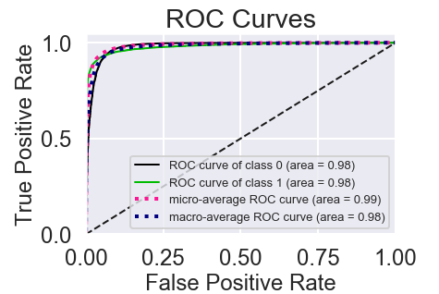
Results Conti.
Logistc Regression
Performace Matrix
Logistic Regression | Precision | Recall | F1 Score | Support
Fully Paid | 0.98 | 0.95 | 0.96 | 41867
Default | 0.85 | 0.92 | 0.89 | 12311
A ‘Default’ recall score of 92% and a ‘Fully Paid’ precision of 98% were achieved.
The ROC curve for Logistic Regression shows that AUC of 0.98, which is better than the Naïve Bayes model.

Slide 15
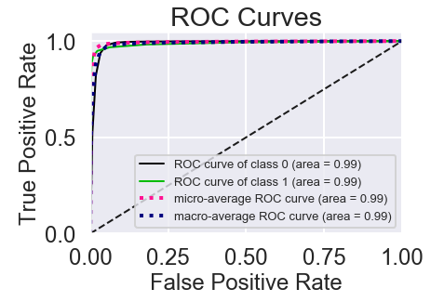
Results Conti.
Random Forest
Table 3: Performace Matrix
Random Forest | Precision | Recall | F1 Score | Support
Fully Paid | 0.97 | 1.00 | 0.98 | 41867
Default | 0.99 | 0.88 | 0.93 | 12311
Here a ‘Default’ recall of 88% and a ‘Fully Paid’ precision of 97% were achieved.
The ROC curve for Random Forest shows that 0.99, which is the highest of all the three models.

Slide 16
Conclusion
The Naïve Bayes model provided “Default” recall of 84% and “Fully Paid” precision of 91%.
The Logistic Regression model provided “Default” recall of 92% and “Fully Paid” precision of 98%.
The Random Forest model provided a “Default” recall of 88% and a “Fully Paid” precision of 97%.
Based on precision/ recall scores, we recommend investors to use Logistic Regression algorithm to identify whether a loan to be “Defaulted” or “Fully Paid”.

Slide 17
Potential Future Work
Find other features that might help to improve overall model performance.
Develop grid search to optimize Random Forest model performance.
Find out other approaches to work around highly imbalanced data.
Try out different classification algorithms such as XGBoost, neural networks or other classification algorithms that could provide better performance.

Slide 18
Thank you!
github account: https://github.com/Ghailemichael/DATA606/branches
email address: gashawh1@umbc.edu

