Slide 1

Credit Risk Analysis and Prediction of Loan Defaults using Lending Club Loan dataset
Gashaw Hailemichael
DATA 606 - Capstone Project
PART III: Model Construction

Slide 2
Review of Exploratory Data Analysis (EDA)
Univariate Analysis
Bivariate Analysis
Dimensionality reduction
Missing Values

Slide 3
Data Transformation
Transform categorical variables using One-hot encoding
Scaling numerical Data using StandardScaler()

Slide 4
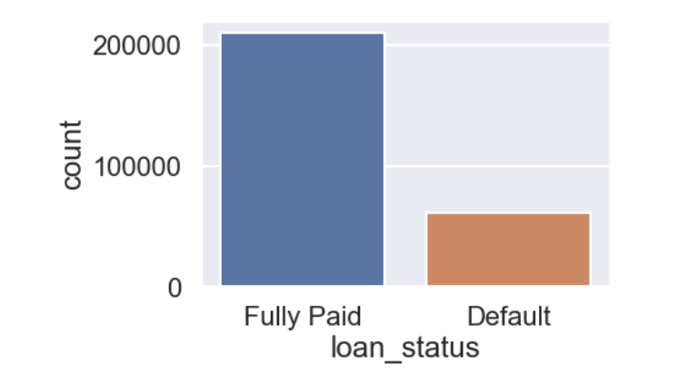
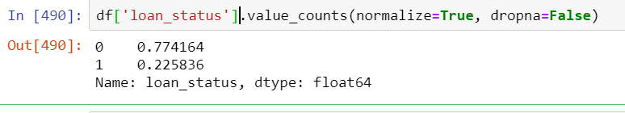
Synthetic Minority Oversampling(SMOTE)

Slide 5
Model
Naïve Bayes
Logistic Regression
Random Forest

Slide 6
Model evaluation techniques
Confusion Metrix
classification_report()
Receiver Operating Characteristic(ROC) curve

Slide 7
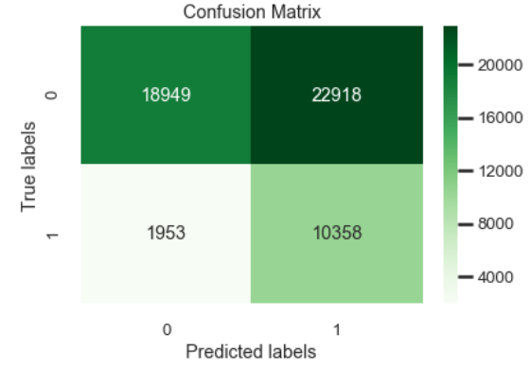
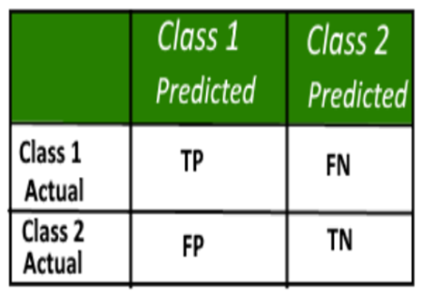
Naïve Bayes

Slide 8
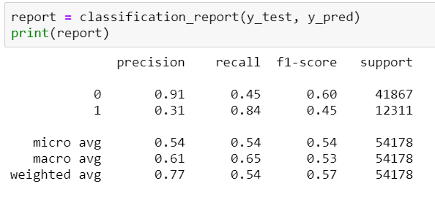
Naïve Bayes Conti…

Slide 9
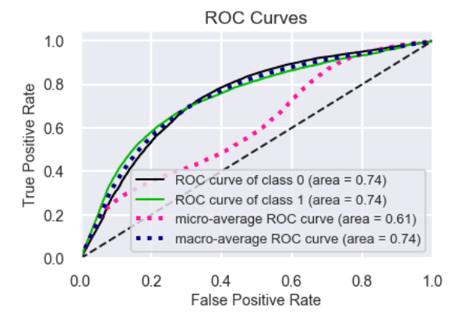
Naïve Bayes cont.…

Slide 10
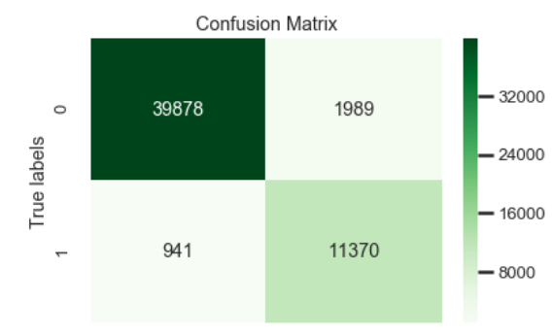

LogisticRegression

Slide 11
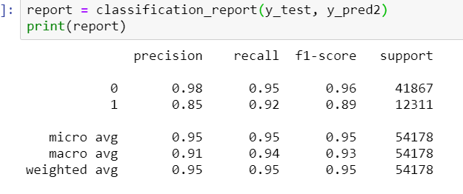
Logistic Regression Conti…

Slide 12
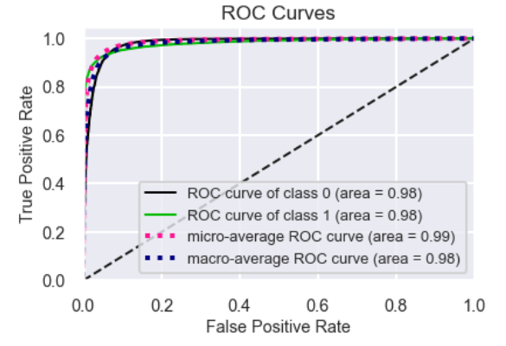
Logistic Regression cont.…

Slide 13
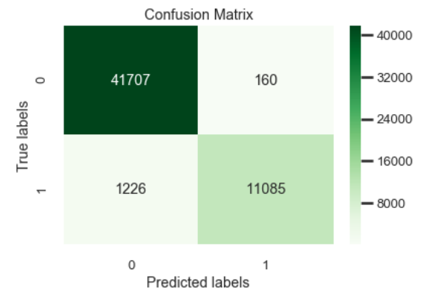
Random Forest

Slide 14
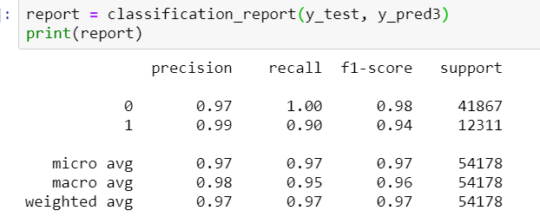
Random Forest conti..

Slide 15
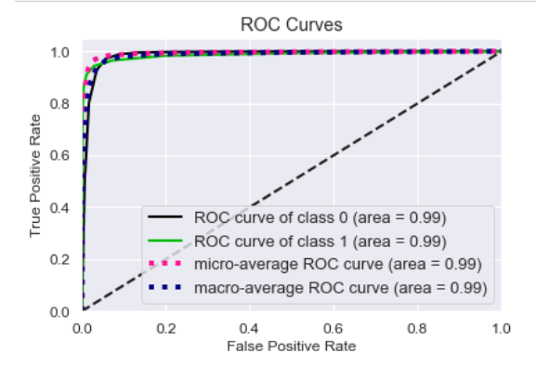
Random Forest conti..

Slide 16
Thank you!
github account: https://github.com/Ghailemichael/DATA606/branches
email address: gashawh1@umbc.edu

