Slide 1
Credit Risk Analysis and Prediction of Loan Defaults using Lending Club Loan dataset
Gashaw Hailemichael
DATA 606 - Capstone Project

Slide 2
Introduction
Credit risk management is important to financial institutions which provide loans to businesses and individuals.
Credit loans and finances have risk of being defaulted or delinquent.
To understand risk levels of credit users, credit providers normally collect vast amount of information on borrowers.
Identifying factors or variables that best summarize risky segments are important.
To avoid loans that are predicted to default, Credit risk prediction is an effective way of evaluating whether a potential borrower will repay a loan.

Slide 3
The Dataset
Lending Club Loan Dataset contain complete loan data for all loans issued through the year 2007 to 2015
Data existed in the open source kaggle website through the link: https://www.kaggle.com/wendykan/lending-club-loan-data
Dataset Size: 2 GB
Number of records: 890 thousand
Number of columns: 75

Slide 4
Methodology
Prediction models will be developed from historical data of credit loans.
Using the dataset, I will conduct Exploratory Data Analysis (EDA) and apply various machine-learning techniques so as to avoid loans that are predicted to default.
The Data Processing, EDA and data Visualization will be performed using Python.
The results will reveal that an effective strategy for calculating the credit risk associated with loan applicants.

Slide 5
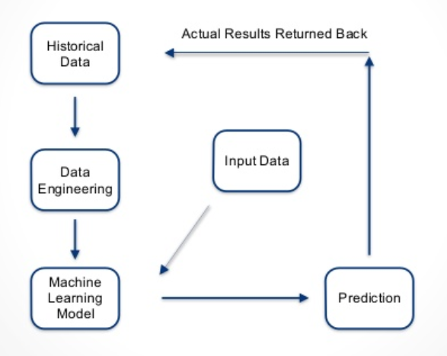
Overview of Data Flow

Slide 6
Goal
Using Lending Club dataset, the goal is to provide a data product that enables investors to avoid loans likely to default.
This will be achieved by conducting Exploratory Data Analysis (EDA) and developing a model using various machine-learning techniques that predicts probability of default for a potential loan so as to avoid loans that are predicted to default.

Slide 7
Thank you!
github account: https://github.com/Ghailemichael/DATA606/branches
email address: gashawh1@umbc.edu

