Slide 1
Subject:Web Development with JSF2
Requirement: STS or Intellij, Tomcat7, MySql and the JSF “jsf_example”.
Presenter: Ghaith Alrabadi.
Date: 12/10/2012

Slide 2
Web Development with JSF2
What is JSF?

Slide 3
Web Development with JSF2
JavaServer Faces (JSF) is a Java-based web application framework intended to simplify development integration of web-based user interfaces.
JSF is a request-driven MVC web framework for constructing user interfaces using components. As a display technology, JSF 2 uses Facelets. JSF 1.x uses JavaServer Pages (JSP) for its display technology.
JSF is a standardized technology which was formalized in a specification through the Java Community Process. It is part of the Java Platform, Enterprise Edition.
JSF is event driven programming model.
JSF is component-driven framework which make it a natural extension of OOD for the developer.

Slide 4
Web Development with JSF2
What is JSF versions?

Slide 5
Web Development with JSF2
Versions:
JSF 2.1 (2010-10-22) — Current version.
JSF 2.0 (2009-06-28).
JSF 1.2 (2006-05-11.
Implementations:
Mojarra: is the new name of the Oracle original JSF reference implementation.
Myfaces by apache.

Slide 6
Web Development with JSF2
How JSF works?

Slide 7
Web Development with JSF2
JSF is based on a component-driven UI design model, using XML files called view templates or Facelets views.
Requests are processed by the FacesServlet, which loads the appropriate view template, builds a component tree, processes events, and renders the response (typically HTML) to the client.
The state of UI components (and some other objects) is saved at the end of each request, and restored upon next creation of that view.
Several types of state-saving are available, including Client-side and Server-side state saving.

Slide 8
Web Development with JSF2
JSF life Cycle

Slide 9
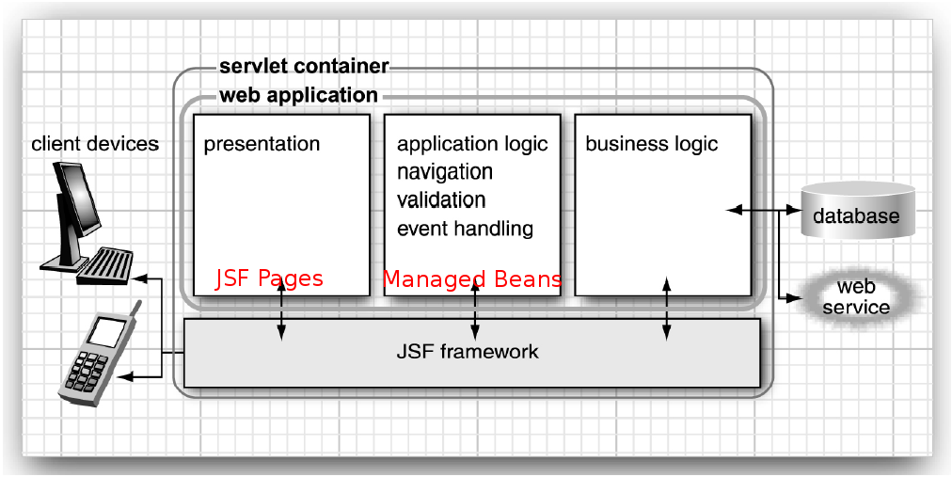
Web Development with JSF2
JSF life Cycle

Slide 10
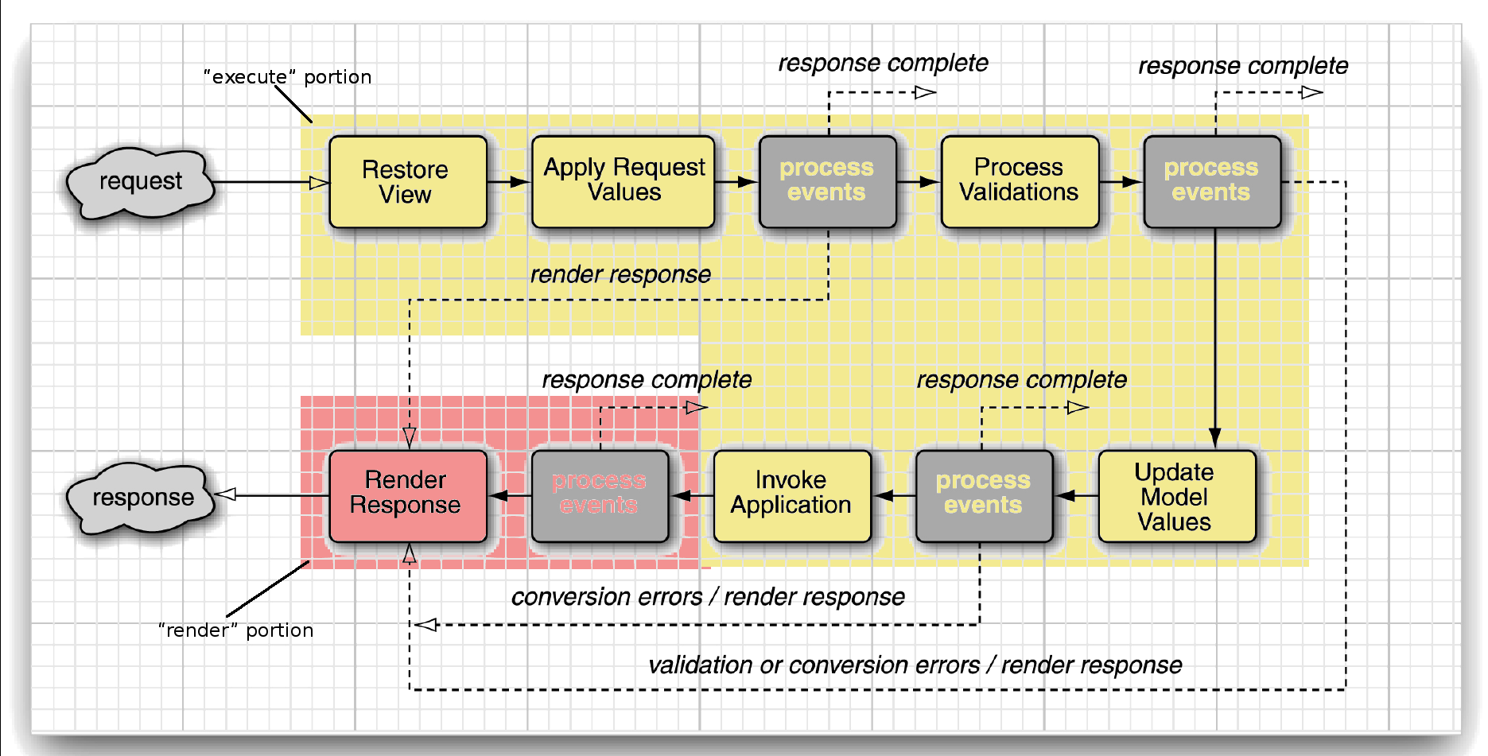
Web Development with JSF2

Slide 11
Web Development with JSF2
JSF life Cycle for Ajax

Slide 12
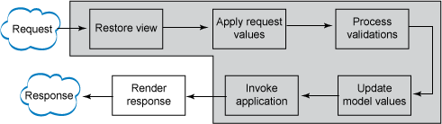
Web Development with JSF2
Execute Phase

Slide 13
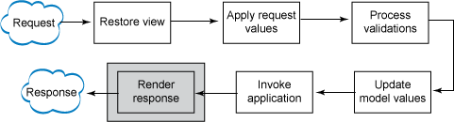
Web Development with JSF2
Render Phase

Slide 14
Web Development with JSF2
Basic Components and Tags in JSF

Slide 15
Web Development with JSF2
JSF core components are components that are not tied to HTML rendering or any other rendering mechanism. They provide functionality like type conversion and validation, listeners among others.
<html xmlns="http://www.w3.org/1999/xhtml"
xmlns:h="http://java.sun.com/jsf/html"
xmlns:f="http://java.sun.com/jsf/core"
xmlns:p="http://primefaces.org/ui">

Slide 16
Web Development with JSF2
JSF HTML components are components that are tied to HTML rendering like button, href, select, table ..etc.
<html xmlns="http://www.w3.org/1999/xhtml"
xmlns:h="http://java.sun.com/jsf/html"
xmlns:f="http://java.sun.com/jsf/core"
xmlns:p="http://primefaces.org/ui">

Slide 17
Web Development with JSF2
JSF Core components Table

Slide 18
Web Development with JSF2
attribute | Sets an attribute (key/value) in its parent component.
param | Adds a parameter child component to its parent component.
facet | Adds a facet to a component.
actionListener | Adds an action listener to a component.
setPropertyActionListener | Adds an action listener that sets a property.
valueChangeListener | Adds a value change listener to a component.
event | Adds a component system event listener.
converter | Adds an arbitrary converter to a component.
convertDateTime | Adds a datetime converter to a component.
validator | Adds a validator to a component.
validateRegex | Validates a value against a regular expression.

Slide 19
Web Development with JSF2
loadBundle | Loads a resource bundle, stores properties as a Map.
selectitems | Specifies items for a select one or select many component.
selectitem | Specifies an item for a select one or select many component.
ajax | Enables Ajax behavior for components.

Slide 20
Web Development with JSF2
JSF HTML components Table

Slide 21
Web Development with JSF2
An Overview of the JSF HTML Tags
• Inputs (input...)
• Outputs (output..., graphicImage)
• Commands (commandButton and commandLink)
• GET Requests (button, link, outputLink)
• Selections (checkbox, listbox, menu, radio)
• HTML pages (head, body, form, outputStylesheet, outputScript)
• Layouts (panelGrid, panelGroup)
• Data table (dataTable and column); see Chapter 6
• Errors and messages (message, messages)

Slide 22
Web Development with JSF2
head | Renders the head of the page
body | Renders the body of the page
form | Renders a HTML form
OutputStylesheet | Adds a stylesheet to the page
outputScript | Adds a script to the page
inputText | Single-line text input control
InputTextarea | Multiline text input control
InputTextarea | Multiline text input control
InputSecret | Password input
inputHidden | Input hidden
outputLabel | Label for another component for accessibility
outputLink | Link to another web site
outputFormat | Like outputText, but formats compound messages
outputText | Single-line text output

Slide 23
Web Development with JSF2
commandButton | Button: submit, reset, or pushbutton
commandLink | Link that acts like a pushbutton
button | Button for issuing a GET request
link | Link for issuing a GET request
message | Displays the most recent message for a component
messages | Displays all messages
graphicImage | Displays an image
selectOneListbox | Single-select listbox
selectOneMenu | Single-select menu
selectOneRadio | Set of radio buttons
selectBooleanCheckbox | Checkbox
selectManyCheckbox | Set of checkboxes
selectManyListbox | Multiselect listbox
selectManyMenu | Multiselect menu

Slide 24
Web Development with JSF2
panelGrid | Tabular layout
panelGroup | Two or more components that are laid out as one
dataTable | A feature-rich table control
column | Column in a dataTable

Slide 25
Web Development with JSF2
General Project Components

Slide 26
Web Development with JSF2
• JAR files
– JSF 2.0 JAR files required; JSTL 1.2 JARs some application servers provide them by default like Glassfish 3, JBoss 6, and other Java EE 6 servers
• faces-config.xml
mappings of action controller values to results pages. Later
tutorial sections will look at explicit values in faces-config.xml.
• web.xml
– Must have a url-pattern for *.jsf (or other pattern you choose)
– Usually sets PROJECT_STAGE to Development
• some-page.xhtml
– Use URL some-page.jsf (matches url-pattern from web.xml)

Slide 27
Web Development with JSF2
faces-config.xml file:
<faces-config
xmlns="http://java.sun.com/xml/ns/javaee"
xmlns:xsi="http://www.w3.org/2001/XMLSchema-instance"
xsi:schemaLocation="http://java.sun.com/xml/ns/javaee
http://java.sun.com/xml/ns/javaee/web-facesconfig_2_0.xsd"
version="2.0">
<!-- JSF and Spring are integrated -->
<application>
<el-resolver>
org.springframework.web.jsf.el.SpringBeanFacesELResolver
</el-resolver>
</application>
<!-- configuration of navigation rules -->
<navigation-rule>
<from-view-id>/pages/index.xhtml</from-view-id>
<navigation-case>
<from-outcome>success</from-outcome>
<to-view-id>/pages/success.xhtml</to-view-id>
</navigation-case>
</navigation-rule>
</faces-config>

Slide 28
Web Development with JSF2
web.xml file:
<web-app xmlns:xsi="http://www.w3.org/2001/XMLSchema-instance" xmlns="http://java.sun.com/xml/ns/javaee" xmlns:web="http://java.sun.com/xml/ns/javaee/web-app_2_5.xsd" xsi:schemaLocation="http://java.sun.com/xml/ns/javaee http://java.sun.com/xml/ns/javaee/web-app_2_5.xsd" id="WebApp_ID" version="2.5">
<display-name>JSF_Example</display-name>
<context-param>
<param-name>contextConfigLocation</param-name>
<param-value>
/WEB-INF/applicationContext.xml
</param-value>
</context-param>
<listener>
<listener-class>
org.springframework.web.context.ContextLoaderListener
</listener-class>
</listener>

Slide 29
Web Development with JSF2
<welcome-file-list>
<welcome-file>/pages/index.xhtml</welcome-file>
</welcome-file-list>
<servlet>
<servlet-name>Faces Servlet</servlet-name>
<servlet-class>javax.faces.webapp.FacesServlet</servlet-class>
<load-on-startup>1</load-on-startup>
</servlet>
<servlet-mapping>
<servlet-name>Faces Servlet</servlet-name>
<url-pattern>*.jsf</url-pattern>
</servlet-mapping>
<servlet-mapping>
<servlet-name>Faces Servlet</servlet-name>
<url-pattern>*.faces</url-pattern>
</servlet-mapping>
</web-app>

Slide 30
Web Development with JSF2
<!DOCTYPE html PUBLIC "-//W3C//DTD XHTML 1.0 Transitional//EN" "http://www.w3.org/TR/xhtml1/DTD/xhtml1-transitional.dtd">
<html xmlns="http://www.w3.org/1999/xhtml" xmlns:h="http://java.sun.com/jsf/html">
<h:head>
<title>Welcome</title>
</h:head>
<f:metadata>
<f:viewParam name="directLogin" value="#{user.canLogin}"/>
</f:metadata>
<h:body>
<h:form>
<h3>Please enter your name and password.</h3>
<table>
<tr>
<td>Name:</td>
<td><h:inputText value="#{user.name}"/></td>
</tr>
<tr>
<td>Password:</td>
<td><h:inputSecret value="#{user.password}"/></td>
</tr>
</table>
<p><h:commandButton value="login" action="#{user.login}"/></p>
</h:form>
</h:body>
</html>

Slide 31
Web Development with JSF2
import java.io.Serializable;
import javax.inject.Named;
import javax.enterprise.context.SessionScoped;
@Named("user") // or @ManagedBean(name="user")// or Spring Component i
@SessionScoped
public class UserBean implements Serializable {
private String name;
private String password;
Private boolean directLogin;
public String getName() { return name; }
public void setName(String newValue) { name = newValue; }
public String getPassword() { return password; }
public void setPassword(String newValue) { password = newValue; }
public boolean isDirectLogin() { return directLogin; }
public void setDirectLogin(boolean newValue) {
if(directLogin)
return "success";
directLogin = newValue;
}
public String login(){
if(name.equals("a"))
return "success"
return "fail"
}
}

Slide 32
Web Development with JSF2
JSF with Spring and Hibernate Maven Structure

Slide 33
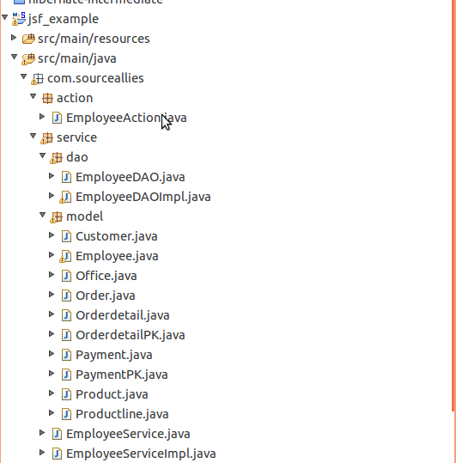
Web Development with JSF2

Slide 34
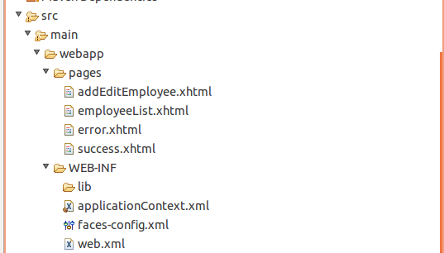
Web Development with JSF2

Slide 35
Web Development with JSF2
Add Tomcat web-server to STS

Slide 36
Web Development with JSF2
Add 'jsf_example' Project to STS

Slide 37
Web Development with JSF2
Create the DB schema on MySql

Slide 38
Web Development with JSF2
Understand the project source code

Slide 39
Web Development with JSF2
Running the Project

Slide 40
Web Development with JSF2
Thank you

