Slide 1

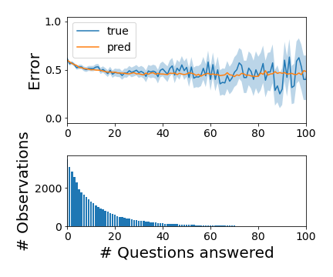
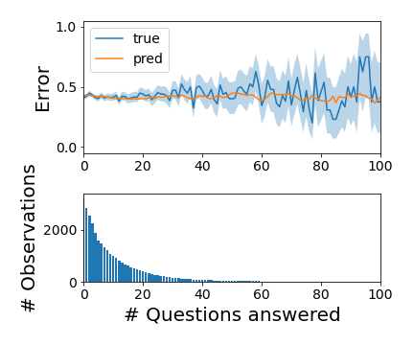
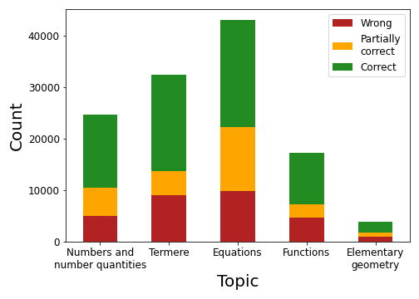
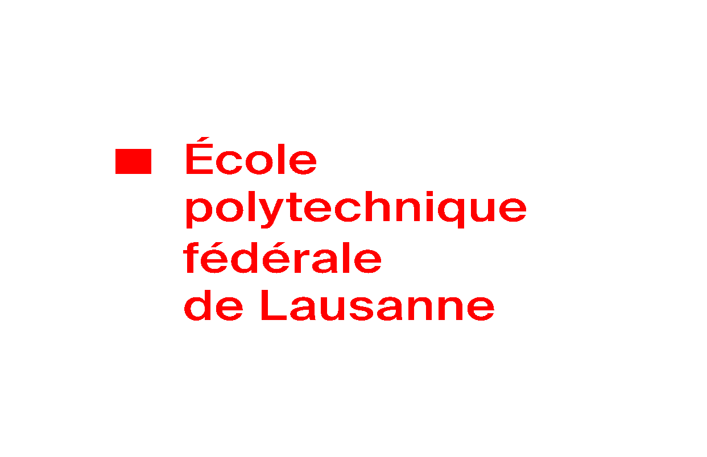
Modelling learning behavior of Learnnavi users
Survey of Knowledge Tracing techniques
Marie Biolková, Ghali Chraibi, Shrirang Bagdi
Machine Learning for Behavioral Data (MLBD) Course, EPFL, 2022
1 INTRODUCTION + RESEARCH QUESTION
3 RESULTS
Educational technologies (EdTechs) support students and teachers.
To improve them, knowledge tracing which aims at modelling student’s mastery of a skill that they are learning. It can provide valuable insights for adapting the curriculum to the student’s needs.
We leveraged data collected from an EdTech startup and performed knowledge tracing with the goal to determine how much the users are learning when it comes to Mathematics.
Figure 2. Learning curves for Equations (left) and Terms (right) topics.
2 METHODOLOGY
The best DKT model is GRU (in both settings) with 16 units, dropout of 0.2 and without the estimated difficulty feature.
In the binary setting, DKT achieves the highest AUC, and lowest RMSE (tied with BKT which has worse AUC).
The RMSE is by design reduced when partial credit is introduced, however the multiclass AUC is poor for both models.
Overall, the models tend to underestimate the error rate.
Dataset
Data Processing
For our research question, we train our models using the topic of the question, the evaluation that a submission receive and also try to consider the difficulty of the question (provided by Learnavi).
Focus on the evaluated trials of the Mathematics part, corresponding to 121’281 answers from 5’192 users.
Keep the subtopics of the five main topics in the Mathematics part (Numbers and Number Quantities, Terms, Equations, Functions and Elementary Geometry) which corresponds to 272 topics.
Consider two settings for the evaluation, the binary setting in which partially correct answers are considered wrong and the partial credit setting in which they are taken into account.
Model Architecture
Figure 1. Distribution of answers across topics and evaluations.
The data is from Learnnavi [1], an online platform where users can study Mathematics and German. It allows users to follow their progress and obtain feedback on their submissions.
Table 1. Root-mean-squared error (RMSE) and area under the ROC curve (AUC) for each models. With + we denote models which include the estimated difficulty of the question.
 | Binary setting |  |  |  |  | Partial credit setting
 | BKT * | AFM | PFA | PFA+ | DKT | PFA+ | DKT
RMSE ↓ | 0.476 | 0.483 | 0.480 | 0.478 | 0.476 | 0.407 | 0.409
AUC ↑ | 0.661 | 0.636 | 0.651 | 0.659 | 0.677 | 0.531 | 0.545
* weighted average of per-topic results
4 CONCLUSION
In conclusion, we achieved to adapt several knowledge tracing models on Learnavi data and obtained an AUC score of 0.677 with a GRU.
Limitations
The notion of partial credit is difficult to use and interpret. The binary setting is more realistic and provides better results.
Times series of the users are of unequal size and mostly short which is not ideal to train some of the models.
Further work
More attention on the processing of the data could provide more accurate results. A first approach would be to filter out users who have made little use of the application or to exploit the classroom feature.
Bayesian Knowledge Tracing [2]
Additive Factors Model [3]
Fit one model per main topic to ensure that the overlap between skills is minimised (BKT assumption).
BKT supports only binary outcomes and cannot be adapted easily in the partial credit setting.
Assumes that the prior knowledge of students may vary.
A question can use multiple skills and the difficulty of the skills are modeled.
Each trial improves the learning.
Performance Factors Analysis [4]
Deep Knowledge Tracing [5]
REFERENCES
Same assumption as in AFM except that the learning rate is now different for correct and wrong answers.
Can be extended for the partial credit setting by considering a third learning rate for partially correct answers and by adding the estimated difficulty feature.
Flexible models that can capture the relationships between different topics.
Fit DKT model with and without considering the difficulty of a topic, on different model architectures (RNN, GRU, LSTM).
[1] Lernnavi. Access at https://app.lernnavi.ch/
[2] Corbett, A. T., & Anderson, J. R. (1994). Knowledge tracing: Modeling the acquisition of procedural knowledge. User modeling and user-adapted interaction, 4(4), 253-278.
[3] Cen, H., Koedinger, K., & Junker, B. (2008). Comparing two IRT models for conjunctive skills. International Conference on Intelligent Tutoring Systems (pp. 796-798). Springer, Berlin, Heidelberg.
[4] Pavlik Jr, Phil & Cen, Hao & Koedinger, Kenneth. (2009). Performance Factors Analysis - A New Alternative to Knowledge Tracing. Frontiers in Artificial Intelligence and Applications.
[5] Piech, C., Bassen, J., Huang, J., Ganguli, S., Sahami, M., Guibas, L. J., & Sohl-Dickstein, J. (2015). Deep knowledge tracing. Advances in neural information processing systems, 28.

