Slide 1

Artifact Model
No smart search(1.05)

Slide 2
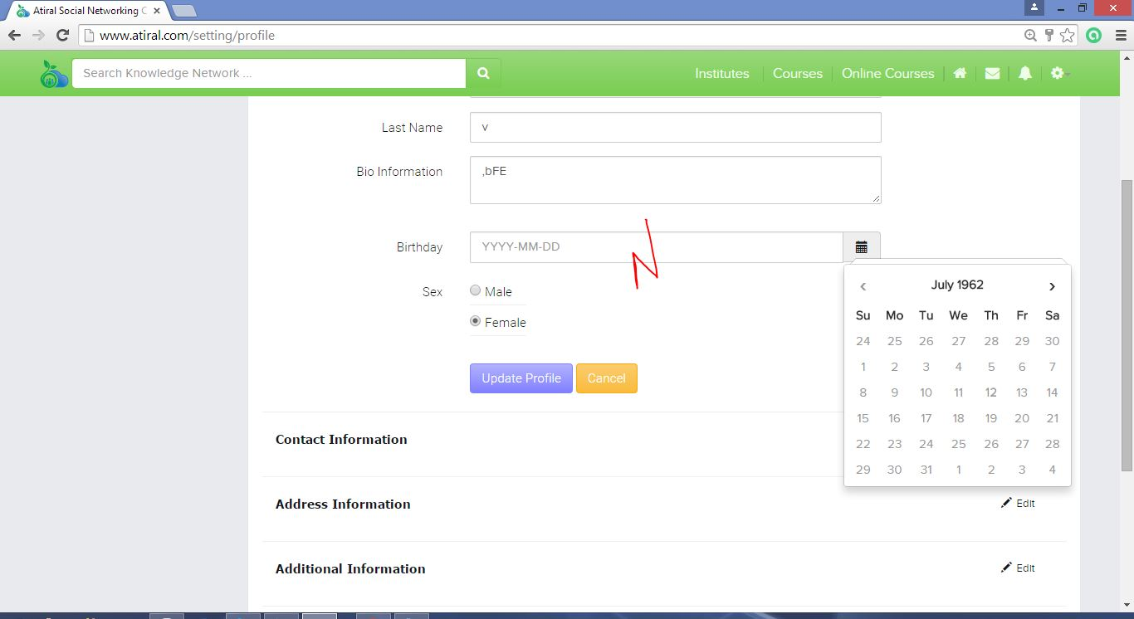
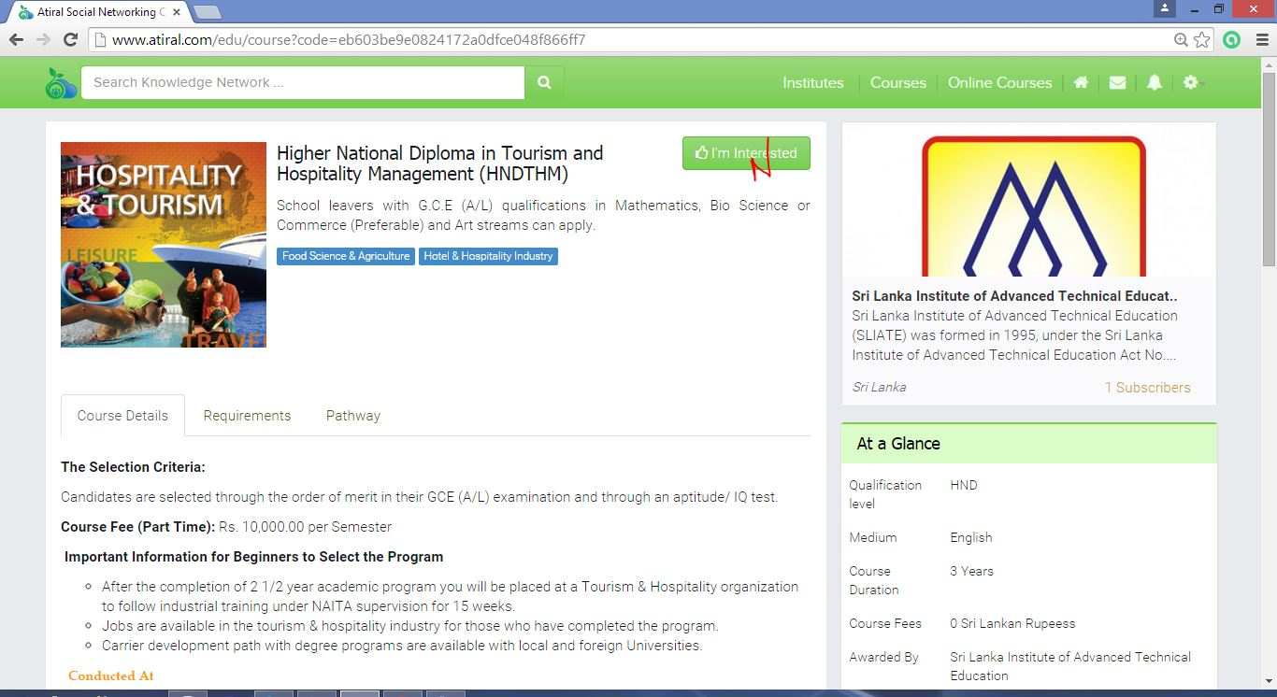
Accept future date(1.30)
Confusing label
(2.10)

Slide 3
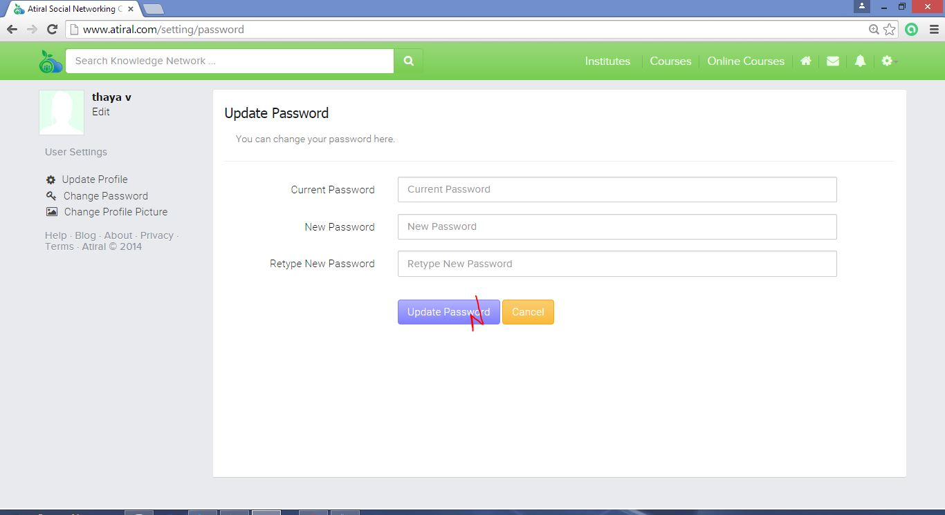
Takes too long to update(1.30)

Slide 4
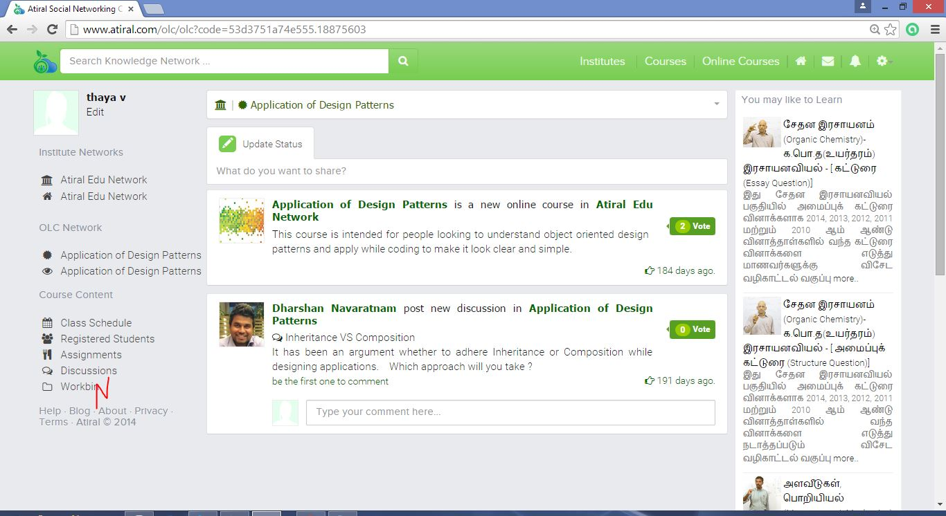
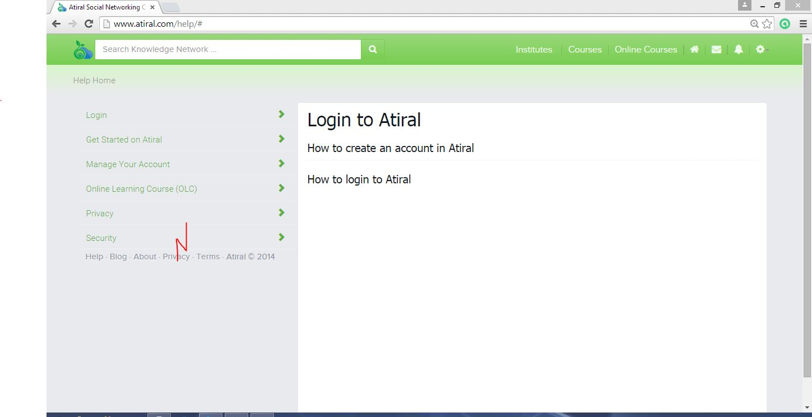
Confusing label (0.55)
Not implemented (1.10)

