Slide 1
19MNG338 - OPERATIONS RESEARCH
Operating Room Capacity Planning and Utilization Optimization Using Surgical Workflow Analytics
BAVESH RAAM S - CB.SC.U4AIE23016
GHANASREE S - CB.SC.U4AIE23028
KAVIN CHAKRAVARTHY S - CB.SC.U4AIE23036
PREM KUMAR R - CB.SC.U4AIE23052
Team Number: A13
Page 1 of 11

Slide 2
Problem Statement
Hospital operates 8 OR suites shared across 10 surgical specialties.
Every week, must decide how many OR-hours to give each specialty.
Too few hours wastes capacity; too many starves other specialties and causes overtime.
Goal: Optimize weekly OR-hour allocations across 10 specialties to maximize surgical throughput while controlling overtime, subject to total suite capacity and historical demand bounds.
Must respect total OR capacity and each specialty's historical demand.
Key Challenge: Throughput vs. Overtime are conflicting objectives.
Page 2 of 11

Slide 3
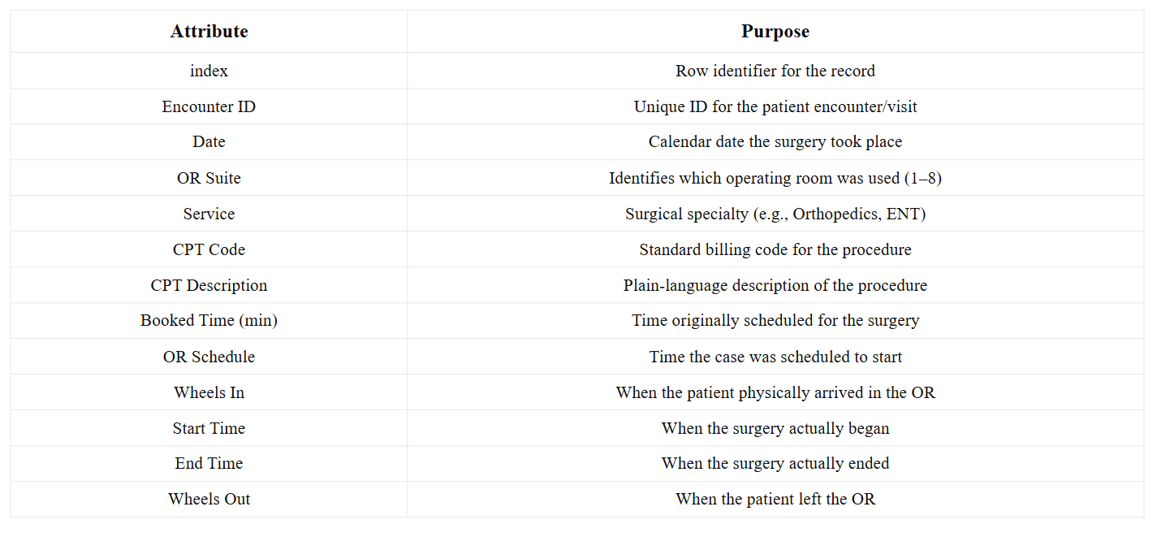
Dataset Description
Source: Kaggle — Optimizing Operating Room Utilization (Q1 2022)
2,172 real surgical case records, 8 OR suites, 10 specialties
kaggle.com/datasets/thedevastator/optimizing-operating-room-utilization
Page 3 of 11

Slide 4
Data Cleaning and Derived Metrics
Fixed inconsistent date formats (DD-MM-YYYY vs MM/DD/YY)
Actual Duration = (End Time − Start Time) × 1440
Overtime = MAX(0, Actual Duration − Booked Time)
Turnover = Next Wheels In − Current Wheels Out (same suite, same day)
Utilization % = Total Actual Duration ÷ (Last Wheels Out − First Wheels In)
Page 4 of 11

Slide 5
Proposed Solution
Approach: A five-stage Excel-based analytics and optimization pipeline, moving from raw data to a decision-ready model.
Clean the dataset — standardize inconsistent date/time formats, convert text-stored numbers into real numeric fields
Compute derived metrics — Actual Duration, Overtime, Turnover, and Utilization % for every OR Suite × Date combination
Build an on-demand statistics dashboard — query by OR Suite or by Service to explore the data interactively
Formulate a Linear Programming model — decide weekly OR-hour allocation per specialty to maximize surgical throughput, solve with Excel Solver and interpret via Sensitivity Analysis
Extend to Goal Programming — balance throughput against overtime simultaneously, instead of optimizing either one alone
Outcome: A data-driven OR scheduling recommendation grounded in one quarter of real surgical records, with a clear, interpretable trade-off between throughput and overtime.
Page 5 of 11

Slide 6
Statistical Analysis
Built an on-demand statistics dashboard in Excel : enter a value, get instant summary statistics.
View by OR Suite : type a suite number (1–8), instantly see:
Average utilization %, Total actual surgery minutes used, Average daily duration, Number of active days in the quarter
View by Service : type a specialty name, instantly see:
Number of surgeries performed, Average actual duration per case, Average overtime per case, Average booked time per case
Key Finding:
Average OR utilization across all 8 suites: ~46%
Indicates significant unused OR capacity across the hospital
This finding directly motivates the optimization models that follow
Page 6 of 11

Slide 7
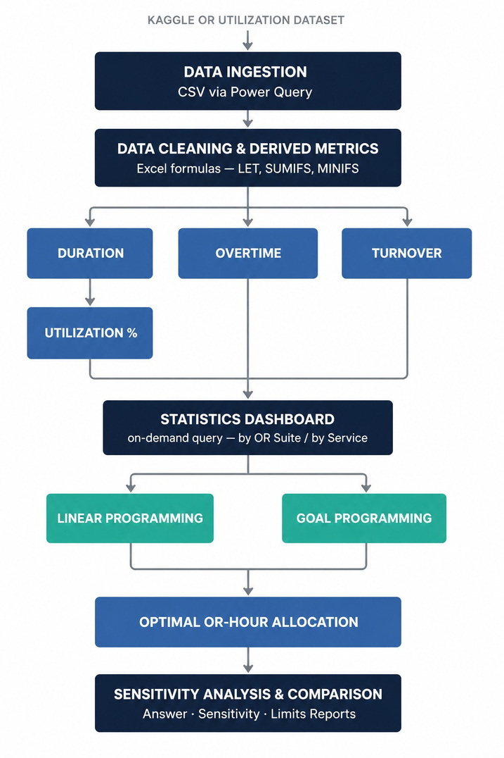
Methodology
Page 7 of 11

Slide 8
Linear Programming Model
Motivation: Before balancing multiple goals, first find the single best allocation that maximizes surgical throughput alone — this becomes the baseline the Goal Programming model builds on.
Decision Variable: Xₛ = OR-hours allocated to specialty s per week (s = 1 to 10)
Objective Function: Maximize Z = Σ (60 × Xₛ ) / Dₛ
Xₛ : OR-hours given to specialty s
Dₛ : average actual case duration for specialty s (minutes)
60 ÷ Dₛ converts hours into number of cases performed
Constraints:
Σ Xₛ ≤ 320 (total weekly OR capacity, all 8 suites combined)
0.8 × historical average ≤ Xₛ ≤ 1.2 × historical average (stay within realistic demand per specialty)
Xₛ ≥ 0 (non-negativity)
Page 8 of 11

Slide 9
Goal Programming Model
Motivation: Throughput maximization alone ignores overtime; Goal Programming balances both conflicting objectives.
Goals:
Goal 1 (Throughput Target): Σ (60 × Xₛ) / Dₛ + d1⁻ − d1⁺ = 200 cases/week
Goal 2 (Overtime Control): Σ Overtimeₛ + d2⁻ − d2⁺ = Target Overtime
Objective Function: Minimize Z = W1 × d1⁻ + W2 × d2⁺
d1⁻ : Under-achievement penalty for case throughput
d2⁺ : Over-achievement penalty for exceeding overtime limits
W1, W2 : Decision-maker priority weights
Hard Constraints:
Σ Xₛ ≤ 320 (Total weekly capacity)
0.8 × avg ≤ Xₛ ≤ 1.2 × avg (Specialty demand bounds)
Xₛ, d1⁻, d1⁺, d2⁻, d2⁺ ≥ 0
Page 9 of 11

Slide 10
Tools and Significance
Tools Used:
Microsoft Excel — primary platform for data, models, and dashboard
Power Query — importing and cleaning the raw CSV dataset
Significance:
Capacity Insight — Sensitivity Analysis reveals the true bottleneck is specialty demand caps, not OR capacity.
Overtime Awareness — Goal Programming explicitly controls overtime instead of ignoring it, unlike single-objective LP
Data-Driven Scheduling — allocation decisions are grounded in one quarter of real historical surgical records, not guesswork
Multi-Objective Decision Making — hospital administrators can weigh throughput against overtime instead of being locked into one goal
Page 10 of 11

Slide 11
Project Status
Completed:
Dataset identified and loaded — Kaggle OR Utilization dataset, Q1 2022
Data cleaning completed — standardized date/time formats, computed derived metrics (Duration, Overtime, Turnover, Utilization %)
Current Status:
Formulating the Linear Programming model — defining decision variables, objective function, and constraints for weekly OR-hour allocation
Future Work:
For larger datasets or multi-quarter analysis, migrate the aggregation and modeling layer to Python (Pandas for data processing, PuLP/SciPy for optimization) while keeping the same underlying LP/Goal Programming formulation.
Page 11 of 11

