Slide 1


Project - 046275 Dynamic Binary Translation & Optimization Techniques
Students : Muhammad Ghanayem, Eman Bsoul
Instructor: Gadi Haber
Semester: Spring 2023
Date : 15/10/2023

Slide 2
Content
Background
Project Goal and Requirements
Profiling Stage Description
Optimization Stage Description
Optimization Results
End

Slide 3
Background
Binary Translation in Computing
At its core, Binary Translation enables real-time translation of native binary code.
The translated code is strategically executed from the Translation Cache.
How to use: Translate once, use often, ensuring optimized code execution and efficient use of computational resources.
Our Methodology
Profiling: Gaining insights into the binary code's behavior.
Caching: Storing the translated code for swift retrieval and execution.
Optimization: Fine-tuning the code to achieve better performance.
Memory Management: Streamlining the allocation and use of memory, reducing overhead.

Slide 4
Background
Tangible Impact
Binary Translation is transformative. Its effects can be quantified:
Drastic Reductions in critical metrics such as I-TLB misses, L1 cache misses, and context switches.
Enhanced Performance: By optimizing these metrics, programs run smoother and more efficiently.
Resource Conservation: Lower misses mean fewer resources are wasted, leading to energy savings and prolonged hardware longevity.
Harnessing the Intel Pin Tool
The Intel pin tool is our chosen instrument for this deep dive into binary translation and optimization in this course and specifically this project.

Slide 5
Project Goal & Requirements
In this project we are going to optimize the binary code.
The pintool should show a reduction of at least 15% for one of the performance metrics as measured by the ‘perf stat’ command as follows: - Total number of branches - Total number of i-cache misses - Total I-TLB misses - Total number of page faults
- Number of Context Switches - User time or Elapsed time

Slide 6
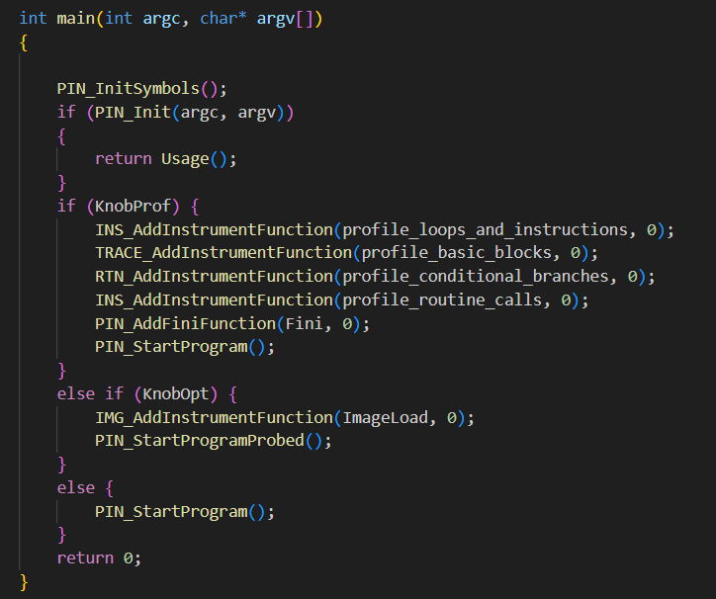
Profiling Stage
4 functions

Slide 7
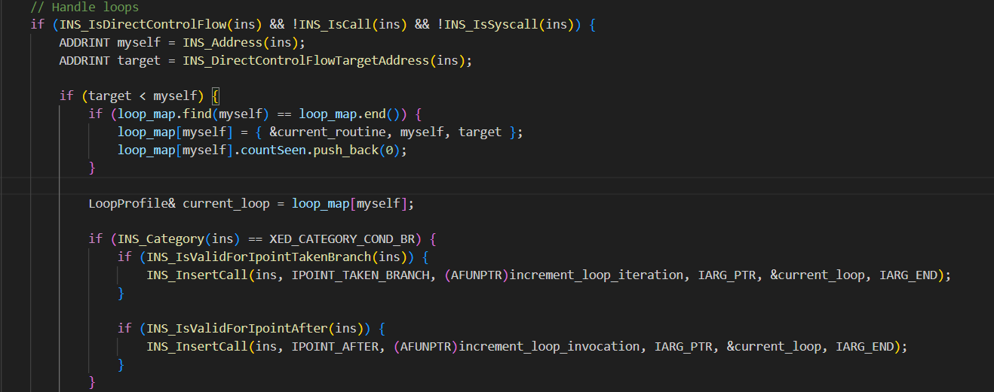
Profiling Stage
VOID profile_loops_and_instructions(INS ins, VOID* v)

Slide 8
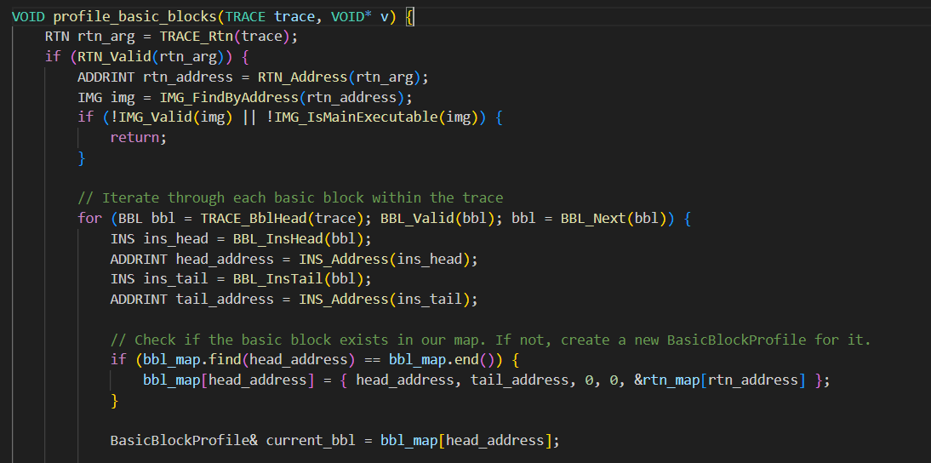
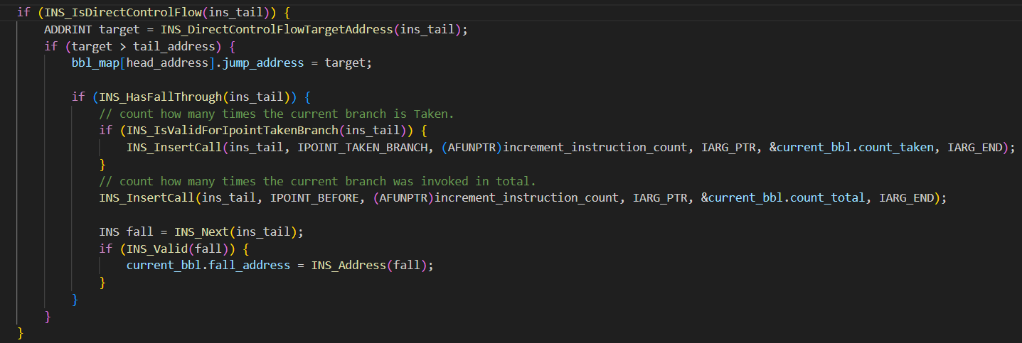
Profiling Stage
VOID profile_basic_blocks(TRACE trace, VOID* v)

Slide 9
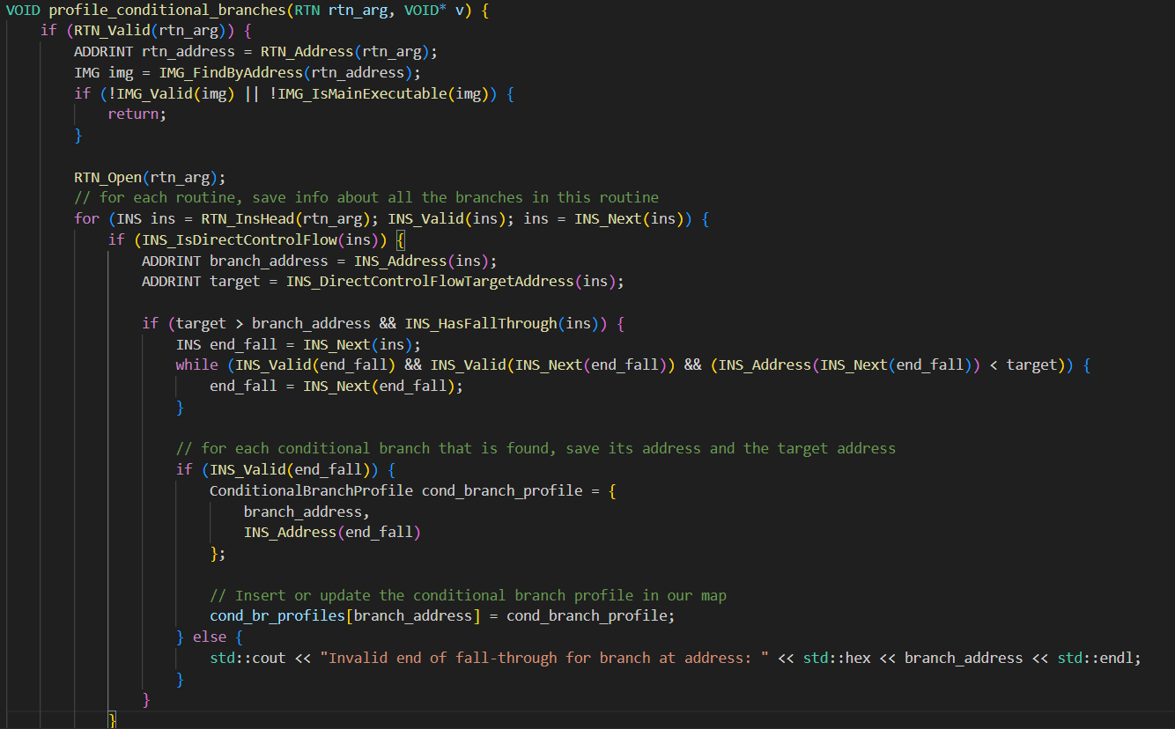
Profiling Stage
VOID profile_conditional_branches(RTN rtn_arg, VOID* v)

Slide 10
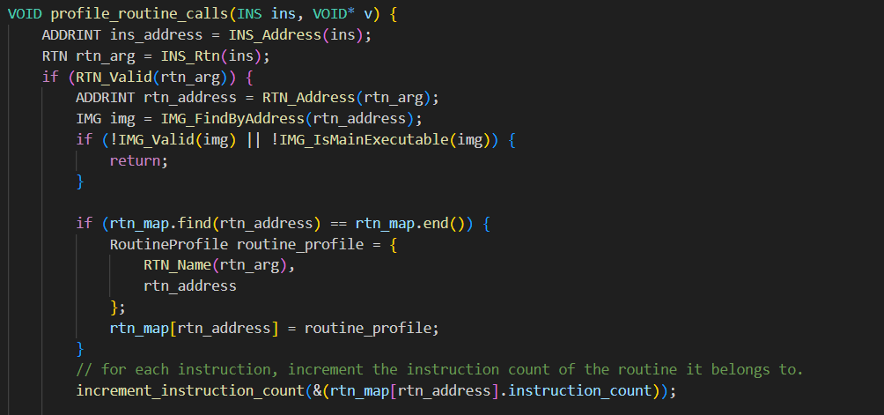
Profiling Stage
VOID profile_routine_calls(INS ins, VOID* v)

Slide 11
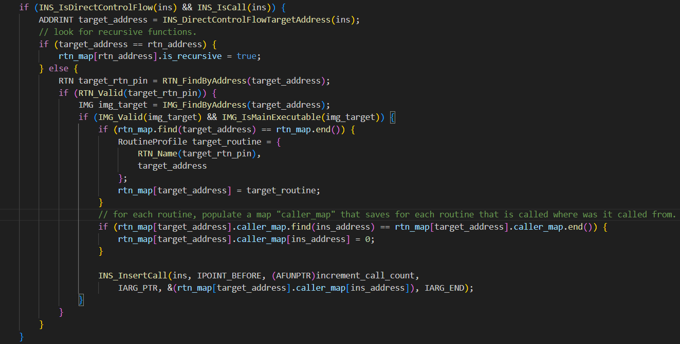
Profiling Stage

Slide 12
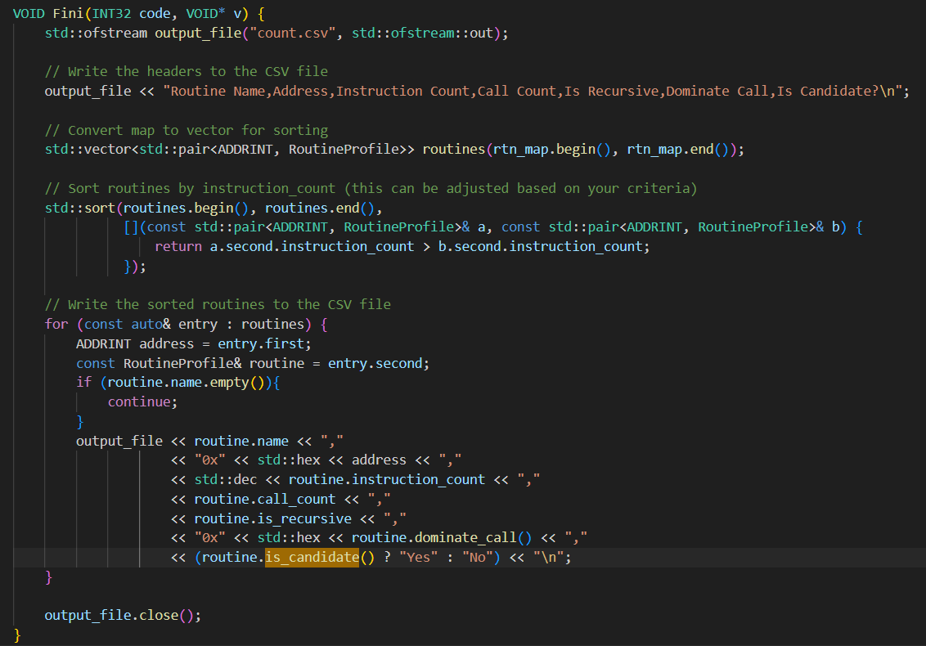
Profiling Stage
Fini function

Slide 13
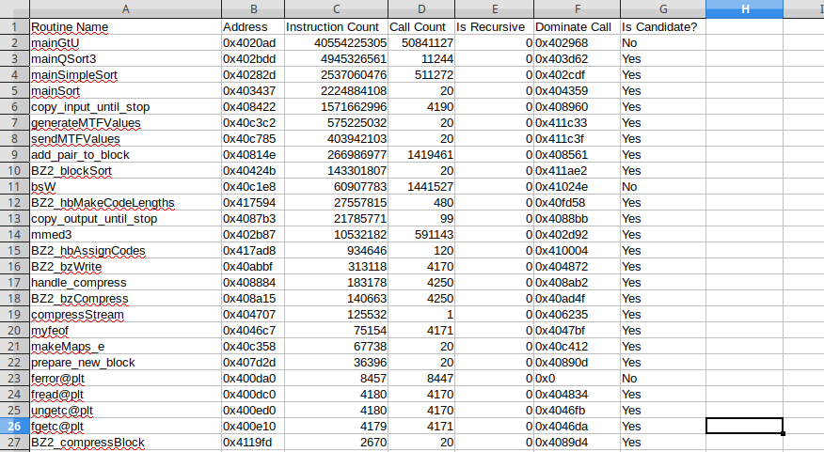
Profiling Stage
Results:

Slide 14
Optimization Stage
1 function, consists of many sub functions

Slide 15
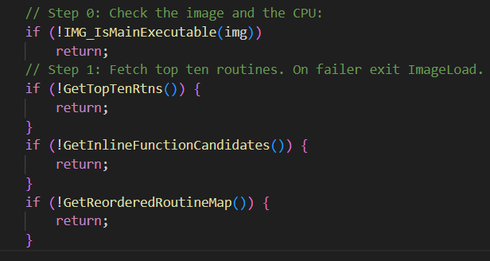
Optimization Stage
3 sub functions:
1st function returns the 10 routines that we are interested in
2nd function does the inlining in the right places.
3rd function reorderes the code after the inlining.

Slide 16
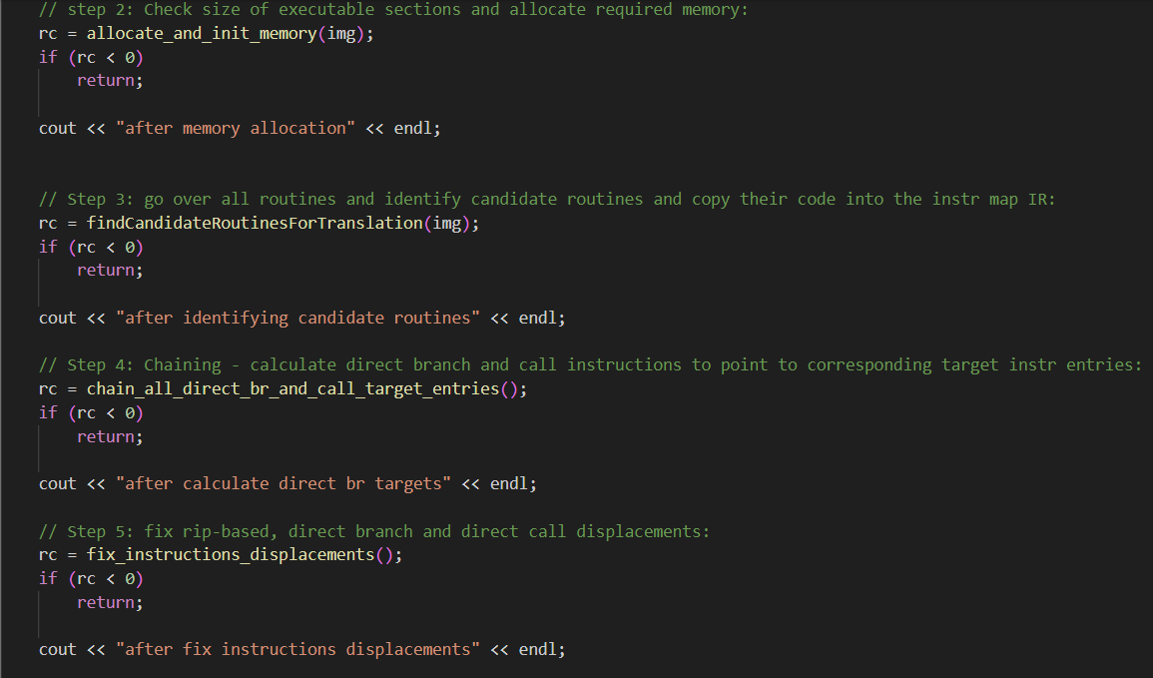
Optimization Stage
Allocate new memory space, copy the new reordered and inlined code and fix all the displacements.

Slide 17
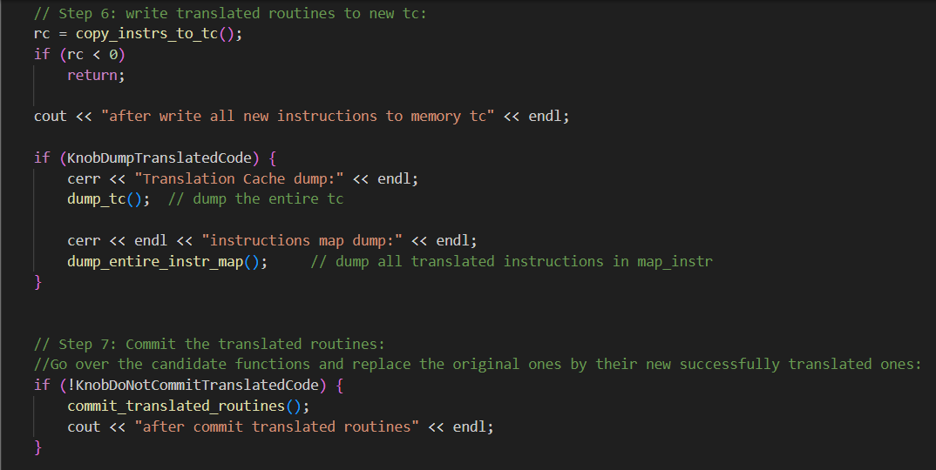
Optimization Stage
Copy the new translated code into the translation cache and finally, commit the changes and update the binary code.

Slide 18
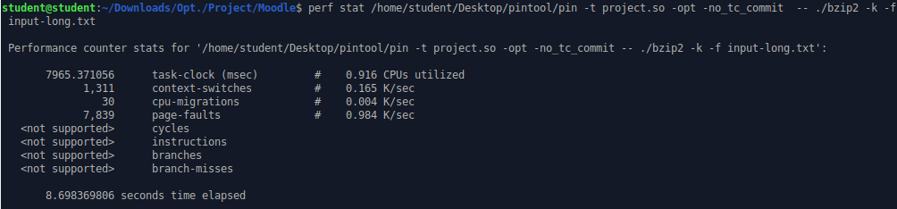
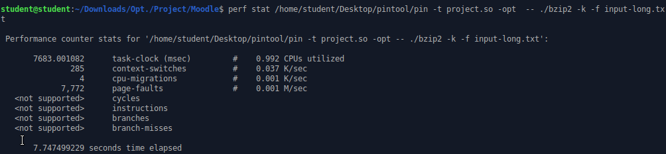
Optimization Results
Before:
After:

Slide 19
Optimization Results
Improvement Percentage | After Optimization | Before Optimization
78.2% | 285 | 1311 | Context Switches
11% | 7.747 | 8.698 | Elapsed Time

