Slide 1
NETWORK SECURITY LAB
Palo Alto Firewall Lab
Configure Default Route on Palo Alto towards ISP
0.0.0.0/0 → next-hop 100.1.1.1 → Ethernet1/2 (Untrust)
Group 6
Ghanendra Tiwari • Hanuman Farroda • Harman Sain • Harshal Gautam • Hemant Pratap Singh
PC1 / VPC → PALO ALTO FIREWALL → ISP

Slide 2
OVERVIEW
Project Objective
Configure and verify a default static route (0.0.0.0/0) on a Palo Alto firewall so that unknown or external destinations are correctly forwarded toward the ISP.
Four Building Blocks
Routing
Path selection to a destination
Configure a default static route on the firewall
Forward unknown / external destinations toward the ISP
Configure Untrust interface Ethernet1/2 — 100.1.1.2/24
Use ISP next hop 100.1.1.1 as the gateway of last resort
Verify routing using the routing table, ping and FIB lookup
Understand Routing vs Security Policy vs NAT vs Return Routing
Security Policy
Permits or denies the traffic
NAT
Translates private → public IPs
Return Routing
Lets reply traffic get back
Palo Alto Firewall Lab | Default Route to ISP
2

Slide 3
LAB SETUP
Lab Topology & IP Addressing
▢
IP Addressing Table
PC1 / VPC
Device | Interface | IP Address | Zone
PC1 / VPC | eth0 | 192.168.10.10/24 | —
Palo Alto | Ethernet1/1 | 192.168.10.1/24 | Trust (LAN)
Palo Alto | Ethernet1/2 | 100.1.1.2/24 | Untrust (WAN)
ISP | eth0 | 100.1.1.1/24 | —
192.168.10.10/24
Trust (E1/1)
▣
Palo Alto Firewall
E1/1 (Trust): 192.168.10.1
E1/2 (Untrust): 100.1.1.2
Lab Environment
Untrust (E1/2)
Built and simulated in PNETLab (topology view)
PC1/VPC, Palo Alto firewall and ISP nodes connected via virtual links eth1/1 and eth1/2
PNETLab hosted on a VMware Workstation virtual machine
☁
ISP
Next Hop: 100.1.1.1/24
Palo Alto Firewall Lab | Default Route to ISP
3

Slide 4
CONCEPT
What is a Default Route?
A default route is written as 0.0.0.0/0 — it matches every possible destination.
The firewall uses it only when no more-specific route matches the destination address.
In this lab, matching traffic is forwarded to the ISP gateway 100.1.1.1.
Traffic exits the firewall through Ethernet1/2, the Untrust interface.
Forwarding Flow
External
Destination
0.0.0.0/0
100.1.1.1
ISP
Rule of thumb: the firewall always prefers the most specific matching route in the routing table. The default route is the catch-all used only when nothing else matches.
ip route → 0.0.0.0/0 via 100.1.1.1 dev ethernet1/2
Palo Alto Firewall Lab | Default Route to ISP
4

Slide 5
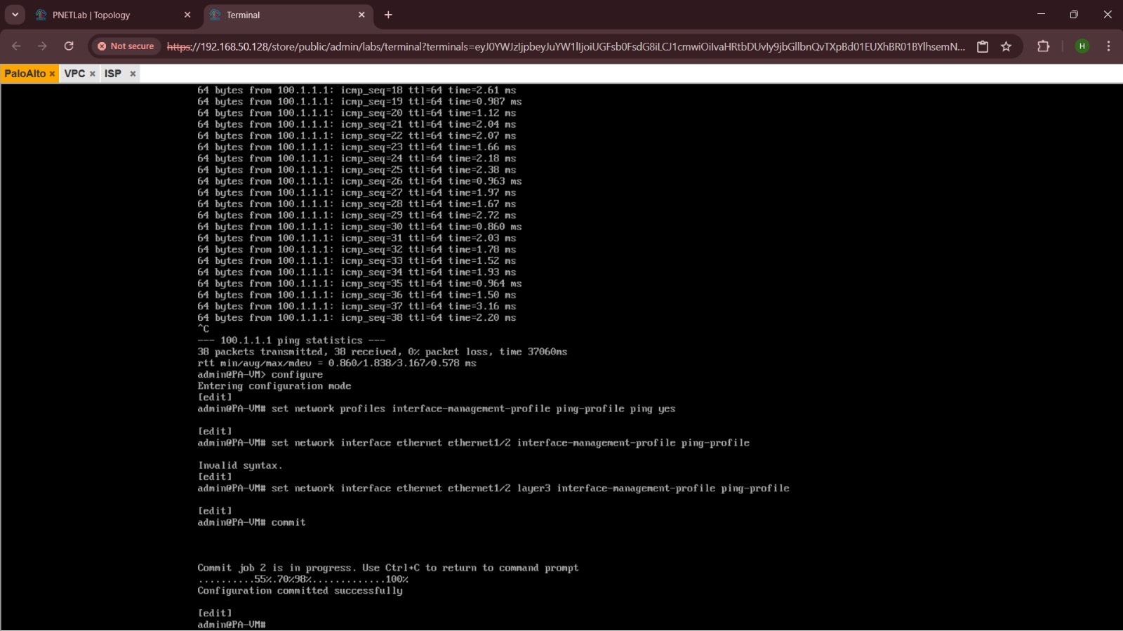
CONFIGURATION
Default Route Configuration
Static Route Parameters
Virtual Router | default
Route Name | DEFAULT-TO-ISP
Destination | 0.0.0.0/0
Interface | Ethernet1/2 (Untrust)
Next Hop | 100.1.1.1
Administrative Distance | 10
Metric | 10
✓ Commit applies the route to the running configuration
Palo Alto CLI — ping test to ISP gateway 100.1.1.1 (38/38 packets, 0% loss), interface management-profile configured on Ethernet1/2, and configuration committed successfully.
Palo Alto Firewall Lab | Default Route to ISP
5

Slide 6
POLICY
Security Policy
Important: Routing alone does NOT automatically allow traffic through the firewall. A matching Security Policy rule must also permit it.
Trust → Untrust Policy Rule
Why This Matters
Field | Value
Source Zone | Trust
Source Address | PC1 / 192.168.10.10
Destination Zone | Untrust
Destination Address | any / required destination
Application | ping / required application
Service | application-default
Action | Allow
The routing table only decides the path a packet could take.
Palo Alto is a Layer 7 firewall — every session is checked against security policy rules.
Without an Allow rule from Trust to Untrust, matching traffic is silently denied.
Policy rules are evaluated top-down; place specific rules above broad deny rules.
Palo Alto Firewall Lab | Default Route to ISP
6

Slide 7
RETURN PATH
ISP Return Route and NAT
Request →
▢
▣
☁
PC1 / VPC
Palo Alto
ISP
192.168.10.10/24
Trust
Trust ↔ Untrust
192.168.10.1 / 100.1.1.2
100.1.1.1/24
← Return traffic
ISP-side route: 192.168.10.0/24 → next-hop 100.1.1.2
Key Points
NAT Considerations
The ISP needs its own return route back to the Trust network: 192.168.10.0/24 via 100.1.1.2.
A default route alone only gets traffic out — it does not guarantee replies find their way back.
Private IP addresses (like 192.168.10.0/24) are not routable on the public Internet.
For real / public connectivity, Source NAT from Trust to Untrust may be required.
NAT design depends on the specific lab simulator and upstream network setup.
Palo Alto Firewall Lab | Default Route to ISP
7

Slide 8
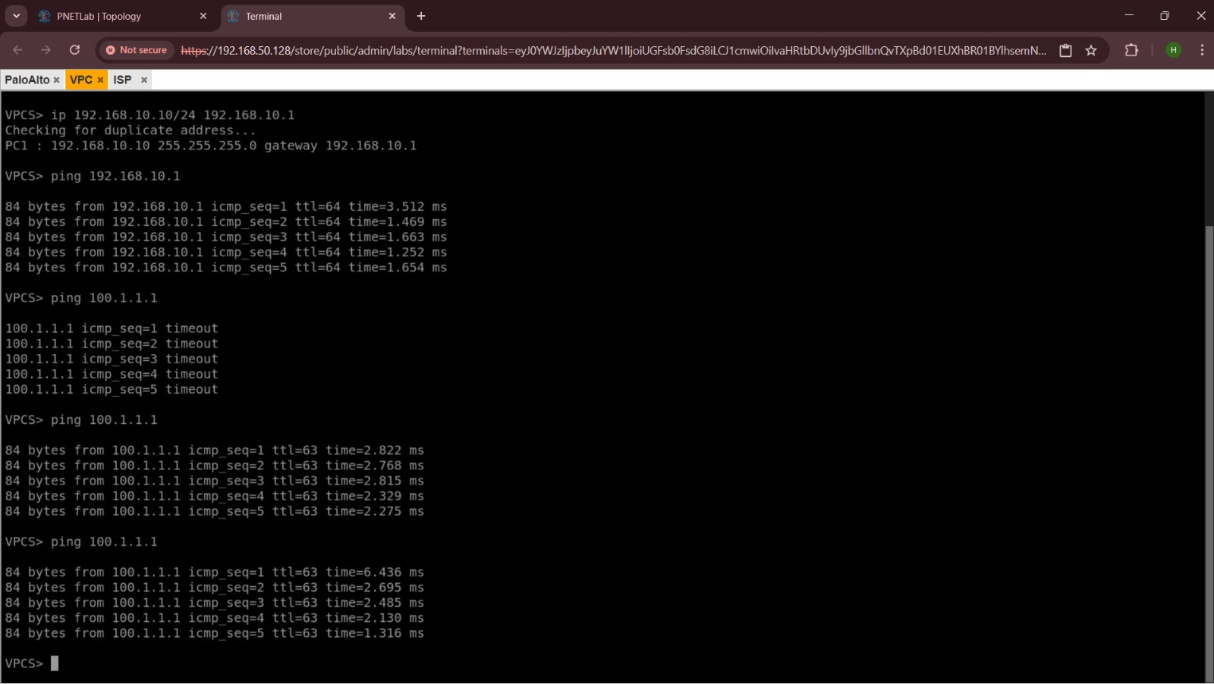
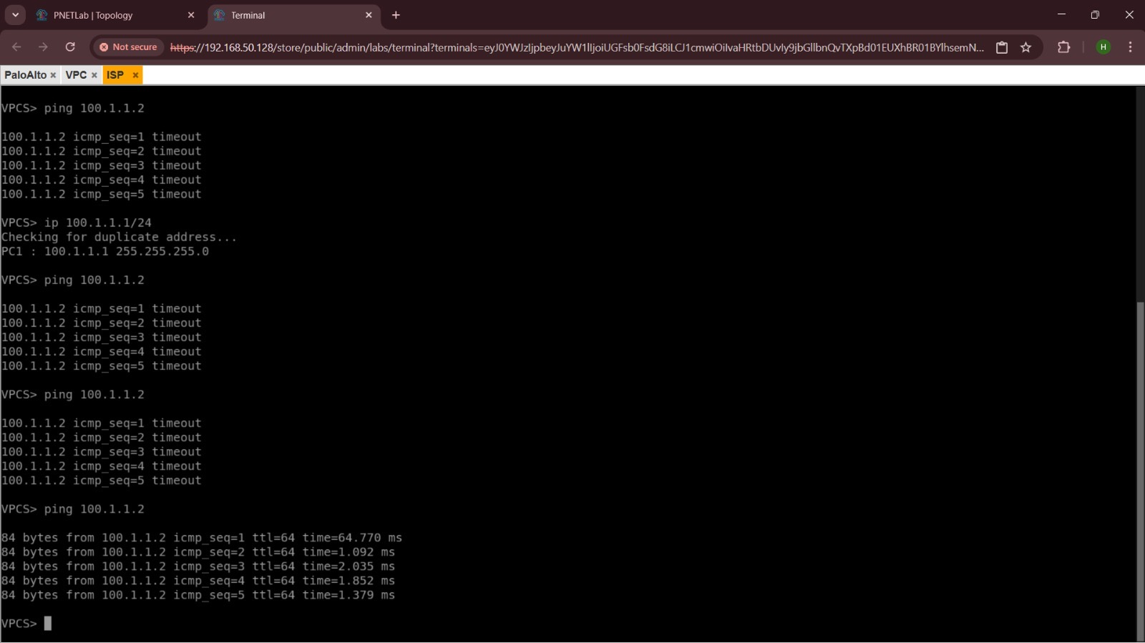
TESTING
Verification
Verification Commands
show routing route
Displays the full routing table
show routing route type static
Filters routing table to static routes only
show routing route destination 0.0.0.0/0
PC1/VPC: gateway reachable at 192.168.10.1; ISP gateway 100.1.1.1 unreachable before routing/config, then successful after the default route takes effect.
Confirms the default route is present
ping source 100.1.1.2 host 100.1.1.1
Tests reachability to the ISP next hop
test routing fib-lookup virtual-router default ip 8.8.8.8
Confirms which route the FIB selects for an external IP
ISP side: ping to Untrust interface 100.1.1.2 succeeds once addressing and the firewall route/commit are in place.
Palo Alto Firewall Lab | Default Route to ISP
8

Slide 9
TROUBLESHOOTING
Troubleshooting Guide
1
Next-hop ping fails
Check WAN IP, physical/virtual link, zone assignment and ISP-side addressing.
2
Default route missing
Check the Virtual Router and static route entry, then Commit the configuration.
3
Route exists but traffic fails
Check Security Policy, NAT rules and the ISP return route.
4
Traffic denied
Check Traffic logs and verify security policy rule order.
5
PC1 cannot reach firewall
Verify IP address, subnet mask and default gateway on PC1.
Palo Alto Firewall Lab | Default Route to ISP
9

Slide 10
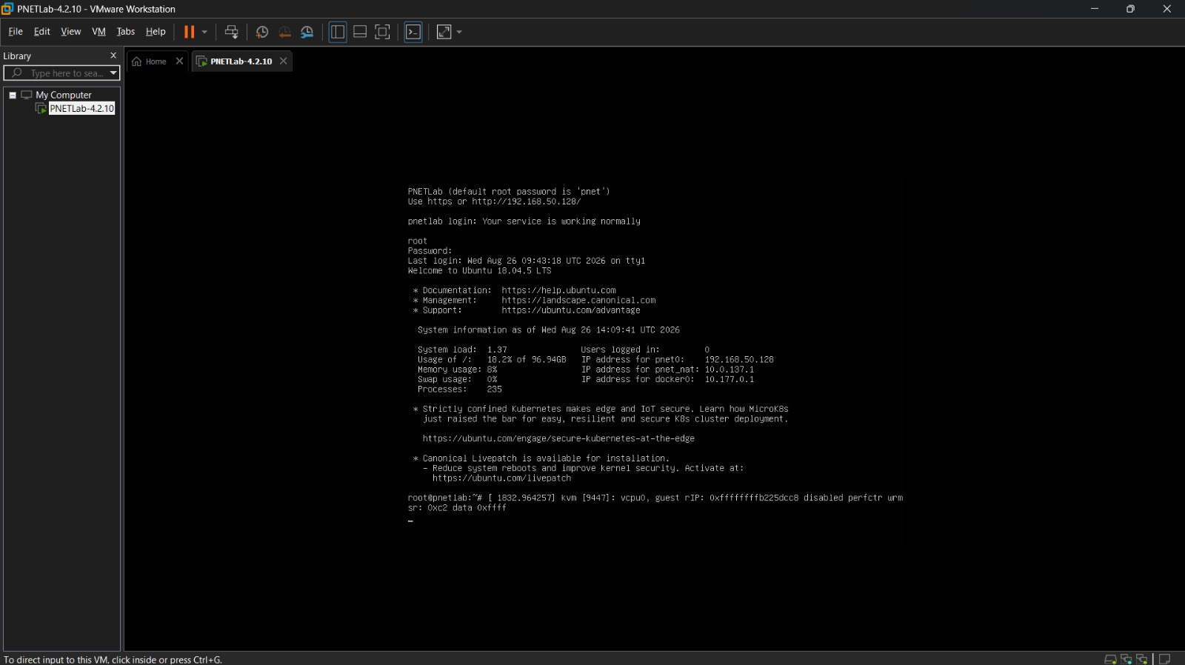
RESULTS
Results / Successful Verification
PC1/VPC is configured as 192.168.10.10/24 with gateway 192.168.10.1.
PC1 successfully reaches the Palo Alto Trust interface (192.168.10.1).
Connectivity to the ISP gateway 100.1.1.1 is successfully demonstrated.
Palo Alto's Untrust interface, 100.1.1.2, responds to the ISP-side host.
The default route correctly forwards unknown destinations toward the ISP.
✓ 0% packet loss recorded on the firewall-to-ISP ping test (38/38 packets)
PNETLab environment running inside VMware Workstation — the virtualization host on which the full PC1 / Palo Alto / ISP topology was executed.
Palo Alto Firewall Lab | Default Route to ISP
10

Slide 11
TAKEAWAYS
Key Learning
Default Route
Security Policy
NAT
Provides a forwarding path for unknown / unmatched destinations.
Controls whether traffic is actually allowed through the firewall.
Translates private addresses when required for real connectivity.
Return Routing
Routing Table / FIB Lookup
Necessary on the far end for genuine two-way communication.
Used to verify exactly how the firewall forwards traffic.
Palo Alto Firewall Lab | Default Route to ISP
11

Slide 12
CONCLUSION
Conclusion
Key route: 0.0.0.0/0 via 100.1.1.1
LAB RECAP
Palo Alto uses the default route only when no more-specific route exists in the routing table.
End-to-end connectivity depends on the combination of Routing, Security Policy, NAT and Return Routing — not routing alone.
The lab successfully demonstrates configuration and verification of a Palo Alto default route toward the ISP, confirmed through live ping tests and CLI output.
PC1 / VPC
↓
Palo Alto Firewall
↓
ISP (100.1.1.1)
Group 6
Palo Alto Firewall Lab
Palo Alto Firewall Lab | Default Route to ISP
12

