Slide 1
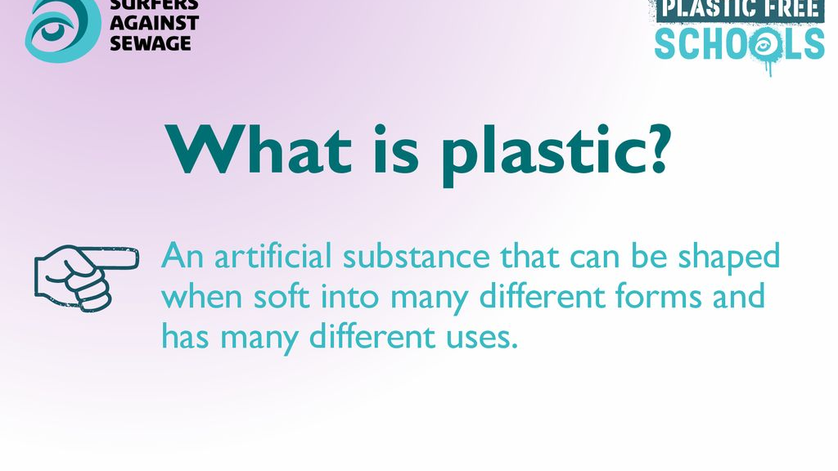

Slide 2
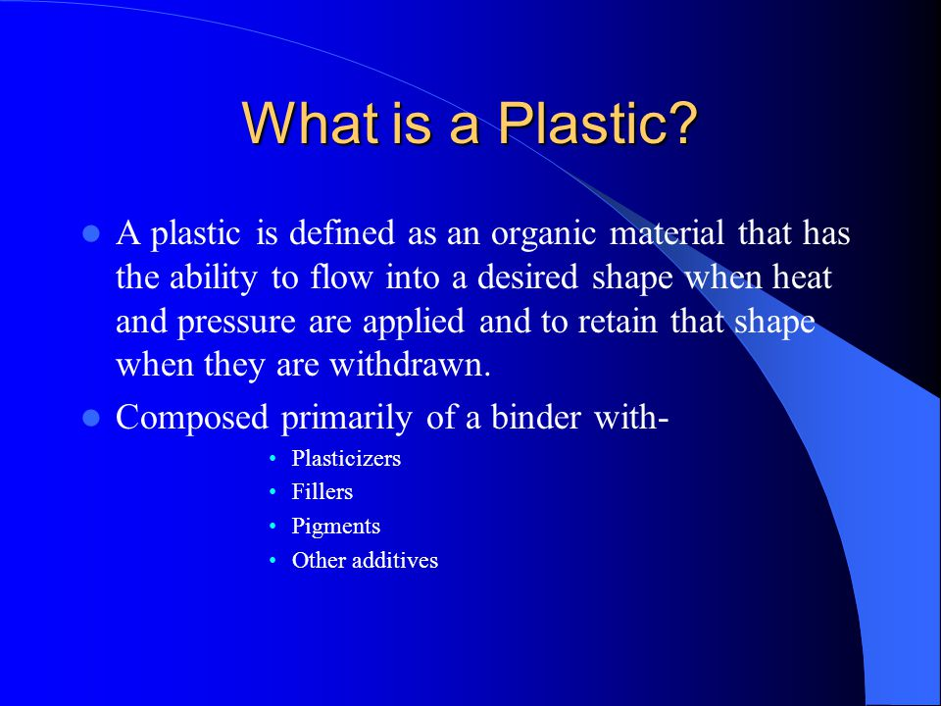

Slide 3
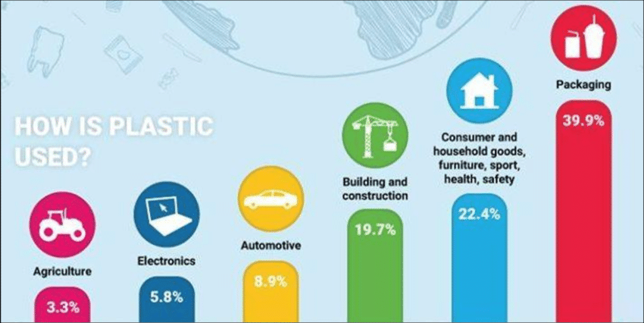

Slide 4
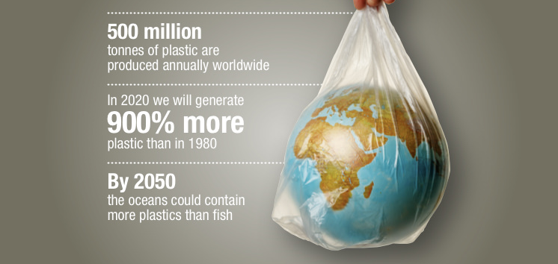

Slide 5
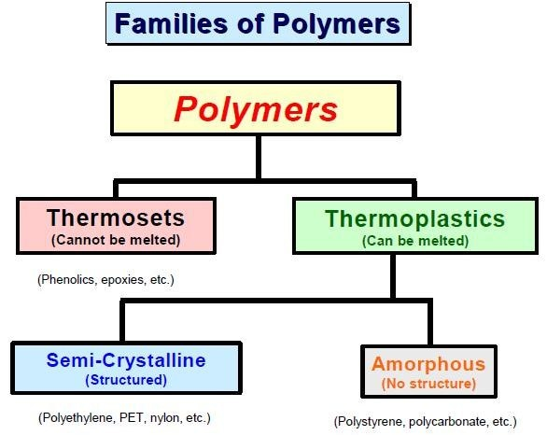

Slide 6
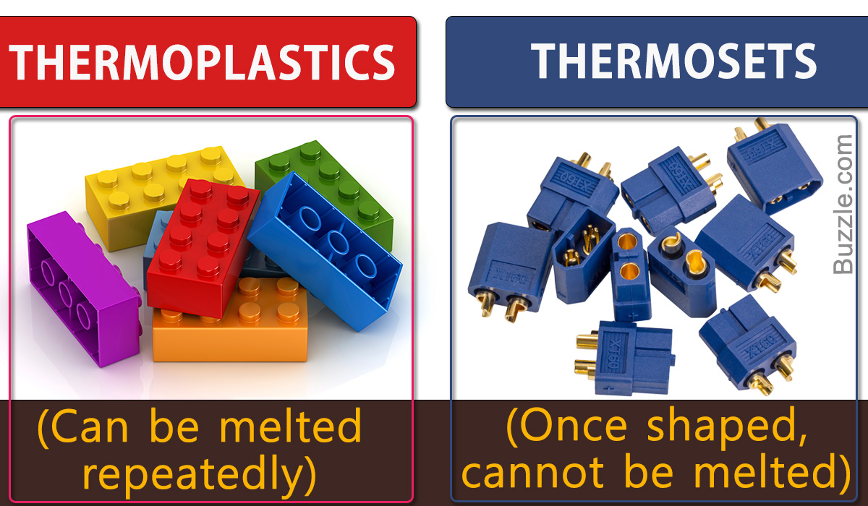

Slide 7
Thermoplastics:
By heating the polymer, if it turns soft, then it is called as Thermoplastic material. At room temperature, they are available in the form as Solids.

Slide 8
Properties of Thermoplastic Material:
By heating the polymer, it turns as soft material.
Loses Strength: By heating the thermoplastic material it loses its strength.
Gains strength: By the action of cooling, the thermoplastic material gains strength.
Shape change: During cooling only, the thermoplastic material changes its shape.
Temperature: The servicing temperature of thermoplastic material is 150°C.
Structure: The thermoplastic material exhibits Linear structure i.e. -CH2-CH2-CH2-CH2-

Slide 9
Thermoplastic Examples:
Polyethylene
Poly Vinyl Chloride(PVC)
Teflon

Slide 10
Thermosetting Plastics or Thermoset Plastics:
By heating the polymer, if it turns hard, then it is called as Thermosetting plastic material. At room temperature, they are available in the form as liquids. Thermosetting plastics or Thermoset plastic are synthetic materials that strengthen during being heated but cannot be successfully remolded or reheated after their initial heat

Slide 11
roperties of a Thermosetting Plastic material:
By heating the polymer, it turns as hard material.
It is available in the form of liquid at Room temperature.
It is a Nn-Recyclable process.
Thermoset in the form of liquid is converted into Thermoset material in the form of solid which is done by the action of heating and its Vice-versa is not possible.
Gains strength: By the action of heating, the thermoset plastic material gains strength.
No change in the strength of the thermosetting plastic is done by the action of cooling.
Shape change: During heating only, the thermoset material changes its shape.
Temperature: The servicing temperature of a thermoset plastic material is 300°C.
Structure: It exhibits a Cyclic structure.

Slide 12
Thermosetting Plastic Examples:
Epoxy Resin
Phenolic(Bakelite)
Vinyl Ester Resin
Cyanate Ester
Poly Ester

Slide 13
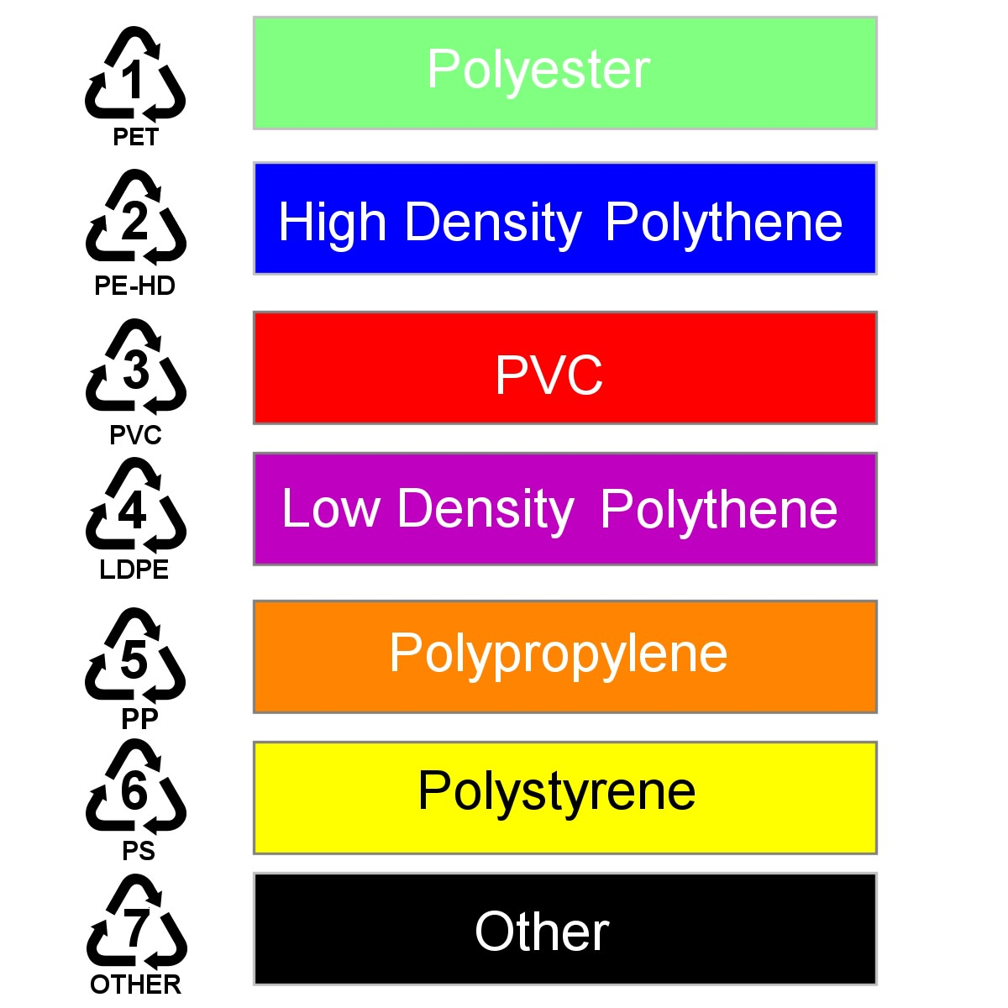

Slide 14


Slide 15
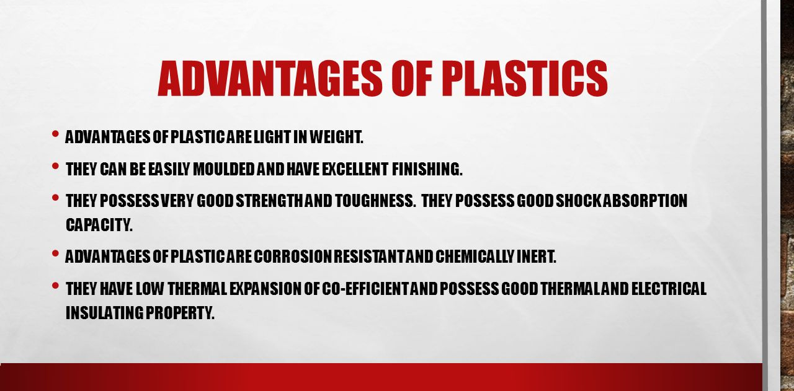

Slide 16
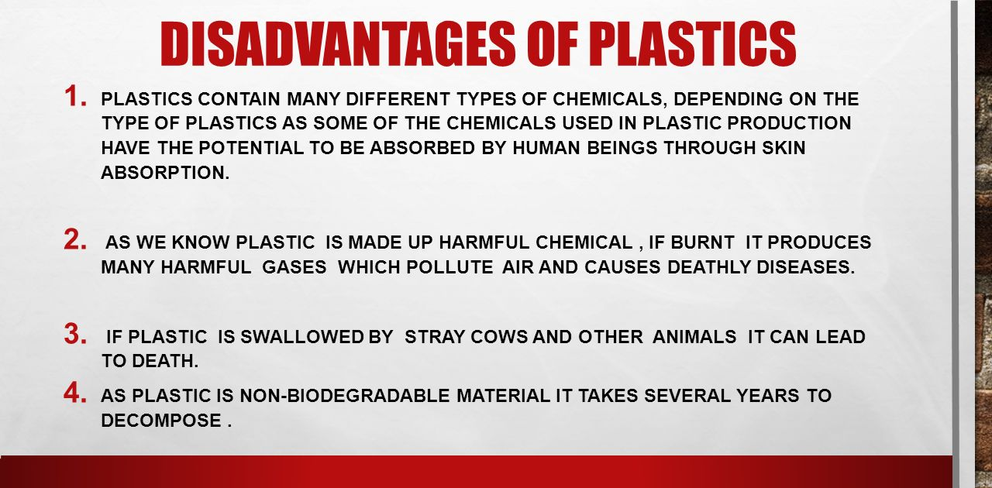

Slide 17
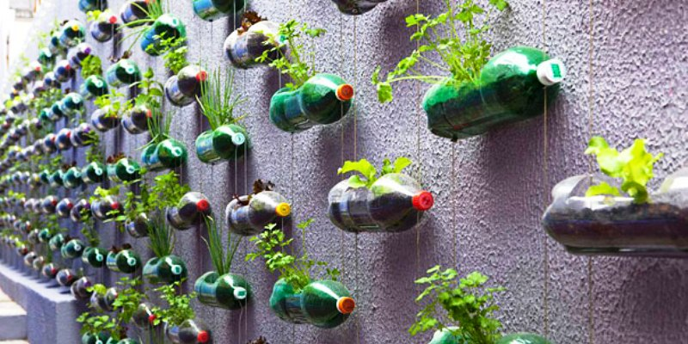

Slide 18

THANK YOU. BY MOHD ABUAR

