Slide 1
BANK OF NEW YORK
Merchant Settlement
Intelligence Platform
How we turned four messy source files into a tested, secure platform, shipped it with CI/CD and blue-green deployment, and recovered from a broken release in seconds.

Slide 2
Problem Statement
₹48 Cr
₹45.8 Cr
₹2.2 Cr
successful payments yesterday
settled to merchants
missing
Why Operations couldn't answer it
Requirement
The data lived in 4 separate systems: transactions, settlements, merchant risk and payment events
They only had nightly Excel reports
The gap could be failed payments, pending settlements, delays, risky merchants or just bad data
Show payment and settlement KPIs in one place
Explain the gap and find delayed settlements
Flag merchants that settle badly
Serve it through an API and dashboard, load new data incrementally, and test it automatically
1

Slide 3
DQ test and Data cleaning
Problem in the data | Solution
One payment, several settlements | Add up settlements per payment BEFORE joining (T1001: 8,000 + 2,000 = 10,000, not 20,000)
Events arriving late | Keep when it happened (event_ts) and when we got it (ingestion_ts); more than 5 min late = kept but flagged
Events in the wrong order | Number events by the time they happened, not the order they arrived
Merchant risk changing over time | Keep risk history (SCD Type 2) so each payment gets the risk that was valid on its date
Dirty records | Sort each one into REJECT / QUARANTINE / WARNING and log it with a reason
3,830 → 3,800
payments: raw → trusted
158
records quarantined for review
28
records rejected
372
late events kept and flagged
2

Slide 4
Data Flow and Data Model
DuckDB — a SQL data warehouse in a single file
4 CSV files
Ingestion
Bronze
Silver
Gold
FastAPI
Dashboard
transactions · settlements
merchants · events
Python loads
new files only
raw copy,
nothing rejected
validated, typed,
de-duplicated
star schema +
daily KPI table
read-only,
API-key secured
HTML / JS
KPIs + charts
Gold layer — star schema (grain = what one row means)
Only new files and rows are loaded (watermark)
Bad rows go to audit.dq_log with a reason
SCD Type 2 keeps merchant risk history
Customer id stored only as a hash
Keys, CHECK rules and indexes enforced
dim_date
dim_merchant (SCD2)
dim_customer
one day
one merchant per risk period
one hashed customer
fact_transaction
one payment attempt
fact_settlement
fact_payment_event
agg_merchant_daily
one settlement record
one lifecycle event
one merchant per day (KPIs)
3

Slide 5
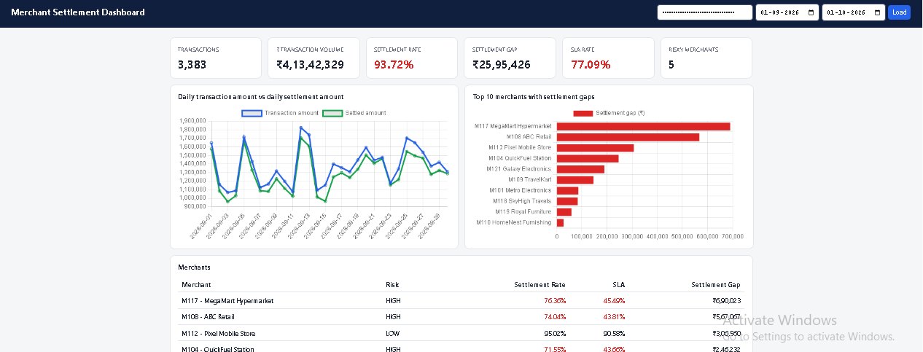
Dashboard and API
3,383
₹4.13 Cr
93.72 %
₹25.95 L
77.09 %
successful payments
payment volume
settled · target 95 %
settlement gap
within 30 min · target 90 %
FastAPI + Pydantic + OpenAPI
/api/v1/settlement-summary
/api/v1/merchant-exceptions
/daily-trend · /merchants · /health
Errors: 400 bad date · 401 no key · 404 unknown merchant · 422 bad input
The dashboard only talks to the API — never to the database
4

Slide 6
CICD workflow
Stage | What it checks | Tool we used | Our result
Validate | Every Python file compiles | python -m compileall | OK
Automated tests | KPI formulas, business rules, pipeline, data model, API, security (22 tests) | pytest + JUnit report | 22 / 22 passed
SAST | Insecure patterns in OUR code (e.g. SQL built from strings) | Bandit | 0 high findings
Secret scan | API keys or passwords in files and git history | Gitleaks | No secrets
SCA | Known vulnerabilities (CVEs) in the libraries we use | pip-audit | No vulnerable libraries
Build | Code + data + database packed into one image, tagged with the commit id | Docker (Docker-in-Docker) | Pushed to registry
Container scan | Vulnerabilities in the whole image (OS + packages) | Trivy | 0 critical
Deploy to dev | The image starts and answers | GitLab service container | Healthy
Smoke test | Health, JSON, response < 500 ms, rate 0–100 % and = 93.72 % | smoke_test.py | PASS
Reconciliation | KPI table matches the fact tables | reconcile.py | PASS
Deploy to production | A person approves; image tagged :production | GitLab manual job | Approved
5

Slide 7
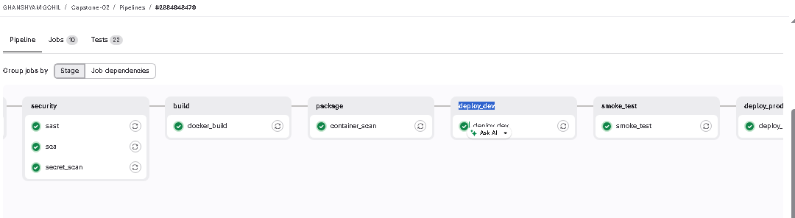
Gitlab Pipeline
validate
test
security
build
package
deploy_dev
smoke_test
deploy_prod
compile
pytest (22)
Bandit · Gitleaks · pip-audit
docker build + push
Trivy scan
start image
business checks
manual approval
How we built it
Pipeline defined in .gitlab-ci.yml in the repo
Each job runs in a fresh container on a GitLab runner
Docker-in-Docker (docker:27 + dind) builds the image and runs the smoke test
Image tagged with the commit id, pushed to the GitLab registry
needs: build only after ALL checks pass
API key = masked, protected variable
Reports kept as artifacts (evidence)
Our real run: 10 jobs green, 22 tests reported, production approved
THEORY CI vs CD
Continuous Integration: every push is automatically tested and scanned. Continuous Delivery: the same image is promoted dev → production, with a person approving the last step.
6

Slide 8
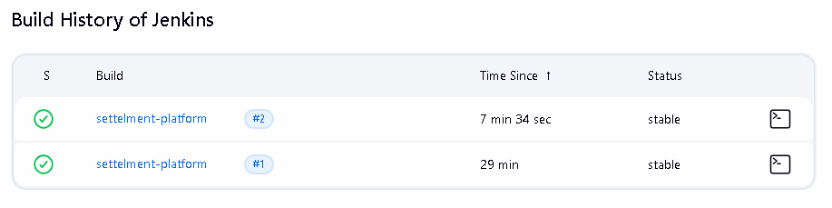
Jenkins Pipeline
Checkout
Install
Run tests
Security checks
Build image
Publish artifact
How we set it up
Jenkins runs in its own container (custom image with Python + Docker CLI)
Uses the VM's Docker through the mounted docker.sock
Jenkinsfile in the repo — pipeline as code
Same tests and security checks as GitLab
Why keep it: legacy bank systems, and a backup if GitLab is down
Builds #1 and #2 green: 22 tests passed, Bandit and pip-audit clean, image built
Something we caught: in build #1, pip-audit had silently failed because a '| tee' pipe hid its error. We fixed the Jenkinsfile to keep the exit code and upgraded pip, and build #2 showed a real, clean result.
7

Slide 9
Blue –Green Deployment
BLUE · V1 1.0.0 :8001
Checks on green before switching
Users
dashboard
Nginx
load balancer :8090
✓
App is healthy
GREEN · V2 2.0.0 :8002
✓
API answers
✓
Database reachable
✓
GitLab + Jenkins green
THEORY Blue-green
Two identical environments. Deploy the new version to the idle one, test it with no users on it, then switch all traffic at once. Rollback = switch back, in seconds.
✓
22 / 22 tests
✓
Smoke test
✓
KPI reconciliation 93.72 %
8

Slide 10
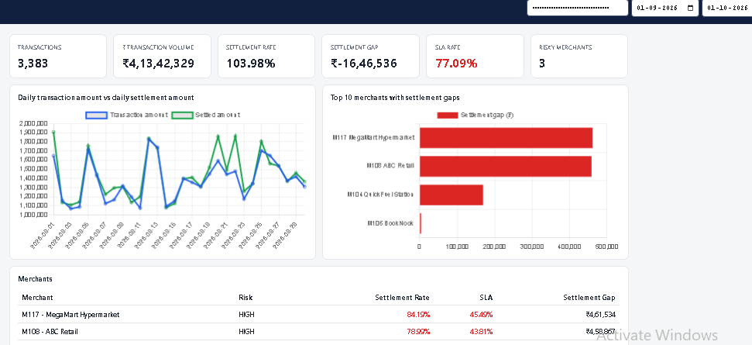
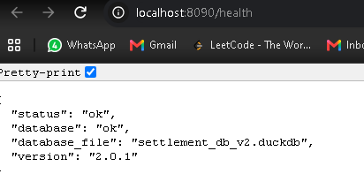
Bad Release Incident
/health: 200 OK — but version 2.0.1 on settlement_db_v2
103.98 %
settlement rate
The dashboard after release 2.0.1 replaced the live green environment
−₹16.5 L
settlement gap
9

Slide 11
Business checks caught it; comparing V1 and V2 explained it
 | V1 (blue) | V2 2.0.1 (green)
Payment amount | ₹4,13,42,329 | ₹4,13,42,329
Settled amount | ₹3,87,46,904 | ₹4,29,88,865
Settlement rate | 93.72 % | 103.98 %
Settlement gap | ₹25,95,426 | −₹16,46,536
Risky merchants | 5 | 3
Grain bug
A
The new query joined settlements BEFORE adding them up, so split settlements counted twice
Wrong configuration
C
It read settlement_db_v2 instead of the approved database
Missing guard
D
Same payments in, different settled amount out → the bug is in the calculation, not the data.
The 0–100 % check was removed, so the impossible number reached users
THEORY Health check vs smoke test
Date bug — checked
B
/health only asks 'is it running?'. Our smoke test and reconciliation ask 'are the numbers right?' — both FAILED: 103.98 %, and ₹4.30 Cr settled vs ₹3.87 Cr in the facts.
Daily totals matched V1, so this one wasn't there
10

Slide 12
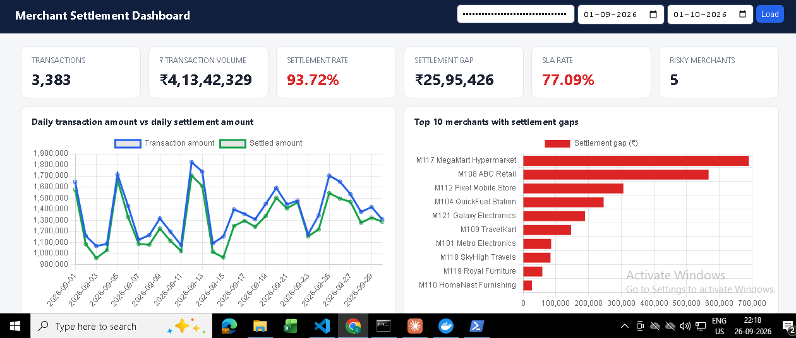
Rollback Scenario
22:05:24
22:06:25
22:06:40
22:13:39
22:13:42
22:13:51
Bad 2.0.1 goes live
Problem spotted
Cause found
Decide: roll back
V1 back live
Numbers confirmed
What we did
When the smoke test showed 103.98 % against our 93.72 % baseline, we ran reconciliation and compared the live green (V2 2.0.1) with blue (V1), which was still running. The payments matched but the settled amount did not, and the code diff revealed three defects. With wrong money figures live and V1 proven and one switch away, we rolled back instead of patching live: switch.ps1 blue pointed Nginx back to blue and reloaded it without dropping requests, so V1 was live 3 seconds later. We re-ran the smoke test and reconciliation — both passed at 93.72 % — and kept green isolated for investigation.
After rollback: 93.72 %, gap ₹25,95,426 — smoke test and reconciliation PASS
11

Slide 13
SUMMARY
From an unexplained gap to a platform people can trust
Operations could not explain why ₹2.2 Cr of successful payments had not reached merchants. We brought the four source files into a DuckDB warehouse through a Bronze–Silver–Gold pipeline that loads data incrementally, logs every bad record, and handles the traps in the data: split settlements, late and out-of-order events, and changing merchant risk. A star schema and daily KPI table feed a secure FastAPI service and dashboard that show a 93.72 % settlement rate, a ₹25.95 L gap and the merchants behind it. To make it production-ready, every change passes 22 automated tests, four security scans (Bandit, Gitleaks, pip-audit, Trivy), a Docker build, a business smoke test and reconciliation in GitLab CI, with Jenkins as a backup, before a manual approval releases it through blue-green deployment. When a faulty release pushed the rate to an impossible 103.98 % while /health still said OK, our business checks caught it within a minute, and we rolled back to the proven version in 3 seconds and verified the numbers. The bank now has clear visibility of settlements, numbers backed by evidence, and releases that are safe to ship and quick to undo.
93.72 %
22 / 22
0
3 s
settlement rate explained
tests passed
critical security findings
rollback of a bad release

