Slide 1
DB2 Application Programming

Slide 2
Modules
Introduction to DB2
Embedded SQL guidelines
SQLCA
Host Variables & Structures
NULL Variables & Structures
Singleton Select
Cursors
Coding Guidelines
Dynamic SQL Programming
NOTE : SQL WILL NOT BE COVERED
Notes:
Majority of CICS systems will provide the user with a menu. This allows the user to choose which function he wants - often with a single keystroke. The menu program then transfers control to the program(s) necessary to process user’s request.
A Menu program is ideal to show the structure of a CICS code.
It is also pseudo-conversational as if user presses a invalid key - he/she is notified of the error and allowed to correct it

Slide 3
Introduction
What is a DB2 Application Program?
  Any Program that access data stored in DB2
Need for rules to embed SQL in a program
  To enable parsing
  Take care of impedance mismatch between non-procedural, set level SQL processing and procedural, record level processing in a program
  Programs can change variables in the SQL predicates at run time
  Enable error, warning communication between DB2 and application program.
Notes:
Majority of CICS systems will provide the user with a menu. This allows the user to choose which function he wants - often with a single keystroke. The menu program then transfers control to the program(s) necessary to process user’s request.
A Menu program is ideal to show the structure of a CICS code.
It is also pseudo-conversational as if user presses a invalid key - he/she is notified of the error and allowed to correct it

Slide 4
Embedded SQL Guidelines
Delimit all SQL Statements
Explicitly declare all DB2 tables
  Place DECLARE statements in WORKING-STORAGE section
Comment each SQL statement
Include SQLCA
Check SQLCODE after every SQL call
Standardize Error Routine (LISTING)
EXEC SQL
PUT TEXT OF SQL STATEMENT HERE
END-EXEC.
EXEC SQL
INCLUDE SQLCA
END-EXEC.
Notes:
Majority of CICS systems will provide the user with a menu. This allows the user to choose which function he wants - often with a single keystroke. The menu program then transfers control to the program(s) necessary to process user’s request.
A Menu program is ideal to show the structure of a CICS code.
It is also pseudo-conversational as if user presses a invalid key - he/she is notified of the error and allowed to correct it

Slide 5
DB2 Responsibilities
Security
Consistency
Concurrency
Performance
Meta-Data

Slide 6
DB2 Objects
Table
View
Synonym
Database
Tablespace

Slide 7
CREATE TABLE EMP
( EMPNO CHAR(6) NOT NULL,
FNAME VARCHAR(20) NOT NULL,
DEPT CHAR(3),
DOJ DATE)
IN DBX.TBX
TS is the physical object (VSAM Dataset) that holds the data for the table
DB is the logical object that allows grouping of tables into logical sets.

Slide 8
DB2 Application Programming
Any program that accesses Data from DB2 is referred to as a DB2 application program.
SQL Statements are embedded in programs written in Host language.
The SQL Statements must always have to be enclosed between delimiters.
EXEC SQL
Statement
END-EXEC.

Slide 9
Host Variables
Host Variables are used in a SQL statement
To supply values to DB2
OR
To receive values from DB2
The host variables must be preceded by ‘:’ when referenced in an SQL statement
EXEC SQL
SELECT DOJ INTO :WS-DOJ
FROM EMP
WHERE EMPNO = :WS-EMPNO
END_EXEC.

Slide 10
Sample COBOL Code
DATA DIVISION.
. . .
WORKING-STORAGE SECTION.
01 EMP-HOST
02 ENO PIC X(6).
02 NAME PIC X(20).
PROCEDURE DIVISION.
MOVE ‘TARAKA’ TO NAME.
MOVE ‘40071’ TO ENO.
EXEC SQL
UPDATE EMP
SET FNAME = :NAME
WHERE EMPNO= :ENO
END-EXEC.

Slide 11
DB2 Data Types Vs Host Variables
DB2 COBOL
SMALLINT PIC S9(4) COMP
INTEGER PIC S9(9) COMP
DECIMAL (n,m) PIC S9(n-m) V 9(m)COMP-3
CHAR (n) PIC X (n)
VARCHAR (n) PIC S9(4) COMP
PIC X (n)
DATE PIC X (10)
TIME PIC X (8)
TIMESTAMP PIC X (26)
The host variables defined in the program must match the DB2 data types

Slide 12
DCLGEN
DCLGEN (Declaration Generator)
Option 2 in DB2I
Generates
SQL DECLARE TABLE
Host Variables declaration for a table or view.

Slide 13
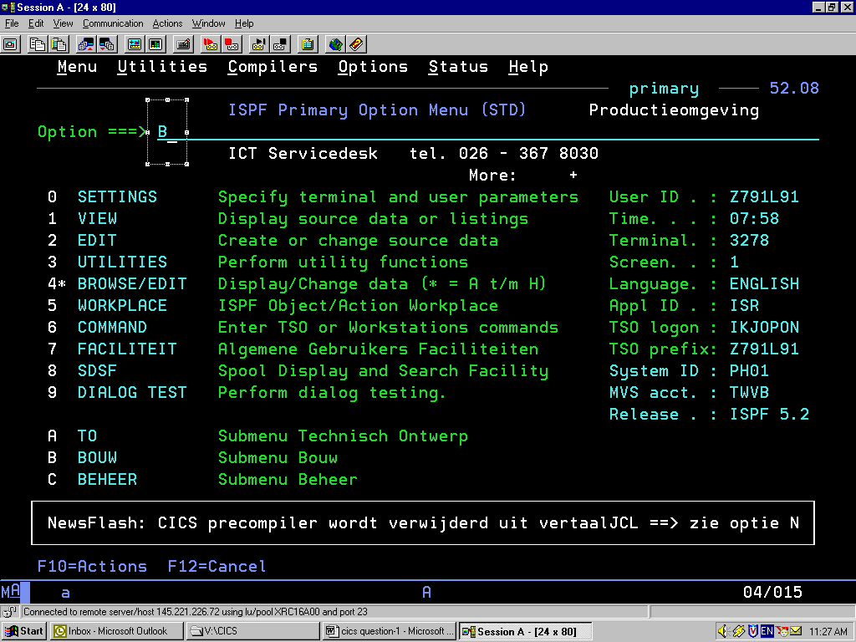

Slide 14
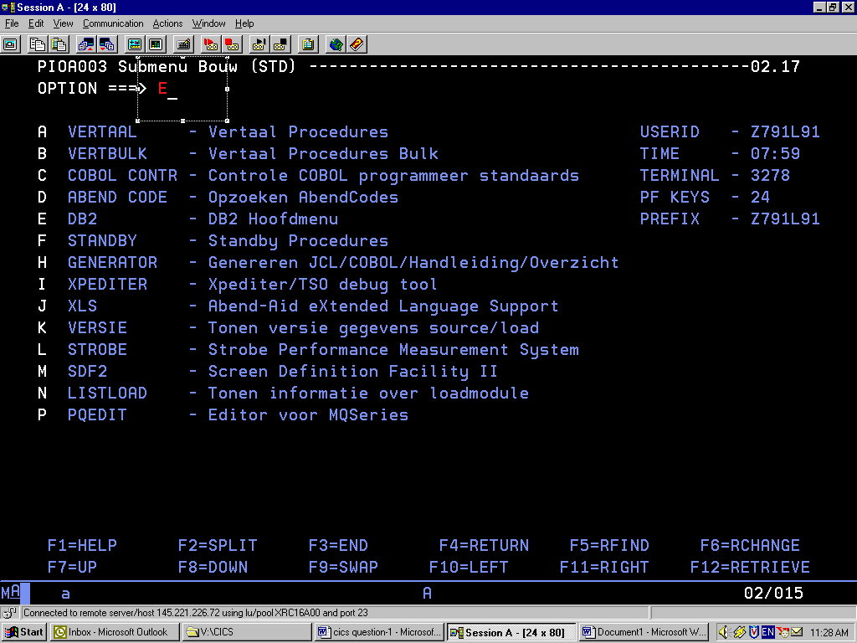

Slide 15
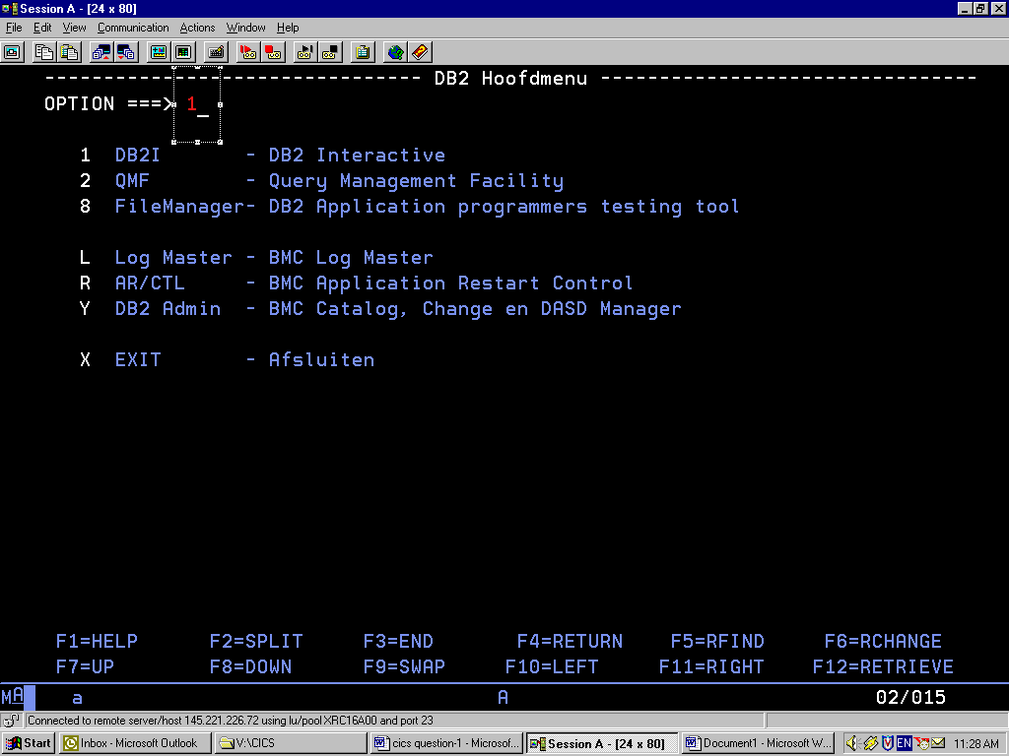

Slide 16
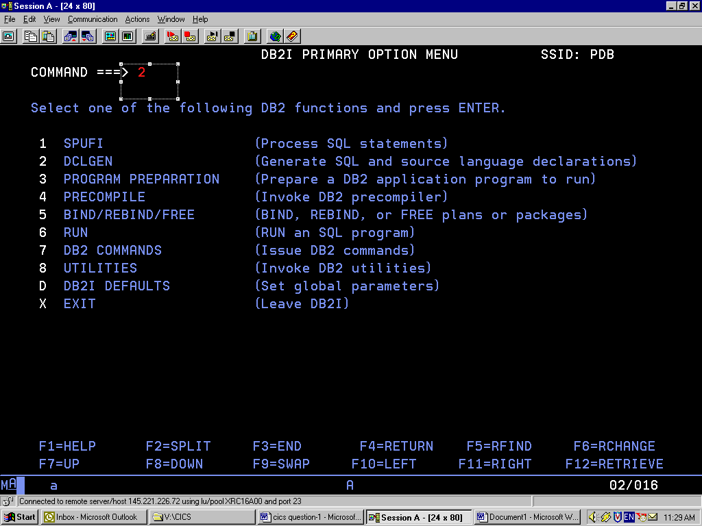

Slide 17
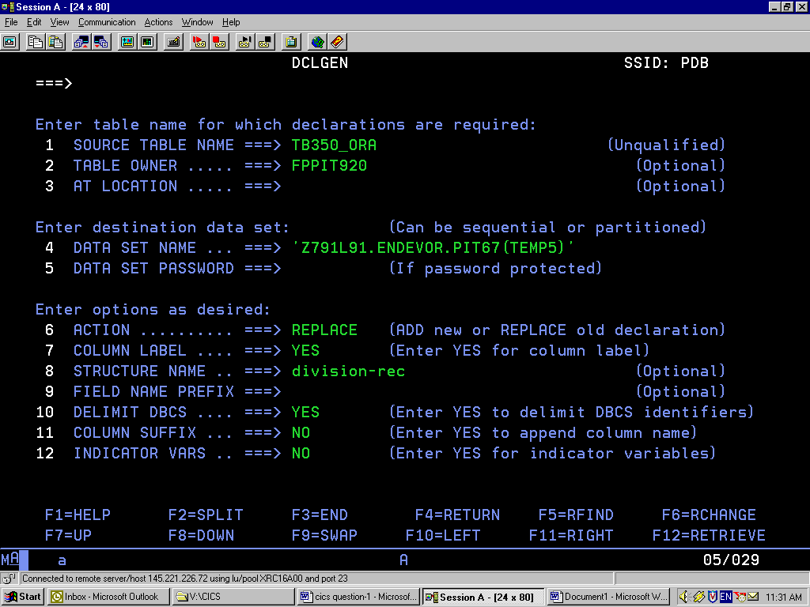

Slide 18
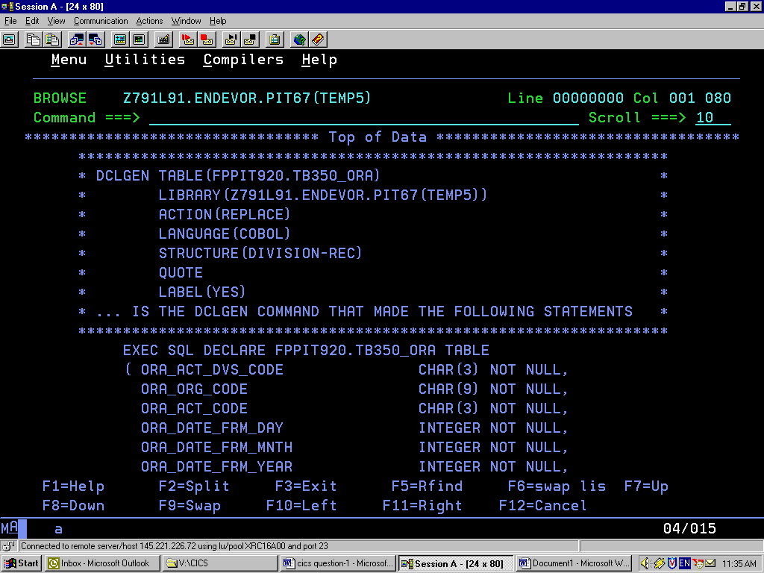

Slide 19
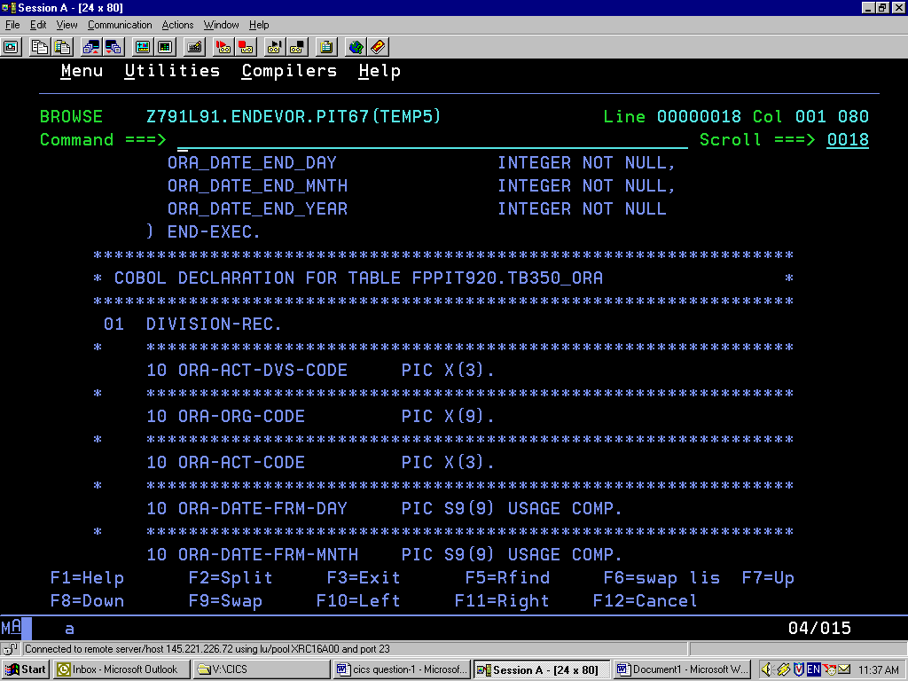

Slide 20
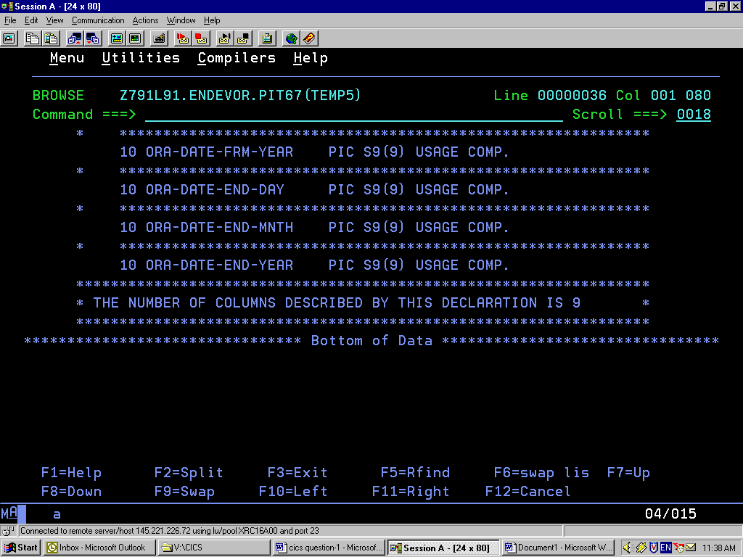

Slide 21
SQLCA
SQLCA (SQL Communication Area)
SQLCA Contains
SQLCODE
SQLSTATE
SQL Communication Area (SQLCA) is a collection of variables that is updated at the end of the execution of every SQL statement.
Values must be checked by application program
EXEC SQL
INCLUDE SQLCA
END-EXEC.
Notes:
Majority of CICS systems will provide the user with a menu. This allows the user to choose which function he wants - often with a single keystroke. The menu program then transfers control to the program(s) necessary to process user’s request.
A Menu program is ideal to show the structure of a CICS code.
It is also pseudo-conversational as if user presses a invalid key - he/she is notified of the error and allowed to correct it

Slide 22
SQLSTATE
SQLSTATE is a cross-platform SQL return code contained in a character string of length 5.
First two digits : SQLSTATE “CLASS”
00 : Successful Execution
01 : Warning
.
.
.
Last 3 digits represent SQLSTATE “SUBCODE”
Example:
SQLSTATE 01501 : String Truncation

Slide 23
SQLCODE
SQLCODE is the SQL return code for DB2 and contains a single numeric value
0
(-ve negative) (+ve positive)
Error Condition Exception Condition
Example: -084 Unacceptable SQL statement
000 Successful Execution
+100 Record not found for FETCH,UPDATE or DELETE, (or) the result of a query is an empty table

Slide 24
CURSORS
Two types of embedded SELECT statements
  Singleton SELECT
  CURSOR SELECT
Singleton SELECT returns just one row & application program process the row.
MUST contain the INTO clause
If more than one row is retrieved, the first one is placed in host variable and SQLCODE is set to -811.
To handle multiple row, use cursor

Slide 25
CURSORS
Four distinct operation on cursors.
  Declare
  Open
  Fetch
  Close
A SQLCODE of +100 is returned, when no more rows exists. This can be when all rows have been retrieved.

Slide 26
CURSOR DECLARATION
The DECLARE CURSOR statement is used to associate a cursor with the SQL Select Statement.
No data access is performed at this stage.
Syntax:
The WITH HOLD Option is used if we are doing a commit inside the fetch loop. Else the cursor will be closed.
EXEC SQL DECLARE Cursor-name CURSOR
[WITH HOLD] FOR select-statement
END-EXEC

Slide 27
Sample code
EXEC SQL
DECLARE VLDNCD7 CURSOR FOR
SELECT
TB370_VLD.VLD_SCH_NUMMER ,
TB370_VLD.VLD_VLD_NUMMER ,
TB370_VLD.VLD_SCH_VELD ,
TB370_VLD.VLD_DB_VELD
FROM
TB370_VLD
WHERE TB370_VLD.VLD_SCH_NUMMER <= :QV-7.SCH-NUMMER AND
TB370_VLD.VLD_VLD_NUMMER <= :QV-7.VLD-NUMMER
ORDER BY TB370_VLD.VLD_SCH_NUMMER DESC,
TB370_VLD.VLD_VLD_NUMMER DESC
FOR FETCH ONLY OPTIMIZE FOR 12 ROWS
END-EXEC.

Slide 28
OPEN CURSOR
Open CURSOR statement positions before the first row.
Syntax:
EXEC SQL
OPEN Cursor-name
END_EXEC

Slide 29
FETCH
Fetch positions on the next record.
Moves the values to the host variables.
If no more records, moves +100 to SQLCODE
Syntax:
EXEC SQL
FETCH Cursor-name
INTO
:host-variable-1
:host-variablr-2 …
END-EXEC

Slide 30
Sample FETCH
EXEC SQL
FETCH VLDNCD7
INTO
:AV-7.SCH-NUMMER ,
:AV-7.VLD-NUMMER ,
:AV-7.VELDNAAM ,
:AV-7.DB2-NAAM :NULL-IND-DB2-AV7
END-EXEC.

Slide 31
CLOSE
Syntax:
EXEC SQL
CLOSE Cursor-name
END_EXEC
EXEC SQL
CLOSE VLDNCD7
END-EXEC.

Slide 32
Host Variables
Area of storage allocated by host language and referenced by SQL statement.
Prefixed with a colon(:). So HOSTVAR_EMPID should be referenced in a SQL as :HOSTVAR_EMPID
Means of moving data from program to DB2 and from DB2 to program
Can be used as
  output data area in the INTO clause
  input data area for SET and UPDATE statements
  input data area for VALUE clause in INSERT statement
  search filed in WHERE clause
  literal in SELECT list of a SELECT statement
Notes:
Majority of CICS systems will provide the user with a menu. This allows the user to choose which function he wants - often with a single keystroke. The menu program then transfers control to the program(s) necessary to process user’s request.
A Menu program is ideal to show the structure of a CICS code.
It is also pseudo-conversational as if user presses a invalid key - he/she is notified of the error and allowed to correct it

Slide 33
Host Variables
Examples
EXEC SQL
SELECT EMPNO
,:INCREASE-PCT
,:SALARY * :INCREASE-PCT
INTO :HOSTVAR-EMPNO
,:HOSTVAR-INCRPCT
,:HOSTVAR-SALARY
FROM EMP
WHERE EMPNO = ‘10110’
END-EXEC.
EXEC SQL
INSERT INTO DEPT
VALUES (:HOSTVAR-DEPTNO
,:HOSTVAR-DEPTNAME
,:HOSTVAR-MGRNO
,:HOSTVAR-ADMRDEPT
END-EXEC.
EXEC SQL
UPDATE EMP
SET SALARY = :HOSTVAR-SALARY
WHERE EMPNO = :HOSTVAR-EMPNO
END-EXEC.
Notes:
Majority of CICS systems will provide the user with a menu. This allows the user to choose which function he wants - often with a single keystroke. The menu program then transfers control to the program(s) necessary to process user’s request.
A Menu program is ideal to show the structure of a CICS code.
It is also pseudo-conversational as if user presses a invalid key - he/she is notified of the error and allowed to correct it

Slide 34
Host Structure
Enable SQL statements to specify a single structure for storing all retrieved columns
01 DCLDEPT
10 DEPTNO PIC X(3).
10 DEPTNAME.
49 DEPTNAME-LEN PIC S9(4) COMP.
49 DEPTNAME-TXT PIC X(36).
10 MGRNO PIC X(6).
10 ADMRDEPT PIC X(3).
10 LOCATION PIC X(16).
EXEC SQL
SELECT DEPTNO, DEPTNAME, MGRNO, ADMRDEPT, LOCATION
FROM DEPT
INTO :DCLDEPT
WHERE DEPTNO = ‘A00’
END-EXEC.
Notes:
Majority of CICS systems will provide the user with a menu. This allows the user to choose which function he wants - often with a single keystroke. The menu program then transfers control to the program(s) necessary to process user’s request.
A Menu program is ideal to show the structure of a CICS code.
It is also pseudo-conversational as if user presses a invalid key - he/she is notified of the error and allowed to correct it

Slide 35
Null Indicator Variables & Structure
Use NULL indicator variable
  to SELECT, INSERT, UPDATE a variable which may be NULL
  Using column functions to retrieve data
Else a -305 SQLCODE is returned.
Null indicators are defined as PIC S9(4) COMP.
To associate a NULL indicator with a particular variable, code the indicator variable immediately after the host variable
SELECT MAX(SALARY)
FROM EMP
WHERE WORKDEPT = ‘ZZZ’;
/* NO ‘ZZZ’ DEPT
SELECT EMPNO, SALARY
INTO :EMPNO
,:SALARY:SALARY-IND
FROM EMP
WHERE EMPNO = ‘001001’
01 EMP-NULL-INDICATORS.
10 JOB-IND PIC S9(4) COMP.
10 SALARY-IND PIC S9(4) COMP.
Notes:
Majority of CICS systems will provide the user with a menu. This allows the user to choose which function he wants - often with a single keystroke. The menu program then transfers control to the program(s) necessary to process user’s request.
A Menu program is ideal to show the structure of a CICS code.
It is also pseudo-conversational as if user presses a invalid key - he/she is notified of the error and allowed to correct it

Slide 36
Null Indicator Variables & Structure
To determine the value of a NULL variable both host variable and indicator variable are required.
Indicator variable contains these null status
  Negative number means that column is NULL
    A value of -2 indicates column is set to NULL as a result of data conversion error
  Positive or Zero indicates it is not NULL
  If column is Character and is truncated on retrieval as host variable is not large enough, indicatior variable contains the length of the original data.
NOTE: Instead of NULL indicator you can use VALUE function. So VALUE(MANAGER_NAME, ‘** No Manager Name**’ will return actual value of Manager Name when column is not null & literal ‘** No Namager Name**’ when MANAGER_NAME column is null
NOTE: Failure to check NULL status or -305 SQLCODE will result the program continue execution but with questionable results.
Notes:
Majority of CICS systems will provide the user with a menu. This allows the user to choose which function he wants - often with a single keystroke. The menu program then transfers control to the program(s) necessary to process user’s request.
A Menu program is ideal to show the structure of a CICS code.
It is also pseudo-conversational as if user presses a invalid key - he/she is notified of the error and allowed to correct it

Slide 37
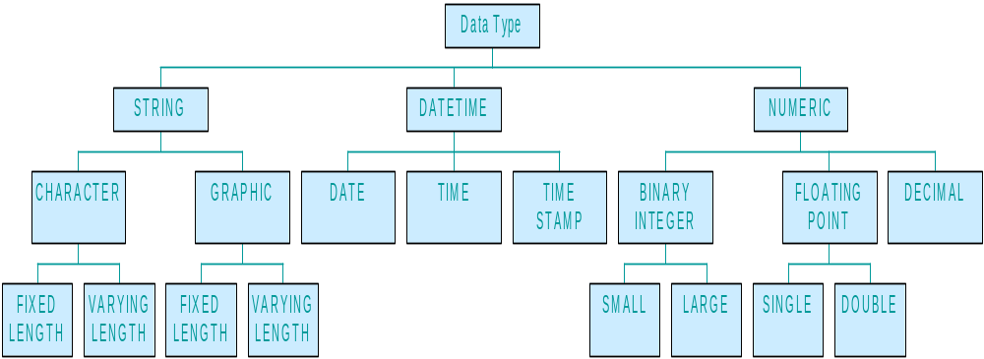
Host & Null Variables Guidelines
Use COLON when referring to host variables
Use syntactically valid names (no underscore)
Avoid using Host and Null variable structures
Define Host Variable precisely
Use DCLGEN for host variable generation
Avoid DCLGEN for NULL Indicator generation
Notes:
Majority of CICS systems will provide the user with a menu. This allows the user to choose which function he wants - often with a single keystroke. The menu program then transfers control to the program(s) necessary to process user’s request.
A Menu program is ideal to show the structure of a CICS code.
It is also pseudo-conversational as if user presses a invalid key - he/she is notified of the error and allowed to correct it

Slide 38
CURSOR SELECTS
Examples.
  Cursor Processing
  Updating with a Cursor
Notes:
Majority of CICS systems will provide the user with a menu. This allows the user to choose which function he wants - often with a single keystroke. The menu program then transfers control to the program(s) necessary to process user’s request.
A Menu program is ideal to show the structure of a CICS code.
It is also pseudo-conversational as if user presses a invalid key - he/she is notified of the error and allowed to correct it

Slide 39
CODING Guidelines
Use Singleton Select if possible (Example)
Avoid certain cursors for modifications
  UNION, DISTINCT, GROUP BY, ORDER BY clauses
  Joins, Subqueries,
Place DECLARE CURSOR statement first
Initialize host variables
Open cursors before fetching
Open cursors only when needed.
Use WHERE CURRENT OF to delete single rows using cursor
Notes:
Majority of CICS systems will provide the user with a menu. This allows the user to choose which function he wants - often with a single keystroke. The menu program then transfers control to the program(s) necessary to process user’s request.
A Menu program is ideal to show the structure of a CICS code.
It is also pseudo-conversational as if user presses a invalid key - he/she is notified of the error and allowed to correct it

Slide 40
CODING Guidelines
Use FOR UPDATE OF clause when updating
  include only columns being updated
  declare them in DECLARE cursor statements
Use care with FETCH
  retrieves data one row at a time in a forward motion. Rows already retrieved can’t be retrieved again.
Explicitly close cursors
IN CICS Transactions, FOR UPDATE OF is not sufficient to ensure integrity. A save and Compare must be done prior to update
Notes:
Majority of CICS systems will provide the user with a menu. This allows the user to choose which function he wants - often with a single keystroke. The menu program then transfers control to the program(s) necessary to process user’s request.
A Menu program is ideal to show the structure of a CICS code.
It is also pseudo-conversational as if user presses a invalid key - he/she is notified of the error and allowed to correct it

Slide 41
CODING Guidelines
Use WITH HOLD clause to retain cursor position when COMMIT is issued
Specify Primary Key in WHERE clause of UPDATE and DELETE statements
Use SET-at-a-Time Inserts
Use LOAD rather than multiple INSERTs
Use SQL to join tables (Example A, Example B)
Use OREDR BY to ensure sequencing
Use FOR READ ONLY for read-only access
Use sample programs
More DB2 Tips & Tricks
Notes:
Majority of CICS systems will provide the user with a menu. This allows the user to choose which function he wants - often with a single keystroke. The menu program then transfers control to the program(s) necessary to process user’s request.
A Menu program is ideal to show the structure of a CICS code.
It is also pseudo-conversational as if user presses a invalid key - he/she is notified of the error and allowed to correct it

Slide 42
Dynamic SQL Programming
EXECUTE IMMIDIATE (Example)
non-SELECT dynamic SQL (Example)
  Using Parameter Markers (Example)
SQLDA
Fixed List SELECT (Example)
Varying List SELECT (Example-A, Example-B)
A Sample Batch Unload Program using Dynamic SQL Calls
Notes:
Majority of CICS systems will provide the user with a menu. This allows the user to choose which function he wants - often with a single keystroke. The menu program then transfers control to the program(s) necessary to process user’s request.
A Menu program is ideal to show the structure of a CICS code.
It is also pseudo-conversational as if user presses a invalid key - he/she is notified of the error and allowed to correct it

