Slide 1
C++ STL & GDB Tutorial
DS221_2021

Slide 2
Agenda
GDB
Vector
Stack
MAP

Slide 3

GDB (GNU Debugger)
Debugger for languages: C/C++/Fortran/OpenCL
Credit: “Redhat Developers”
$gdb executable
CLI(Command Line Interface)
For GUI, seamlessly integrated to popular IDE’s (VSCode, Eclipse, Emacs).
Debugging Techniques:
Reactive : Actions we take after encountering bug.
Preemptive : Actions we can take before encountering a bug.
Programming Errors:
Build Errors:
Runtime Errors:
Logic Errors: {Expected : result = 25}
Debugging Tools
checking/comparing values
error: expected ';' before '}' token
warning: division by zero [-Wdiv-by-zero]
GDB
result = 20
Ref: “https://uchicago-cs.github.io/debugging-guide/"

Slide 4
GDB (GNU Debugger)
Useful Commands
Help
Start program
Set breakpoint
Delete all breakpoint
Execute current and step to next line
Continue program after breakpoint
List source code from current line number
Print value of expression at current line
(gdb) help
(gdb) run
(gdb) break line_number
(gdb) delete
(gdb) step
(gdb) continue
(gdb) list
(gdb) print expression
Ref: “https://web.eecs.umich.edu/~sugih/pointers/summary.html”

Slide 5
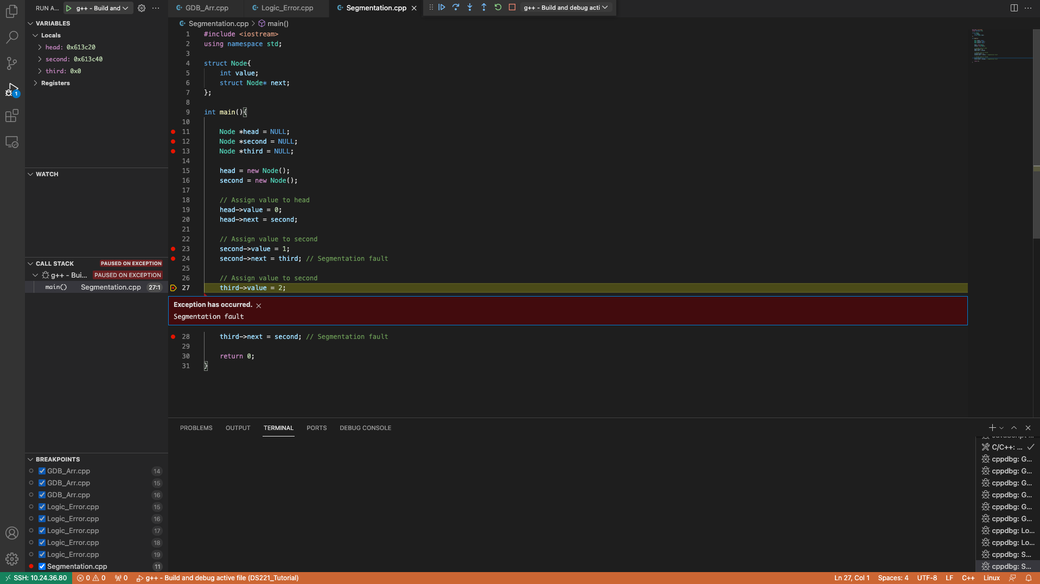
GDB (GNU Debugger) VSCode Interface
continue
step over
step into
step out
restart
stop

Slide 6
GDB (GNU Debugger)
1 #include <iostream>
2 using namespace std;
3
4 float avg_floatE(float a, float b){
5 return a + b / 2 ;
6 }
7
8 float avg_float(float a, float b){
9 return (a + b )/ 2 ;
10 }
11
12 int main(){
13 float a = 10.5;
14 float b = 10.5;
15 cout << "Average float Values " << endl;
16 float c = avg_floatE(a,b);
17 cout << c << endl;
18 float d = avg_float(a,b);
19 cout << d << endl;
20 return 0;
21 }
Logic Error (Ex: Logical Error)
Logics can cause program to produce unexpected results.
Program terminates normally.
Ex: Calculating Average of two float values.

Slide 7
GDB (GNU Debugger)
1 #include <iostream>
2 using namespace std;
3
4 struct Node{
5 int value;
6 struct Node* next;
7 };
8
9 int main(){
10
11 Node *head = NULL;
12 Node *second = NULL;
13 Node *third = NULL;
14
15 head = new Node();
16 second = new Node();
17
18 // Assign value to head
19 head->value = 0;
20 head->next = second;
21
22 // Assign value to second
23 second->value = 1;
24 second->next = third;
25
26 // Assign value to second
27 third->value = 2; // Segmentation fault
28 third->next = second;
29
30 return 0;
31 }
Runtime Error (Ex: Segmentation fault)
Most common condition, causes program to crash
Caused when program is trying to read/write an illegal memory location.
Ex: illegal memory access in Singly Linked list.

Slide 8
STL
Standard Template Library
Set of C++ template classes to provide common programming data structures and functions.
Components of STL
Algorithms {Sorting/Searching}
Containers {vector, list, deque}
Functions {Functors: transform()}
Iterators {used for working upon sequence of values}
Ref: “https://www.geeksforgeeks.org/the-c-standard-template-library-stl/”

Slide 9
Vector
1 #include <iostream>
2 #include <vector>
3 #include <algorithm>
4 using namespace std;
5 int main(){
6 // Declaring a vector
7 vector<int> vector1;
8
9 cout<<"Initialising a vector with 10
10 elements ranging from from 0 to 9"<<endl;
11 for(int i=0;i<10;i++){
12 vector1.push_back(i);
13 }
14 //Check Vector size
15 cout<<"Vector size = "<<vector1.size()<<
16 endl;
17
18 // Change value at any index
19 cout<<"Changing element at 6th index to 50"<
20 <endl;
21 vector1[5]=50;
22
23 // Print Vectors
24 cout<<"Printing Vector"<<endl;
25 for(auto i = vector1.begin();i!=vector1.end(
26 );i++){
27 cout<<*i<<"\t";
28 }
29 cout<<endl;
30
31 // Access values in vector with at()
32 cout<<"Vector element at position 1 using
33 at() method="<<vector1.at(1)<< endl;
34
35 // Access values in vector with [] operator
36 cout << "which is same as accessing using []
37 operator "<<vector1[1]<<endl;
38
39 // Use insert() to add value at any
40 specific index
41 cout<<"Inseting 25 to 2nd position"<<endl;
42 vector1.insert(vector1.begin()+2,25);
43
44 // Calculate new vector size
45 cout<<"New vector size = "<<vector1.size()<<
46 endl;
47 vector1.pop_back();
48
49 // Calculate new vector size
50 cout<<"New vector size = "<<vector1.size()<<
51 endl;
52
53 // Print vector using index
54 for(int i=0;i<vector1.size();i++){
55 cout<<vector1[i]<<"\t";
56 }
57 cout<<endl;
58
59 // Sorting a vector with STL algorithm
60 cout<<"Sorting vector"<<endl;
61 sort(vector1.begin(),vector1.end(),greater<
62 int>());
63 for(auto i = vector1.begin();i!=vector1.end(
64 );i++){
65 cout<<*i<<"\t";
66 }
67 cout << endl;
68
69 }
Can be understood as dynamic arrays.
Storage is being handled automatically by containers.
Vector elements are placed in contiguous storage.
vector.begin() : Returns iterators pointing to the first element.
vector.end() : Returns iterators pointing to the last element.
vector.size() : Returns number of elements.
vector.push_back() : push element from back of vector.
vector.pop_back() : pop/remove element from back of vector.
vector.insert() : inserts new elements before the element at specified position.
vector.swap(): swap contents of one vector with another vector of same type.
vector.swap(): swap contents of one vector with another vector of same type.

Slide 10
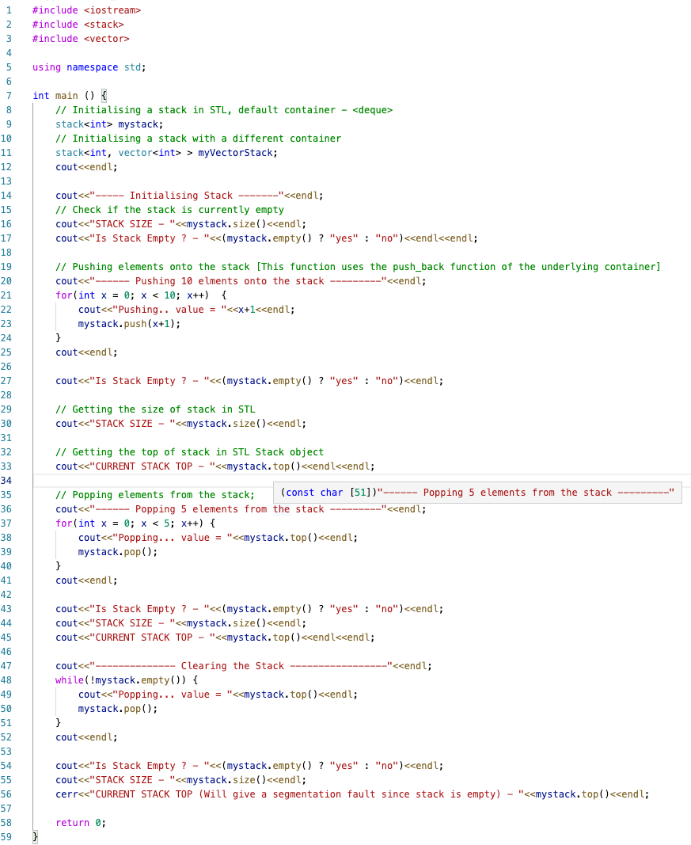
Stack
Container adaptors with LIFO(Last In First Out) type of working.
Stack uses encapsulated object of either vector , deque(default) or list.
stack.size() : Returns the size of stack.
stack.empty() : Returns whether the stack is empty.
stack.top() : Returns a reference to the top most element of stack.
stack.push(A) : Adds element A to the top of stack.
stack.pop() : Deletes the top most element of stack.

Slide 11
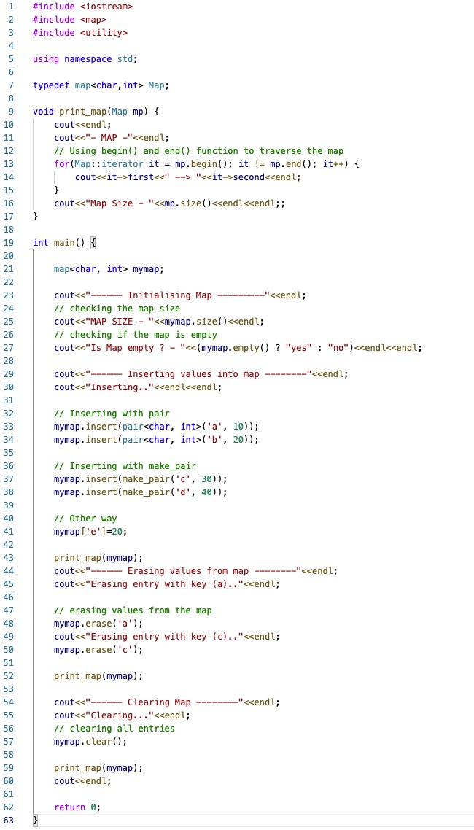
Map
Maps are associative containers that store elements in a mapped fashion.
map (internally implemented with BBT) O(log n) vs unordered_map (internally implemented with hashing) O(1)
map.begin() :Returns an iterator to the first element in map.
map.end() : Returns an iterator to the last element of the map.
map.size() : Returns the number of elements in map.
map.max_size() : Returns the maximum number of elements that the map can hold.
map.insert() : Adds new element to the map.
Ref : “ https://www.geeksforgeeks.org/map-associative-containers-the-c-standard-template-library-stl/”

Slide 12
Thanks!
ghanshyamc@iisc.ac.in
https://github.com/Ghanshyamchandra74/DS221_2021

Slide 13
References
1) https://www.cplusplus.com/reference/stl/
2) https://en.cppreference.com/w/cpp/container
3)https://www.topcoder.com/thrive/articles/Power%20up%20C++%20with%20the%20Standard%20Template%20Library%20Part%20One
4) https://www.hackerearth.com/practice/notes/c-stls-when-to-use-which-stl/

