Slide 1
Hi !!!
welcome to everyone
Introduction To Database
Ceckpoint

Slide 2
Agenda
01. Introduction To RDBMS
02. MySQL
03. PostgreSQL
04. SQL SERVER
05. Comparison betwen the three RBDMS

Slide 3
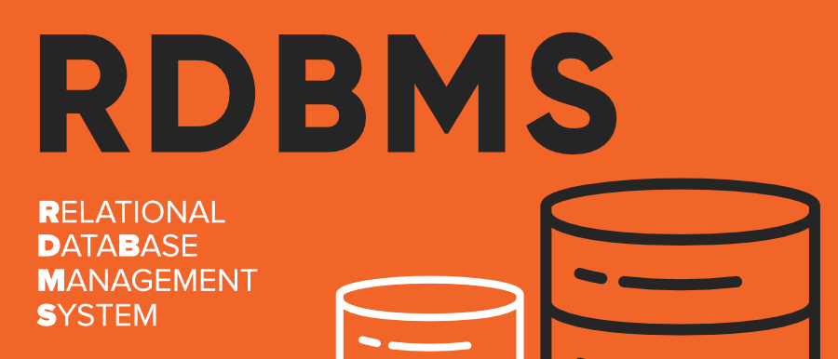
Introduction
What is RDBMS?
RDBMS is the collection of programs and capabilities that enables the user to interact with a relational database. A relational database management system (RDBMS) is a type of DBMS with a row-based table structure. Most commercial RDBMS use SQL. The most basic RDBMS functions are related to create, read, update and delete operations, collectively known as the CRUD cycle.

Slide 4
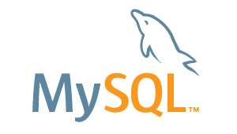
Section 1 :
What is MySQL
Definition :
Functionnalities :
MySQL is an Oracle-backed open source relational database management system (RDBMS) based on Structured Query Language (SQL). MySQL runs on virtually all platforms, including Linux, UNIX and Windows. Although it can be used in a wide range of applications, MySQL is most often associated with web applications and online publishing
Relational Database Management System (RDBMS) MySQL is a relational database management system. ...
Easy to use. MySQL is easy to use. ...
It is secure. ...
Client/ Server Architecture. ...
Free to download. ...
It is scalable. ...
Speed. ...
High Flexibility.

Slide 5
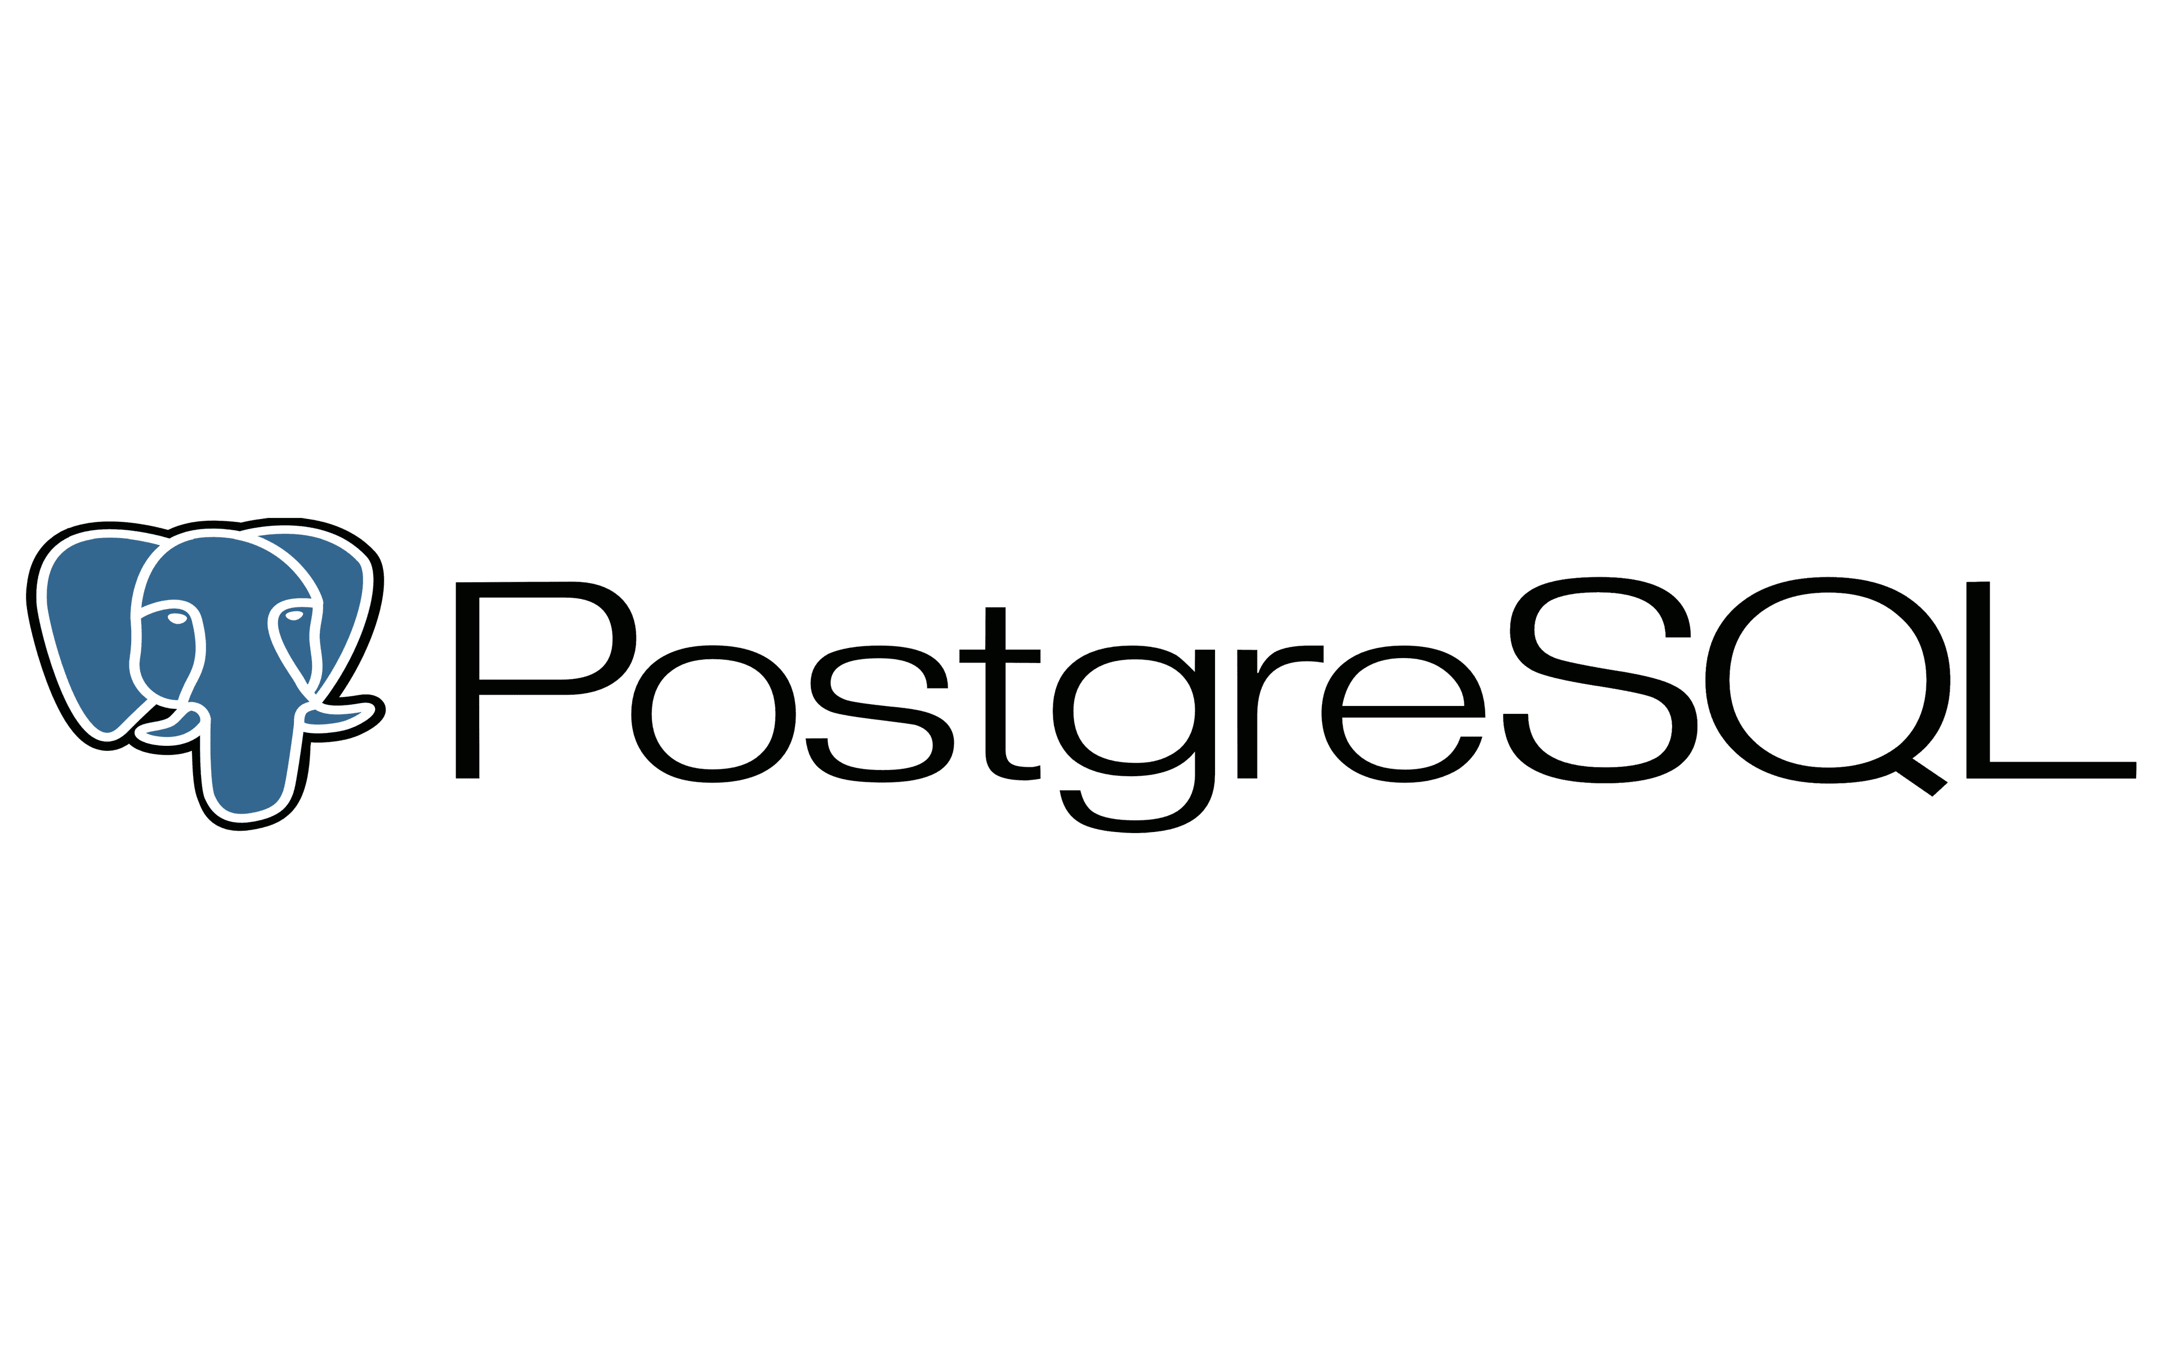
Section 2 :
What is PostgreSQL
Definition :
Functionnalities :
PostgreSQL is an open-source, object-relational database management system (ORDBMS) that is not owned or controlled by one company or individual. Because postgresSQL software is open-source, it is managed mostly through a coordinated online effort by an active global community of developers, enthusiasts and other volunteers.
User-defined types.
Table inheritance.
Sophisticated locking mechanism.
Foreign key referential integrity.
Views, rules, subquery.
Nested transactions (savepoints)
Multi-version concurrency control (MVCC)

Slide 6
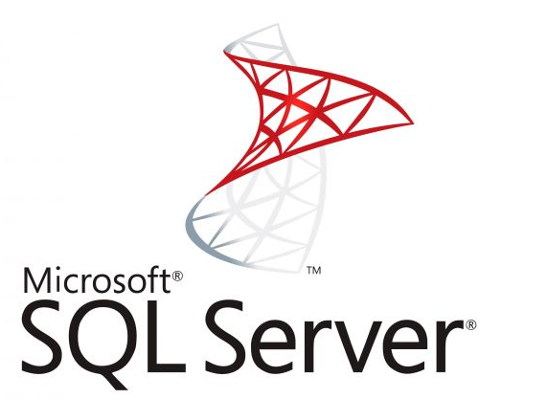
Section 3 :
What is SQL SERVER
Definition :
Functionnalities :
SQL Server is Microsoft's relational database management system (RDBMS). It is a full-featured database primarily designed to compete against competitors Oracle Database (DB) and MySQL.
Like all major RBDMS, SQL Server supports ANSI SQL, the standard SQL language. However, SQL Server also contains T-SQL, its own SQL implemention. SQL Server Management Studio (SSMS) (previously known as Enterprise Manager) is SQL Server's main interface tool, and it supports 32-bit and 64-bit environments.
Intelligence across all your data with Big Data Clusters. Break down data silos. ...
Choice of language and platform. Run SQL Server anywhere. ...
Industry-leading performance. #1 in performance. ...
Most secured data platform. ...
Unparalleled high availability. ...
End-to-end mobile BI. ...
SQL Server on Azure.

Slide 7
Comparison betwen the three RDBMS
Part 1
Name | SQL Server | MySQL | PostgreSQL
Description | Microsofts flagship relational DBMS | Widely used open source RDBMS | Widely used open source RDBMS
Primary database model | Relational DBMS | Relational DBMS | Relational DBMS
Secondary database models | Document store Graph DBMS Spatial DBMS | Document store Spatial DBMS | Document store Spatial DBMS
Developer | Microsoft | Oracle | PostgreSQL Global Development Group
Initial release | 1989 | 1995 | 1989
License | commercial | Open Source | Open Source
Cloud-based only | No | No | No
Implementation language | C++ | C and C++ | C++
Server operating systems | Linux Windows | FreeBSD Linux OS X Solaris Windows | FreeBSD,HP-UX,Linux NetBSD,OpenBSD OS X,Solaris,Unix Windows

Slide 8
Name | SQL Server | MySQL | PostgreSQL
Data scheme | yes | yes | yes
Typing | yes | yes | yes
XML support | yes |  | yes
Secondary indexes | yes | yes | yes
SQL | yes | yes | yes
APIs and other access methods | ADO.NET / JDBC ODBC / OLE DB | ADO.NET/JDBC/ODBC Proprietary native API | ADO.NET/JDBC native C library ODBC streaming API for large objects
Server-side scripts | Transact SQL, .NET languages, R, Python and (with SQL Server 2019) Java | Yes | user defined functions
Replication methods | yes, but depending on the SQL-Server Edition | Multi-source replication Source-replica replication | Source-replica replication
MapReduce | No | No | No
Foreign keys | Yes | Yes | Yes
Transaction concepts | ACID | ACID | ACID
Part 2

Slide 9
Part 3
Name | SQL Server | MySQL | PostgreSQL
Concurrency | Yes | Yes | Yes
Durability | Yes | Yes | Yes
Yes | Yes | Yes | No
User concepts | fine grained access rights according to SQL-standard | Users with fine-grained authorization concept | fine grained access rights according to SQL-standard
Supported programming languages :
SQL SERVER : C# , C++,,Delphi , Go , Java , JavaScript (Node.js) , PHP , Python , R , Ruby
2. MySQL : Ada , C , C# , C++ , D , Delphi , Eiffel , Erlang , Haskell , Java , JavaScript (Node.js) Objective-C , Ocaml , Perl , PHP , Python , Ruby , Scheme , Tcl
3. PostgreSQL : .Net , C , C++ , Delphi , Java , JavaScript (Node.js) ,Perl ,PHP, Python , Tci

Slide 10


Thank you
Powed By Oussema Ghaoui

