Slide 1





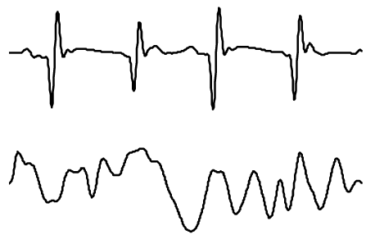
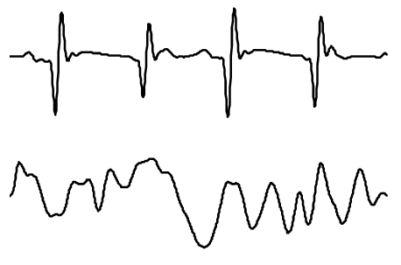
EEG-Controlled Wheelchair
Military Technical College
Biomedical Engineering Department

Slide 2


Introduction
The integration of brain-computer interface (BCI) technology into assistive devices has shown tremendous potential in empowering individuals with neurological disorders, particularly those with severe motor impairments, to regain control over their mobility.
This project aims to design and implement a complete system for controlling an electric wheelchair – that normally operates with a joystick – according to EEG signal taken from a fully-paralyzed or elderly person

Slide 3







Contents
Joystick Control
Control Signal Generation
Speech Recognition
Data
Acquisition
Feature Extraction
Classification & Decision Making
EEG
Signal

Slide 4



Joystick
Speed Control
Power
Stick
Sound Alarm
Dr. Ortho wheelchair joystick

Slide 5

Joystick
The joystick sends movement commands to the wheelchair microcontroller. Next, it sends them in the form of digital signal to the motor driver.
F/R
5V
Passed
Result
through
signal
B/L
Stick doing right & left motion
Oscilloscope
0V
t
Moving the joystick forward given the same voltage level as right (5v), moving it backward given the same voltage level as left (0V).

Slide 6





Joystick
Speed Control
Speed control buttons change the duty cycle of the PWM signal generated by the joystick (the larger the duty cycle the more speed).
A duty cycle of 1 indicates maximum wheelchair speed
PWM Signal

Slide 7





Control Signal Generation
Joystick
The wheelchair control circuit requires a specific DC voltage at its pins to operate properly.
As a preliminary step, we wanted to replace the joystick by a MATLAB app to wirelessly communicate with control circuit.
We proposed a model for the required circuit to achieve our objective as follows.
x
Implement a MATLAB user-friendly GUI to facilitate sending orders to Arduino board through serial communication
01010010101
Implement an Arduino code to produce the required voltage level as a PWM signal with specific duty cycle
5v
50%
Duty Cycle
Design a circuit to convert the PWM signal to its DC equivalent level – because the control circuit requires DC-.
2.5v

Slide 8


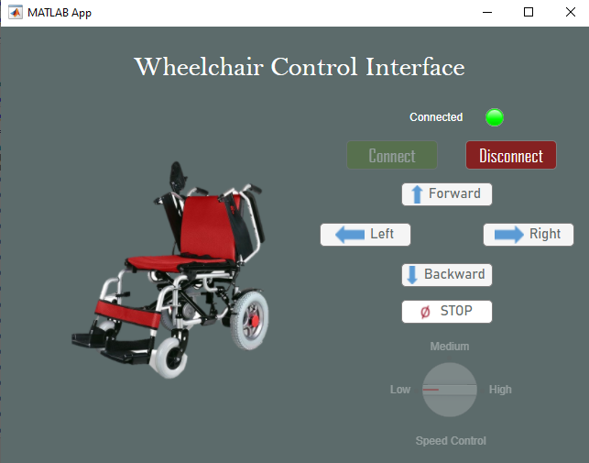
Control Signal Generation
Joystick
MATLAB GUI
% Button pushed function: BackwardButton
function BackwardButton Pushed (app, event)
if app. Speed ControlKnob.Value == "Low"
for x = 0
write(a, 2, "int8");
end
elseif app. Speed Controlknob.Value == "Medium"
for x = 0
write(a,6, "int8");
end
else
for x = 0
write(a, 10, "int8");
end
end
First, we implemented an app that sends serial data according to required action
Arduino will translate this data and produce a PWM signal with a specific predetermined duty cycle.
This example shows that BW button sends ‘2’, ‘6’, and ‘10’ for low, medium, and high speeds, respectively.
Sample code for clicking backward button
Control GUI

Slide 9



Control Signal Generation
Joystick
Arduino Code
Serial.begin(9600);
pinMode(9, OUTPUT);
analogWrite(9, 145);
void loop() {
y = Serial.read() ;
if (y == 2) //Backward Low
{
analogWrite(9, 180);
}
else if (y == 6) //Backward Medium
{
analogWrite(9, 210);
}
else if (y == 10) //Backward High
{
analogWrite(9, 255);
}
}
Second step was to implement an Arduino code that will accept GUI serial data.
Arduino will translate this data and produce a PWM signal with a specific predetermined duty cycle corresponding to data received.
The example shown is an Arduino code showing how the circuit will act upon receiving the previous data.
Receiving a ‘2’, ‘6’, or ‘10’ will give the order for moving backward with low, medium, or high speed ,respectively.

Slide 10


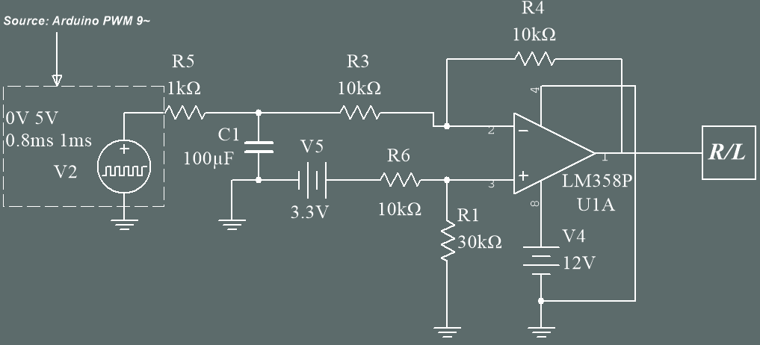
Control Signal Generation
Joystick
PCB Design
Last step was to design the PWM-to-DC conversion cir.
The circuit is a low pass filter that takes PWM signal – from Arduino – and converts it to DC.
This circuit is a single channel and was used two times for both movements.
Single channel
LPF circuit

Slide 11








Speech Recognition
Control Signal Generation
Joystick
Audio Capturing
Feature Extraction
Encoding
As a preliminary step, we used Voice Recognition Module v3.1 to control the wheelchair and test our circuits.
The model was trained for 5 different vocal commands for the 4 directions of motion and STOP command.
Training and testing was done through Arduino microcontroller.
Training Stage
Audio Capturing
Feature Analysis
Acoustic Modelling
Storage
Testing Stage
Result & Validation

Slide 12
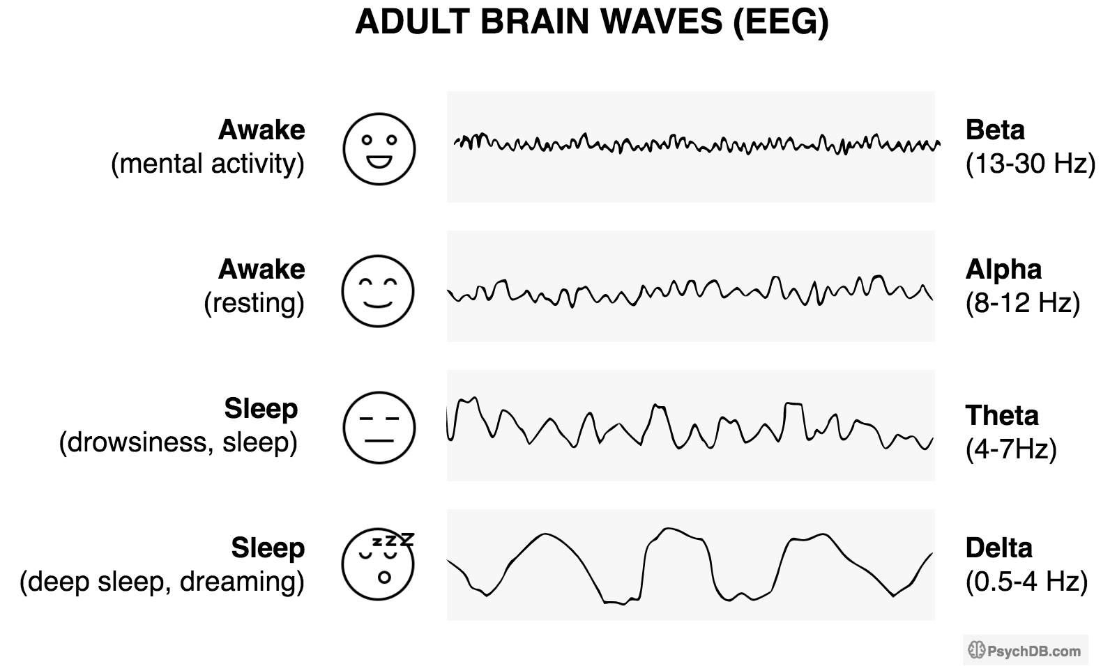
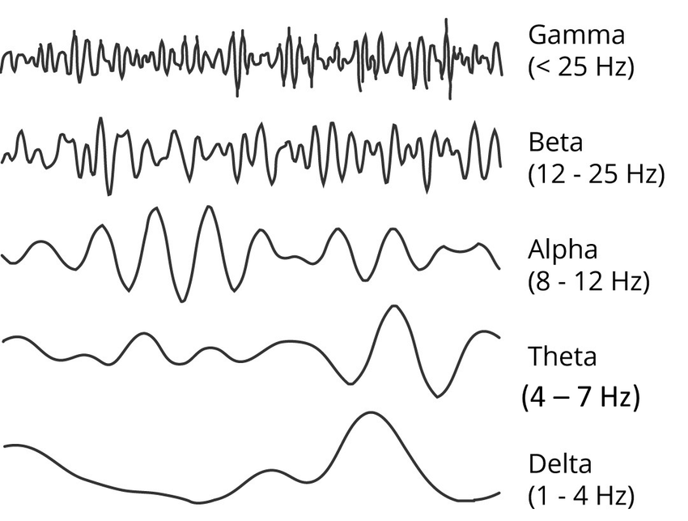
EEG
signal
Control Signal Generation
Speech Recognition
Joystick
EEG Signal: It is a method to record an electrogram of the spontaneous electrical activity of the brain. It is typically non-invasive, with the EEG electrodes placed along the scalp.
It was shown that frequencies existing in the EEG can be classified into 5 bands.
δ
0.5 - 3 Hz
5 – 250 pV
Attention tasks
Delta
θ
4 - 7 Hz
20 – 100 pV
Drowsiness
Theta
α
8 - 13 Hz
20 – 120 pV
Relaxed/Reflex
Alpha
γ
Beta
β
14 - 30 Hz
5 – 50 pV
Focus/Stress
γ
31 - 60 Hz
~ –10 pV
Match objects
Gamma
Rhythms of EEG signal

Slide 13

Data Acquisition
Control Signal Generation
EEG
Signal
Speech Recognition
Joystick
Data acquisition is done through Unicorn Hybrid Black Headsuite.
we have made our own data through a recording experiment on a person in comfortable conditions.
The dataset contains 150 recording session, each of which consisting of 15 trials with a total of 5,062,500 data point.
Fz
Fz
C3
Cz
C4
Pz
P07
P08
Oz

Slide 14
Feature Extraction
Control Signal Generation
EEG
Signal
Speech Recognition
Data Acquisition
Joystick
Frequency-domain Features
Time-domain Features
Power Spectral Density
Zero-crossing Rate
The spectral energy distribution over frequencies
The no. of times signal crosses the X-axis
Features used for classification
Standard Deviation
Relative powers of the certain frequency bands
Measures how dispersed the data is w.r.t. its mean
Variance
Signal Energy
The squared deviation from the mean of a random variable
Area under the squared magnitude of the signal

Slide 15


Classification & Decision Making
Control Signal Generation
EEG
Signal
Speech Recognition
Data Acquisition
Feature Extraction
Joystick
Random Forest Model
Random Forest Model is a supervised machine learning algorithm. It builds decision trees on different samples and takes their majority vote for classification and average for regression. This model was used as our classifier.
First step is creation of many random decision trees each predicting a particular class according to the features given to it. Next, each tree predicts a class, a voting is carried out to take into consideration the final class according to majority.
Our data was divided into 90% of the data for training the model (135 sessions OR 2025 trials) and 10% of the data as testing data (15 sessions OR 225 trials).

Slide 16
Thank You!

