Slide 1


Reducing electrode dependence for proposed SSVEP expirement
Mai Ghaith
Ahmed Gharib

Slide 2
Table of contents
BCI Approach
Visualization Codes Optimization
SSVEP
Feature Extraction & Statistical Analysis
Experiment Setup
Results
Channel Selection

Slide 3
BCI Approach
Active control
Pattern Recognition
Synchronous BCI
Offline
Non-Invasive
Universal

Slide 4
01
SSVEP
02
Expermint Setup
03
Channel Selection

Slide 5
01
SSVEP
02
Expermint Setup
03
Channel Selection

Slide 6
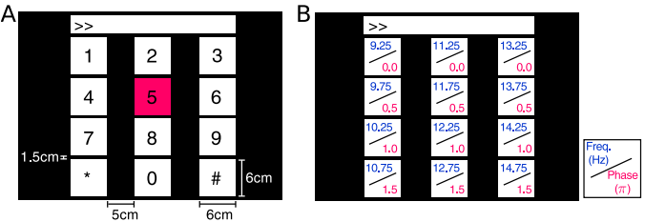

Slide 7
01
SSVEP
02
Expermint Setup
03
Channel Selection

Slide 8
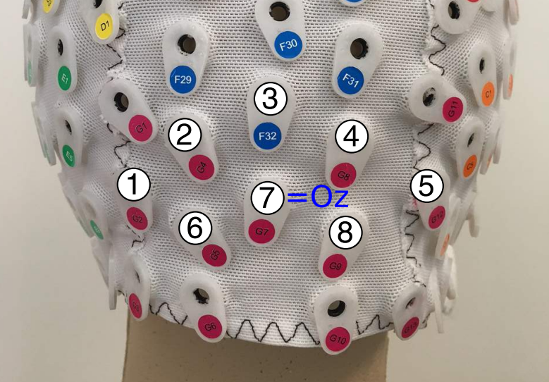
Pz
POz
PO3
PO4
PO8
PO7
O1
O2
BioSemi ActiveTwo EEG system

Slide 9
01
Visualization-Codes Optimization
02
Expermint Setup
03
Channel Selection

Slide 10
Visualization-Codes Optimization
All processing is done on:
MATLAB R2022b
CPU: 11th Gen Intel(R) Core(TM) i7-11800H @ 2.30GHz
GPU: NVIDIA GeFore RTX 3060
RAM: 16.0 GB
Windows 11 Home

Slide 11
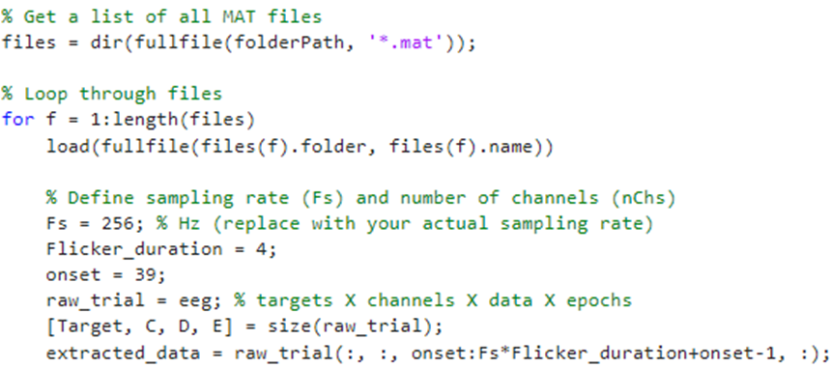
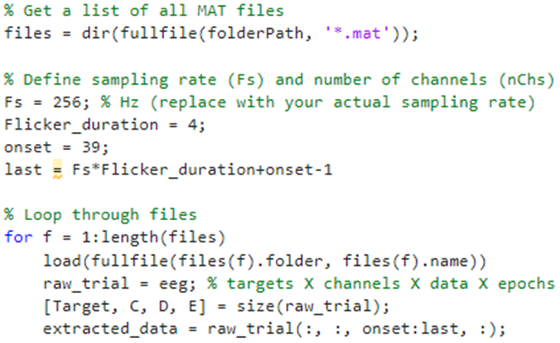
Visualization-Codes Optimization
From .mat to .csv code:
Normal
First Modification: Setting constants only once (not each loop iteration)
Before
After

Slide 12
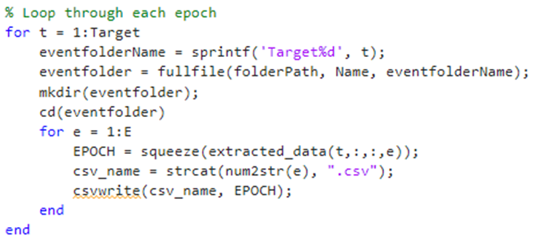
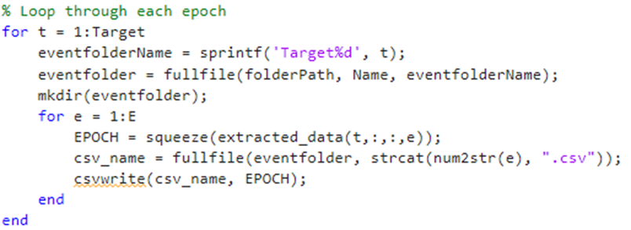
Visualization-Codes Optimization
From .mat to .csv code:
Second Modification: Avoiding changing directory each loop (cd) and using the full path
Before
After
Final Result: Code processing time is reduced by ~0.7 seconds

Slide 13

Visualization-Codes Optimization
Time/Frequency/Spectrogram Plotting codes:
Normal
First Modification: Setting constants only once (not each loop iteration) and removing cd

Slide 14
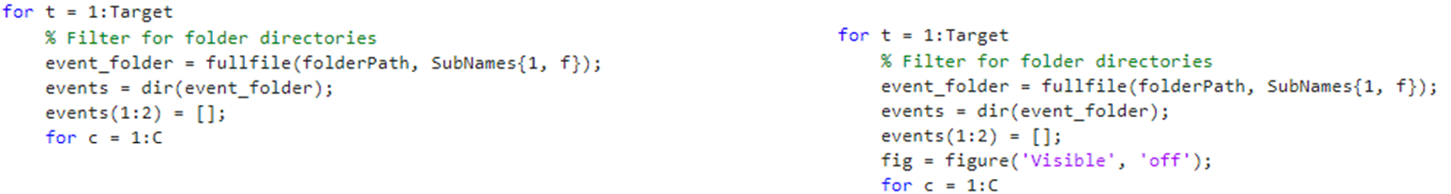
Visualization-Codes Optimization
Time/Frequency/Spectrogram Plotting codes:
Second Modification: Making figures invisible when they are generated as they are already being saved
Final Result: Code processing time is reduced by ~27.3 seconds (for time plotting)

Slide 15
01
Visualization-Codes Optimization
02
Feature Extraction & Statistical Analysis
03
Results

Slide 16
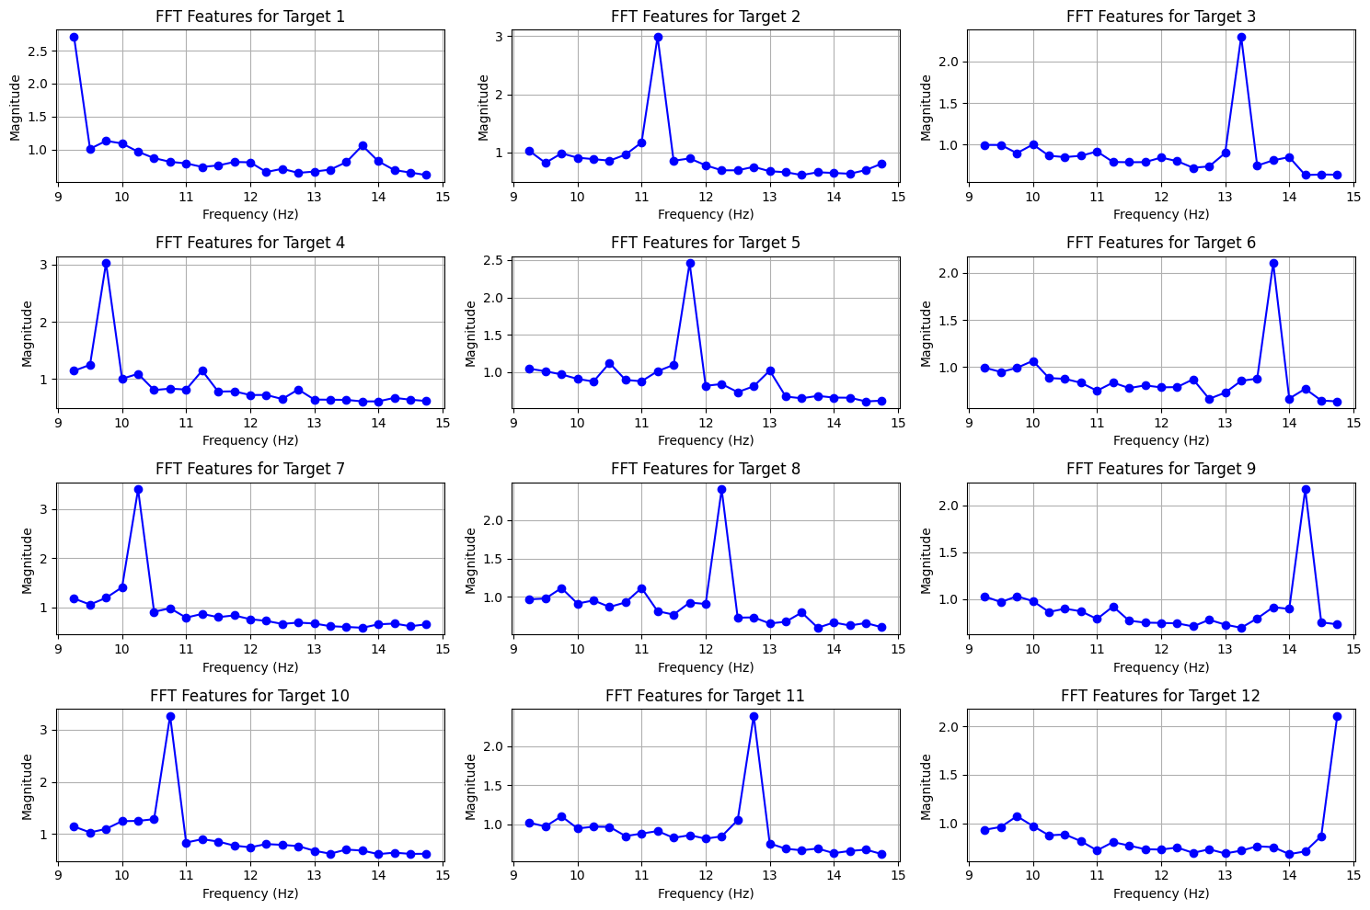
Target signals averaged over all trials (150) for O1 Channel

Slide 17
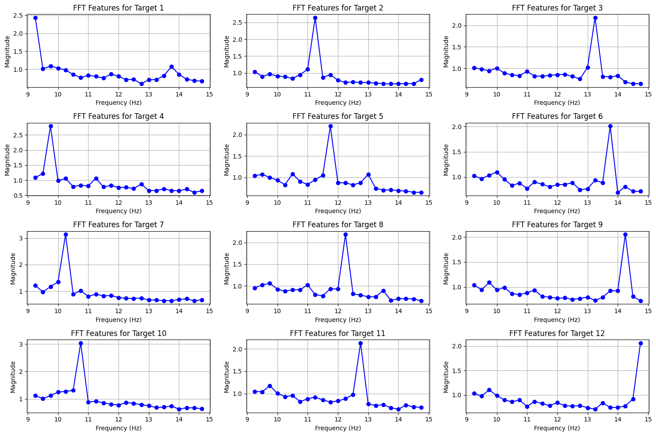
Target signals averaged over all trials (150) for O2 Channel

Slide 18
The feature extraction steps has gone through many trials, with/without harmonics, with 0.25/0.5Hz steps

Slide 19
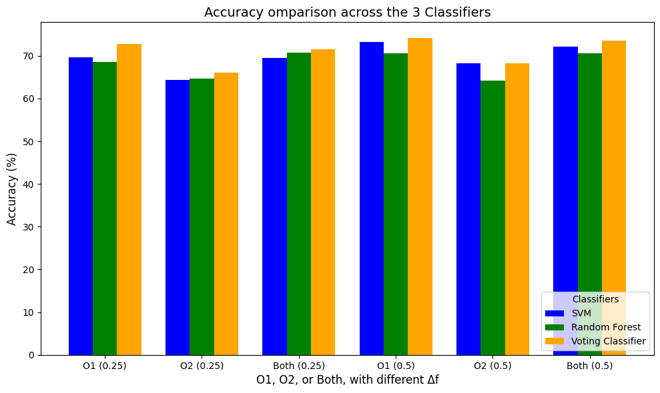
Accuracy comparison for all subjects through 3 classification models with 0.25/0.5Hz steps, and without considering harmonics

Slide 20
Local Result: 0.5Hz steps give slightly higher accuracy so we will go on with it

Slide 21
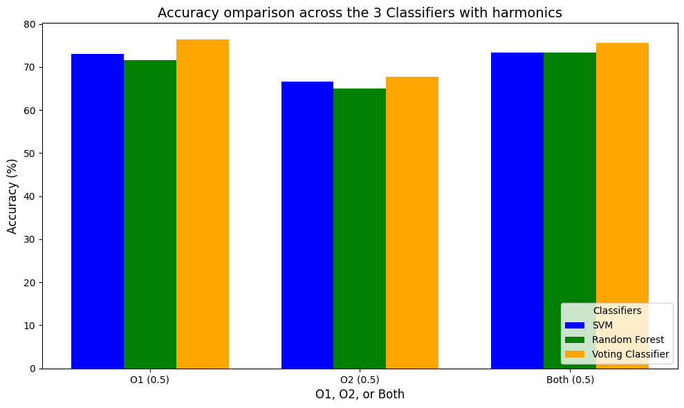
Accuracy comparison for all subjects through 3 classification models with 0.5Hz steps, and with considering harmonics

Slide 22
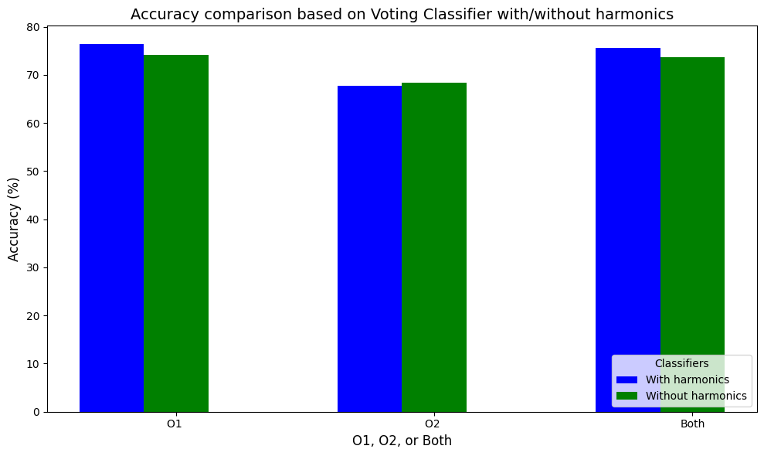
Accuracy comparison for all subjects with/without harmonics using voting classifier

Slide 23
Local Result: Harmonics give slightly higher accuracy so we will go on with it

Slide 24
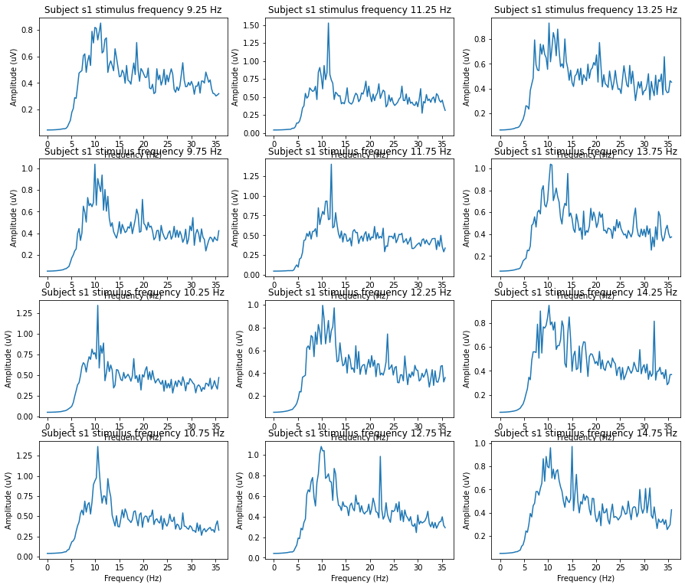
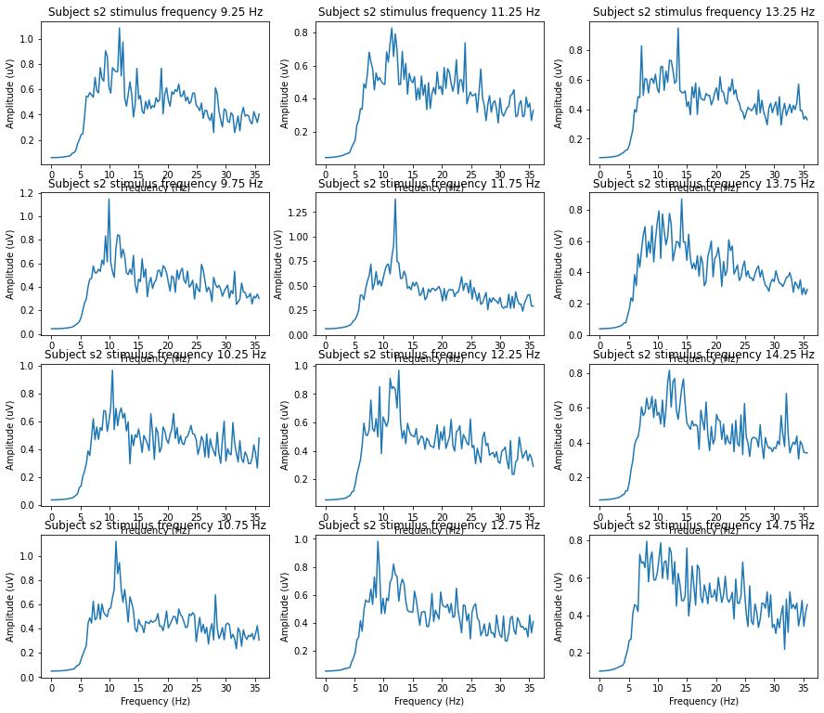
Through visual inspection, subjects 1 and 2 has shown very low SNR and high disturbance in signal (O1 Channel)
S1O1
S2O1

Slide 25
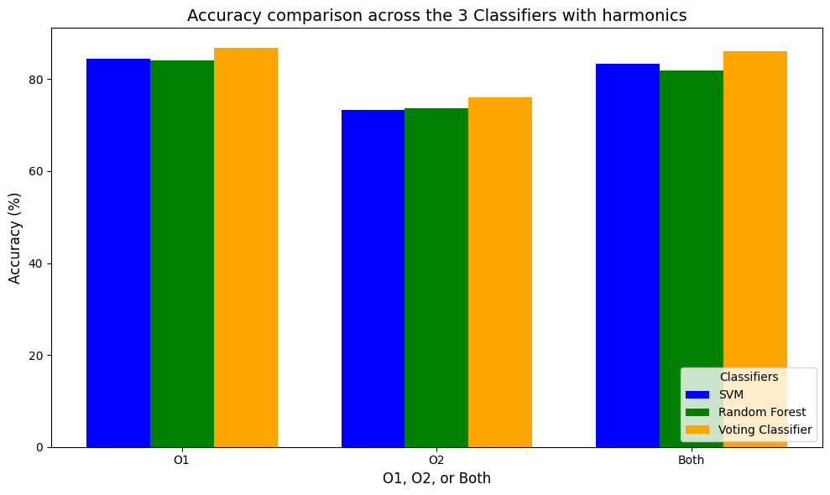
Retrained models after dropping S1 & S2

Slide 26
01
Visualization-Codes Optimization
02
Feature Extraction & Statistical Analysis
03
Results

Slide 27
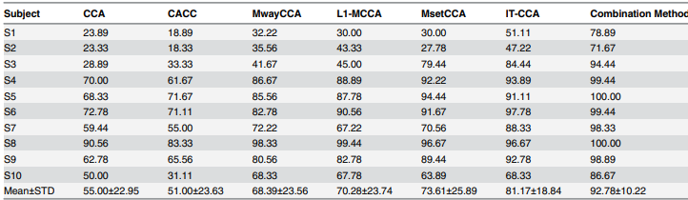
Paper Results

Slide 28
O1
Conditions |  | Random Forest | Support Vector Machine | Voting Classifier
Without Harmonics | 0.25Hz steps | 68.61 | 69.72 | 72.78
 | 0.5Hz steps | 70.65 | 73.33 | 74.17
With Harmonics | 0.5Hz steps | 71.67 | 73.06 | 76.39
Dropping S1,S2, with harmonics and 0.5Hz steps |  | 84.03 | 84.38 | 86.81

Slide 29
O2
Conditions |  | Random Forest | Support Vector Machine | Voting Classifier
Without Harmonics | 0.25Hz steps | 64.72 | 64.44 | 66.11
 | 0.5Hz steps | 64.17 | 68.33 | 68.33
With Harmonics | 0.5Hz steps | 65 | 66.67 | 67.78
Dropping S1,S2, with harmonics and 0.5Hz steps |  | 73.61 | 73.26 | 76.04

Slide 30
Both
Conditions |  | Random Forest | Support Vector Machine | Voting Classifier
Without Harmonics | 0.25Hz steps | 70.83 | 69.44 | 71.49
 | 0.5Hz steps | 70.56 | 72.22 | 73.61
With Harmonics | 0.5Hz steps | 73.33 | 73.33 | 75.56
Dropping S1,S2, with harmonics and 0.5Hz steps |  | 81.94 | 83.33 | 86.11

Slide 31
Conclusion:
Channel O1 has shown the most acceptable accuracy (highest 86.81%) for all analysis techniques.
Using both channels also gives relatively high accuracy (highest 86.11%) .
O2 channel has the lowest accuracy compared to all results (highest 76.04%) .
Preprocessing and dropping noisy trials can be very significant, as all high results mainly appeared after dropping subjects 1 and 2.
With using single or 2 channels instead of 8, we have overcome the requirement of complex and expensive setups, and have highly decreased the time and computational power required for processing this amount of data.

Slide 32
Any Question?

