Slide 1

Car Mileage
Hackathon Fall 2017
Kabsah Team

Slide 2
Developers:
Mohamed Gharibi, mggvf@mail.umkc.edu
Khaled Al-Malki, kjaf3f@mail.umkc.edu
Gharib Gharibi, ggk89@mail.umkc.edu

Slide 3
Car Mileage
It is a cool, practical iOS app that calculates the mileage for old cars that do not include this service. It can manage the mileage in two ways:
Manually: user can add gas manually in two ways:
User can add number of gallons of oil added to the car or add a full tank (15 gallons). We assume that each gallon drives the user 23 miles.
User can add the cost of gas. We assume each gallon costs $2.
Automatically: the app calculates the distance on the map in two ways:
Based on the user’s coordinates from the current position to a specific location (user drops a pin on the map for the final destination)
User sets starting point and destination point (similar to GPS apps)

Slide 4
Tools and Programming Languages
Xcode 9 (Platform for iOS developers)
Swift 4 (Programming Language provided by Apple)
Userdefaults (Local database storage on Apple devices)
MKMap (Map services provided by Apple)
Xcode Simulator to run the app and test its functionality.

Slide 5
DEMO
A live demonstration of the app is illustrated at: https://youtu.be/ziiJT0fTORg

Slide 6
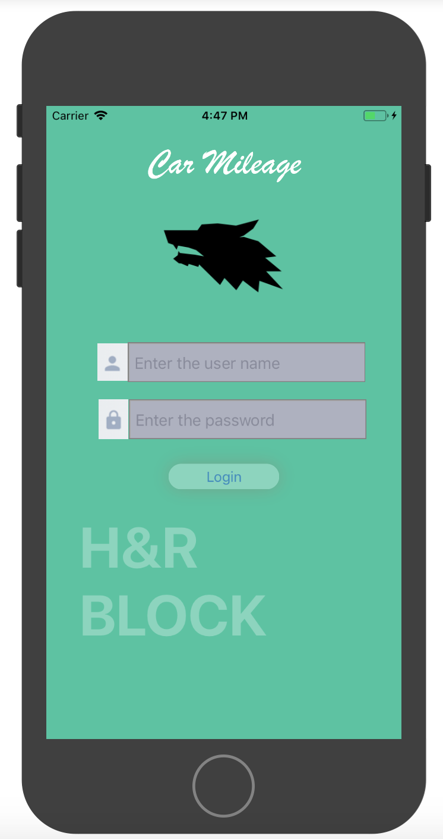
The main user interface.
Users must create an account and secure it with a password.

Slide 7
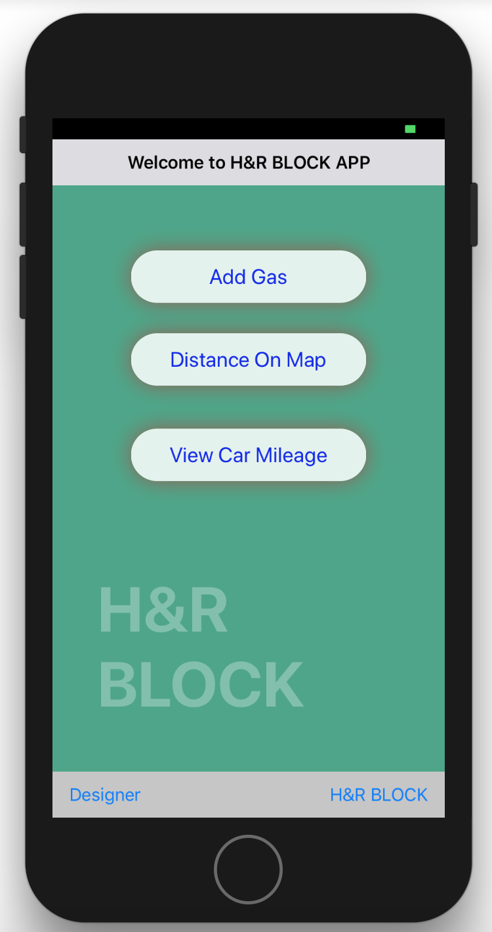
First page of the app after log-in.
Options:
Add gas manually
Add gas automatically using the map
View current mileage (data will not be lost if user closes the app. It will be stored in a local database on the phone)

Slide 8
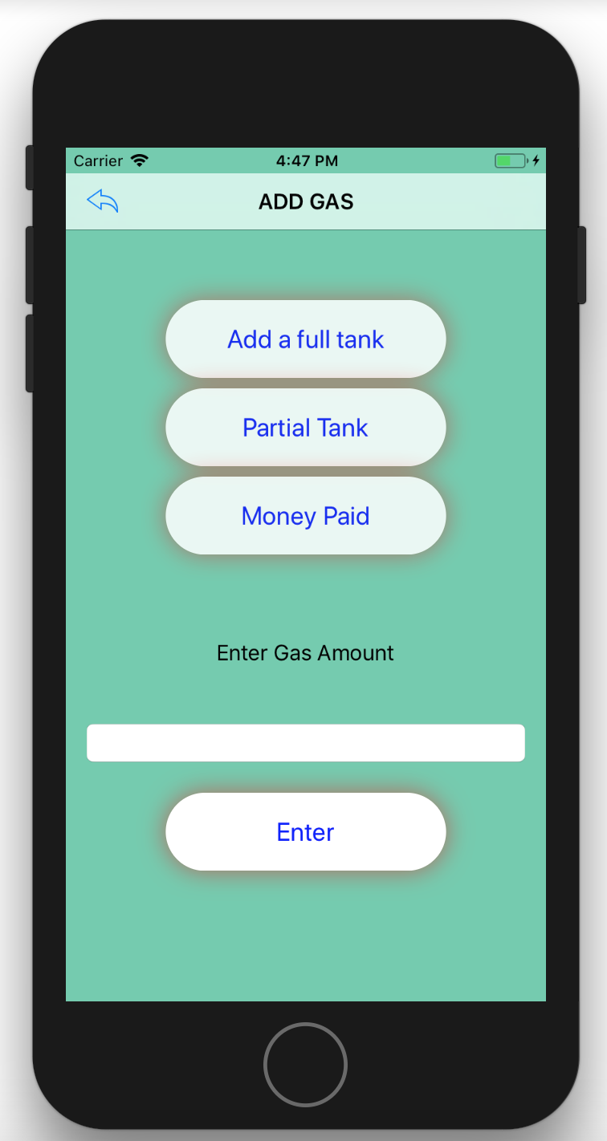
Adding mileage manually using gas or money
Options:
Add a full tank
Add partial tank
Add amount of money paid for gas

Slide 9
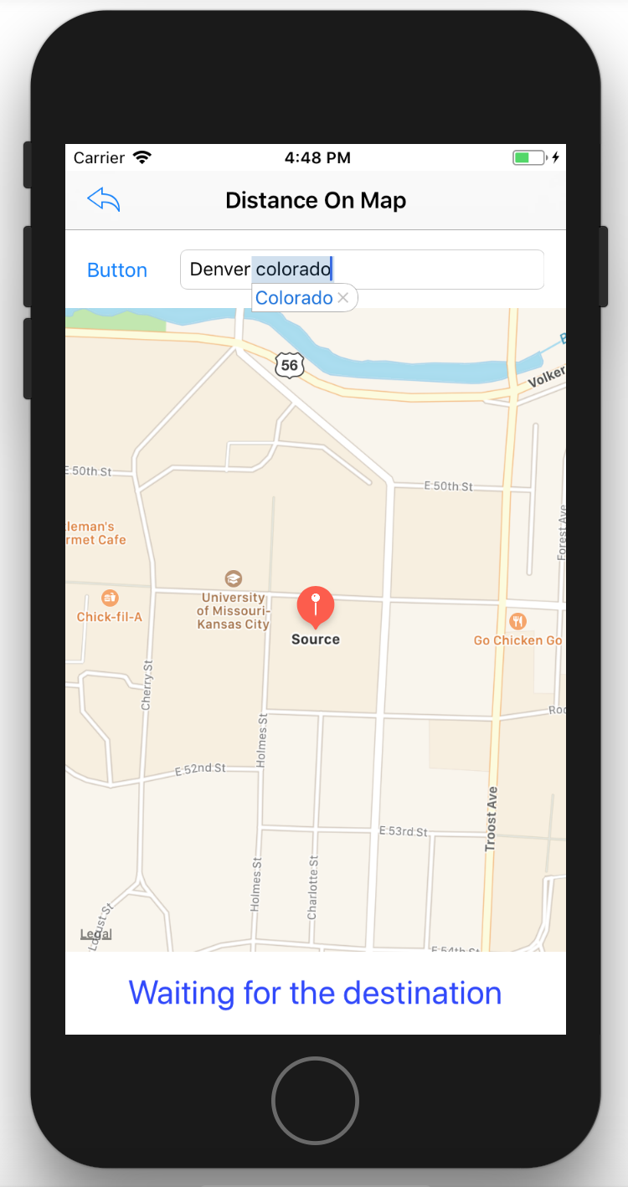
Adding mileage automatically based on the distance traveled.
Real map and real distance are used in the app.

Slide 10
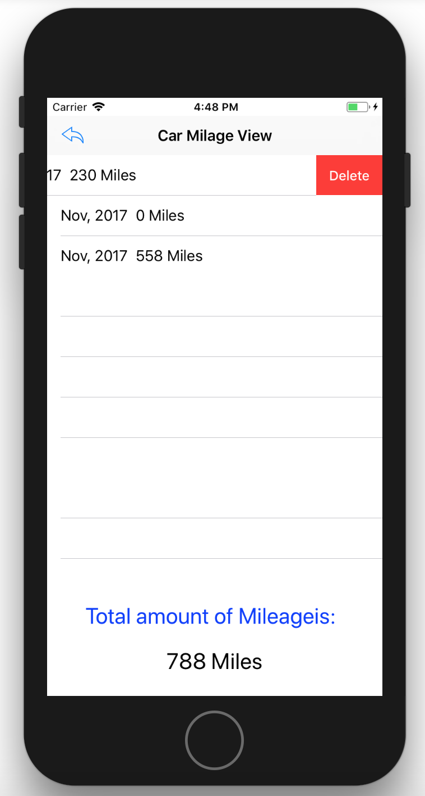
View the total mileage on the car and a list of all trips made.
You can add a new trip (as mentioned before), or delete a specific trip and the mileage will be updated.

Slide 11
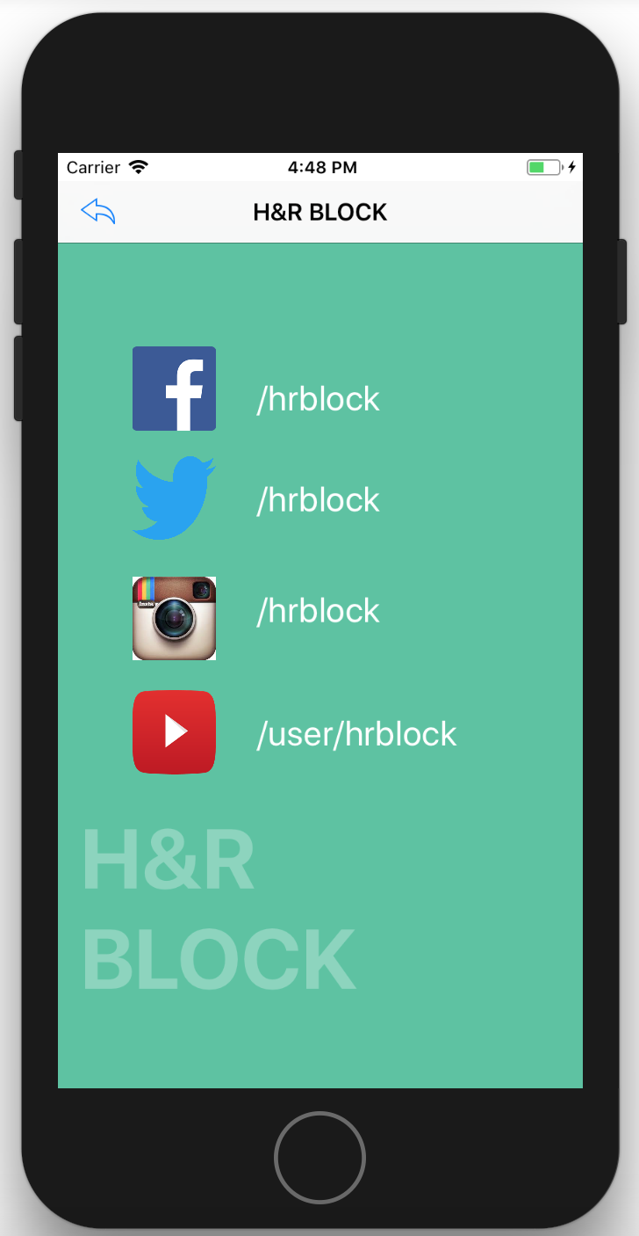
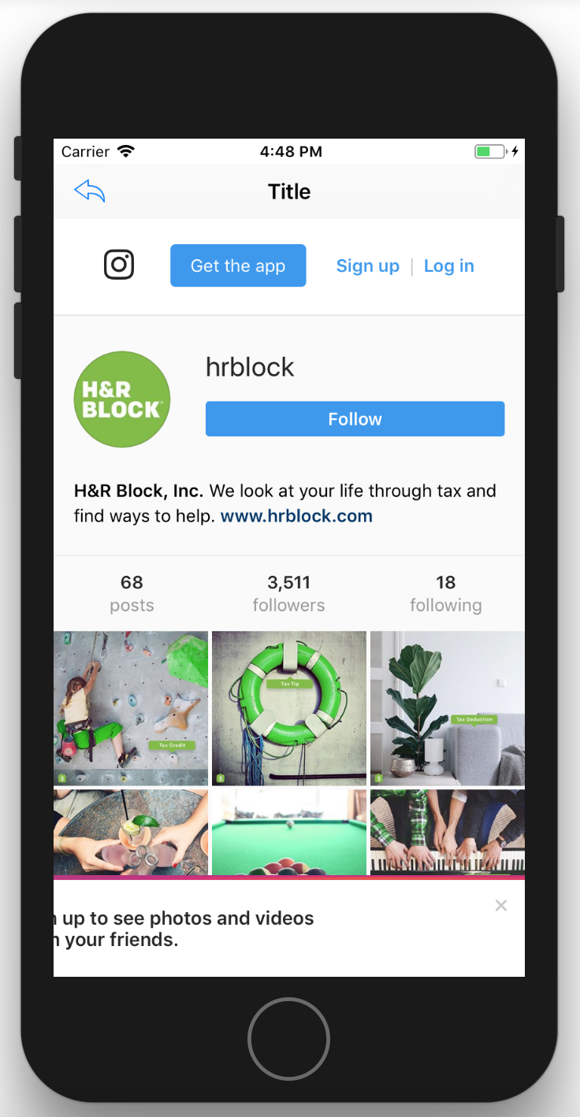
Connection to social media accounts

Slide 12
Drive Safe!
THANK YOU

