Slide 1
youglish.com
Ghassan 2019

Slide 2

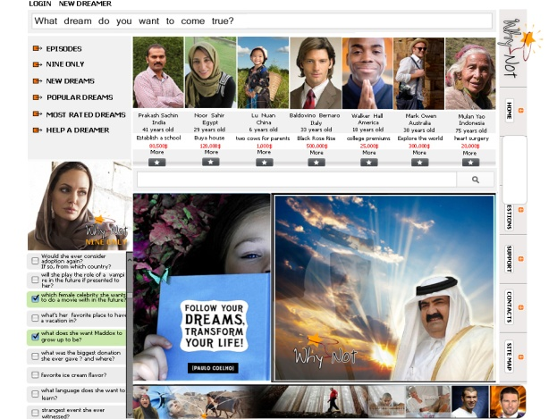
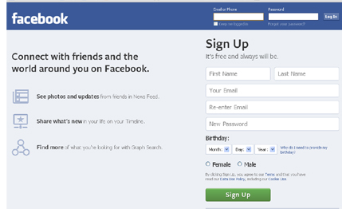
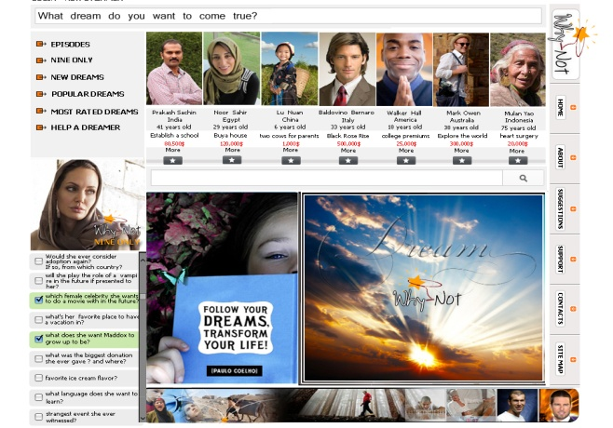
Introduction
Many people want to have social connections so they use websites like facebook, and many other search for things through searching engines like google , but all people want have dreams they want to come true and our website is the one and only that makes people’s dreams come true and plant hope in their hearts.

Slide 3



Problem
Every person has a dream, but due to the lack of job opportunities the increasing of cost of living and the difficulty of getting an education, the dreamers have become hopeless.
We can summarize the problem with the following questions.
1-How can know the dreams of all or must of the people in the world?
2-What is the destiny of the people’s dreams? And how to plant hope in the heart of the unfortunate?
3-How to transform the audience from receivers to event marks?

Slide 4



Solution
Why Not?
A SaaS Online Social Media Portal
Let people express and share their dreams through a social network
Let the audience participate in helping make dreams a reality.
Provide a means for the online audience to vote for the most deserving dreamer.
Raise funding through celebrity contributions and through hosted soccer championships

Slide 5

Current Status
Design
Prototype
Operational Plan

Slide 6
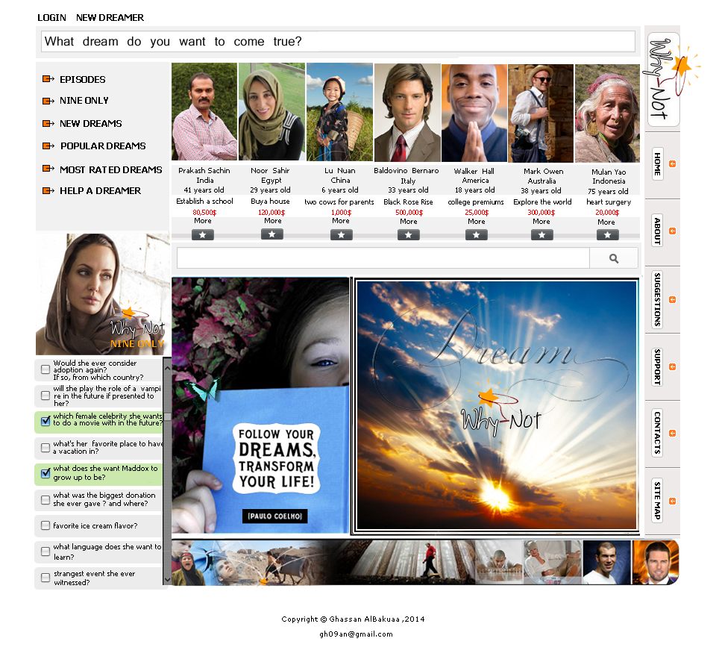
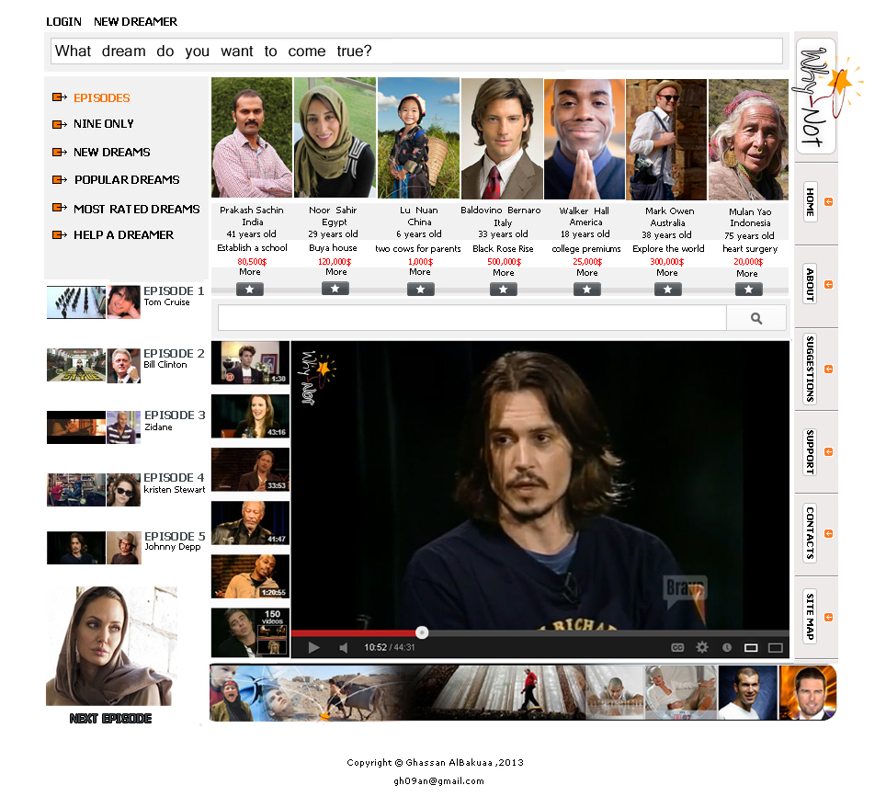
Dreams
Celebrity Questions
previous episodes

Slide 7
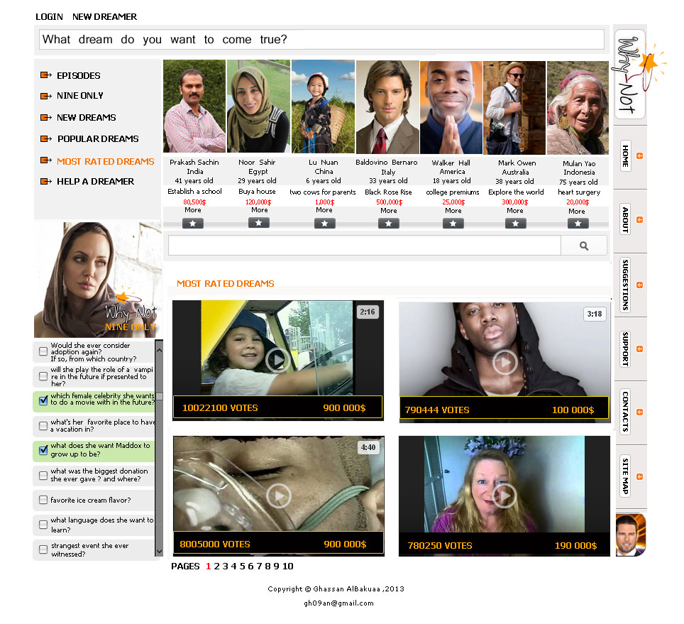
Results

Slide 8
Marketing
The success of the project depends on the number of the audience, and in order to get the biggest number of audience in a short time we must do something that people desires and we will do that something through a soccer championship where people will choose the participating teams through voting, and then we will broadcast the championship exclusively on the website, but in order for people to see the championship they must register in the dream department . Also not to forget that we will also be depending on Ads in the most famous TV channels and most popular websites in the world for the marketing of the championship, the dream program and the celebrities in “Nine Only” plus focusing on the fact that people for the first time ever are the event makers who control things through voting.

Slide 9
Broadcasting Online
The soccer championship exclusively on the website after voting for the choices of championship teams
The winning dreams
Celebrity shows during the championship.

