Slide 1

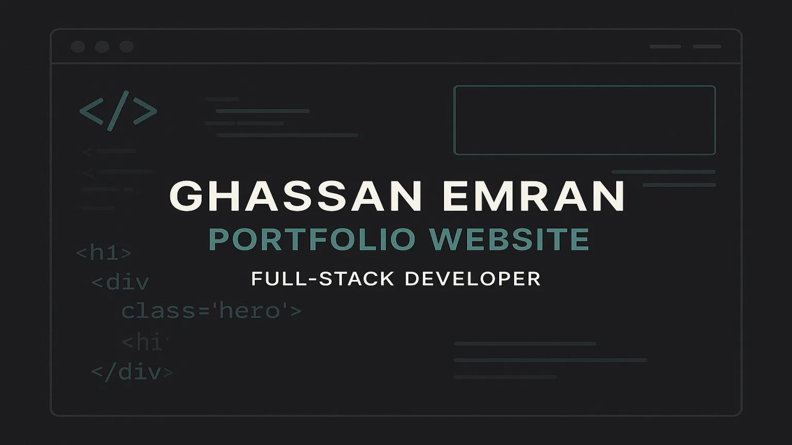
<div class="portfolio">
</div>

Slide 2
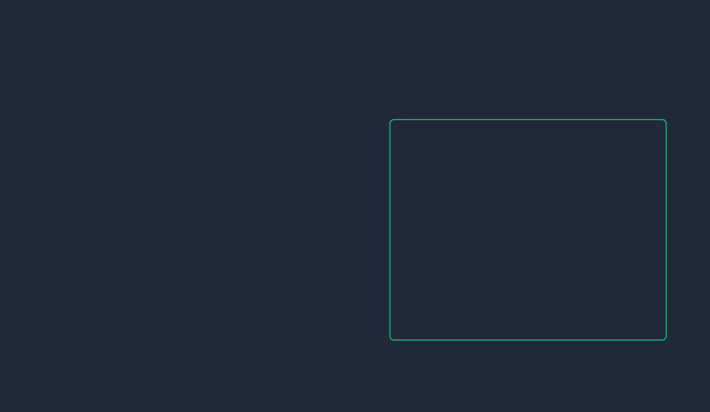
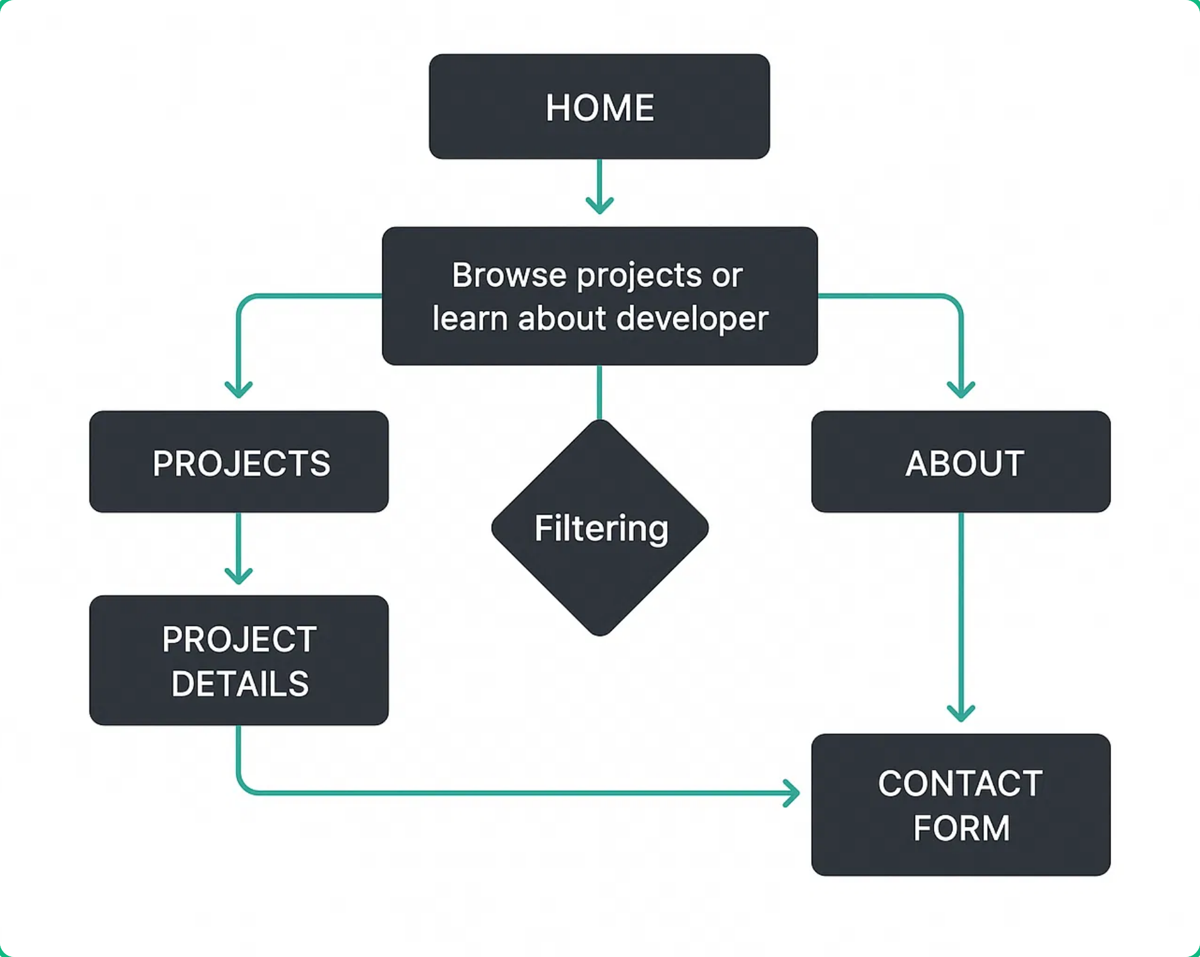

Project Overview
Portfolio Website Project
A modern, responsive portfolio website designed to showcase Ghassan Emran's skills, projects, and professional experience as a full-stack developer.
Target Audience
Potential employers, clients, and fellow developers looking to collaborate on projects.
Key Features
Modern dark theme with emerald green accents
Fully responsive design for all devices
Interactive project showcase with filtering
Smooth animations and transitions
Contact form with validation

Slide 3
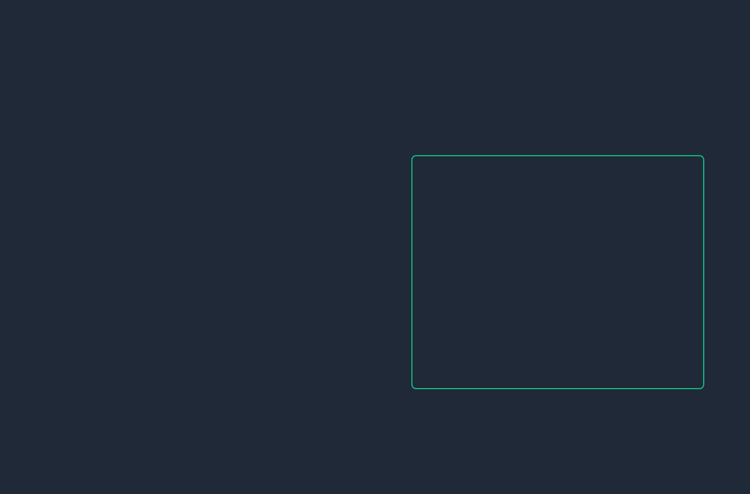
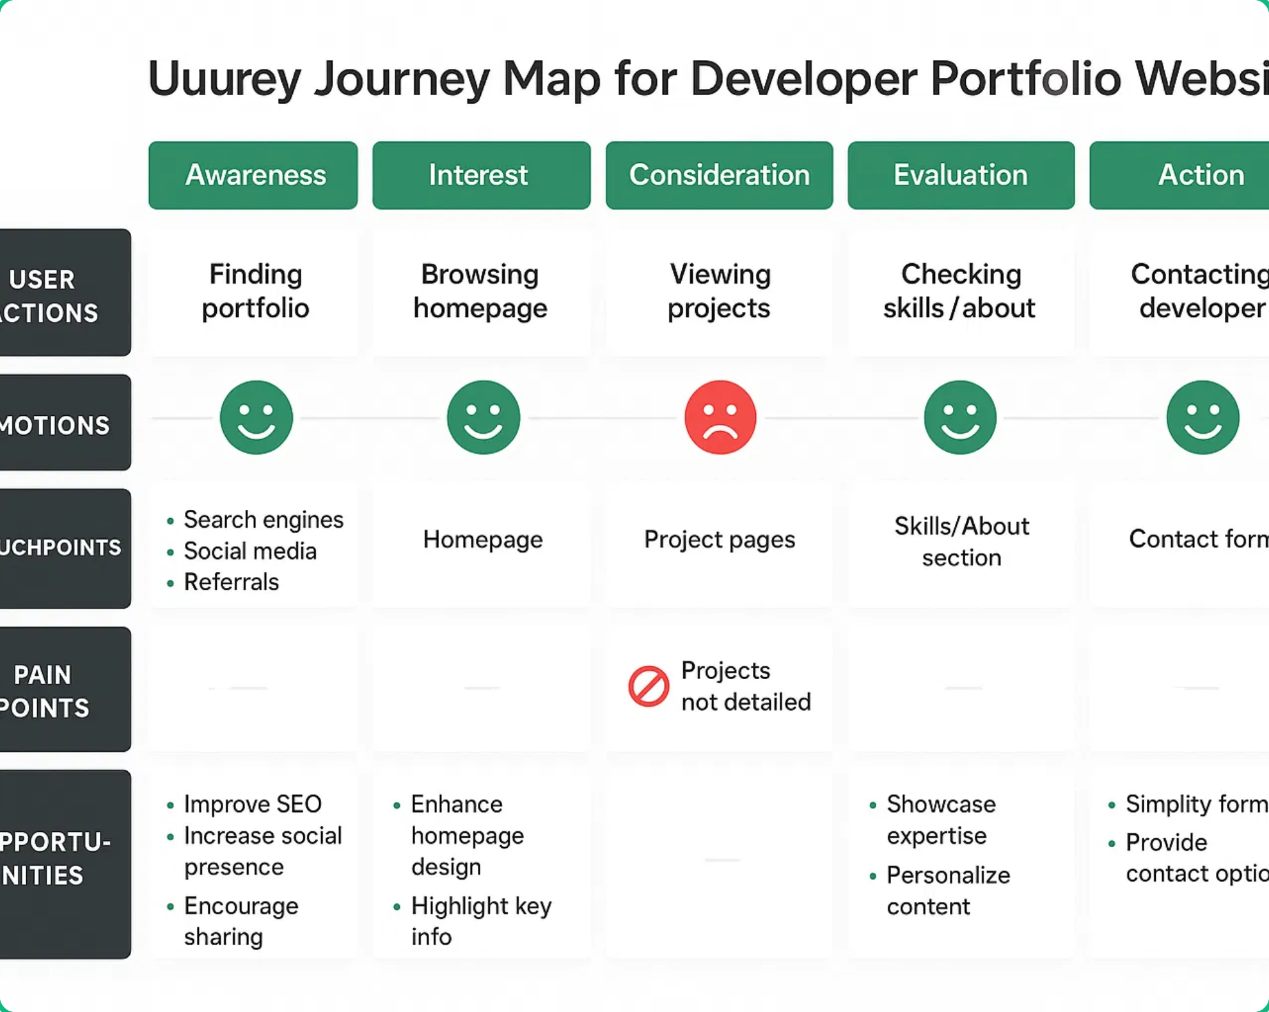






UX Research & Strategy
User Research Findings
Research focused on understanding the needs of potential employers and clients when evaluating a developer's portfolio website.
Primary Persona: Tech Recruiter
Hiring Manager at Tech Companies
Needs quick access to skills and projects
Limited time to review portfolios (2-3 minutes)
Looking for specific technical expertise
Secondary Persona: Potential Client
Business Owner Seeking Web Development
Focuses on visual appeal and design quality
Values clear communication channels
Interested in similar project examples

Slide 4
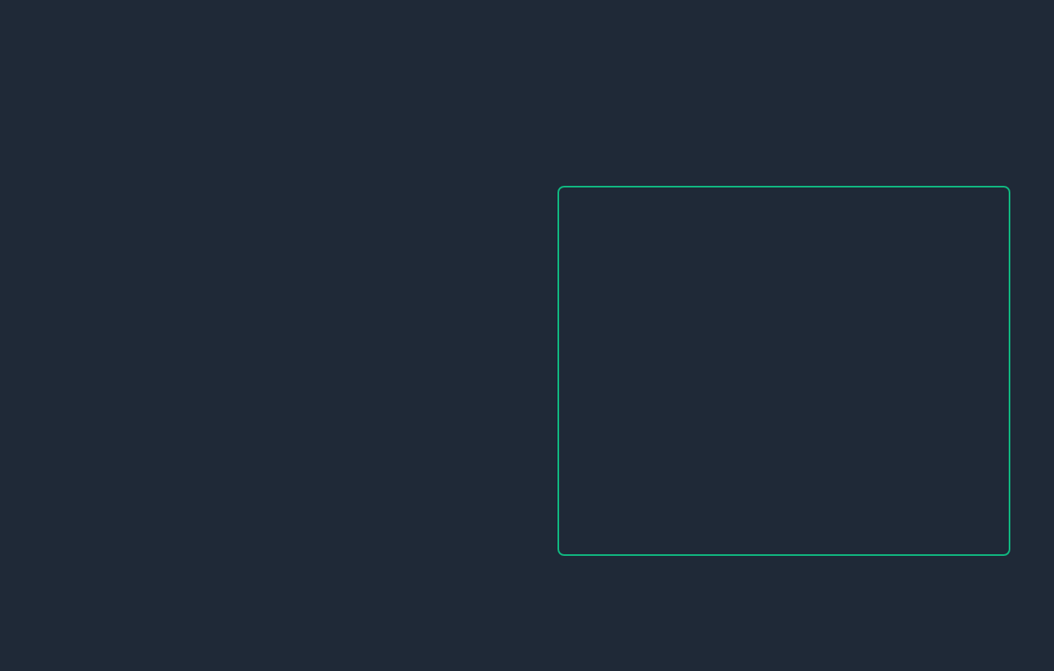
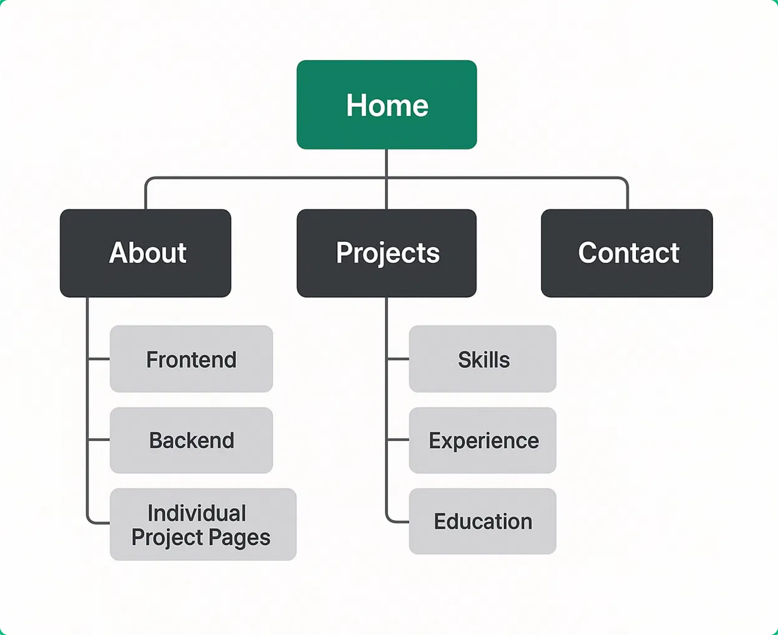






Information Architecture & Sitemap
Website Structure
The portfolio website follows a clear, intuitive structure designed to guide visitors through Ghassan's professional journey and showcase his work effectively.
Home/Hero
- Engaging introduction and call-to-action
About
- Professional background and skills
Experience
- Work history and achievements
Projects
- Featured and other development work
Contact
- Communication channels and form
User Navigation Flow
The site employs a single-page design with smooth scrolling navigation, allowing users to easily move between sections. Strategic CTAs guide visitors toward viewing projects and making contact, with a logical progression from introduction to engagement.

Slide 5
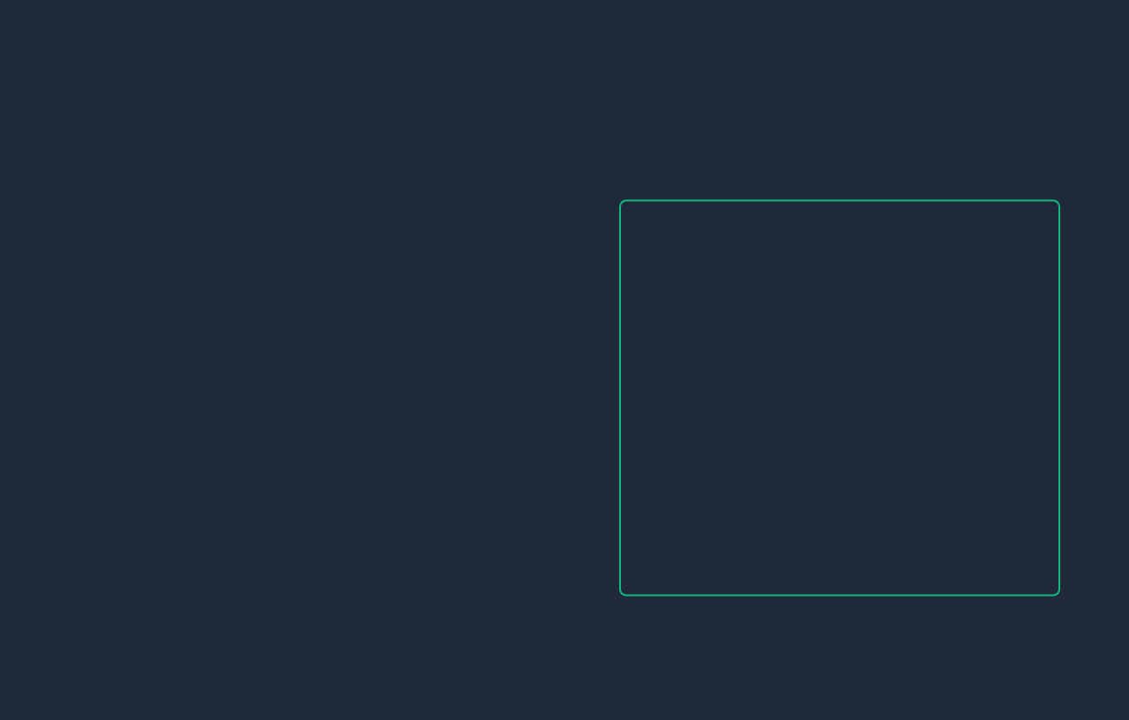
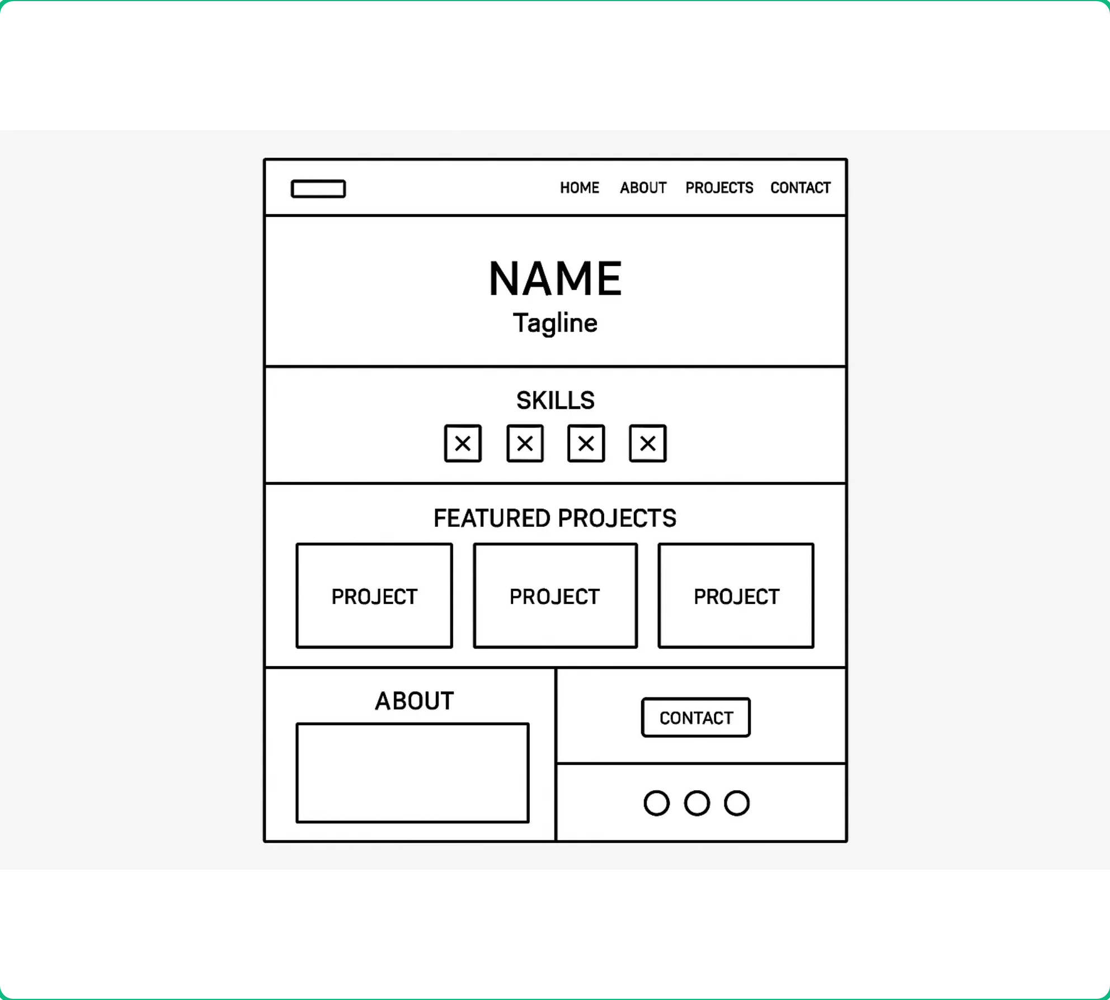


Wireframes
Basic Wireframes
Wireframes serve as the skeletal framework of the portfolio website, focusing on layout, structure, and functionality before visual design elements are applied.
Pages Wireframed
Homepage with hero section
About page with skills section
Projects showcase page
Contact page with form
Mobile responsive versions
Benefits of Wireframing
Focuses on functionality and user flow without visual distractions
Allows for quick iterations and feedback before detailed design
Establishes clear content hierarchy and information architecture

Slide 6
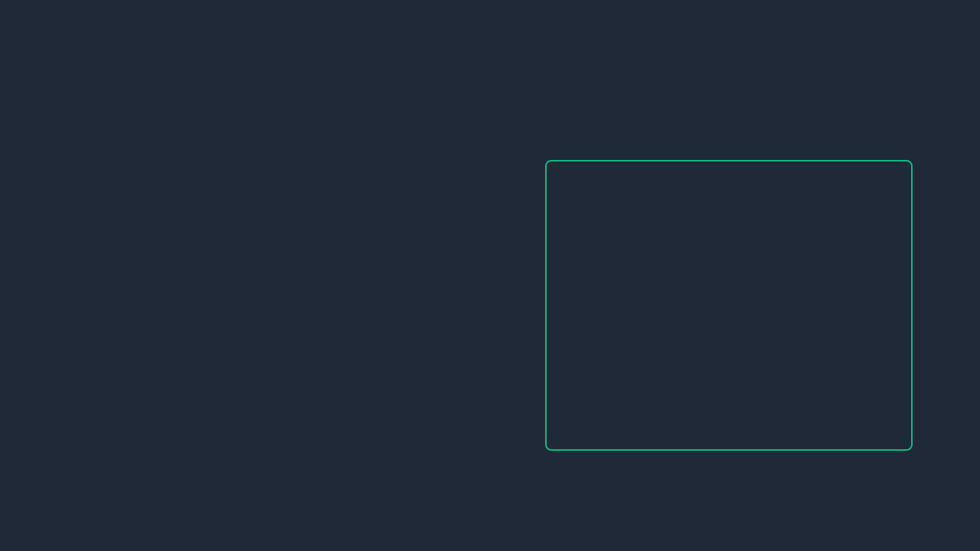
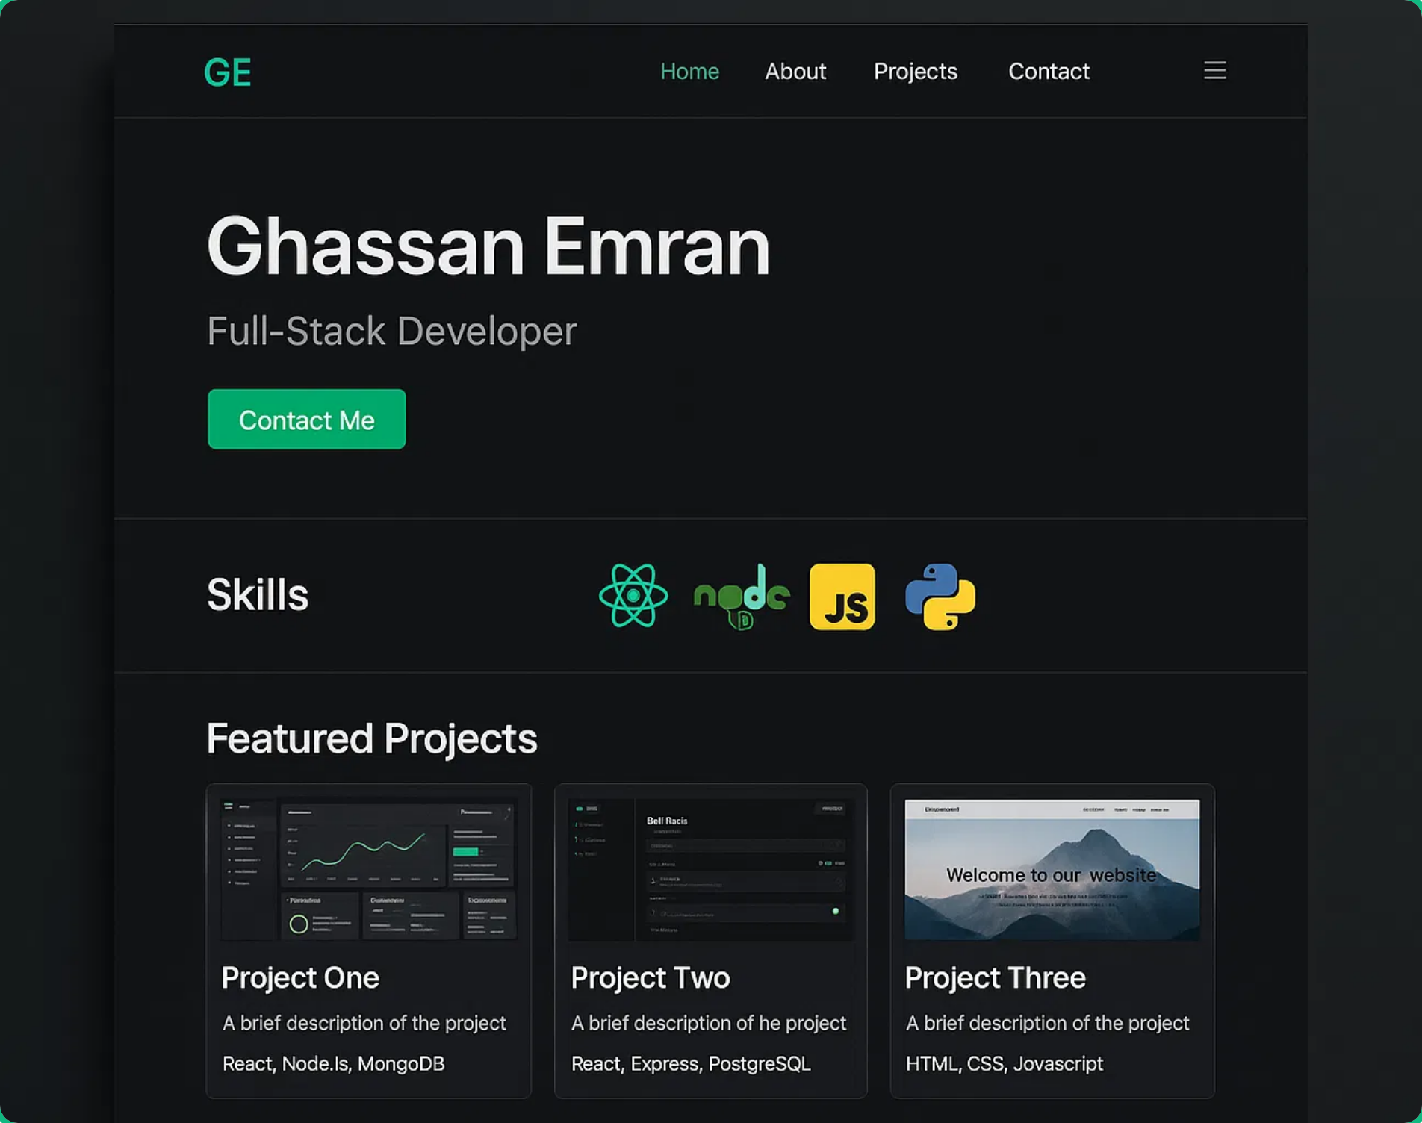

UI Design & Visual Identity
Color Palette
#D1D5DB
#10B981
#1F2937
#374151
#F9FAFB
Subtle Text
Primary
Background
Secondary
Text
Typography
Inter Bold (Headings)
Inter SemiBold (Subheadings)
Inter Regular (Body Text)
UI Components
Primary Button
Secondary Button
Icon
The design system emphasizes clean, modern aesthetics with a dark theme and emerald green accents. All UI elements maintain consistent styling for a cohesive user experience.

Slide 7
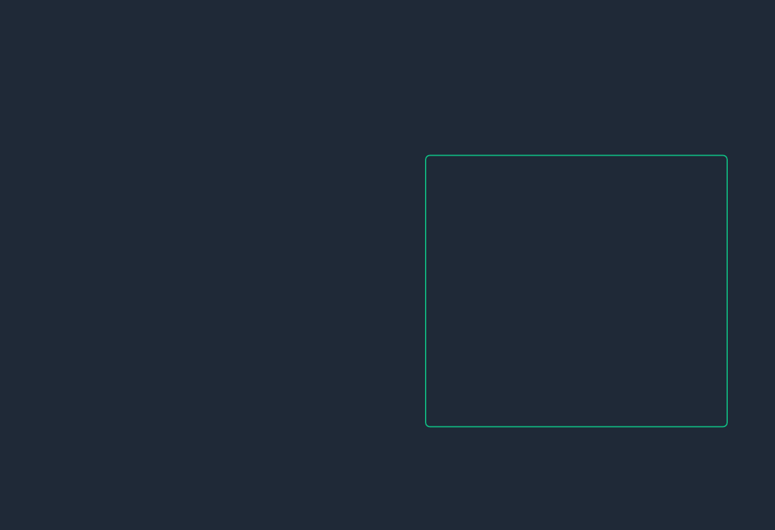
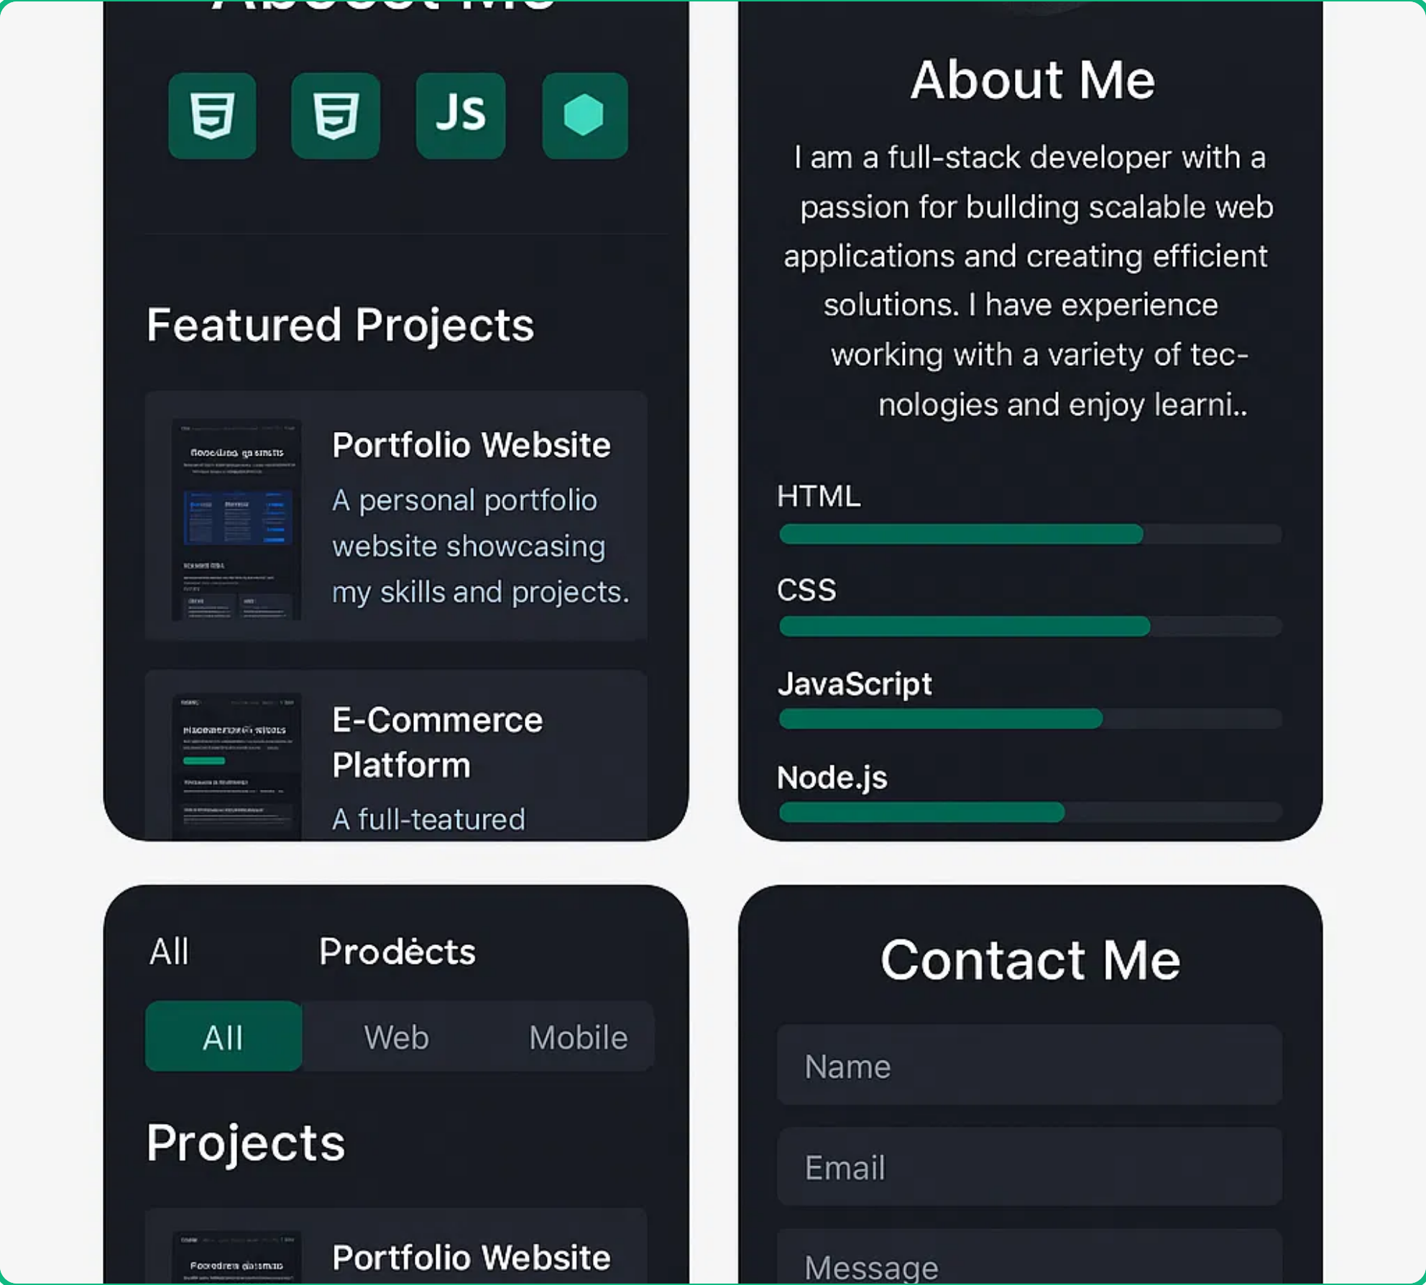




Responsive Design
Mobile-First Approach
The portfolio website is built with a mobile-first approach, ensuring optimal user experience across all devices from smartphones to large desktop screens.
Responsive Breakpoints
Mobile:
< 640px
Tablet:
640px - 1024px
Desktop:
> 1024px
Key Responsive Features
Adaptive Navigation
: Transforms into a hamburger menu
on smaller screens for better usability
Flexible Grid System
: Projects and skills sections adjust
columns based on screen width
Responsive Typography
: Font sizes scale appropriately for
different screen sizes
Optimized Images
: Images resize and reposition for
optimal viewing on all devices

Slide 8
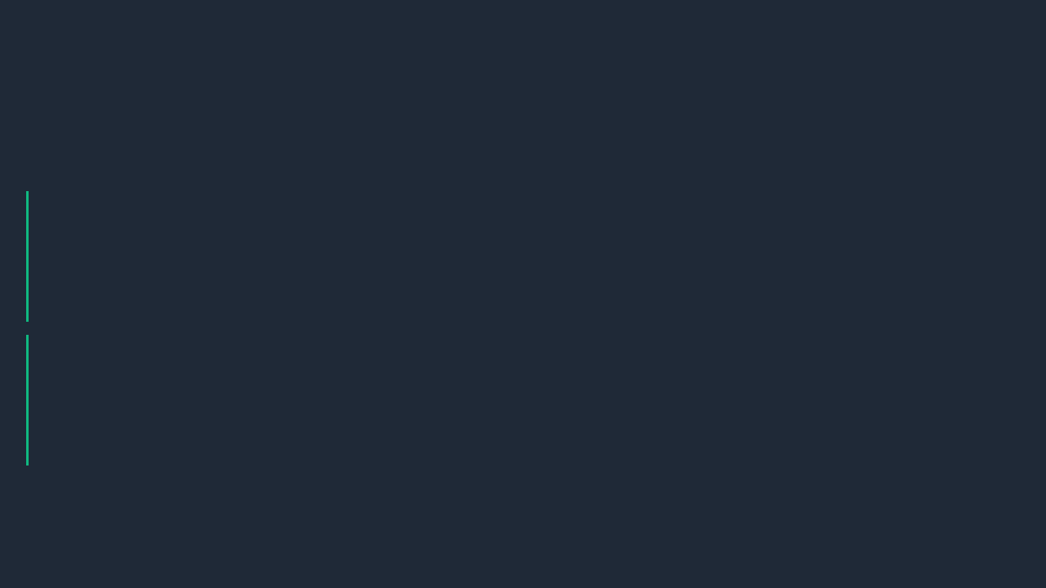
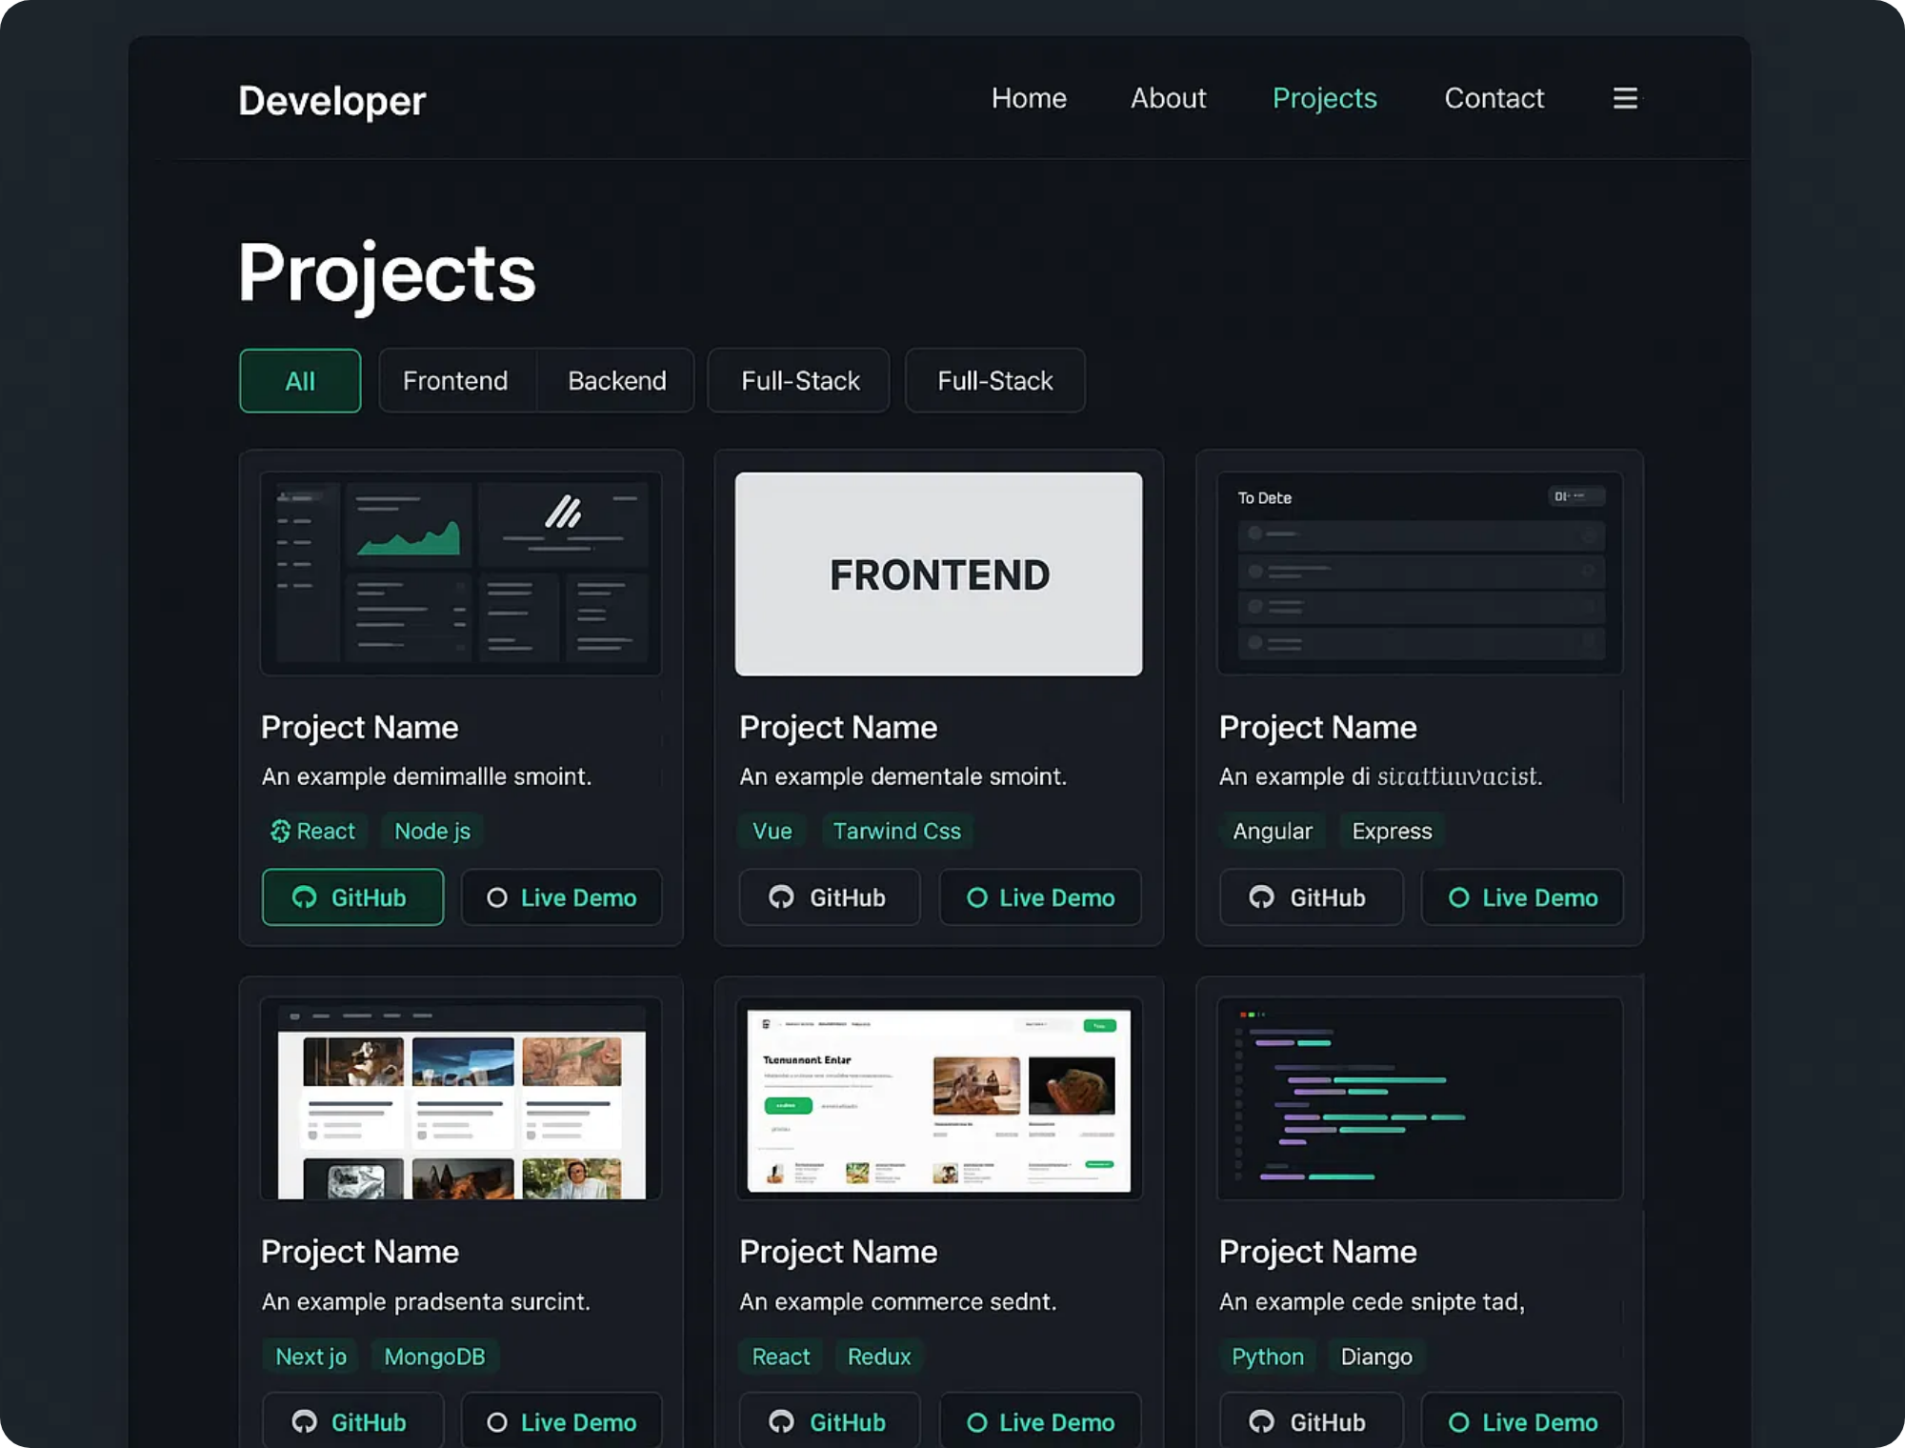


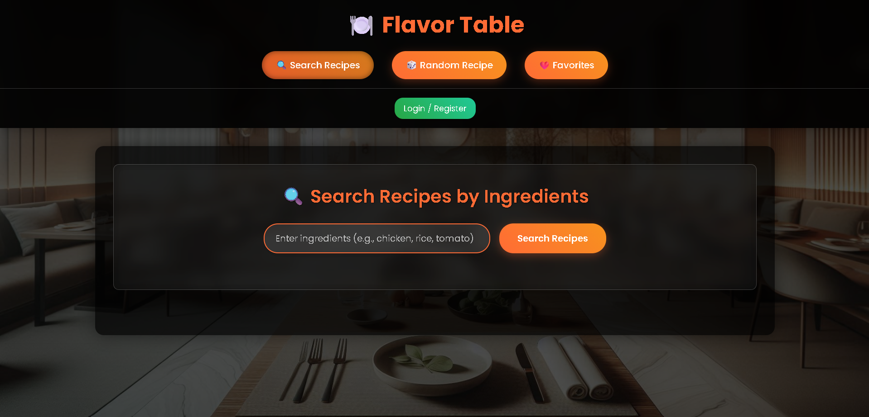
Featured Projects
Highlighted Portfolio Projects
The portfolio showcases a variety of projects demonstrating full-stack development skills.
Flavors-Table
A modern recipe discovery application with user authentication and recipe management.
HTML5
CSS3
JavaScript
Node.js
GitHub
Live Demo
Task Management App
A collaborative task management application with real-time updates and team features.
React
TypeScript
Redux
GitHub

Slide 9
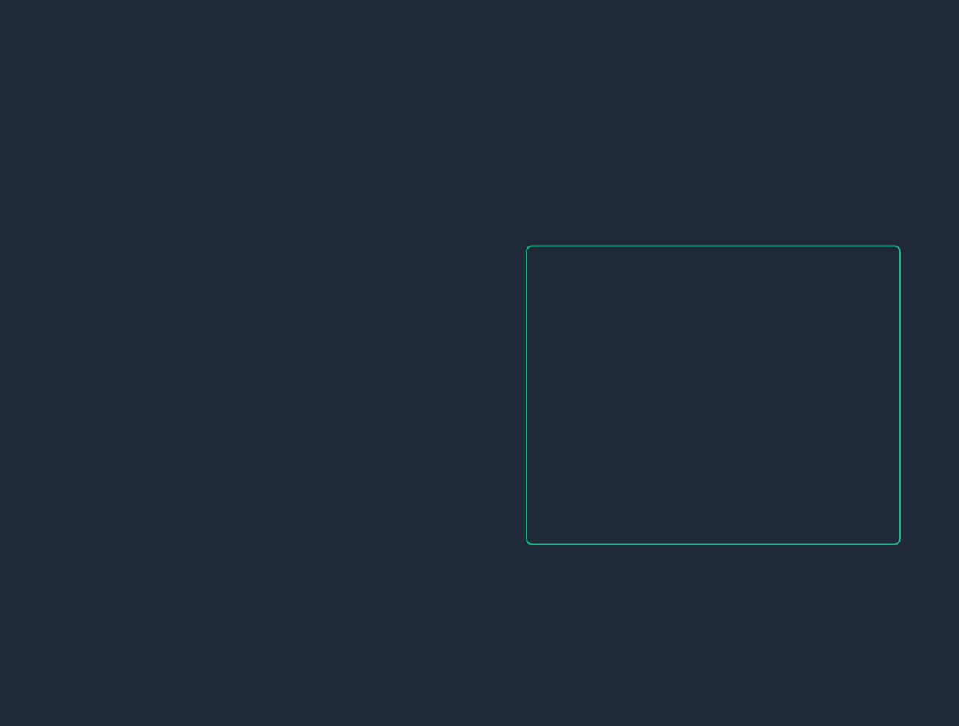

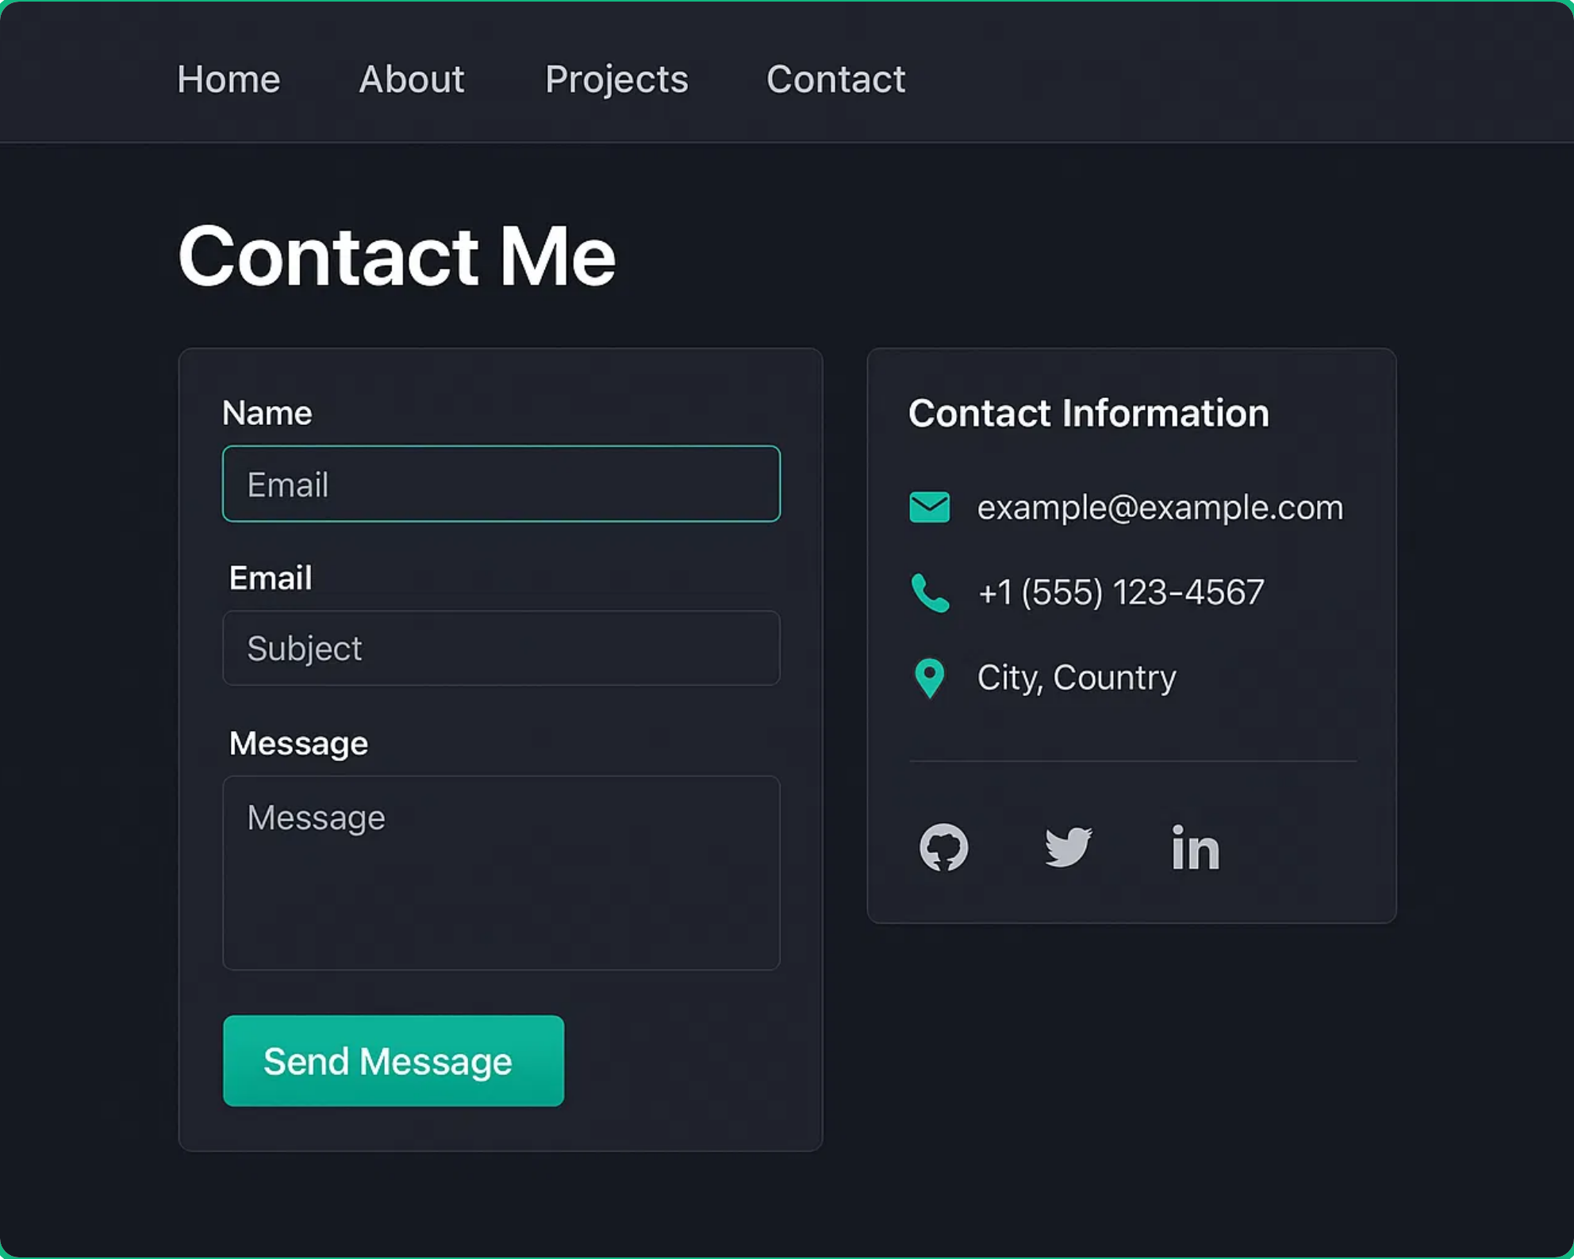


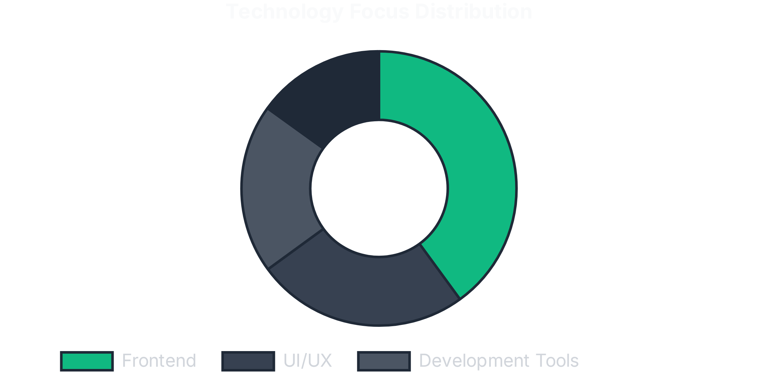
Technology Stack
Portfolio Website Technologies
The portfolio website is built with modern web technologies, focusing on performance, responsiveness, and maintainability.
Frontend
React 19.1.0
Tailwind CSS 4.1.11
Framer Motion 12.23.0
Lucide React 0.525.0
JavaScript (ES6+)
Backend & APIs
Node.js
Express.js
RESTful APIs
Development Tools
Vite 7.0.0
ESLint 9.29.0
PostCSS 8.5.6
Git & GitHub

Slide 10
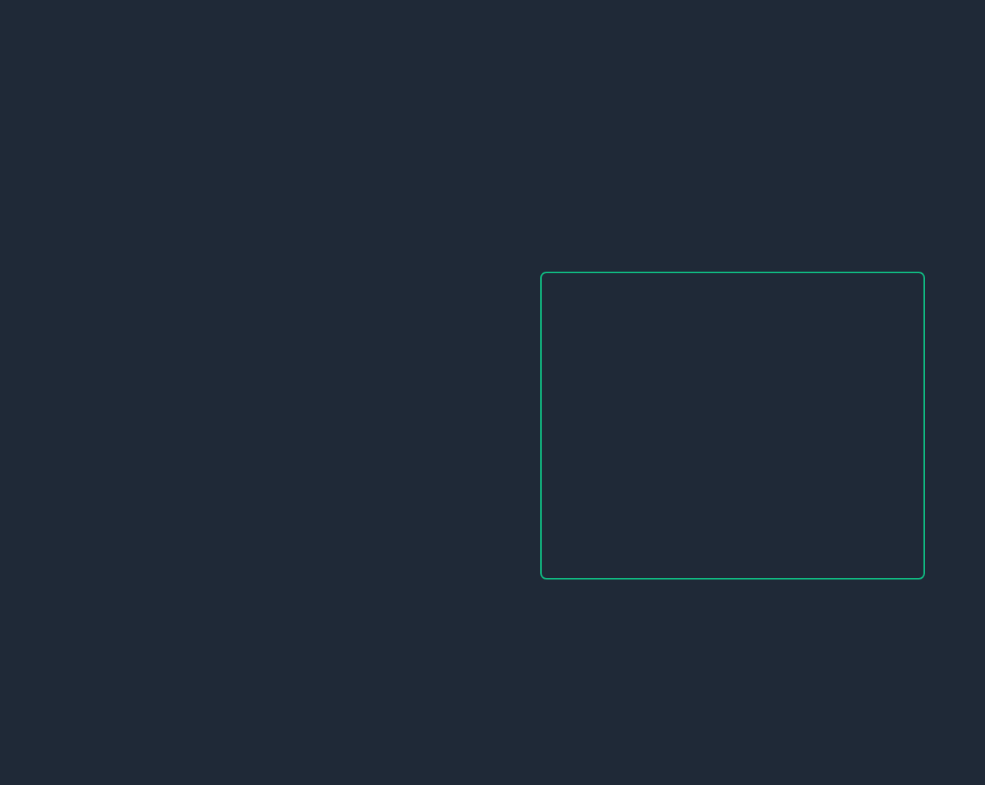

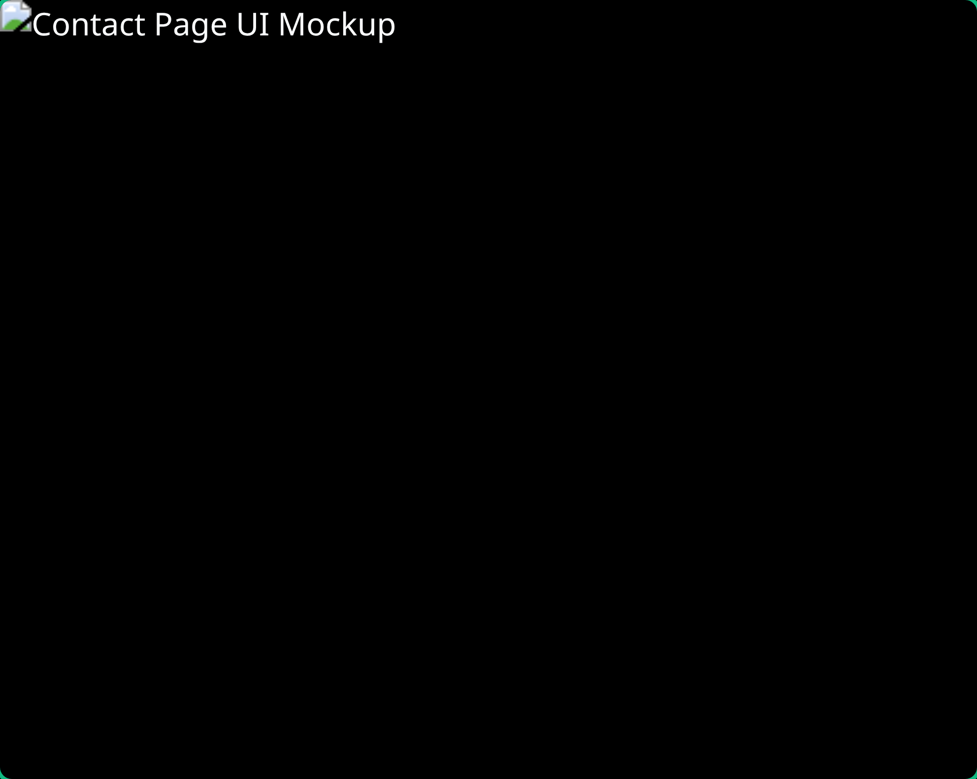

Conclusion & Next Steps
Project Summary
The portfolio website successfully showcases Ghassan Emran's skills and projects through a modern, responsive design with intuitive navigation and engaging visuals.
Modern dark theme with emerald green accents for professional appearance
Fully responsive design optimized for all devices
Interactive project showcase with filtering capabilities
Functional contact form with validation for client communication
Future Enhancements
1
Implement blog section to share technical insights and project details
2
Add dark/light theme toggle for improved accessibility
3
Integrate project case studies with detailed development processes
4
Add testimonials section from previous clients and employers
Thank You!
For more information:
ghassan.98@yahoo.com

