Slide 1

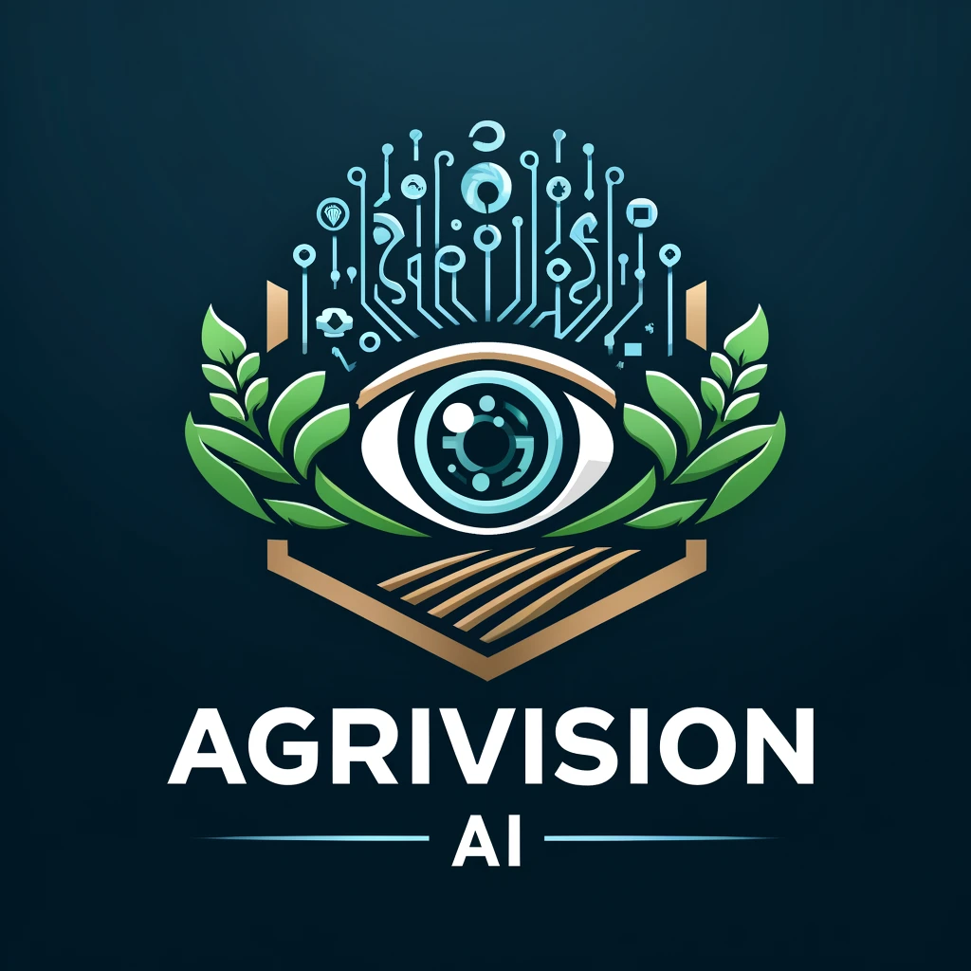
AgriVision AI
By Ghassan Wehbe.

Slide 2

Table of Content:
Introduction.
Problem statement.
Solution overview.
Technologies implemented.
Target Market.
Challenges and future work.
Conclusion.

Slide 3
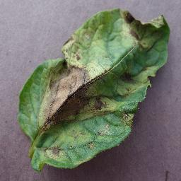
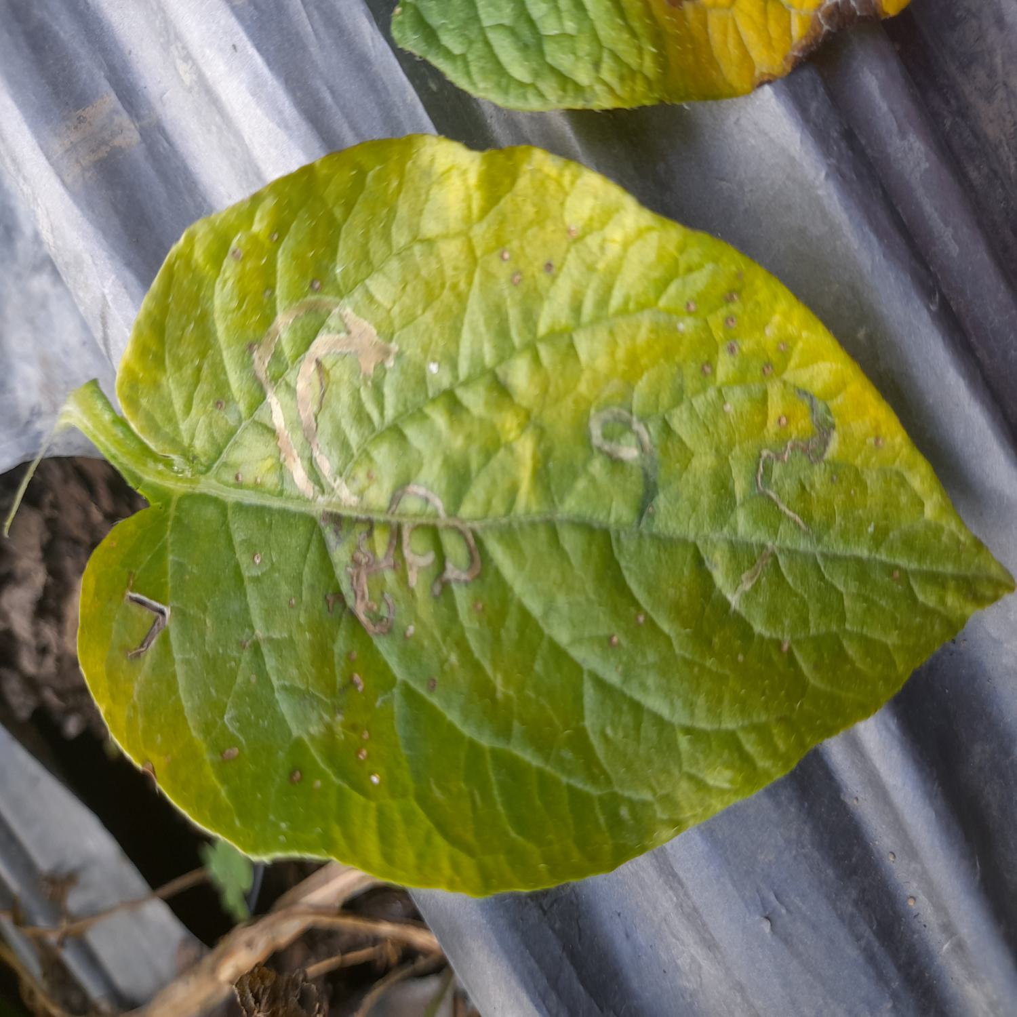
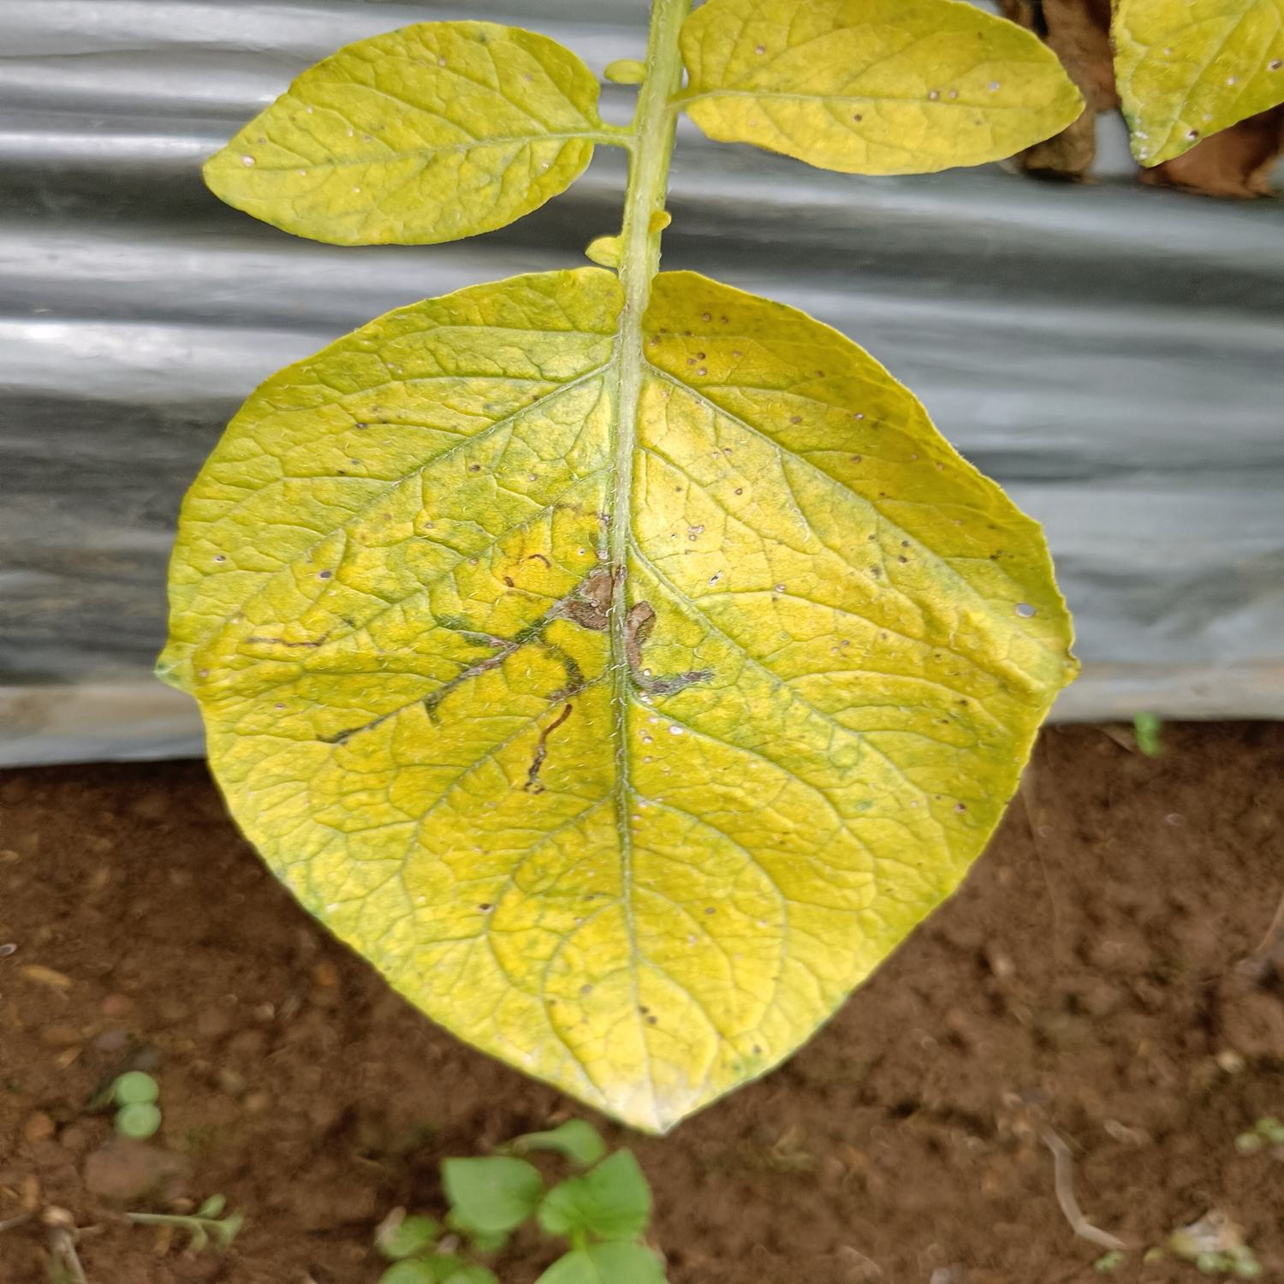
Introduction
Global Impact
Disease Prevalence
Detection Challenges
Economic Losses
Need for Innovation
Blight
Pests
Nematode

Slide 4
Problem statement
What problem do we solve?
Experts need, and time consumption reduction.
Accuracy and Speed!
84% model accuracy and quick disease identification.
Early Detection is Critical!
effective management of diseases and preventing their spread.
Technological Advancement!
enhances the precision of plant health monitoring.

Slide 5
Solution overview
How did AI solve the problem?
Immediate Benefits:
Efficiency.
Accessibility.
Scalability.
Technological Foundation:
Python.
Machine Learning.
Deep Learning.
Additional Tools:
FastAPI.
Docker.
Git & GitHub.

Slide 6

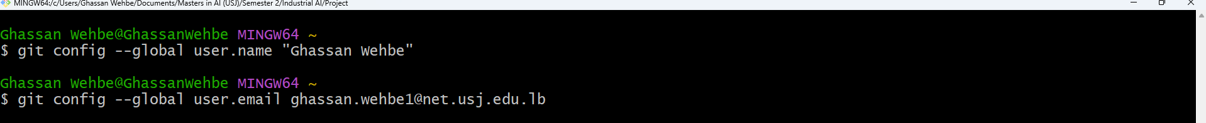
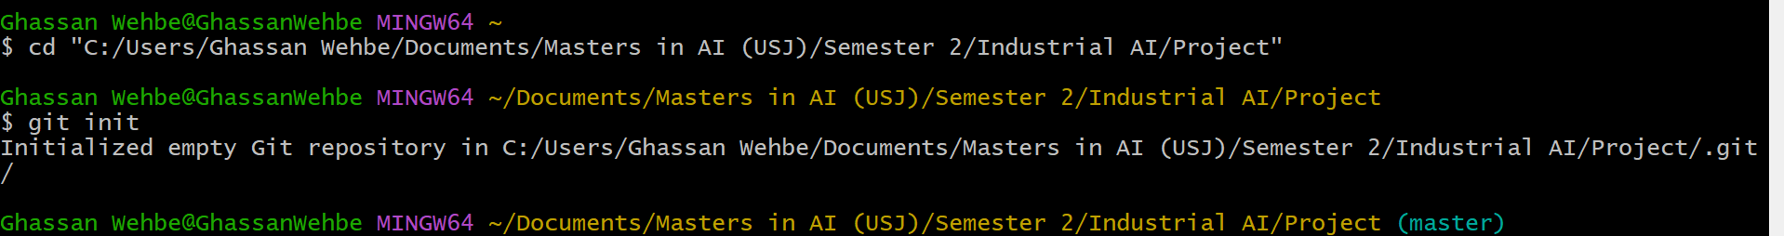
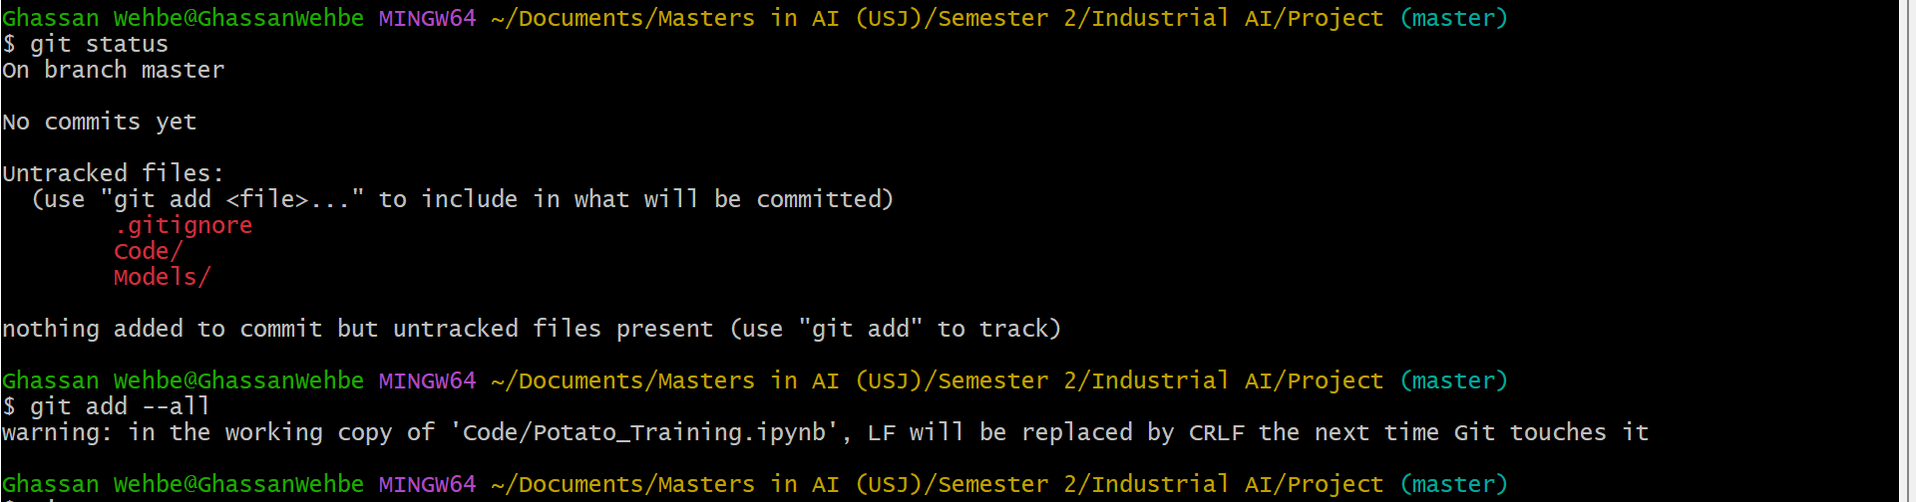
Technologies implemented
Git and Github:

Slide 7
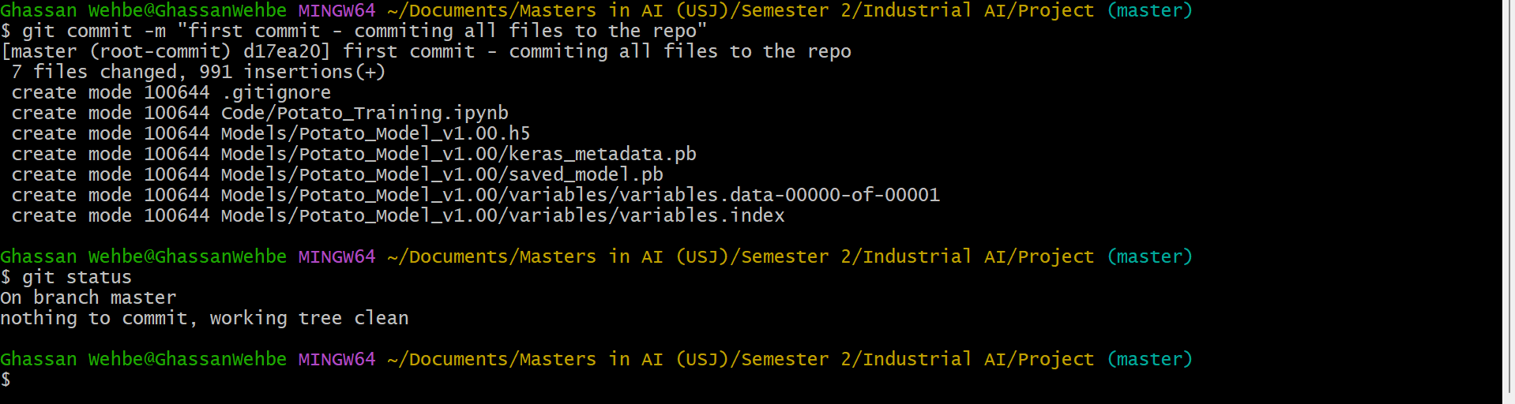
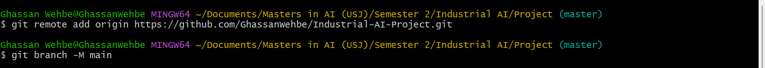
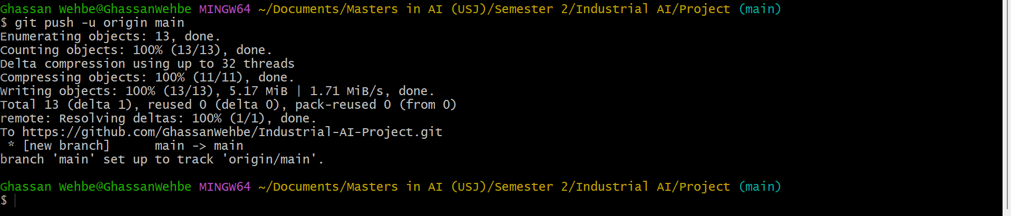
Git and Github:

Slide 8

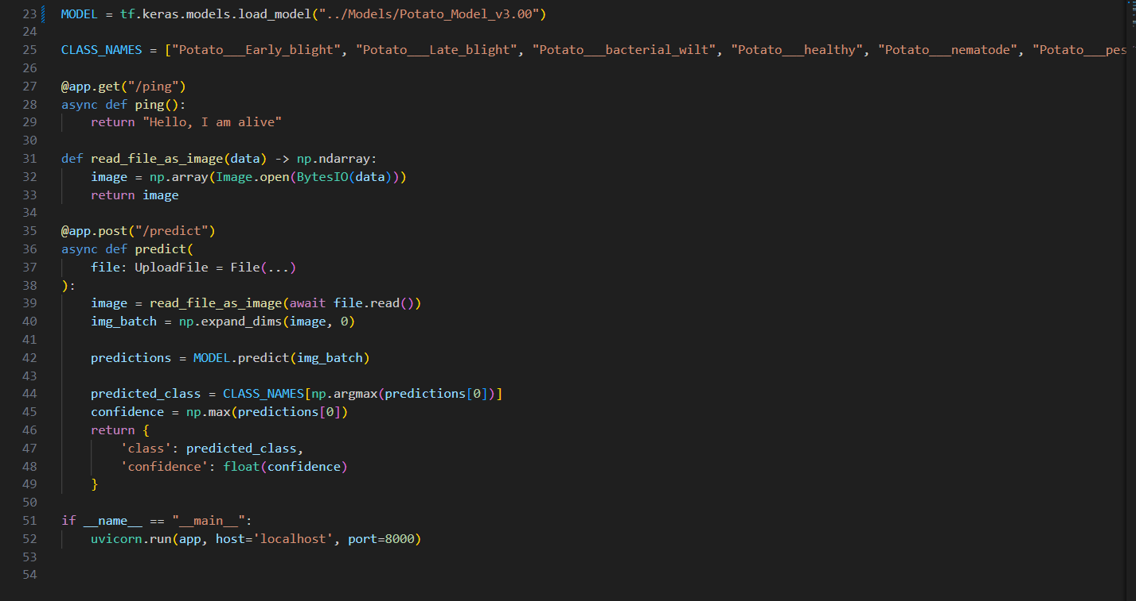
FastAPI:

Slide 9

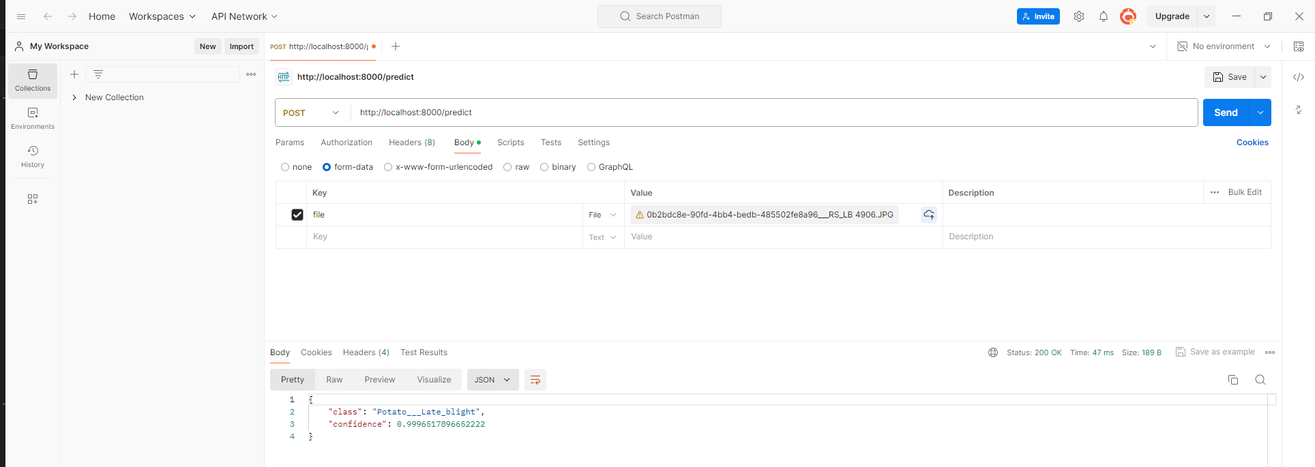
Postman:

Slide 10

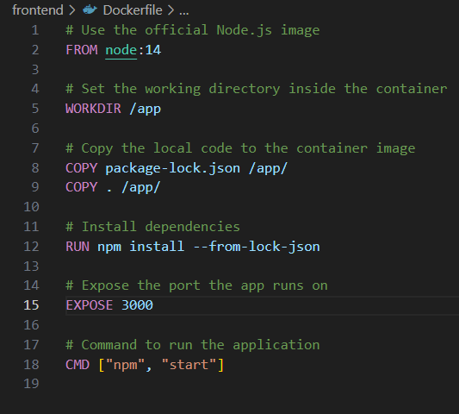
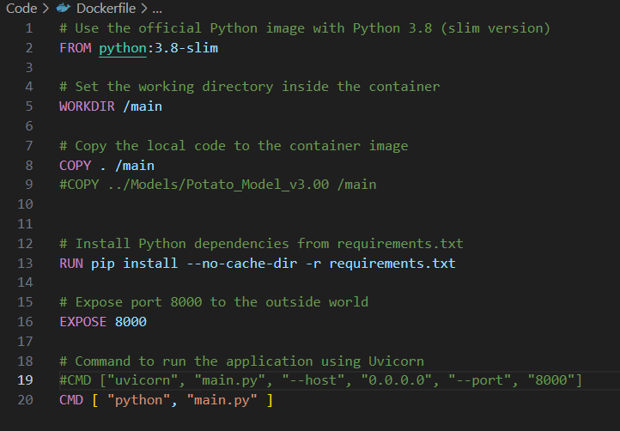
Docker:

Slide 11
Target Market
Primary market:
Individual farmers.
Secondary market:
Agricultural cooperatives.
Agricultural consultants.
Governmental agricultural departments.

Slide 12
Revenue model
Free model with basic services.
Subscription-based services:
Updates
Customer support
Medical suggestions based on the found disease

Slide 13
Challenges and future work
Model Improvement
User Interface Enhancements
Expand Crop Range

Slide 14

Q&A
Thank you for your attention!
Contact info:
email: gwehbe123@gmail.com
Phone: +96170484713

