Slide 1


Start page
Tracking System
Start
Developed by Ghassen Jamoussi

Slide 2
Scan your
Student Card
using NFC Scanner
Display matriculation number here
Bestätigen

Slide 3
Scan the
QR Code using the QR Scanner
Display device name here
Back
Bestätigen

Slide 4
Login with the Admin Password
Display device name here
Back
Bestätigen

Slide 5
Device assigned successfully
Device :
Assigned to :
Back
Home

Slide 6
Device assigned successfully
Device :
Assigned to :
Back

Slide 7





Start page
Tracking System
Tracking System
Start
Start
Developed by Ghassen Jamoussi
Developed by Ghassen Jamoussi
Tracking system
Developed by Ghassen Jamoussi
Start

Slide 8
Scan the QR code using the external scanner:
Display device name here
Back
Bestätigen

Slide 9

Start page
Tracking system
Tracking system
Developed by Ghassen Jamoussi
Start
Developed by Ghassen Jamoussi
Start

Slide 10


Slide 12



Start page
Tracking system
Tracking system
Start
Developed by Ghassen Jamoussi
Developed by Ghassen Jamoussi
Start

Slide 13
Tracking system
Developed by Ghassen Jamoussi
Start

Slide 14
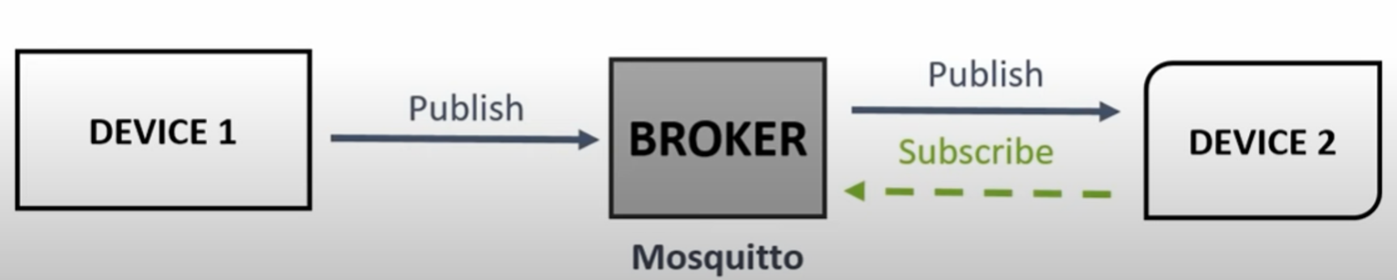
Publisher
Subscriber
RaspBerry Pi 1
pi@192.168.2.220
Local computer
192.168.2.172
RaspBerry Pi 2
gaston@192.168.2.222
mosquitto -v -c mosquitto.conf

Slide 15
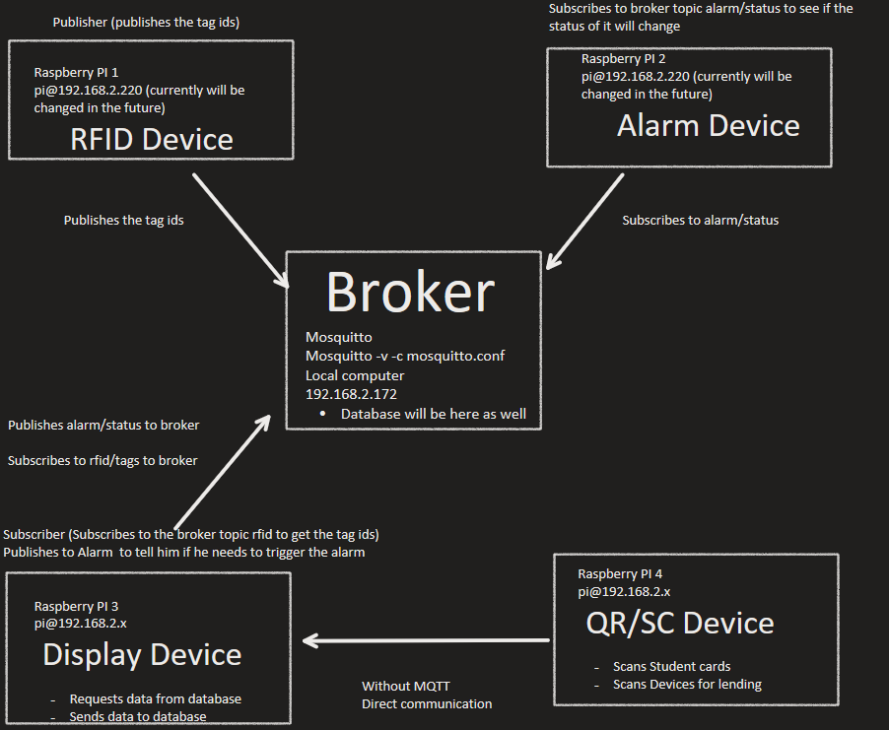

Implementing Raspberry Pi System (chatgpt.com)

Slide 16
Relay
Raspi
VCC
NO
Siren
COM
GND
IN
+ -
Power Supply
Alarm
+ -
+ -

Slide 17
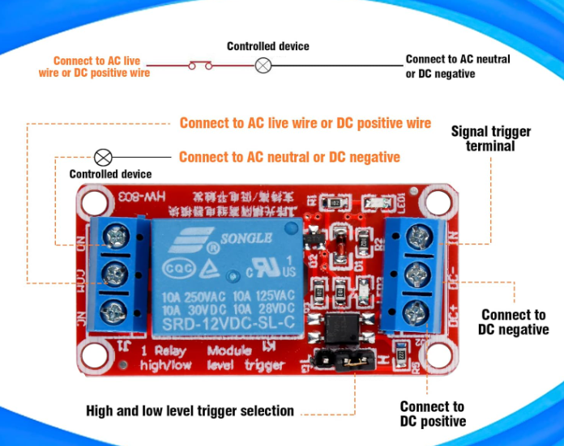
Raspi
Relay
Siren
VCC
GND
IN
+ -
Power Supply
+ -

