Slide 1
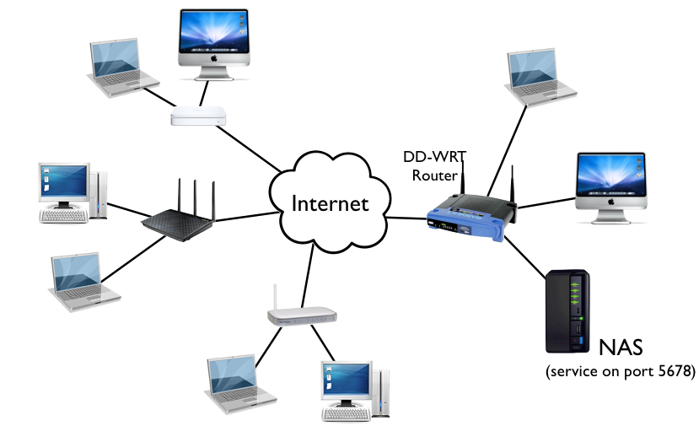
Fullstack Bootcamp : Checkpoint 1
What is the internet:
is the global system of interconnected computer networks that uses the Internet protocol (TCP/IP) to communicate between networks and devices. It is a network of networks that consists of private, public, academic, business, and government networks of local to global scope, linked by a broad array of electronic, wireless, and optical networking technologies
The internet carries a lot of services such as the inter-linked hypertext documents and applications of the World Wide Web (WWW), electronic mail, telephony, and file sharing. Each of these use a specific transmission protocol such as HTTP or SMTP

Slide 2
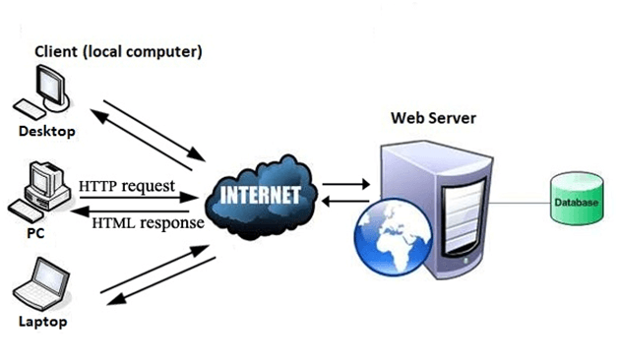
What is the web:
An information system built on top of the internet. Where information can be accessed via a URL that is transformed by a DNS to an IP address.
The transmission protocol used by the web is the HTTP.
The documents may be accessed by users using a software application called a web browser and are published by a software application called a web server

Slide 3
Steps required to load a web page
1) If the URL contains a domain name, the browser first connects to a domain name server and retrieves the corresponding IP address for the web server.
The web browser connects to the web server and sends an HTTP for the desired web page.
2)The web server receives the request and checks for the desired page. If the page exists, the web server sends it. The web browser receives the page back and the connection is closed.
3) The browser then parses through the page and looks for other page elements it needs to complete the web page. These usually include images, applets, etc.
4) For each element needed, the browser makes additional connections and HTTP requests to the server for each element.
5)When the browser has finished loading all images, applets, etc. the page will be completely loaded in the browser window.

Slide 4
To become a web developer :
Master front end development :
- HTML
-CSS
- JavaScript
Frameworks : Angular Js, React, Vue Js
Master Backend development :
- Node Js, Express Js
- Python backend libraries : Django
- ASP.NET, C#
- Java
Master DataBase management
- SQL : MySQL , Oracle, Postgres
- NoSQL : MangoDB, Casandra

Slide 5
Role of a fullstack developer
Design front end of websites using HTML, CSS and Javascript.
Design APIs of the backend using Python or Express
Manage Databases
Debug the code in case of a failure
Deploy the code to production …

