Slide 1
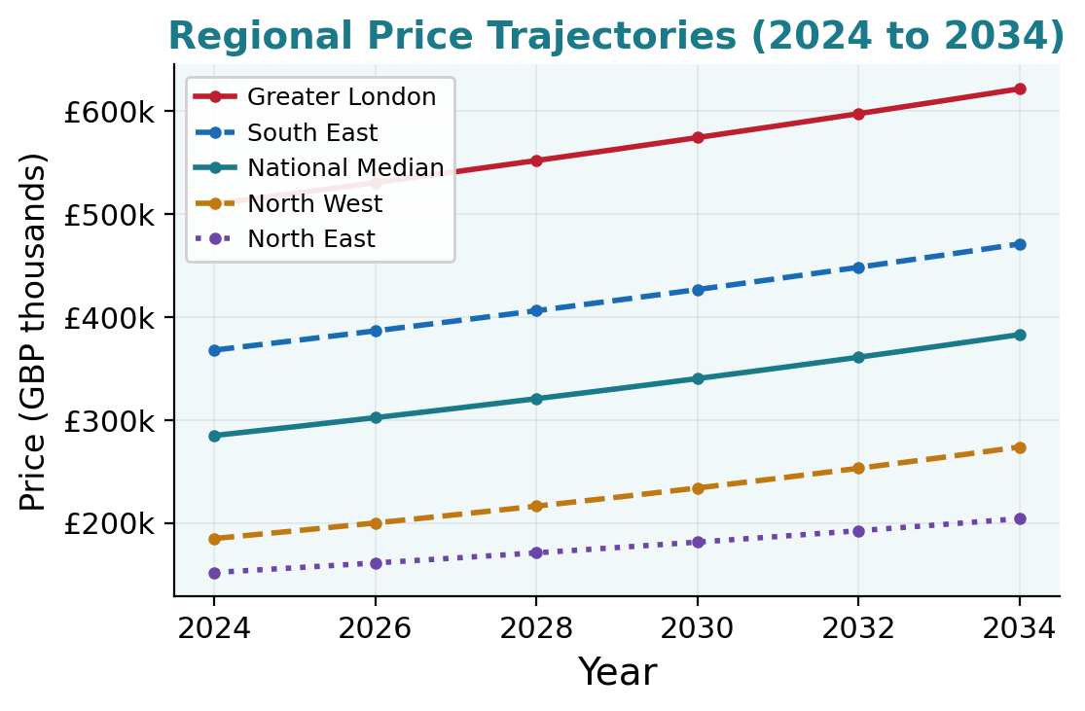
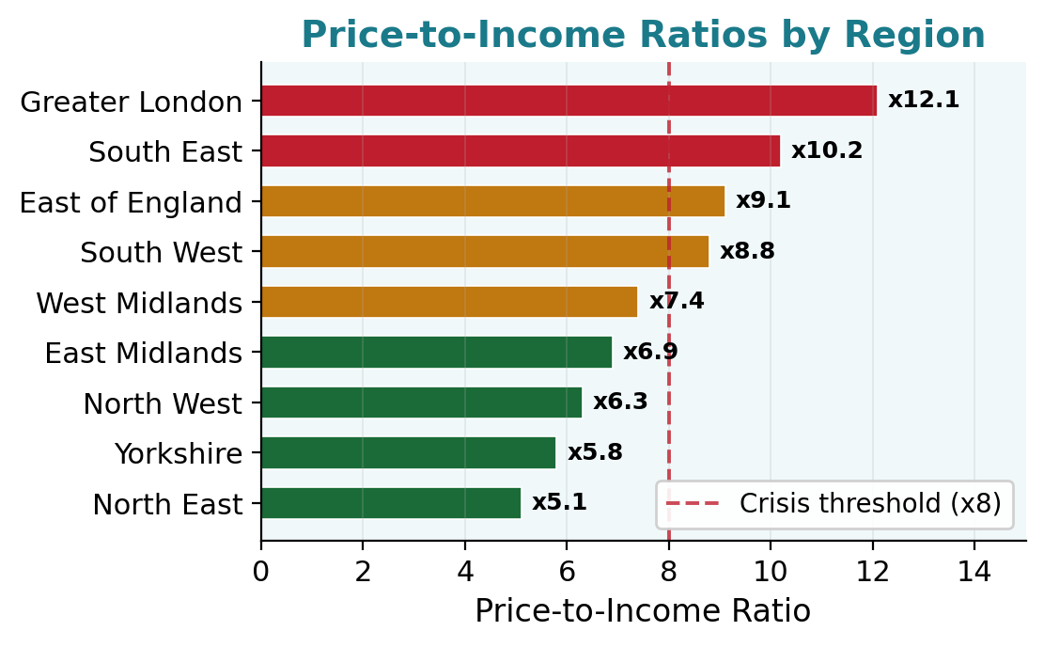
Department of Computer Science
University
of Reading
AI Agent-Based Modelling of the UK Housing Market
An LLM-Driven Simulation of UK Housing Affordability
Kieran Thompson | University of Reading | Department of Computer Science | 2024/25
INTRODUCTION
RESULTS
UK house prices now exceed 8x median earnings nationally, rising above 12x in London. Under-35 homeownership has fallen since 2003 despite repeated policy intervention. This project builds an LLM-driven Agent-Based Model to simulate UK housing affordability across a 10-year horizon.
RESEARCH QUESTIONS
67.4%
Homeownership rate (10 yr)
34.2 yrs
Median FTB age
18.3%
Avg deposit as % of price
R2=0.87
Model accuracy
Q1 Can LLM-driven agents reproduce UK housing decisions?
Q2 How do decisions vary by income, age and region over 10 years?
Q3 Which policy interventions best improve affordability?
QUALITATIVE RESULTS
Emergent Behaviours
◆ Agents defer purchase in high interest-rate periods
◆ Job loss extends saving periods by a mean of 1.8 years
◆ London agents delay first purchase by 2 to 4 years vs Northern equivalents
METHODOLOGY
Policy Scenario Testing
Each household agent uses LLM contextual reasoning backed by rigorous financial algorithms. The pipeline runs for 10 annual timesteps with stochastic life events.
★ Help-to-Buy: 12% homeownership gain, 8% price rise in eligible bands
★ 2% rate shock: 23% fewer transactions, saving periods up 1.8 years
★ Shared ownership: most effective for 25k to 40k household income
★ Stamp duty relief: first-time buyers enter market 8 months sooner
DATA
Land Registry, ONS and BoE: collection and preprocessing
SETUP
Agent initialisation: income profiling and life-stage scoring
AGENT ARCHITECTURE
LOOP
LLM ReAct cycle with 4 specialist tools per annual timestep
▸ PropertySearchTool: Land Registry fuzzy search by region, type and budget
▸ MortgageCalcTool: LTV ratios, monthly payments and stress tests
▸ AffordabilityTool: income percentile, deposit and price ratio
▸ FinancialHealthTool: savings trajectory, debt and disposable income
SIMULATE
Annual salary growth, stochastic life events and market dynamics
OUTPUT
Affordability metrics, CSV export and policy scenario analysis
DATA SOURCES
CONCLUSIONS AND FUTURE WORK
▸ Land Registry: 4.2M price transactions, 2020 to 2024
▸ ONS: household income by age and region
▸ Bank of England: base rates and mortgage data
▸ ONS UK HPI: regional annual price growth rates
▸ HMRC/SDLT: stamp duty and first-time buyer relief
✓ LLM-driven ABM reproduces realistic UK housing affordability dynamics
✓ Hybrid AI and algorithm approach outperforms traditional econometric models
✓ Framework enables testing across multiple policy intervention scenarios
Future Work
TECHNOLOGY STACK
▸ Add seller and lender agents for full market-side modelling
▸ Incorporate spatial neighbourhood and commuter-belt effects
▸ Extend to Scottish, Welsh and Northern Irish housing markets
▸ LLM Engine: Ollama llama3.2, local inference
▸ LangChain ReAct with 4 specialist domain tools
▸ Pandas and NumPy over 4.2M+ housing records
▸ Output: SimulationLogger, CSV and matplotlib charts
References
HM Land Registry (2024). UK House Price Index. ONS (2023). UK House Price Statistics. Bank of England (2024). Mortgage Market Data.
Bonabeau, E. (2002). Agent-based modeling. PNAS 99(S3). Brown, T. et al. (2020). Language Models are Few-Shot Learners. NeurIPS.
Degree Programme
BSc Computer Science | University of Reading

