Slide 1
Prayer Times

Slide 2
Status Quo
We take times published by ISIJ Toronto and add a flat 4 minutes to account for our distance from the GTA. (JCC+4)
Occasional times published by IHS / Shk. Saleem Bhimji that do not agree with JCC+4 times.

Slide 3
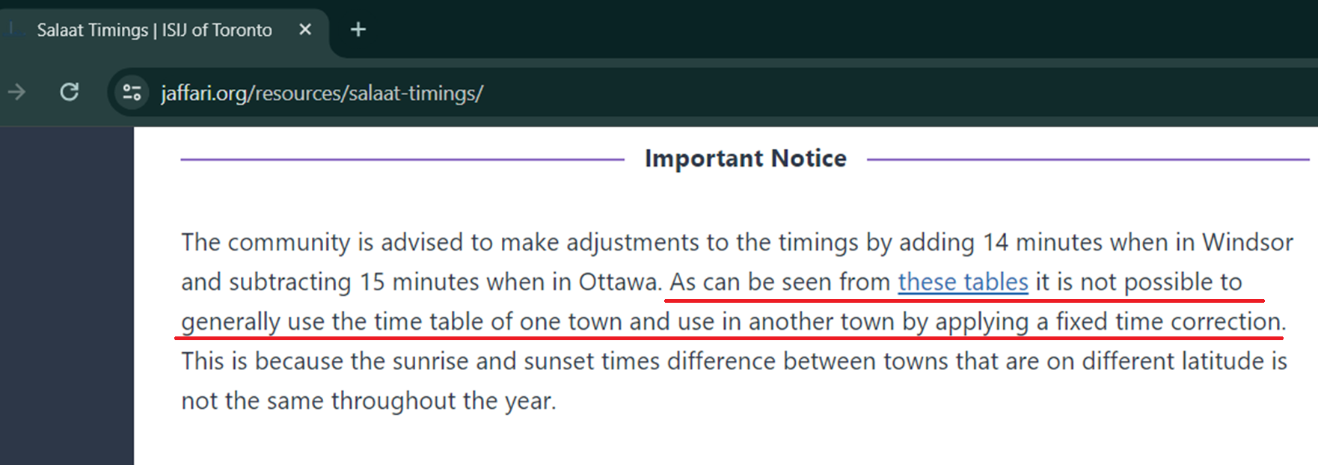
The Issue (JCC)

Slide 4
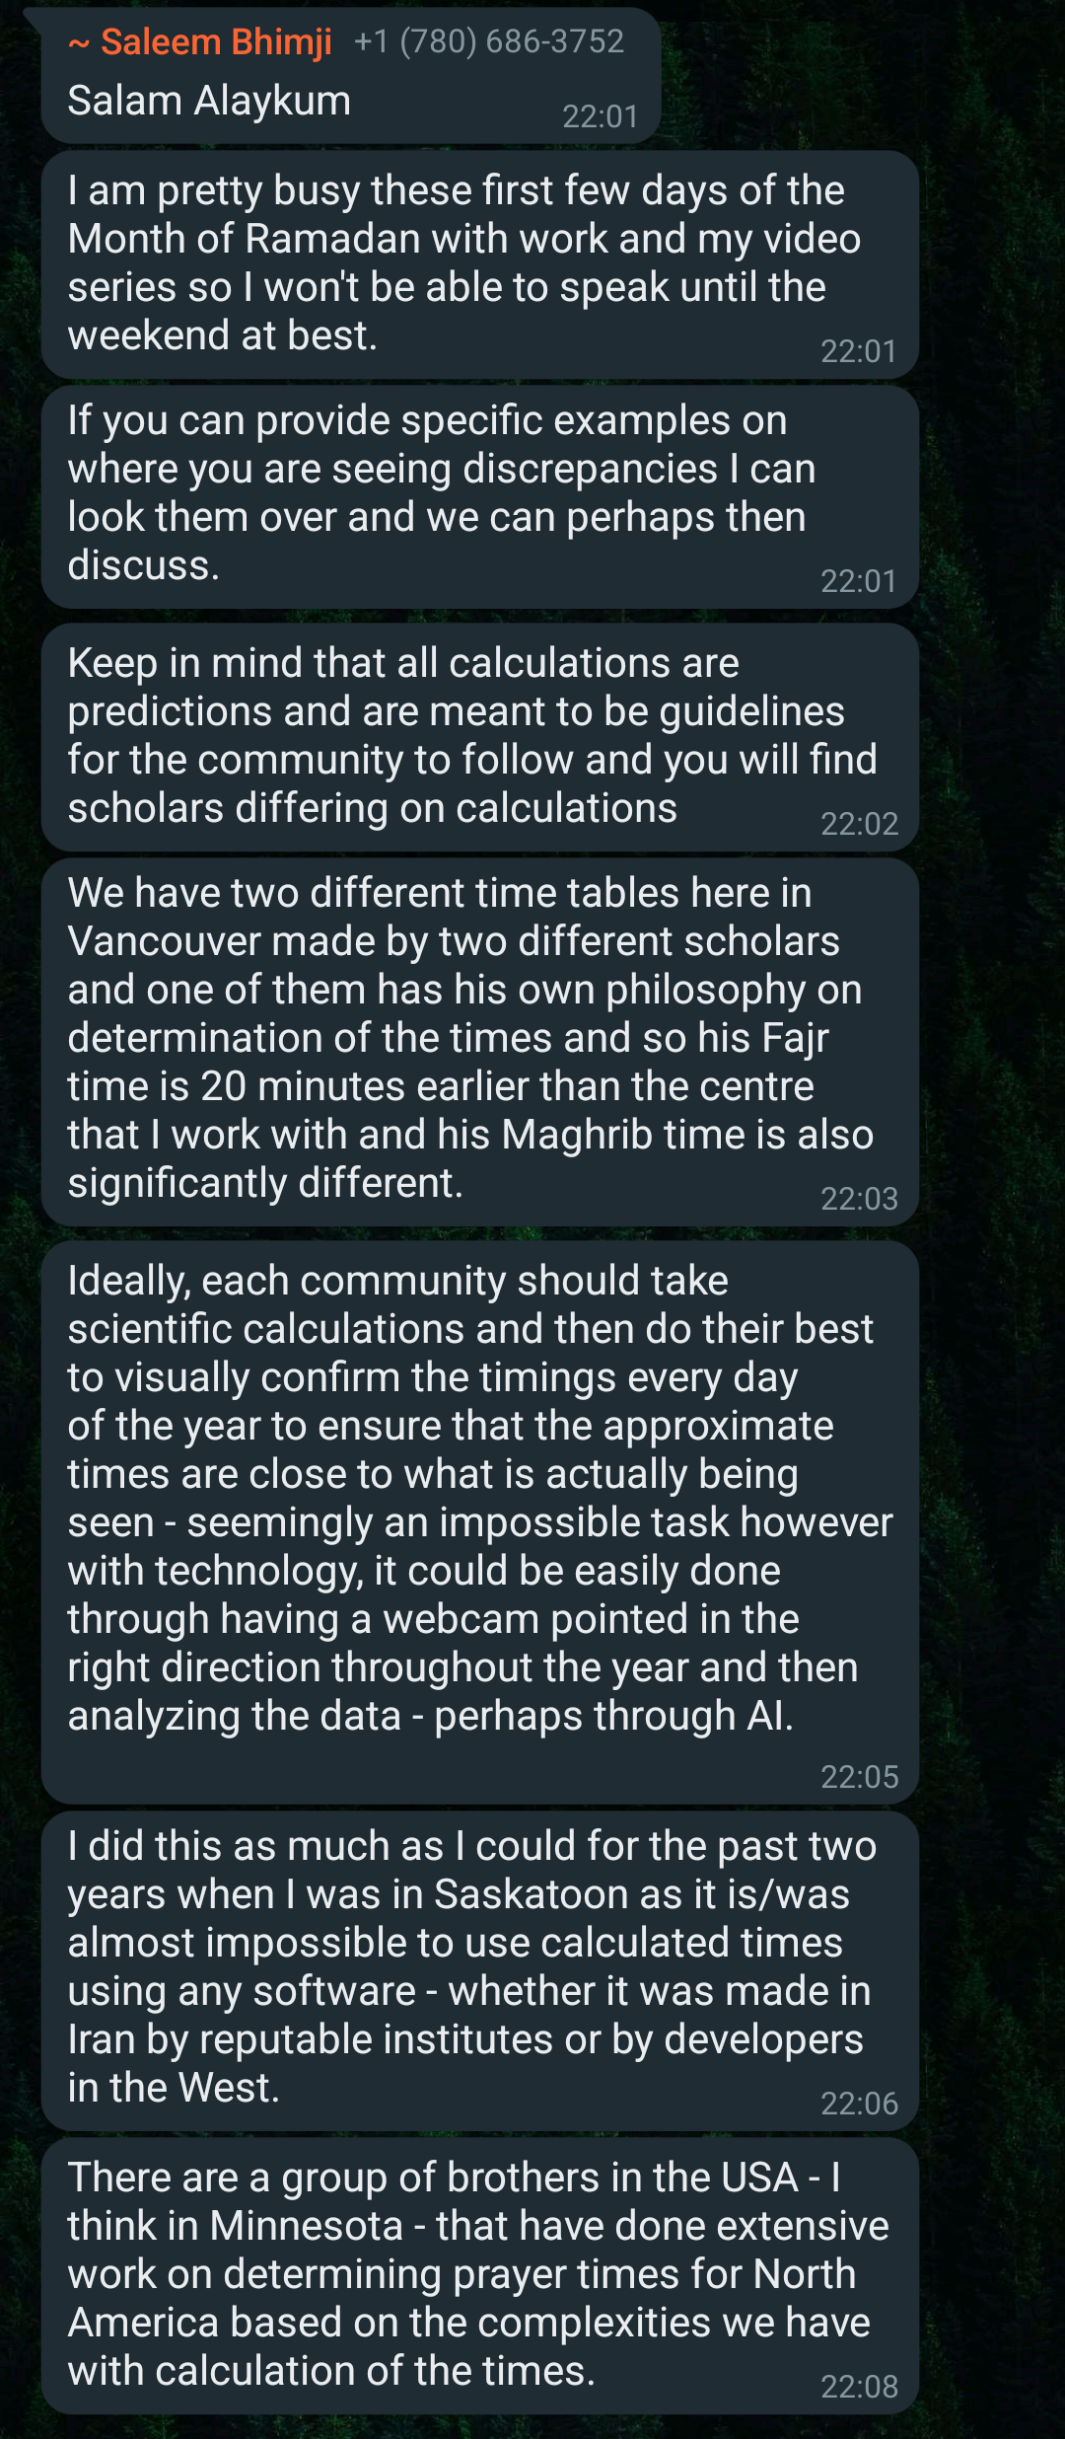
The Issue (IHS)

Slide 5
The Solution - Creating Dedicated Year-Round Times for KW
There are two sets of solar angle conventions created based on Shia view.
One is by the Leva Institute, Qom, and the other is by the University of Tehran.
Conversed with Shk. Hasanain Kassamali and Maulana Rizvi, who both agreed Leva Institute can be followed and that the times created based on the Leva dataset and KW’s coordinates should be good for us.
Shk. Hasanain Kassamali stated this timesheet is good for publication, but we should remind people to observe precaution.

Slide 6
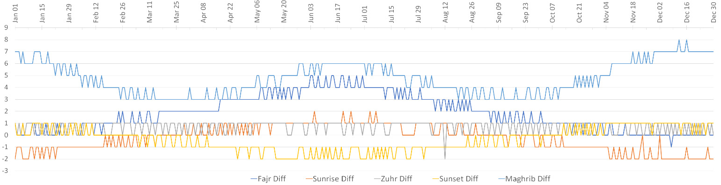
Difference of JCC+4 and New Times (New Time – JCC+4)

Slide 7
Difference of JCC+4 and New Times (New Time – JCC+4)
Date | Fajr Diff | Sunrise Diff | Zuhr Diff | Sunset Diff | Maghrib Diff
January 1 | 1 | -2 | 1 | 1 | 7
April 1 | 2 | 0 | 1 | 0 | 4
July 1 | 4 | 1 | 1 | -2 | 6
October 1 | 2 | 0 | 1 | -1 | 3

