Slide 1
Matrix Calculator
Python Program

Slide 2
Table of contents
01
02
03
Addition
Multiplication
Inverse
04
05
Transpose
Determinant

Slide 3
Multiplication matrix multiplication is a binary operation that produces a matrix from two matrices.
Addition
matrix addition is the operation of adding two matrices by adding the corresponding entries together.

Slide 4
Inverse
An inverse matrix is a matrix that when multiplied with a given matrix gives the identity matrix.
Transpose the transpose of a matrix is an operator which flips a matrix over its diagonal it switches the row and column indices of the matrix by producing another matrix
Determinant The determinant of a matrix is a single numerical value which is used when calculating the inverse or when solving systems of linear equations

Slide 5
The Program
The program asks the user for the number of rows and columns for 2 matrices.
Next, the program proceed to calculate the five mentioned operations.
Lastly, the program prints out the output of each operation.

Slide 6
Library
There is another libraries that can apply these operations like :
Numpy matrix
SciPy sparse matrix.

Slide 7
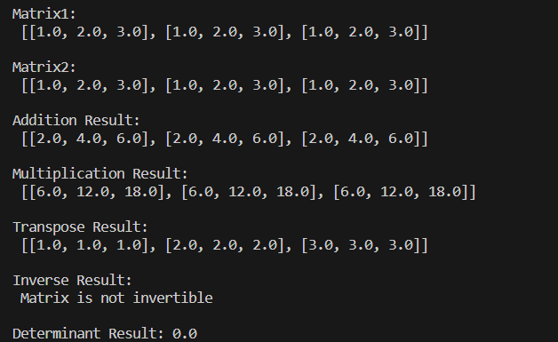
Output of the code

Slide 8
Done by:
Ghazal helal
Course: Linear Algebra

