Slide 1


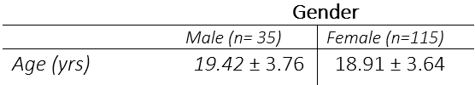
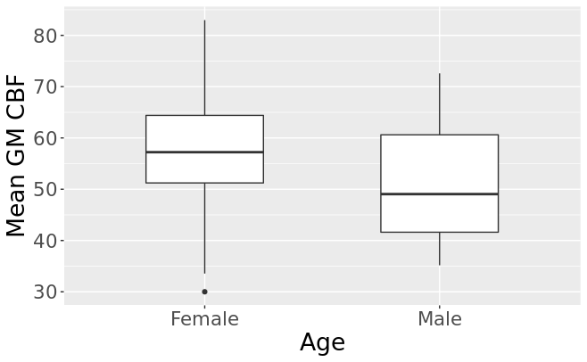
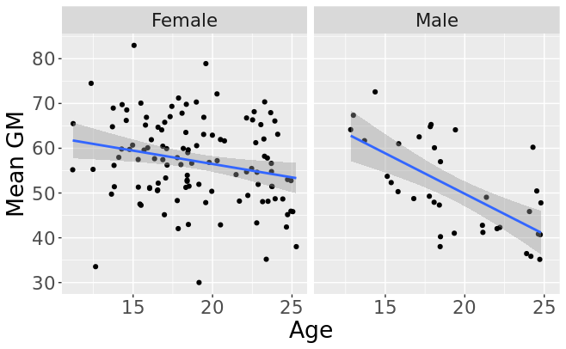

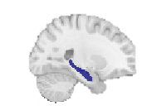
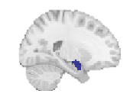
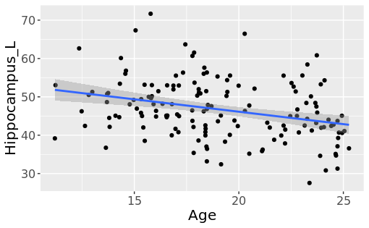
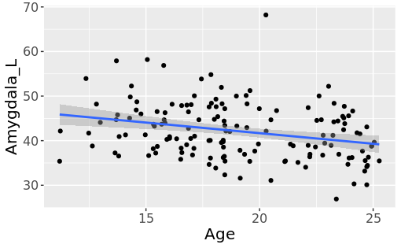
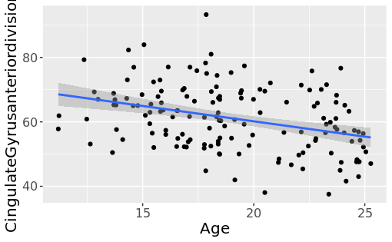
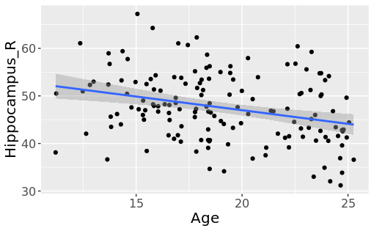
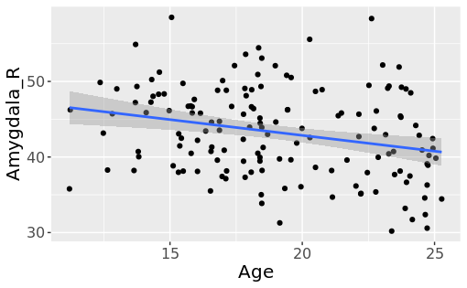
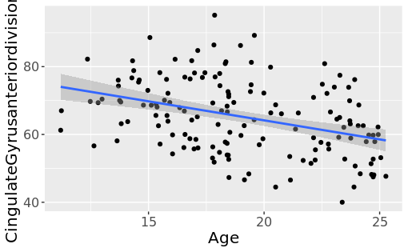
Characterizing Effects of Age and Sex on Cerebral Perfusion of Adolescents Assessed by Magnetic Resonance Arterial Spin Labelling
G Ahmadzadeh^{1,2}, E.W. Dickie^{1,2}, M Joseph¹, J. Wong ¹, B. Goldstein ^{1,2}, B. MacIntosh ³, D. Felsky ^{1,2}, G. Foussias ^{1,2}, H. Hamilton ¹, J. Henderson ^{1,2},
J.D. Haltigan ^{1,2}, K. Cleverley ^{1,2}, L. Quilty ^{1,2}, N. Kozloff ^{1,2}, S. Hill ^{1,2}, S. Ameis ^{1,2}, S. Kidd ^{1,2}, W. Tempelaar ^{1,2}, W. Wang ¹, and Y. Nikolova ^{1,2}, A. Voineskos ^{1,2}
1 Campbell Family Mental Health Research Institute, Center for Addiction and Mental Health, Toronto, Canada
2 Department of Psychiatry, University of Toronto, Canada
3 Hurvitz Brain Sciences Research Program, Sunnybrook Research Institute, University of Toronto, Toronto, ON, Canada
Background
Result 1
Result 3
Mood and anxiety disorders are associated with abnormal structural and functional connectivity and often exhibit sex and age differences (Dimick et al.)
In this study we examined baseline cerebral blood flow (CBF) in treatment seeking adolescents with mood and anxiety disorders using pseudocontinuous arterial spin labeling (PCASL)
Table 1. Participant demographic and clinical characteristics at baseline - (11.20-25.27±3.65 years of age, Mean=19.01). Out of 167 participants who completed MRI scans, 157 did ASL, 152 of which passed the imaging quality control (96% pass rate).
Fig 3. Left; Boxplot of global mean GM CBF in males and females - Females have higher overall CBF in global mean GM (p< 0.002), Fig 4. Right; Plot of age vs. CBF of global mean GM in males and females - Correlational analysis shows a significant negative correlation between age and global mean GM (r = -0.34)
Result 2
Fig 1. Regions of interest (ROI)- From left to right, Cingulate gyrus anterior division, Hippocampus, Amygdala.
Objective
Conclusion
The results of this study concurs with previously reported age and sex effects on CBF and the high imaging quality control pass rates, provide an indication that the TAY imaging and quality control can be feasibly implemented in this cohort of participants
The findings of this study serve as an important biomarker revealing specific patterns that may predict symptom profiles and subsequently inform early interventions and treatments for these patients
Confirm feasibility in acquiring high quality images as well as to replicate previously reported cross sectional effects of age and biological sex
Methods
Each participant received baseline clinical assessments (including mental health and neuroimaging assessments).
Structural high-resolution T1-weighted images were collected for anatomical registration. ASL images were pre-processed and used to compute CBF maps.
Fig 2. Plot of age vs. CBF of ROIs - Correlational analysis shows a significant negative correlation between age and anterior region of the Cingulate gyrus, Hippocampus, and Amygdala
References
Dimick, Mikaela K et al. “Cerebral Blood Flow and Core Mood Symptoms in Youth Bipolar Disorder: Evidence for Region-Symptom Specificity.” Journal of the American Academy of Child and Adolescent Psychiatry, S0890-8567(22)00209-X. 26 Apr. 2022, doi:10.1016/j.jaac.2022.04.010

