Slide 1
Programming Fundamentals in C++
(Practical#11)

Slide 2
Objective: OOP Inheritance, to become familiar with the concept of constructor chaining.
What is Inheritance ?
Definition: Inheritance: Is a feature OOP which is a form of software reuse.
A mechanism where in a new class is derived from an existing class.
It allows us to create a new class (derived class) from an existing class (base class).
OR
Is the process of creating new classes called subclasses from existing classes or Baseclasses
The subclass will inherit and extend the features (i.e. members) of its Baseclass and in addition can have its own.
Inheritance promotes code-reusability.

Slide 3
Important terminology:
Base Class: The class whose features are inherited is known as Base class or a parent class.
Sub Class: The class that inherits the other class is known as child class(or a derived class, extended class, or sub class). The subclass can add its own fields and methods in addition to the superclass fields and methods.
Reusability: Inheritance supports the concept of “reusability”, i.e. when we want to create a new class and there is already a class that includes some of the code that we want, we can derive our new class from the existing class. By doing this, we are reusing the fields and methods of the existing class.

Slide 4
class Base {
..... .....
………
}
class Sub : Base {
..... .....
}

Slide 5
The idea behind inheritance in C++ is that you can create new classes that are built upon existing classes. When you inherit from an existing class, you can reuse methods and fields of parent class.
Moreover, you can add new methods and fields /data members in your current class also.
Why use inheritance in c++
For Code Reusability.

Slide 6
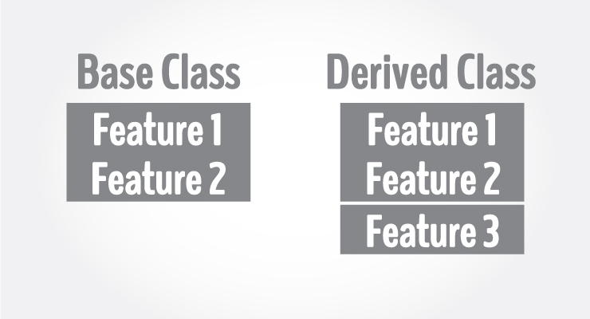
Inheritance is one of the key features of Object-oriented programming in C++. It allows user to create a new class (derived class) from an existing class(base class).
The derived class inherits all the features from the base class and can have additional features of its own.

Slide 7
Product Base Class
Product class
#Name : Sring #Price: float #Description: String
+setPrice()
Inheritance Example 1
Inheritance symbol
Is-a kind of relationship
Sub classes
Medicine class
-MgtDate : String -ExpDate : String
+setmfDate() +setExpDate()
Book class
#authorName : Sring #Edition : Sring
+setauthor(authorName:String)

Slide 8
Person Base Class
Person
# Name : Sring
+Person() +setName(newName:String) +getName():String
Inheritance Example 2
Student
-RollNo : String #Dept/Technology: String
+setRollno(rollno:String) +setDept(dept:String) +displayData()
Employee
- Empno : String #Designation/jobTitle : String #Salary: double
+setDesignation(dept:String) +setSalary()

Slide 9
Some more examples
1.Students
2. Bank account
3.Product
3. Employees
4. Vehicle
Note: A Base class’s private members are not inherited by its sub class.
Constructors are not inherited.

Slide 10
“IS-A” relationship or IS-A kind of relationship
Inheritance represents the ”IS-A relationship”, also known as parent-child relationship. In an Is- a relationship, an object of sub class can also be treated as an object of superclass /Base class
If a class “A” is derived from a class “B”. We can say that ‘B’ is kind of A.
This is because B has all the characteristics of ‘A’, and in addition some of its own.
For this reason inheritance is often called an
“IS-A” relationship or A kind of relationship

Slide 11
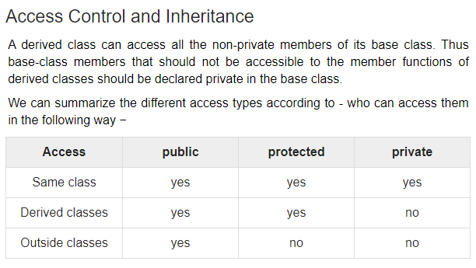

Slide 12
Modes of Inheritance
Public mode: If we derive a sub class from a public base class. Then the public member of the base class will become public in the derived class and protected members of the base class will become protected in derived class.
Protected mode: If we derive a sub class from a Protected base class. Then both public member and protected members of the base class will become protected in derived class.
Private mode: If we derive a sub class from a Private base class. Then both public member and protected members of the base class will become Private in derived class.

Slide 13
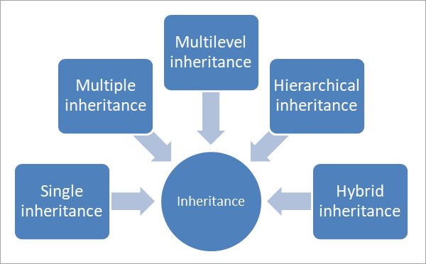

Slide 14
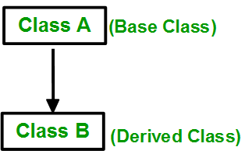
Types of Inheritance in C++
Single Inheritance: In single inheritance, a class is allowed to inherit from only one class. i.e. one sub class is inherited by one base class only.

Slide 15
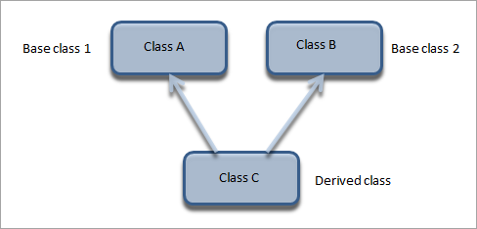
Multiple inheritance is a type of inheritance in which a class derives from more than one classes. As shown in the diagram, class C is a subclass that has class A and class B as its parent.
In a real-life scenario, a child inherits from its father and mother.

Slide 16
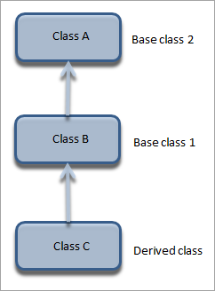
Multilevel Inheritance
Multilevel inheritance is represented below.
In multilevel inheritance, a class is derived from another derived class. This inheritance can have as many levels as long as our implementation doesn’t go wayward. In the above diagram, class C is derived from Class B. Class B is in turn derived from class A.

Slide 17
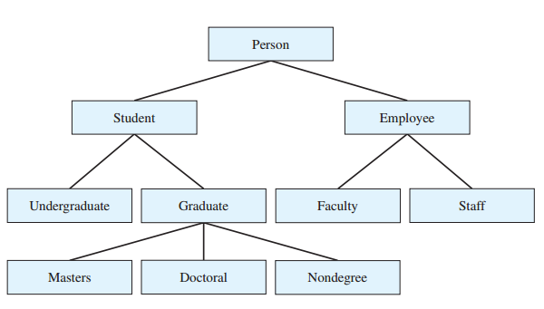
An example of class hierarchy:
Inheritance relationship form tree-like hierarchical structure.
A super class exists in hierarchical relationship with its subclasses.

Slide 18
Product Base Class
Product class
#Name : Sring #Price: float #Description: String
+setPrice()
Inheritance Example 1
Inheritance symbol
Is-a kind of relationship
Sub classes
Medicine class
-MgtDate : Date -ExpDate : Date
+setmfDate() +setExpDate()
Book class
#authorName : Sring #Edition : Sring
+setauthor(authorName:String)

Slide 19
Person Base Class
Person
# Name : Sring
+Person() +setName(newName:String) +getName():String
Inheritance Example 2
Student
-RollNo : String #Dept/Technology: String
+setRollno(rollno:String) +setDept(dept:String) +displayData()
Employee
- Empno : String #Designation/jobTitle : String #Salary: double
+setDesignation(dept:String) +setSalary()

