Slide 1
Programming Fundamentals in C++
(Practical#10)

Slide 2
Object Oriented Programming
Objective: Introduction to Object Oriented Programming, to become familiar with Objects and classes, declaring a class with variables(member data) and member functions/methods and Instantiating an object of a class, and become familiar with:
Member data and Member functions
access specifiers : private, public and protected
set() and get() functions.
Constructor and Destructor.
static (class) variables

Slide 3
Object Oriented Programming
What is a Programming Paradigm ?
Definition: A programming paradigm is a style or “way” of programming.
Some of the more common paradigms are:
Structured — Programs have clean, goto-free, nested control structures.
Array-based —
Functional Programming

Slide 4
Object Oriented Programming
Some of the more common paradigms are:
Event-Driven — Control flow is determined by asynchronous actions (from humans or sensors).
GUI-Based

Slide 5
Programming Paradigm
Imperative — Control flow is an explicit sequence of commands.
Procedural — Imperative programming with procedure calls.
Flow-Driven — Computation is specified by multiple processes communicating over predefined channels.
Logic (Rule-based) — Programmer specifies a set of facts and rules, and an engine infers the answers to questions.

Slide 6
Programming Paradigm
Constraint — Programmer specifies a set of constraints, and an engine infers the answers to questions.
Aspect-Oriented — Programs have cross-cutting concerns applied transparently
Object-Oriented — Computation is effected by sending messages to objects; objects have state and behavior.
Class-based — Objects get their state and behavior based on membership in a class.

Slide 7
Introduction to Object-Oriented Programming
Object-Oriented Programming : is a Programming paradigm or a software
development methodology in which a program is conceptualized as a group of objects .
A Programming technique in which a program is organized as a collection of objects.
A software development approach for writing and developing computer programs based on objects.

Slide 8
Introduction to Object-Oriented Programming
OOP provides an easy of modeling things in the real world.
OOP organizes & combines data and functions together, hides and encapsulates the implementation details and offers several features for developing computer softwares.

Slide 9
Introduction to Object-Oriented Programming
OOP : makes the development process easier faster and less time consuming.
OOP features :
Classes and Objects
Data Encapsulation and Abstraction
Inheritance
Polymorphism
And a programming language that supports or follows these features is called an Object-Oriented Programming Language.

Slide 10
OOP Classes and Objects
Two key concepts in OOP are :
Objects and classes
An object is and entity that has certain attributes or properties sometimes called characteristics which may be assigned values. The values can be numeric or non-numeric.

Slide 11
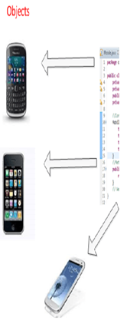

Introduction to Object-Oriented Programming
An Analogy
Examples of real world Objects
In the real world everywhere we look we see objects such :

Slide 12
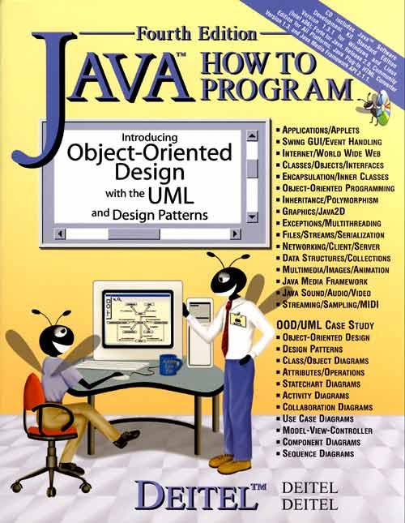

Introduction to Object-Oriented Programming
An object represents a real world entity
Following figure shows some real-world entities
Students
Object
Book object

Slide 13
Introduction to Object-Oriented Programming
Book object
Attributes/Properties
BookName
AuthorName
Price
Edition

Slide 14
Introduction to Object-Oriented Programming
car object
Attributes
Name
Model
Price
Color

Slide 15
Introduction to Object-Oriented Programming
Attributes are represented as variables in a class declaration.
Students
Attributes
Object
Name
RollNo
Address

Slide 16
Introduction to Object-Oriented Programming
Attributes with values
Students
Object
Name=“anyName”
RollNo=19Sw
Address=xyz

Slide 17
Introduction to Object-Oriented Programming
Attributes with values
car object
Name=Alto
Model=2017
Price=
Color=white

Slide 18
Introduction to Object-Oriented Programming
Attributes
Name
car object
Model
Price
Color
Behavior
Change gear()
Apply breaks()
Accelerate()

Slide 19
Introduction to Object-Oriented Programming
Attributes
Behavior is equivalent to a method in a program
Name
RollNo
Address
Behavior
setName()
changedept();

Slide 20
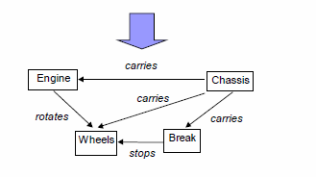
An Analogy
Classes : A class is a template for an object. Or
Classes are the definitions (or blueprints) Used to created objects.
The structure or Design of a car

Slide 21
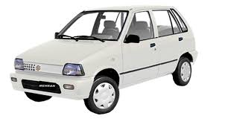
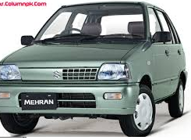
An Analogy
Object 1
Object 2

Slide 22
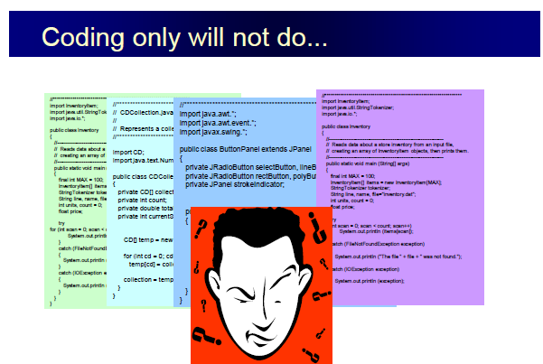
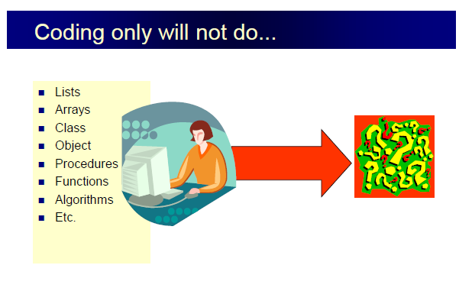

Slide 23
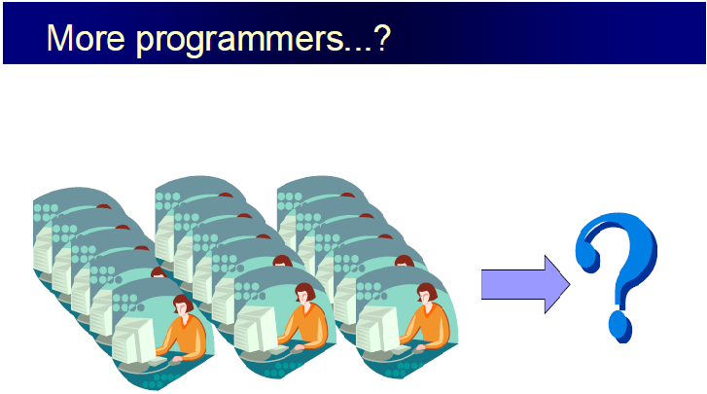

Slide 24
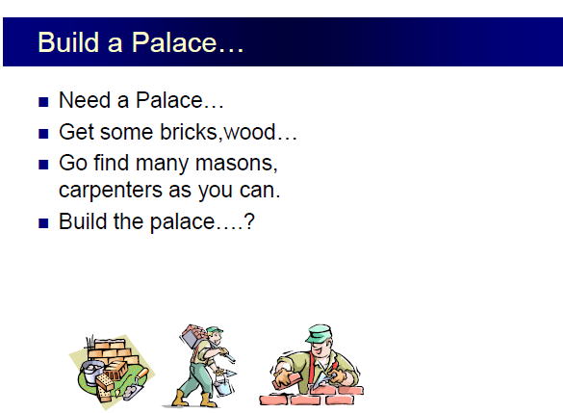


Slide 25
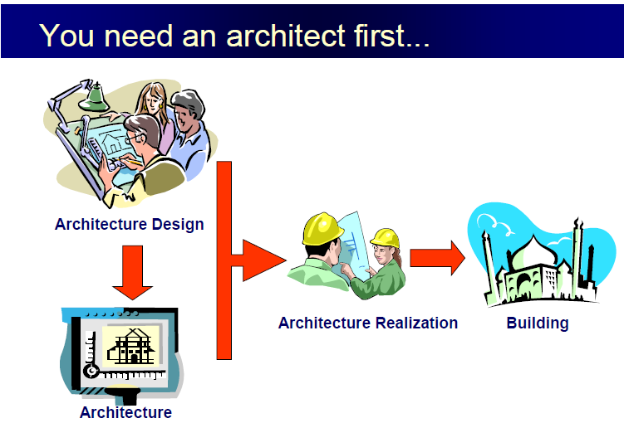


Slide 26
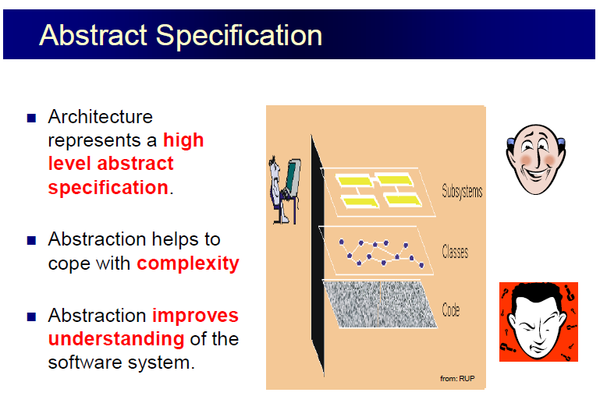
Coding is flat only in trivial systems.

Slide 27
University
BM
CS
SW
………..
Examination
Admission
Finance
Employees
Students

Slide 28
OOP Class and Object
Class: A class is a template for an object. OR
Classes are the definitions (or blueprints) Used to created objects.
Object : in general an object is an entity that has certain attributes or properties which may be assigned values The values can be numeric or non-numeric.
In OOP an Object is an instance of a class OR
an Object is a working copy of a class OR Look like a class.
Objects in a program can represent real world things e.g. automobiles, Mobiles, Books houses and employees.

Slide 29
OOP Class and Object
There are just two kinds of things that you can include in a class definition:
Fields: These are variables that store data items .They are also referred to as data members of a class.
The data, or variables, defined within a class are called member data
Methods: These define the operations you can perform for the class —so they determine what you can do to, or with, objects of the class. Methods typically operate on the fields —the data members of the class.
Collectively, the methods and variables defined within a class are called members of the class.

Slide 30
OOP Class and Object
Syntax
class classname {
type variable1;
type variable2;
type variableN;
type methodname1(parameter-list) {
// body of method
}
// ...
type methodnameN(parameter-list) {
// body of method
}
} ;

Slide 31
Declaring a class with a method and Instantiating an object of a class.
A Simple Class
class MyClass {
public : // access specifier
void DispayMsg()
{
Cout<<“Welcome to Class 19SW-Section-I”;
}// end method
} ; // end class
Use MyClass Class
int main () {
// Creating an object of MyClass
MyClass MyObj; // Instantiating an object of MyClass
{
// calling MyObj’s method DisplayMsg()
MyObj.DisplayMsg();
return 0;
} // end main method

Slide 32
Declaring a class with Variables
A Simple Class
class Students {
Private:
string student_rollno; // instance variable
Public:
void set_rollno(string rollno)
{
student_rollno = rollno;
} // end method
string get_rollno()
{
return student_rollno;
} // end method
} ; // end class
Use Students Class
int main () {
// Creating an object and asdign it to objStd
Students objStd;
{
// calling objStd’s method set_rollno()
objStd. set_rollno(“20SW01");
// calling objStd’s method get_rollno()
/ cout<<“Welcome”+ objStd. get_rollno());
return 0;
} // end main method

Slide 33
Each object (instance) of a class contains/maintains it’s own copy of the class’s instance variables and functions.

Slide 34
Primitive Types vs. Reference Types
Data types in C++ are divided into two categories
Primitive Types and Reference Types
Primitive Types are byte, int, char, Boolean, short, long, float and double.
A primitive variable can store exactly one value of its declared type at a time.

Slide 35
Reference Types
All non primitive types are references types, so classes, we specify the types of objects are reference types.
Variables of reference types (normally called references) store the locations of objects in the computer’s memory. Such variables are said to refer to objects in the program.

Slide 36
OOP set() & get() methods
(Set methods) & (get methods)
These are the public member functions methods.
Allow the client of the class to set(i.e. assign values) to the private instance variables , and
get (i.e. obtain values) of private instance variables.

Slide 37
OOP Access Specifiers
Access Specifiers : Define level of Accessibility of a variable or a method OR
Specify which part of the program can access a variable or a function.
Private : variables or methods declared with access specifier private are accessible only within a class in which they are declared.
Public : variables or methods declared with access specifier public are accessible anywhere in the program (i.e. within a class in which they are declared and also outside that class)
Protected : variables or methods declared with access specifier protected are accessible within a class in which they are declared and also in the derived class).

Slide 38
Introduction to Object-Oriented Programming
Data Encapsulation & Abstraction
Data Encapsulation or data hiding: Is an OOP feature that binds together data and functions. OR
The wrapping of data and functions into a single unit. OR
The internal of the object is private to that object and may not be accessed from outside the object
Abstraction: refers to the act of representing the functionality of a program and hide the internal details. OR
A feature of OOP where by the implementation details of class are kept hidden from the user.

Slide 39
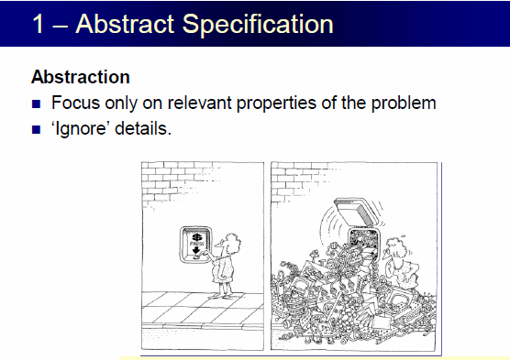
Data Encapsulation & Abstraction

Slide 40
OOP Constructor
A Constructor : is a special member function which is called automatically whenever an object of class is created.
When an object of class is created, the constructor of that class is called.
Is used to Initialize an object, and to initialize the instance variables.
A constructor has two special characteristics that differentiate it from other class methods:
A constructor always has the same name as the class
A constructor never returns a value, and you must not specify a return type —not even of type void.

Slide 41
A Simple Class with Constructor
class Students {
private:
string studentName; // instance variable
public:
Students () //Constructor
{
studentdName=“anyName”) ; }
void setName(String stdName)
{
studentName=stdName;
} // end method
public String getName()
{
return studentName;
} // end method
}; // end class
int main () {
// Creating an object
Students objStd;
{
// calling objStd’s method getName()
cout<<“Initial Value:”+ objStd.getName());
objStd.setName(“Ahmed");
cout<<“Welcome”+ objStd.getName());
return 0;
} // end main method

Slide 42
OOP Constructors
No-argument constructor initializes data members to constant values,
A multi-argument constructor can initialize data members to values passed as arguments,
A default copy constructor initializes an object with an other object of the same type.
This is one argument constructor whose argument is an object of the same class as the constructor.

Slide 43
Static class variables
Each object (instance) of a class contains/maintains it’s own copy of the class’s instance variables.
Static instance variables are not duplicated for each object, rather a single data item (i.e. static member is shared by all objects of a class)

Slide 44
OOP Destructor
Destructor : Is a member function which is called automatically whenever an object is destroyed.
It has the same name as the constructor (which is the same as the class name) but is preceded by a Tilde ~ .
The most common use of destructor is to deallocate the memory that was allocate by the constructor for the object.

Slide 45
Destructors are usually used to deallocate memory and do other cleanup for a class object and its class members when the object is destroyed. A destructor is called for a class object when that object passes out of scope or is explicitly deleted.
If you do not define a destructor, the compiler will provide a default one; for many classes
If no user-defined destructor exists for a class and one is needed, the compiler implicitly declares a destructor. This implicitly declared destructor is an inline public member of its class.
The compiler will implicitly define an implicitly declared destructor when the compiler uses the destructor to destroy an object of the destructor's class type

Slide 46
When does the destructor get called?
A destructor is a member function that is invoked automatically when the object goes out of scope or is explicitly destroyed by a call to delete
The program finished execution. 2) When a scope (the { } parenthesis) containing local variable ends. 3) When you call the delete operator.

Slide 47
#include <iostream>
using namespace std;
class HelloWorld{
public:
//Constructor HelloWorld(){
cout<<"Constructor is called"<<endl; }
//Destructor
~HelloWorld(){
cout<<"Destructor is called"<<endl; }
//Member function
void display(){ cout<<"Hello World!"<<endl;
} };
int main(){
//Object created
HelloWorld obj;
//Member function called obj.display();
return 0; }
Output:
Constructor is called
Hello World!
Destructor is called

Slide 48
Structures and Classes
Structures are the important building blocks in understanding of Objects and classes. You can use structures in almost exactly the same way that you use classes.
The difference between class and struct are:
A structure is collection of data, while a class is collection of both data and functions.
In a class the members are private by default, while in a structure they are public by default.
Classes are reference types, while structures are values types.
http://www.differencebetween.info/difference-between-class-and-structure-in-cplusplus

Slide 49
Difference between Class and Structure
Class | Structure
Classes are of reference types. | Structs are of value types.
All the reference types are allocated on heap memory. | All the value types are allocated on stack memory.
Allocation of large reference type is cheaper than allocation of large value type. | Allocation and de-allocation is cheaper in value type as compare to reference type.
Class has limitless features. | Struct has limited features.
Class is generally used in large programs. | Struct are used in small programs.
Classes can contain constructor or destructor. | Structure does not contain parameter less constructor or destructor, but can contain Parameterized constructor or static constructor.
Classes used new keyword for creating instances. | Struct can create an instance, with or without new keyword.
A Class can inherit from another class. | A Struct is not allowed to inherit from another struct or class.
The data member of a class can be protected. | The data member of struct can’t be protected.
Function member of the class can be virtual or abstract. | Function member of the struct cannot be virtual or abstract.
Two variable of class can contain the reference of the same object and any operation on one variable can affect another variable. | Each variable in struct contains its own copy of data(except in ref and out parameter variable) and any operation on one variable can not effect another variable.

Slide 50
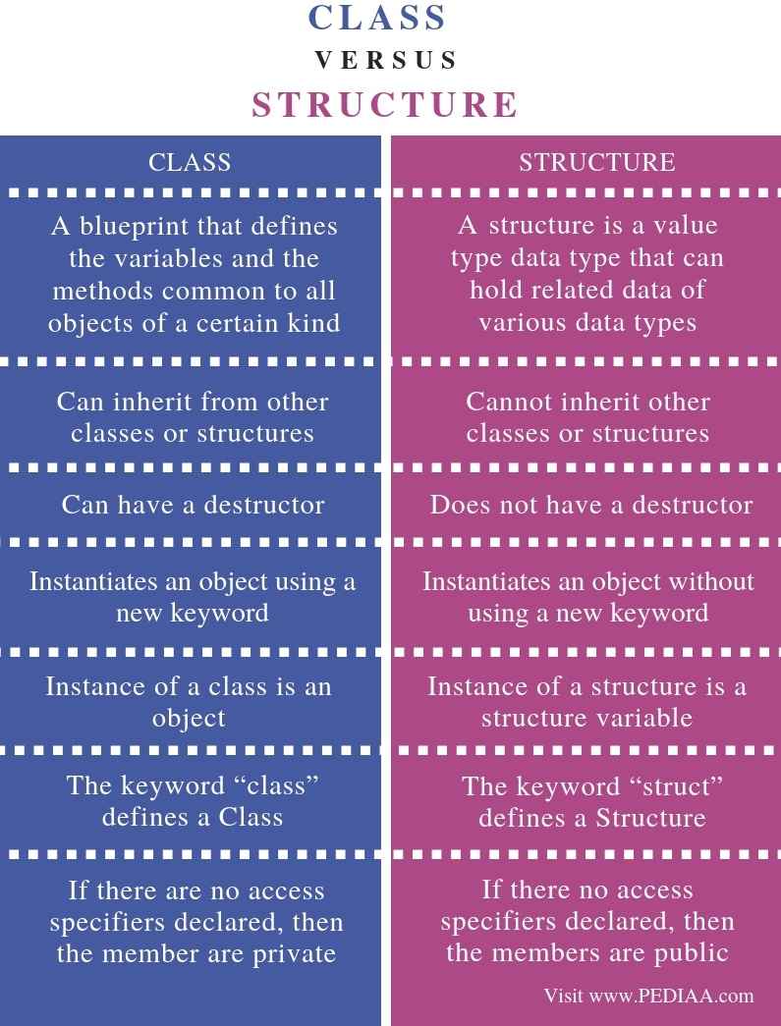
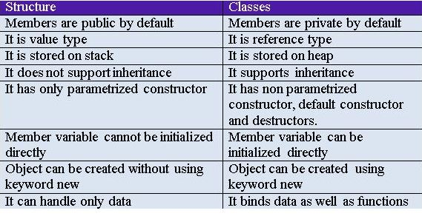

Slide 51
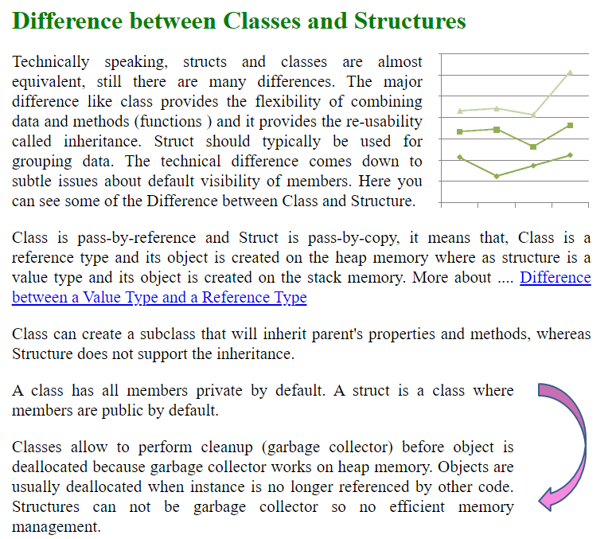

Slide 52
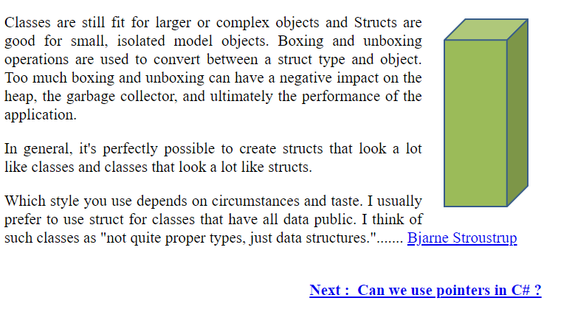

Slide 53
Tasks for Lab # 10
Task # 1 Create a class having 4 functions, add, sub, muland div. Each function accepts 2 parameters and returns the sum, difference, multiplication and division of these numbers
Create a main () function that uses the above class.
Task # 2
Create a class called MyClass that has one int member. Include member functions to initialize it to 0, to initialize it to an integer value, to display it.
Write a program to test this class.
Task # 3 Create an employee class. The member should comprise an int for storing the employee number, and float for the employee’s salary. Member functions should allow the user to enter this data and display it. Write a main() function that allows the user to enter data for three employees and display it.
Task # 4 Create a class that includes a data member that holds a “Serial number” for each object created from the class. That is, the first object created will be numbered 1, the second 2, and so on.
Task # 5 Demonstrate the use of the following:
Constructor
Access specifiers private and public.
Set() and ge() functions.
static class members.

Slide 54
Tasks for Lab # 10
Develop the Student Registration System by the object oriented scenarios. It should consist of two classes namely Student, and Course.
using OOP to write a C++ Program to Store Information of a Student in a class

