Slide 1
Restaurant Food Ordering System
Presented By: Ghazanfar Rasheed
Roll_No: 2025_SET_14
Department: Software Engineering
Session: 2025_2029
Program: Software Engineering Technology

Slide 2
Introduction
A C++ console application for placing food orders.
Helps simulate a restaurant ordering environment.
Uses basic concepts:
cin, cout, if-else, switch, loops, arrays, and functions.

Slide 3
Objective
Allow users to:
View menu categories
Select food items
Calculate total bill
Repeat order or exit
Build using basic C++ only (no advanced OOP).

Slide 4
Tools Used
Language: C++
IDE: Dev C++ / VS Code
Environment: Console-based application

Slide 5
Features
Simple menu-driven interface
Categorized food items (e.g., Fast Food, Desserts, Drinks)
Billing with quantity input
Option to reorder
Use of:
switch statements for menu
if-else for validations
while / do-while for repetition

Slide 6
Menu Structure
Fast Food
Burger – Rs. 350
Fries – Rs. 150
Desserts
Ice Cream – Rs. 180
Cake Slice – Rs. 200
Drinks
Cold Drink – Rs. 100
Water – Rs. 50

Slide 7
Program Flow
1. Display welcome message
2. Show main menu
3. User selects category
4. Show items
5. User enters quantity
6. Total calculated
7. Ask if user wants to order again
8. Exit with thank you message

Slide 8
Code Structure
Main Function
Controls loop, display menu
Functions
displayMenu()
takeOrder()
calculateBill()
Arrays for storing prices and names

Slide 9
Sample Code Snippet
cout << "1. Burger - Rs. 350" << endl;
cin >> choice;
if (choice == 1) {
cout << "Enter quantity: ";
cin >> qty;
total += qty * 350;
}

Slide 10
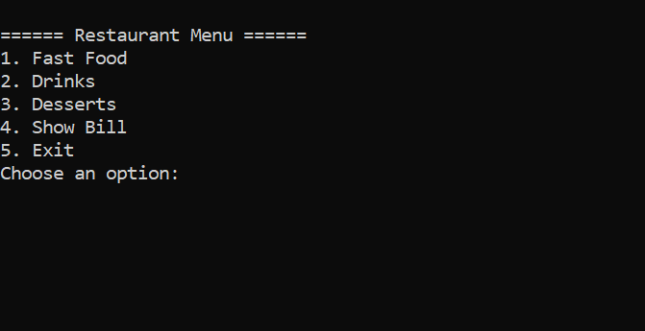
Output Screenshots
Menu screen

Slide 11
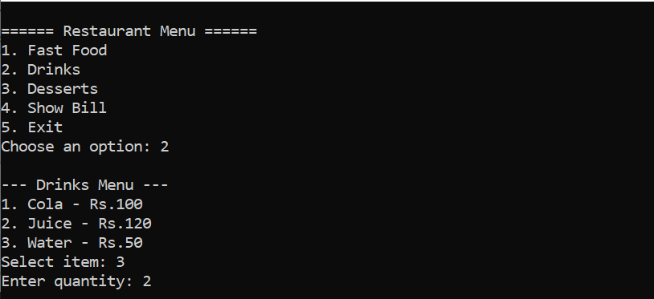
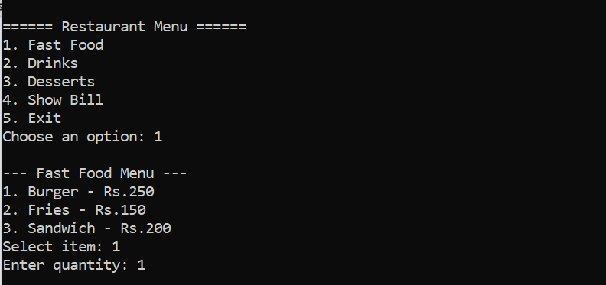
Output Screenshots
Order input

Slide 12
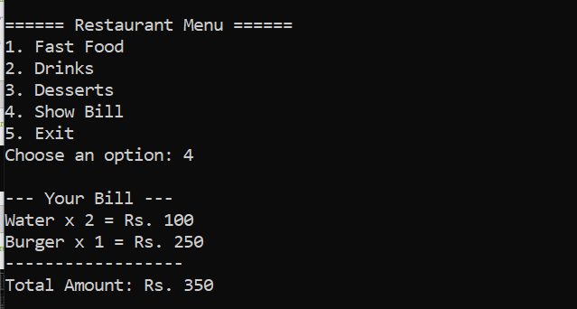
Output Screenshots
Final bill display

Slide 13
Challenges Faced
Managing multiple categories using simple logic
Input validation without advanced data types
Avoiding repetition with loops

Slide 14
Learnings
Practice with basic C++ syntax
Use of nested conditions and loops
Building real-time logic in console apps
Simulating real-world systems

Slide 15
Conclusion
The project demonstrates how even basic programming concepts can be used to create functional applications.
Can be extended later with:
File handling
User login
Data storage

Slide 16
Thanks
Questions and Answers?
Thank You for Your Attention!

