Slide 1
ARIA
Adaptive Response Intelligence Automation
AI-Assisted SOC/SOAR Platform
Ghazi Mabrouki
Final-Year Project | Huawei Technologies | 2026
Notes:
<!--pageType:cover-->

Slide 2
CONTENTS
01
The SOC Challenge
Problem statement & identified gap
05
AI-Assisted Operations
AI response & remediation
02
ARIA Overview & Objectives
Platform introduction & goals
06
Architecture & Deployment
System design & CI/CD
03
Data Collection & Ingestion
Multi-layer telemetry sources
07
Security & Validation
Controls & testing evidence
04
Intelligence Pipeline
From raw data to incidents
08
Value & Roadmap
Impact & future enhancements
GHAZI MABROUKI
Notes:
<!--pageType:table_of_contents-->

Slide 3
01
CHAPTER 01
The SOC Challenge
Why modern SOC environments struggle to keep pace with threats
Notes:
<!--pageType:chapter-->

Slide 4
01 SOC
02 ARIA
03 DATA
04 INTEL
05 AI
06 ARCH
07 SEC
08 PLAN
The Modern SOC Problem
Fragmented Tools
Heterogeneous Data
Alert Fatigue
Multiple disconnected security systems generate alerts in isolation, with no unified view of the threat landscape.
Different formats and schemas across network, host, and runtime sources make unified processing extremely difficult.
Thousands of noisy, low-value alerts overwhelm analysts, burying critical threats in a flood of false positives.
Expert Dependency
Slow Response
No Audit Trail
Manual correlation across host, network, runtime, and metrics demands scarce senior analyst expertise.
Unverified manual fixes leave windows of exposure open for extended periods, increasing breach risk.
Inconsistent traceability makes compliance reporting difficult and post-incident analysis nearly impossible.
Result: SOC teams spend most of their time on repetitive tasks instead of strategic threat hunting.
GHAZI MABROUKI
4
Notes:
<!--pageType:content-->

Slide 5
01 SOC
02 ARIA
03 DATA
04 INTEL
05 AI
06 ARCH
07 SEC
08 PLAN
State of the Art & Identified Gap
Category | Examples | Strengths | Limitations
Traditional SIEM | Splunk, IBM QRadar | Mature, comprehensive log management | Expensive licensing; complex deployment
EDR / XDR | CrowdStrike, SentinelOne | Advanced endpoint threat detection | Endpoint-only; no network/runtime view
SOAR Platform | Palo Alto XSOAR | Rich automation & playbook ecosystem | Costly integration; steep learning curve
Open-Source Stack | Wazuh + ELK | Free, flexible, community-driven | No built-in SOAR or AI capabilities
Cloud-Native | Azure Sentinel | Tight cloud integration, scalable | Vendor lock-in; cloud-only architecture
IDENTIFIED GAP
No open, integrated solution combines multi-layer monitoring + automatic enrichment + AI analysis + human-controlled remediation in a single deployable platform.
GHAZI MABROUKI
5
Notes:
<!--pageType:content-->

Slide 6
02
CHAPTER 02
ARIA Overview & Objectives
An intelligent, open SOAR/SOC automation platform
Notes:
<!--pageType:chapter-->

Slide 7
01 SOC
02 ARIA
03 DATA
04 INTEL
05 AI
06 ARCH
07 SEC
08 PLAN
What is ARIA?
ARIA is an intelligent SOC/SOAR platform connecting monitoring foundation to backend intelligence and a Next.js dashboard.
INGEST
ENRICH
ASSIST
VERIFY
Poll Elasticsearch indices continuously. Transform heterogeneous raw documents into a unified common alert model.
Sources: Wazuh, Suricata, Falco, Telegraf
Add GeoIP location, MITRE ATT&CK context. Remove duplicates and filter noise. Group related alerts into incidents.
GeoIP, MITRE, dedup, correlation
Generate AI-powered investigation summaries, risk scores, and narratives. Propose Ansible playbooks with analyst approval gates.
LLM-powered, human-in-the-loop
Execute playbooks, re-check evidence, archive closed cases with complete audit trail for compliance.
Execute, verify, archive, audit
GHAZI MABROUKI
7
Notes:
<!--pageType:content-->

Slide 8
01 SOC
02 ARIA
03 DATA
04 INTEL
05 AI
06 ARCH
07 SEC
08 PLAN
Key Objectives
Centralized Visibility
Event Ingestion
Normalization & Enrichment
Correlation & Detection
Multi-layer monitoring across network, host, runtime, and infrastructure in one unified view
Multi-source pipeline ingesting alerts from Wazuh, Suricata, Falco, and Telegraf via Elasticsearch
Common alert model with GeoIP, MITRE ATT&CK mapping, and contextual enrichment
Time-windowed and indicator-based incident grouping to reconstruct attack chains
AI-Assisted Investigation
Incident Management
Automated Response
Monitoring & Auditability
LLM-powered analysis generating summaries, risk scores, and remediation narratives
Full lifecycle tracking: open, investigating, resolved, archived with status controls
Ansible playbooks with analyst approval gates for safe, controlled remediation
Complete traceability of every action, decision, and transition for compliance
GHAZI MABROUKI
8
Notes:
<!--pageType:content-->

Slide 9
01 SOC
02 ARIA
03 DATA
04 INTEL
05 AI
06 ARCH
07 SEC
08 PLAN
ARIA End-to-End Workflow
Wazuh | Suricata
Falco | Telegraf
ARIA Backend
Map | Enrich | Dedup | Correlate
Elasticsearch
AI Analysis
Incident
REMEDIATION FLOW
Analyst Review
Approval Gate
Ansible
Verify
Archive
4 Sources
12 Steps
AI-Assisted
Full Audit
Monitoring tools
Pipeline stages
Human-in-the-loop
Complete traceability
GHAZI MABROUKI
9
Notes:
ARIA's end-to-end workflow: Security tools (Wazuh, Suricata, Falco, Telegraf) generate events that are collected into Elasticsearch. ARIA backend polls ES using cursor-based ingestion, then processes alerts through mapping (source-specific parsers), enrichment (GeoIP, MITRE), deduplication (Redis + DB checks), and correlation (time-windowed grouping). AI analysis generates investigation summaries, risk scores, and proposed playbooks. Incidents are presented to analysts for review and approval. Approved playbooks execute via Ansible with staged remediation, verification, and archival.
<!--pageType:content-->

Slide 10
03
CHAPTER 03
Data Collection & Ingestion
Multi-layer telemetry from the entire attack surface
Notes:
<!--pageType:chapter-->

Slide 11
01 SOC
02 ARIA
03 DATA
04 INTEL
05 AI
06 ARCH
07 SEC
08 PLAN
Data Sources & Monitoring Stack
NETWORK
HOST
RUNTIME
INFRA
Suricata
Wazuh
Falco
Telegraf
NIDS with deep packet inspection. Generates EVE JSON alerts for suspicious traffic, malware, and intrusion patterns.
HIDS with agent-based monitoring. Tracks authentication events, file integrity, policy violations, and system anomalies.
eBPF-based syscall monitoring for containers and hosts. Detects runtime threats, privilege escalation, and anomalous process behavior.
System metrics collection: CPU, RAM, disk I/O, network throughput, and process monitoring for performance baselines.
COLLECTION LAYER
Filebeat forwards Wazuh & Suricata logs | Falcosidekick routes Falco events | All stored in Elasticsearch
GHAZI MABROUKI
11
Notes:
<!--pageType:content-->

Slide 12
01 SOC
02 ARIA
03 DATA
04 INTEL
05 AI
06 ARCH
07 SEC
08 PLAN
Alert Ingestion Pipeline
Cursor-Based Polling
Redis
Per-source cursors
For each source index pattern, ARIA maintains a per-source cursor (last processed timestamp) in Redis. Queries only fetch events newer than the cursor.
Adaptive pacing: many alerts = brief sleep; empty = polling interval.
Asynchronous: each source polled independently.
wazuh-alerts-*
falco-*
ARIA
Polling
Engine
suricata/filebeat-*
telegraf-*
Timestamp Cursors
No events missed or reprocessed
Adaptive Pacing
Dynamic sleep between batches
Async Sources
Independent per-source polling
Index Patterns
Wildcard source matching
GHAZI MABROUKI
12
Notes:
<!--pageType:content-->

Slide 13
04
CHAPTER 04
Intelligence Pipeline
From raw documents to actionable incidents
Notes:
<!--pageType:chapter-->

Slide 14
01 SOC
02 ARIA
03 DATA
04 INTEL
05 AI
06 ARCH
07 SEC
08 PLAN
Normalization & Enrichment
RAW ALERT
NORMALIZED SOC ALERT
{
"_index": "wazuh-alerts-4.x-2026.01.15",
"_source": {
"timestamp": "2026-01-15T08:23:17Z",
"rule": {
"id": "5712", "level": 10,
"description": "SSHD brute force..."
},
"agent": {"name": "web-server-01",
"ip": "192.168.1.50"},
"srcip": "203.0.113.44",
"location": "/var/log/auth.log"
}
}
title: SSH Brute Force Attack Detected
severity: 10 (high)
source: Wazuh
timestamp: 2026-01-15T08:23:17Z
source_ip: 203.0.113.44
hostname: web-server-01
rule_name: ssh_brute_force
geoip.country: CN (China)
geoip.city: Beijing
mitre.tactic: Credential Access
mitre.tech: T1110 (Brute Force)
MAP
Source-Specific Mappers: wazuh.py | suricata.py | falco.py | filebeat.py | generic.py → Common Alert Model
GHAZI MABROUKI
14
Notes:
<!--pageType:content-->

Slide 15
01 SOC
02 ARIA
03 DATA
04 INTEL
05 AI
06 ARCH
07 SEC
08 PLAN
Deduplication & Noise Filtering
Ordered logic: deduplicate first → filter noise second → enrich third
STAGE 1: DEDUPLICATION
STAGE 2: NOISE FILTERING
Layered duplicate detection in three tiers:
1. Redis keys — short-term repeat detection (seconds)
2. In-memory set — within-cycle repeat tracking
3. DB check — already-persisted duplicate lookup
Sigma rules identify known-noisy event categories:
Low-value DNS queries and NXDOMAIN floods
Routine HTTP probes, protocol chatter, ICMP
Container noise — routine Falco activity
Only alerts above severity threshold that survive both stages become active and proceed to correlation
GHAZI MABROUKI
15
Notes:
<!--pageType:content-->

Slide 16
01 SOC
02 ARIA
03 DATA
04 INTEL
05 AI
06 ARCH
07 SEC
08 PLAN
Incident Correlation
CORRELATION SIGNALS
EXAMPLE SCENARIO
Source IP — same attacker origin
Hostname — same target asset
MITRE pattern — tactic/technique match
Kill-chain — attack progression
Time window — temporal proximity
User/Container — entity scope
Suricata: Port scan detected from 203.0.113.44
+
Correlated Incident
3 related alerts grouped
Confidence: HIGH
Source IP: 203.0.113.44
Target: web-server-01
Wazuh: SSH brute-force from 203.0.113.44
+
Falco: Shell activity on web-server-01
=
INCIDENT LIFECYCLE
OPEN
INVESTIGATING
RESOLVED
ARCHIVED
GHAZI MABROUKI
16
Notes:
<!--pageType:content-->

Slide 17
05
05 — AI-Assisted Operations
Artificial intelligence that supports, never replaces, the analyst
Notes:
<!--pageType:chapter-->

Slide 18
SOC CHALLENGE
OVERVIEW
DATA
PIPELINE
AI OPERATIONS
ARCHITECTURE
SECURITY
VALUE
AI Response Engine
Reference: main.pdf Section 3.12
1
2
3
CONTEXT BUILDING
PROVIDER ROUTING
STRUCTURED OUTPUT
Alert timeline from incident
Indicators — IPs, hashes, URLs
MITRE ATT&CK tactics & techniques
Behavioral history patterns
Risk score calculation
Host & network context
Multi-LLM client architecture
Ollama — local models
Google Gemini API
OpenRouter gateway
NVIDIA NIM inference
Graceful fallback on failure
Executive summary
Attack narrative timeline
Risk assessment level
Playbook (YAML)
Parsed into Investigation model
Malformed output fallback
AI is a fallible assistant — output is always parsed, validated, and constrained before presentation
GHAZI MABROUKI
18
Notes:
The AI Response Engine operates as a three-stage pipeline. Stage 1 (Context Building) aggregates all relevant alert data, indicators, MITRE ATT&CK context, and behavioral history into a structured prompt. Stage 2 (Provider Routing) implements a multi-LLM client with support for Ollama (local), Google Gemini, OpenRouter, and NVIDIA NIM, with automatic fallback between providers. Stage 3 (Structured Output) parses the LLM response into a validated Investigation model containing summary, narrative, risk assessment, and playbook YAML. The AI is always treated as fallible — its output is parsed, validated, and never acted upon without analyst review.
<!--pageType:content-->

Slide 19
SOC CHALLENGE
OVERVIEW
DATA
PIPELINE
AI OPERATIONS
ARCHITECTURE
SECURITY
VALUE
Controlled Remediation & Verification
Reference: main.pdf Sections 3.13-3.14
INVESTIGATION LIFECYCLE
PENDING
AWAITING APPROVAL
APPROVED
RUNNING
COMPLETED
ARCHIVED
DECLINED
FAILED
APPROVAL TYPES
STAGED EXECUTION
Manual
1. Baseline — Record current system state
2. Dry-Run — Simulate changes safely
3. Containment — Isolate the threat
4. Hardening — Apply security fixes
5. Forensics — Collect evidence
6. Verification — Confirm resolution
Analyst must explicitly review and approve every remediation action
Auto-Approved
Low-risk actions execute automatically based on configured policy
Blocked
Critical or high-risk actions are prevented regardless of approval
Every sensitive transition is persisted as an audit event with actor, timestamp, and full context
GHAZI MABROUKI
19
Notes:
Remediation in ARIA is strictly separated from proposal. The AI may generate a playbook, but execution is always gated by an approval mechanism. The investigation lifecycle follows six states: pending, awaiting_approval, approved/declined, running, completed/failed, and archived. Three approval types exist: manual (analyst decides), auto-approved (low-risk only), and blocked (critical/high-risk). Execution follows six stages: baseline, dry-run, containment, hardening, forensics, and verification. The verifier re-checks evidence before closing — execution success is never assumed. Every sensitive transition is persisted as an audit event.
<!--pageType:content-->

Slide 20
SOC CHALLENGE
OVERVIEW
DATA
PIPELINE
AI OPERATIONS
ARCHITECTURE
SECURITY
VALUE
SOC Analyst Dashboard
Reference: main.pdf Chapter 4
KPI Cards
Alert Triage
Incident Detail
AI Investigation
IPS Attack Map
Alert counts, investigation stats, and trend indicators at a glance
Severity badges, source labels, and triage filters for rapid sorting
Correlated alerts with status controls and timeline visualization
AI summary, risk assessment, evidence, and generated playbook
GeoIP-located attack origins with interactive world map view
Runtime Security
Performance Metrics
AI Assistant
AI Operator
Asset Management
Container and syscall monitoring with Falco integration
Infrastructure monitoring — CPU, RAM, disk, network, processes
Conversational queries for threat intelligence and investigation
Natural language to Ansible playbook generation and execution
Multi-server scoped views with per-asset alert filtering
GHAZI MABROUKI
20
Notes:
<!--pageType:content-->

Slide 21
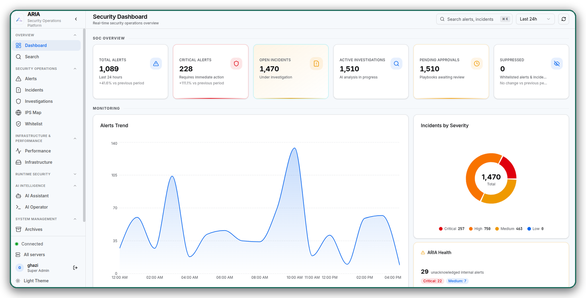
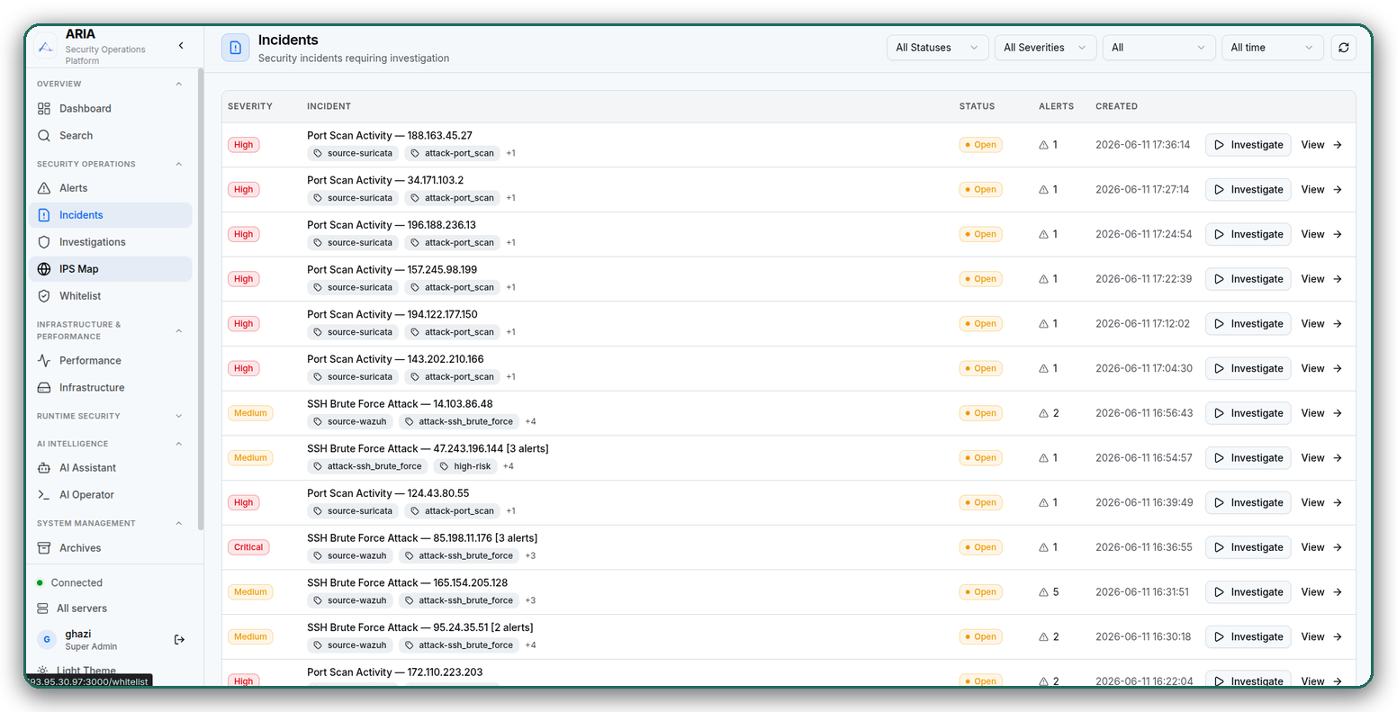
The ARIA Platform — Live Product
Real-time SOC dashboard
Correlated incident queue
Captured from the running system — a live demonstration follows.

Slide 22
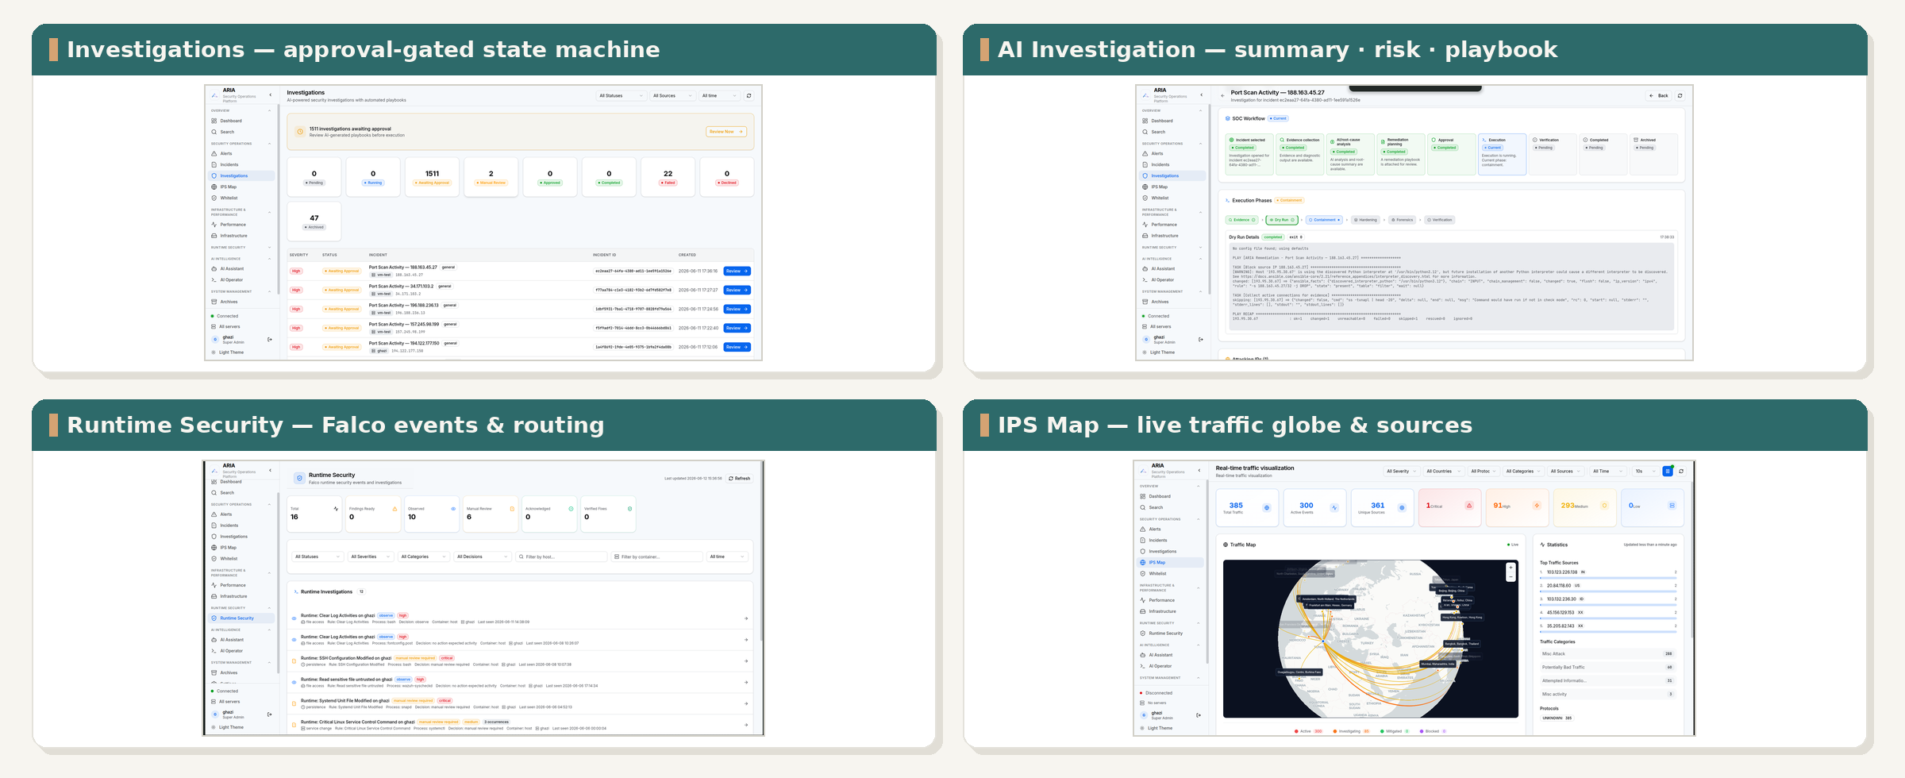
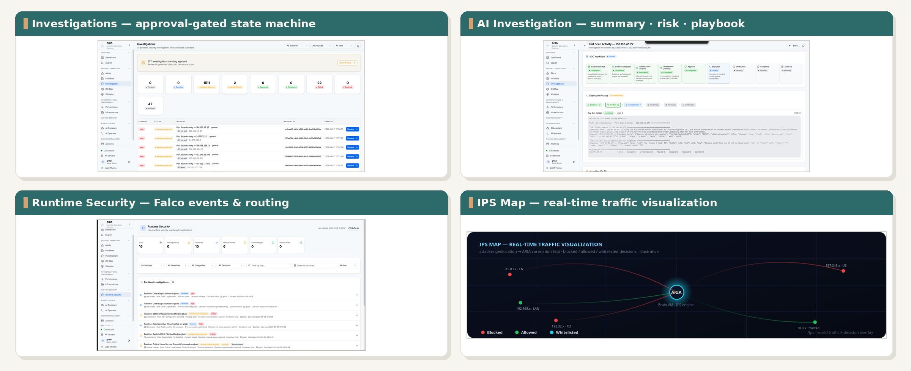
Platform Tour — Detection & Investigation
Captured from the running system — investigation, runtime & traffic views.
GHAZI MABROUKI
22
Notes:
<!--pageType:content-->

Slide 23
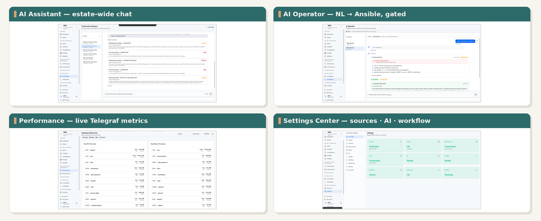
Platform Tour — AI & Operations
Estate-wide assistant, natural-language operator, live metrics & settings.
GHAZI MABROUKI
23
Notes:
<!--pageType:content-->

Slide 24
06
06 — Architecture & Deployment
Four-tier stack deployed on Huawei Cloud
Notes:
<!--pageType:chapter-->

Slide 25
SOC CHALLENGE
OVERVIEW
DATA
PIPELINE
AI OPERATIONS
ARCHITECTURE
SECURITY
VALUE
Logical Architecture
Reference: main.pdf Sections 3.3-3.5
FRONTEND
Next.js Dashboard — SWR API client, WebSocket real-time updates, responsive UI
API LAYER
FastAPI — REST endpoints, CORS, rate limiting, WebSocket for live updates
WORKFLOW
Pipeline (poll, map, enrich, dedup, correlate) • Incident Manager • AI Response • Operator
INFRA
ES 7.17 (telemetry) • Redis (cache/cursors) • SQLite (state) • Ansible (execution) • LLM
Technology Stack: FastAPI • Next.js • Elasticsearch 7.17 • Redis • SQLite + SQLAlchemy • MITRE ATT&CK • Sigma
GHAZI MABROUKI
25
Notes:
The logical architecture consists of four cooperating layers. The Frontend layer (Next.js, SWR, WebSocket) provides the analyst interface. The API layer (FastAPI, REST, rate limiting) handles all client requests. The Workflow layer contains the core intelligence engines: alert pipeline, incident manager, AI response engine, and operator. The Infrastructure layer provides data persistence and external integrations: Elasticsearch for telemetry, Redis for caching and cursors, SQLite for workflow state, Ansible for execution, and LLM providers for AI assistance.
<!--pageType:content-->

Slide 26
SOC CHALLENGE
OVERVIEW
DATA
PIPELINE
AI OPERATIONS
ARCHITECTURE
SECURITY
VALUE
Physical Deployment Architecture
Reference: ARIA_ARCHITECTURE.md
BRAIN VM — CENTRAL ECS
ARIA DOCKER COMPOSE
Ubuntu 24 • Huawei Cloud ECS • demonstrated: 64 vCPU / 128 GB RAM
Redis — port 6380 (cache, cursors)
FastAPI — port 8001 (backend API)
Worker — async task processing
Next.js — port 3001 (frontend)
Core Services:
Elasticsearch 7.17.13
Kibana
Wazuh Manager 4.5.4
Filebeat
Suricata (NIDS)
Runtime & Security:
Falco + Falcosidekick
Telegraf
Fail2Ban
UFW Firewall
MONITORED VMs
Wazuh Agent • Filebeat • Suricata
Falco • Telegraf
NETWORK TOPOLOGY
KEY PORTS
VPC → Private Subnet → Security Groups → Elastic IP → Brain VM
9200 ES / 5601 Kibana / 6380 Redis / 8001 API / 3001 UI / 55000 Wazuh
Deliberate Installation Order: Search core first → Security tools → Detection rules → ARIA stack → Agents
GHAZI MABROUKI
26
Notes:
The physical deployment runs on Huawei Cloud with a VPC containing an isolated private subnet and security groups. The central Brain VM (64 vCPU, 128GB RAM) runs Ubuntu 24 and hosts all core services: Elasticsearch 7.17.13, Kibana, Wazuh Manager 4.5.4, Filebeat, Suricata, Falco with Falcosidekick, Telegraf, Fail2Ban, and UFW. The ARIA stack runs as Docker Compose with Redis (port 6380), FastAPI (8001), Worker, and Next.js frontend (3001). Monitored VMs run Wazuh Agent, Filebeat, Suricata, Falco, and Telegraf. A deliberate installation ordering ensures the search core comes first, then security tools, then detection rules.
<!--pageType:content-->

Slide 27
SOC CHALLENGE
OVERVIEW
DATA
PIPELINE
AI OPERATIONS
ARCHITECTURE
SECURITY
VALUE
CI/CD & Infrastructure Automation
Reference: BRAIN_VM_SETUP.md
DEPLOYMENT SCRIPTS
Script | Purpose
siem_setup.sh | Elasticsearch + Kibana + Filebeat with TLS encryption
wazuh_setup.sh | Wazuh Manager 4.5.4 with agent registration
suricata_setup.sh | NIDS with automatic interface detection
setup-falco.sh | Runtime threat detection with Falcosidekick
telegraf_setup.sh | System metrics collection
hardening_setup.sh | Fail2Ban + UFW + SSH hardening
DEPLOYMENT METHODS
Docker Compose
Ansible Playbooks
Installation Ordering
ARIA stack: Redis, FastAPI, Worker, Next.js with orchestrated startup
Mass deployment to monitored VMs with idempotent configuration
Search core → Security tools → Detection rules → ARIA stack → Agents
GHAZI MABROUKI
27
Notes:
ARIA uses a fully scripted deployment approach for reproducibility. The setup_script_telegraf.sh orchestrates installation with per-component flags. Individual scripts handle each service: siem_setup.sh installs Elasticsearch, Kibana, Filebeat with TLS; wazuh_setup.sh deploys Wazuh Manager 4.5.4; suricata_setup.sh configures the NIDS with interface detection; setup-falco-server-elastic.sh sets up runtime detection; telegraf_setup.sh handles metrics collection; hardening_setup.sh applies Fail2Ban, UFW, and SSH hardening. The ARIA application stack runs via Docker Compose. Ansible handles mass deployment to monitored VMs. The deliberate ordering ensures dependencies are satisfied: search core first, then security tools, then detection rules.
<!--pageType:content-->

Slide 28
07
07 — Security & Validation
Security by design, validated by evidence
Notes:
<!--pageType:chapter-->

Slide 29
SOC CHALLENGE
OVERVIEW
DATA
PIPELINE
AI OPERATIONS
ARCHITECTURE
SECURITY
VALUE
Security by Design
Reference: main.pdf Section 3.16
No Blind Execution
Approval Gate
Admin-Secret Gate
AI must produce a preview and risk classification before any action is taken. No automated remediation without structured output.
Explicit analyst decision required for every remediation action. Three modes: manual, auto-approved (low-risk), blocked (critical).
Protected endpoints require the X-ARIA-Admin-Secret header. Admin-level operations are cryptographically gated.
Asset Validation
Secret Handling
Verification + Audit
Execution requires a concrete target asset. Global or wildcard selections are rejected to prevent accidental mass actions.
Passwords and keys are redacted from all logs and API responses. Secrets never transit in plaintext.
Evidence is re-checked before case closure. Every sensitive transition is persisted with actor, timestamp, and full context.
HUMAN-IN-THE-LOOP: AI proposes • Analyst reviews • System validates and controls
GHAZI MABROUKI
29
Notes:
ARIA implements six security control mechanisms: (1) No blind execution — the AI must produce a preview and risk classification before any action; (2) Approval gate — explicit analyst decision required for remediation; (3) Admin-secret gate — protected endpoints require the X-ARIA-Admin-Secret header; (4) Asset validation — execution requires a concrete target, global selections are rejected; (5) Secret handling — passwords and keys are redacted from logs and API responses; (6) Verification plus audit logging — every sensitive transition is persisted with actor, timestamp, and context. The core principle is human-in-the-loop: AI proposes, analyst reviews, system validates and controls.
<!--pageType:content-->

Slide 30
SOC CHALLENGE
OVERVIEW
DATA
PIPELINE
AI OPERATIONS
ARCHITECTURE
SECURITY
VALUE
Validation & Testing Results
Reference: main.pdf Chapter 6
910
146
200 OK
Tests passing (May acceptance)
Python Modules
API health verified
Multi-Server Scoping Validated
SERVICE VALIDATION MATRIX
Component | Status | Evidence
Backend Build | PASS | Lint and build complete, no errors
Frontend TypeScript | PASS | Type check and build pass
API Root | PASS | HTTP 200 OK response
Elasticsearch Indices | PASS | All source families with document counts
Remediation Workflow | PASS | Observe/no-remediation safety + full 9-stage
Systemd Services | PASS | All services active and healthy
End-to-end SOC scenarios demonstrated with live data across all monitoring layers
GHAZI MABROUKI
30
Notes:
<!--pageType:content-->

Slide 31
08
08 — Value & Roadmap
From prototype to production-ready SOC platform
Notes:
<!--pageType:chapter-->

Slide 32
SOC CHALLENGE
OVERVIEW
DATA
PIPELINE
AI OPERATIONS
ARCHITECTURE
SECURITY
VALUE
Value of ARIA
Reference: main.pdf General Conclusion
Faster Investigation
Better Correlation
Reduced Alert Fatigue
AI-generated summaries and narratives reduce manual analysis time. Analysts get context-rich investigations instantly.
Time-windowed and indicator-based grouping reconstructs complete attack chains from isolated alerts.
Deduplication and Sigma noise filtering suppress repetitive and low-value alerts before they reach analysts.
Stronger Visibility
Consistent Response
Improved Efficiency
Network + host + runtime + metrics in a unified monitoring stack. No blind spots across the attack surface.
Approval-gated Ansible playbooks with verification ensure every response follows the same controlled process.
Analysts focus on decisions, not repetitive tasks. The platform handles correlation, enrichment, and documentation.
910 TESTS (MAY ACCEPTANCE) | 146 MODULES | 12-STEP PIPELINE | MULTI-SERVER DEPLOYMENT
GHAZI MABROUKI
32
Notes:
<!--pageType:content-->

Slide 33
SOC CHALLENGE
OVERVIEW
DATA
PIPELINE
AI OPERATIONS
ARCHITECTURE
SECURITY
VALUE
Roadmap & Future Enhancements
Reference: main.pdf Section 6.9
Current Limits (Honest)
Future Roadmap
Single-node Brain model — no ES clustering or HA
SQLite as operational-state SPOF
Mutable latest Docker tags
Production hardening of TLS/SSH/authorization needs review
Detection Model Improvement — More Sigma rules, behavioral baselines
Additional Connectors — More data sources and ingestion paths
Threat Intelligence Feeds — STIX/TAXII integration
ML Anomaly Detection — Statistical + ML beyond threshold-based
Expanded Playbooks — Broader Ansible coverage
Multi-Tenant & HA — ES cluster, PostgreSQL migration
Scalability Optimization — Distributed processing
Acknowledging limits is the first step toward a production-ready platform
GHAZI MABROUKI
33
Notes:
<!--pageType:content-->

Slide 34
ARIA
From raw data to intelligent SOC operations.
The platform thinks before acting.
Ghazi Mabrouki
Adaptive Response Intelligence Automation | Huawei Technologies
Thank You
Questions & Discussion
Notes:
<!--pageType:final-->

