Slide 1
Title
**ARIA**
Adaptive Response Intelligence Automation
**AI-Assisted Security Operations, Incident Response, and Remediation Platform**
**Ghazi Mabrouki**
Professional Final Year Project (PFE) — Huawei Technologies
ESPRIT University — Academic Year 2025–2026

Slide 2
Problem Statement
SOC Operations Are Fragmented and Slow
Challenge | Impact
 | **Fragmented tools**
 | **Heterogeneous data**
 | **Alert overload**
 | **Expert dependency**
 | **No closed loop**
**Result:** analysts spend more time switching tools than acting on incidents.

Slide 3
Project Objectives
Three Pillars
1. **Visibility**
◦ Centralize host, network, runtime, and metric telemetry
◦ Normalize alerts into one common operational model
2. **Intelligence**
◦ Correlate alerts into incidents
◦ Explain incidents and generate Ansible playbooks with AI
3. **Controlled Response**
◦ Human approval gate for every sensitive action
◦ Verify fixes before archiving; full audit trail

Slide 4
State of the Art
SOC / SOAR Market Landscape
Solution | Strength | Limitation
 | Splunk Enterprise Security | Powerful SIEM, rich apps
 | IBM QRadar | Correlation, asset DB
 | Microsoft Sentinel | Cloud-native, AI alerts
 | Palo Alto XSOAR | Strong playbook marketplace
 | Wazuh + ELK | Open, good visibility
 | Falcon / SentinelOne | EDR-centric

Slide 5
Identified Gap
What Is Missing?
No existing solution combines **multi-layer monitoring** (host, network, runtime, metrics) with **alert enrichment**, **incident correlation**, **AI-generated playbooks**, and **human-controlled Ansible remediation** in a single, open, local-deployment platform.
ARIA fills this gap by turning raw telemetry into actionable, approved, verifiable incidents.

Slide 6
Three-Phase Roadmap
From Infrastructure to Intelligence
┌─────────────┐ ┌─────────────────┐ ┌─────────────────────┐
│ Phase 1 │ ──► │ Phase 2 │ ──► │ Phase 3 │
│ Monitoring │ │ Cloud Infra │ │ Backend Intelligence│
│ Foundation │ │ Huawei Cloud │ │ ARIA Platform │
└─────────────┘ └─────────────────┘ └─────────────────────┘
Jan–Feb Feb–Mar Mar–Jul
• **Phase 1:** Elasticsearch, Kibana, Wazuh, Suricata, Falco, Filebeat, Telegraf, Redis
• **Phase 2:** VPC, subnet, security group, EIP, ECS on Huawei Cloud
• **Phase 3:** ARIA backend, dashboard, AI response, controlled remediation, onboarding
┌─────────────┐ ┌─────────────────┐ ┌─────────────────────┐ │ Phase 1 │ ──► │ Phase 2 │ ──► │ Phase 3 │ │ Monitoring │ │ Cloud Infra │ │ Backend Intelligence│ │ Foundation │ │ Huawei Cloud │ │ ARIA Platform │ └─────────────┘ └─────────────────┘ └─────────────────────┘ Jan–Feb Feb–Mar Mar–Jul

Slide 7
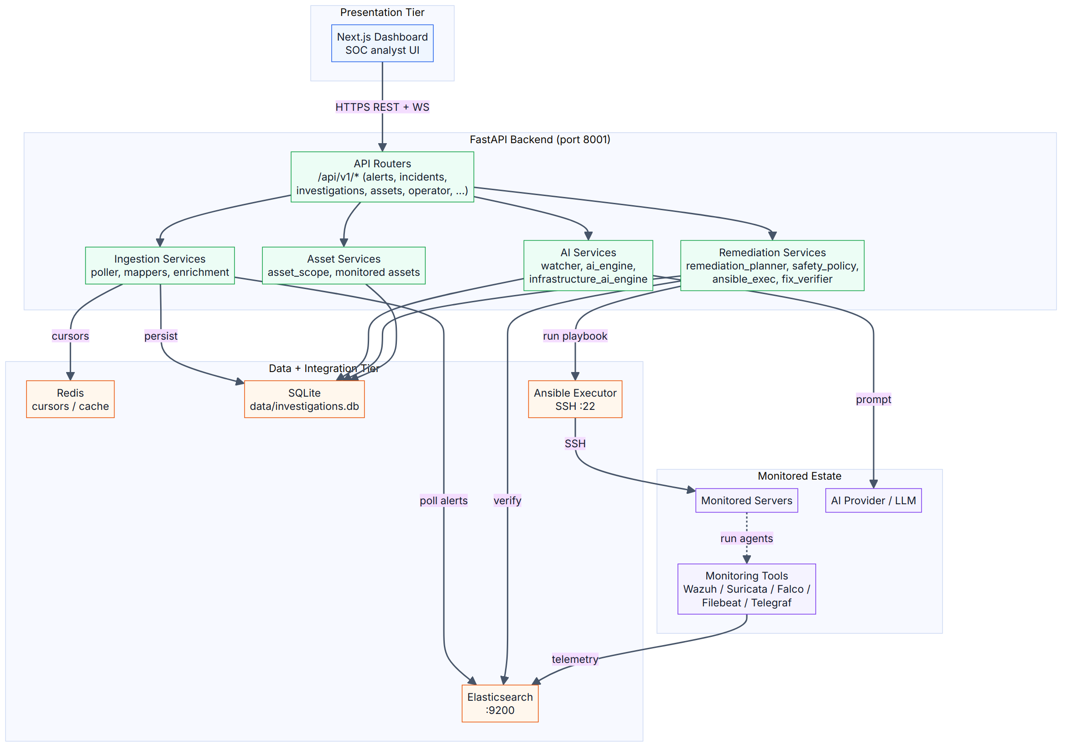
High-Level Architecture
Four-Tier SOC Automation Stack
• **Presentation:** Next.js dashboard
• **API:** FastAPI + REST/WebSocket
• **Workflow:** Pipeline, correlation, AI engine, operator, runtime, infrastructure
• **Data + Integration:** Elasticsearch, Redis, SQLite, Ansible, monitored assets

Slide 8
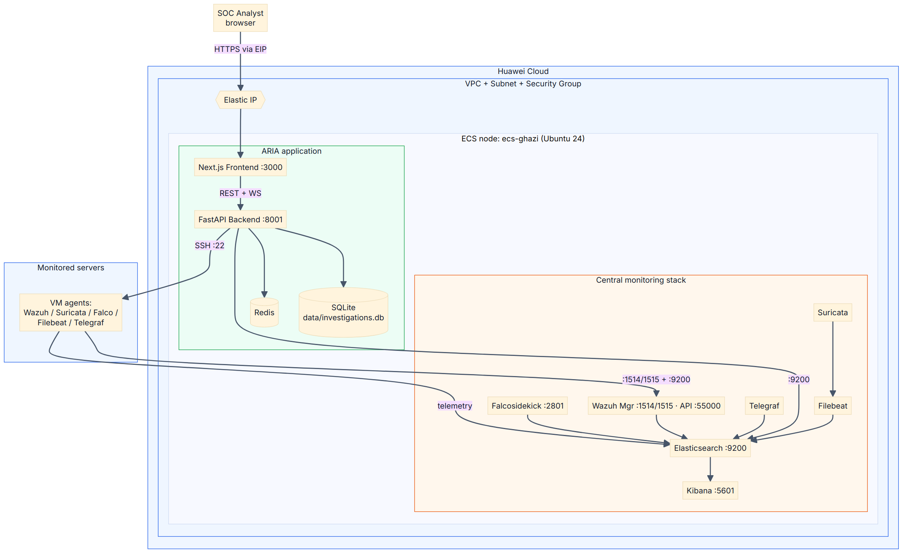
Deployment Architecture
Brain VM + Monitored VM on Huawei Cloud
• Public Elastic IP → Security Group → ECS instances
• Brain VM hosts Elasticsearch, Kibana, Redis, ARIA backend, frontend
• Monitored VM runs Wazuh agent, Filebeat, Falco, Telegraf
• **Elasticsearch and Redis remain internal only**

Slide 9
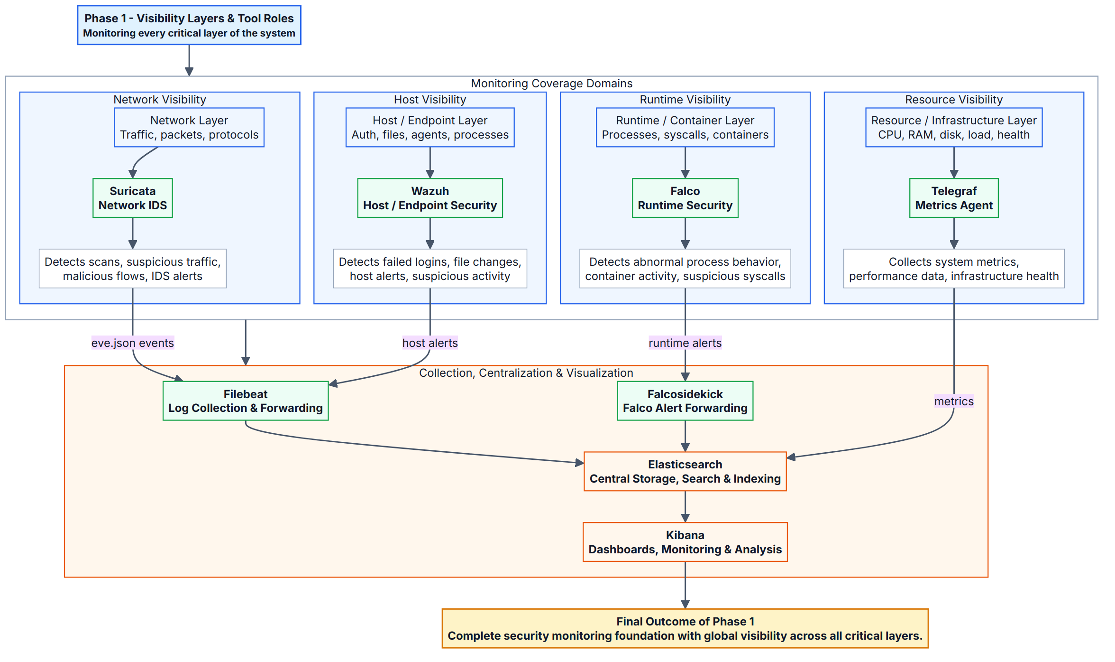
Phase 1: Visibility Layers & Tools
Monitoring Foundation
Layer | Tool | Data
 | Host | Wazuh
 | Network | Suricata + Filebeat
 | Runtime | Falco
 | Metrics | Telegraf
 | Cache / State | **Redis**

Slide 10
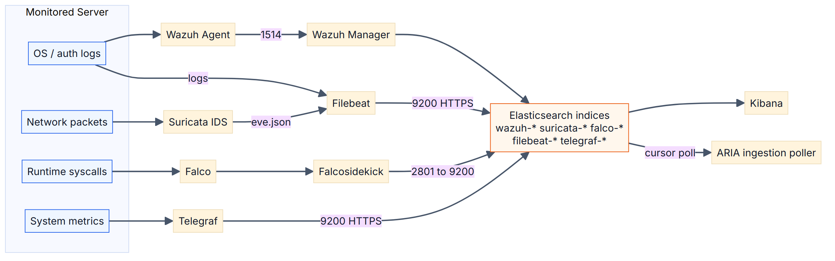
Phase 1: Data Flow
From Agents to Elasticsearch
1. Wazuh, Suricata, Falco, Telegraf produce events
2. Filebeat / Falcosidekick forward to Elasticsearch
3. Kibana visualizes raw telemetry
4. ARIA polls the same Elasticsearch indices

Slide 11
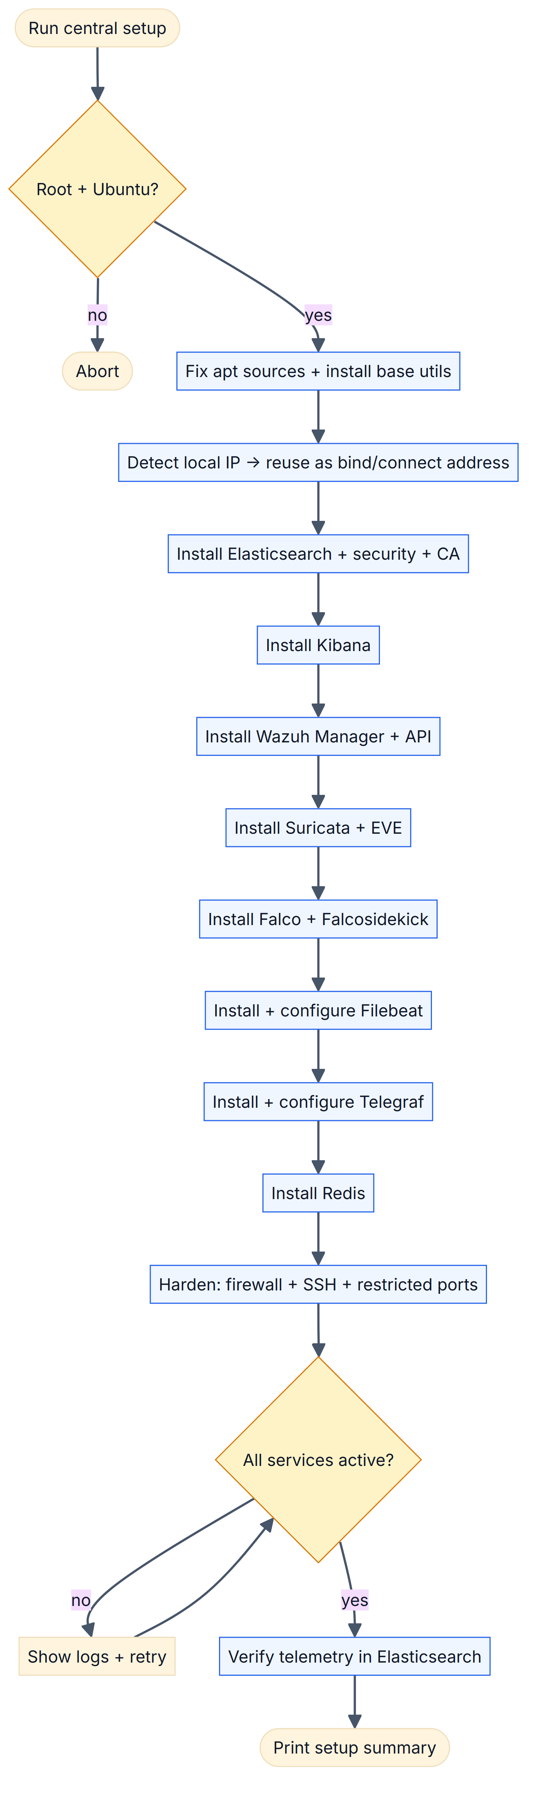
Central Setup Script Flow
Automated Foundation Deployment
• One orchestrator script installs every component
• Per-component flags allow selective reinstall
• Each script is idempotent: detect → remove → install → configure → verify

Slide 12
Hardening & Validation
Central Server Security
Control | Implementation
 | Firewall
 | SSH brute-force
 | Service exposure
 | TLS
 | Secrets
Validation: service health checks + Kibana index verification

Slide 13
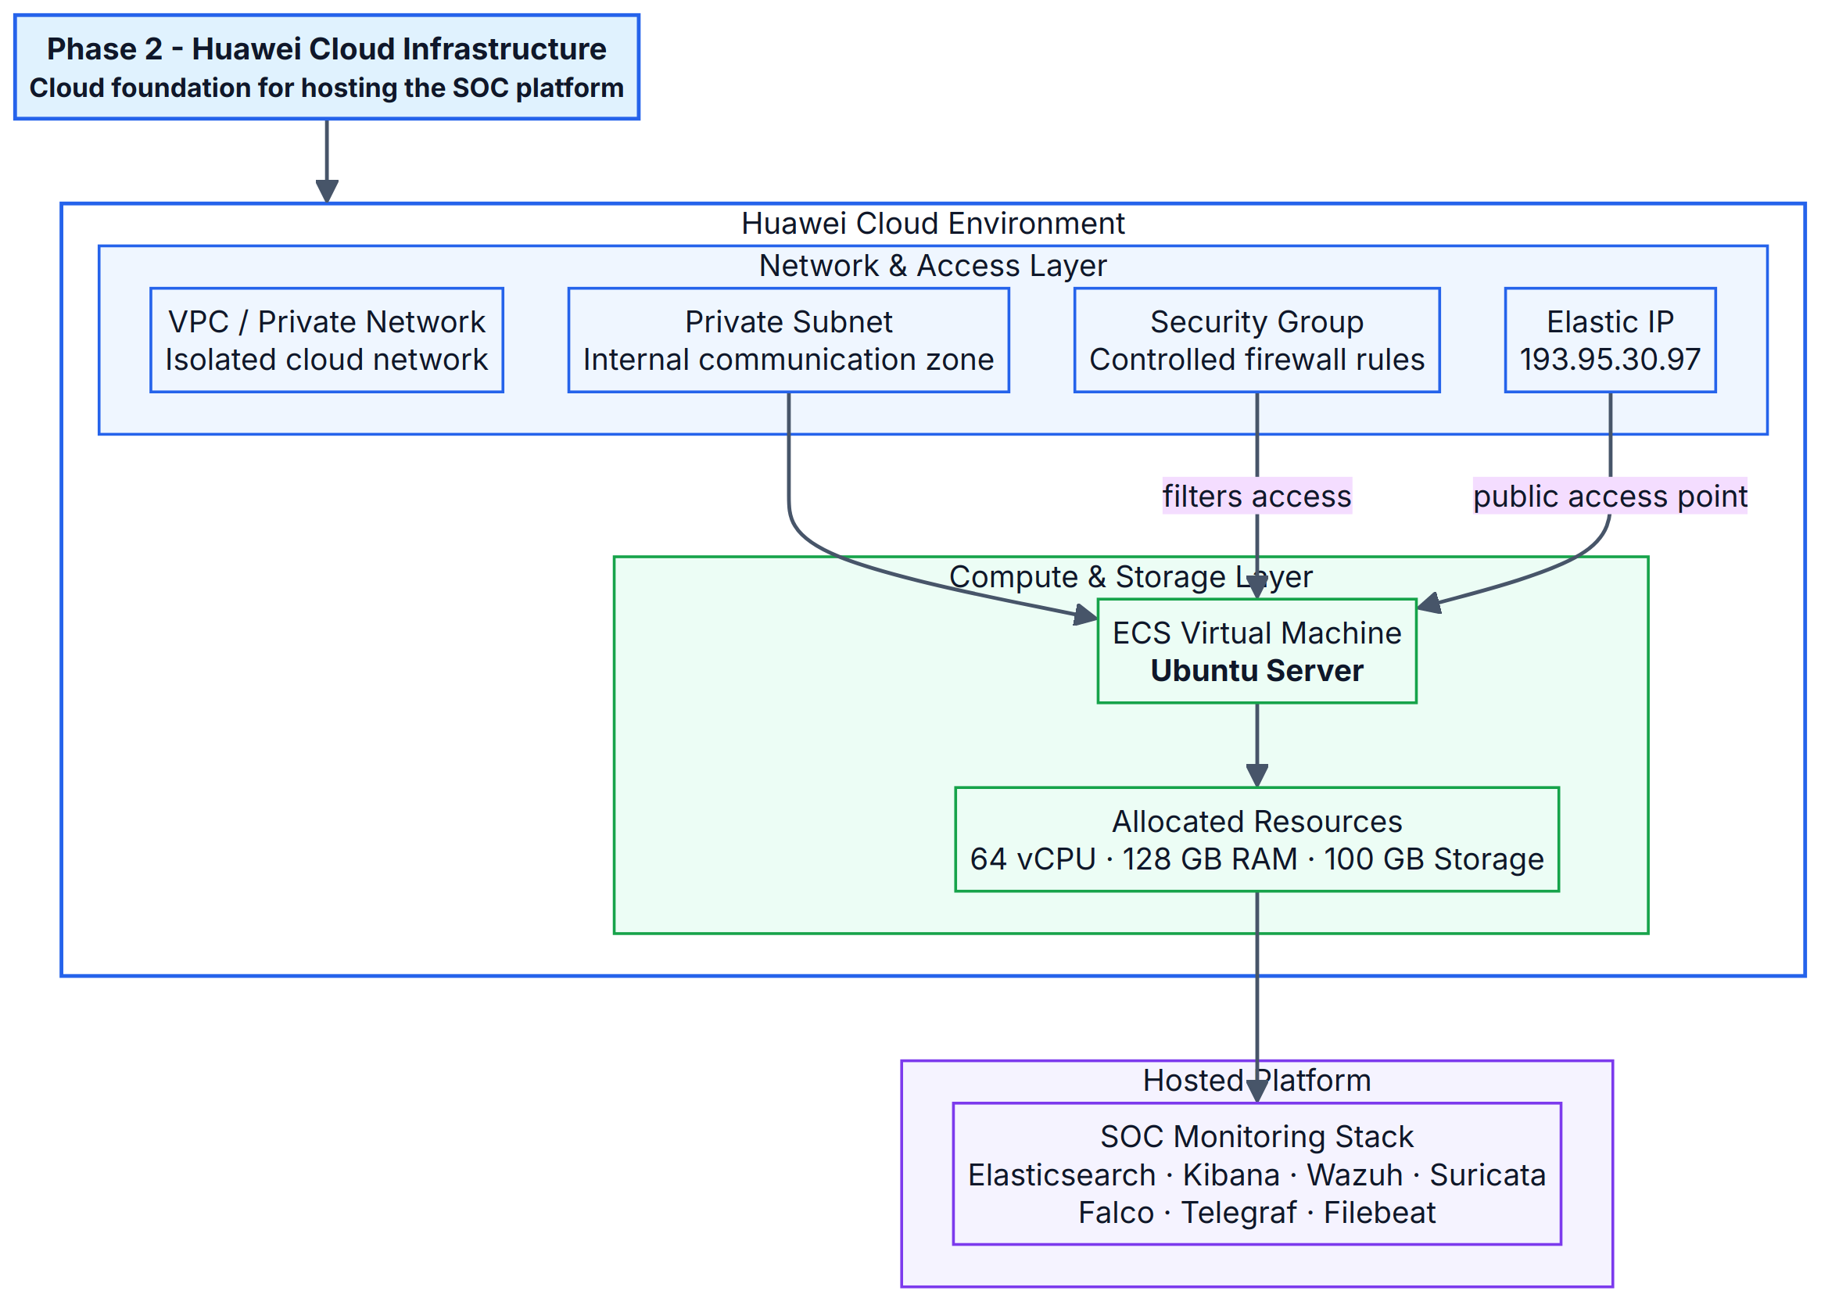
Phase 2: Huawei Cloud Topology
Cloud Resources
Resource | Purpose
 | VPC
 | Subnet
 | Security Group
 | Elastic IP
 | ECS

Slide 14
Security Strategy & Ports
Exposure Principles
Port | Service | Exposure
 | 3001 | ARIA frontend
 | 8001 | ARIA backend
 | 9200 | Elasticsearch
 | 5601 | Kibana
 | 6379 | Redis
 | 1514/1515 | Wazuh agent
 | 55000 | Wazuh API
**Rule:** Elasticsearch and Redis are **never** exposed to the public internet.

Slide 15
The 12-Step Intelligence Pipeline
From Raw Alert to Closed Case
1. **Ingestion** — poll Elasticsearch every 10 s
2. **Mapping** — source-specific mappers normalize alerts
3. **Enrichment** — GeoIP, MITRE ATT&CK, IOCs
4. **Deduplication / noise filtering** — Redis + Sigma + DB
5. **SQLite storage** — operational shadow database
6. **Correlation** — group alerts into incidents
7. **Investigation** — create case and build context
8. **AI analysis** — summary, narrative, risk, playbook
9. **Approval** — analyst review + admin-secret gate
10. **Execution** — Ansible playbook on target host
11. **Verification** — re-check evidence / remote state
12. **Archive + dashboards** — close case with audit trail

Slide 16
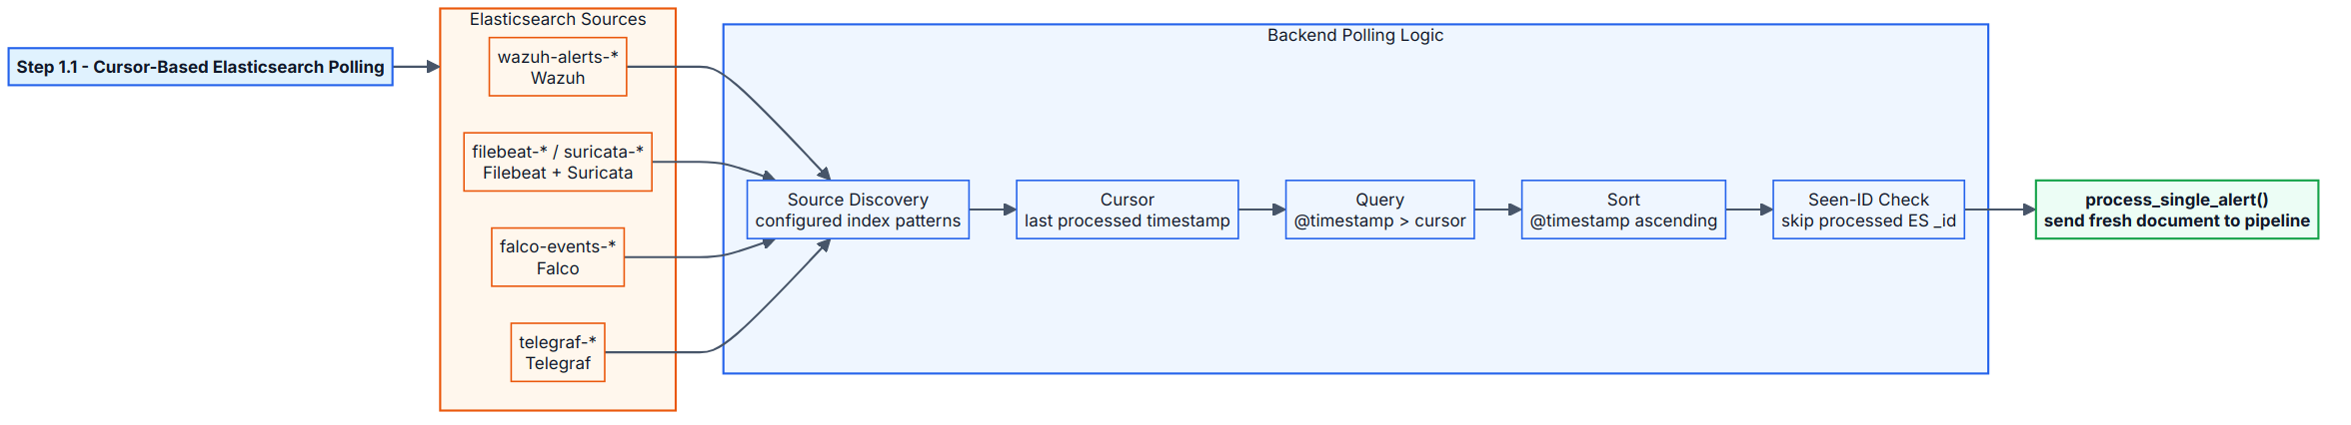
Alert Ingestion
Cursor-Based Polling
• Per-source cursor stored in Redis (file fallback)
• Query only events newer than the cursor
• Adaptive sleep: fast during bursts, quiet during idle periods
• Each source polled asynchronously

Slide 17
Normalization
Raw Document → Clean SOC Alert
Common fields regardless of source:
• title, severity, source, timestamp
• source/destination IP, hostname, rule name
• dedup_key, asset_id, IOCs
• alert_metadata: geoip, mitre

Slide 18
Deduplication & Noise Filtering
Fighting Alert Fatigue
Stage | Mechanism
 | Deduplication
 | Noise filtering
 | Whitelist
Order matters: dedup → filter → enrich → correlate

Slide 19
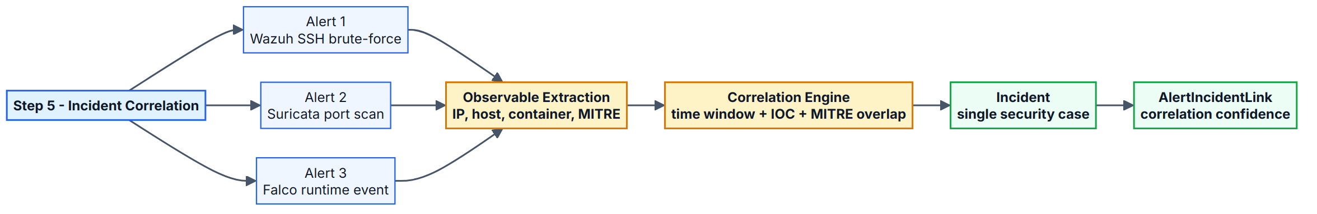
Incident Correlation
From Alerts to Incidents
• Group by source IP, destination IP, hostname, user, container
• Time-windowed and indicator-based logic
• 13 attack-type categories: brute force, malware, web attack, cryptomining, container escape, etc.

Slide 20
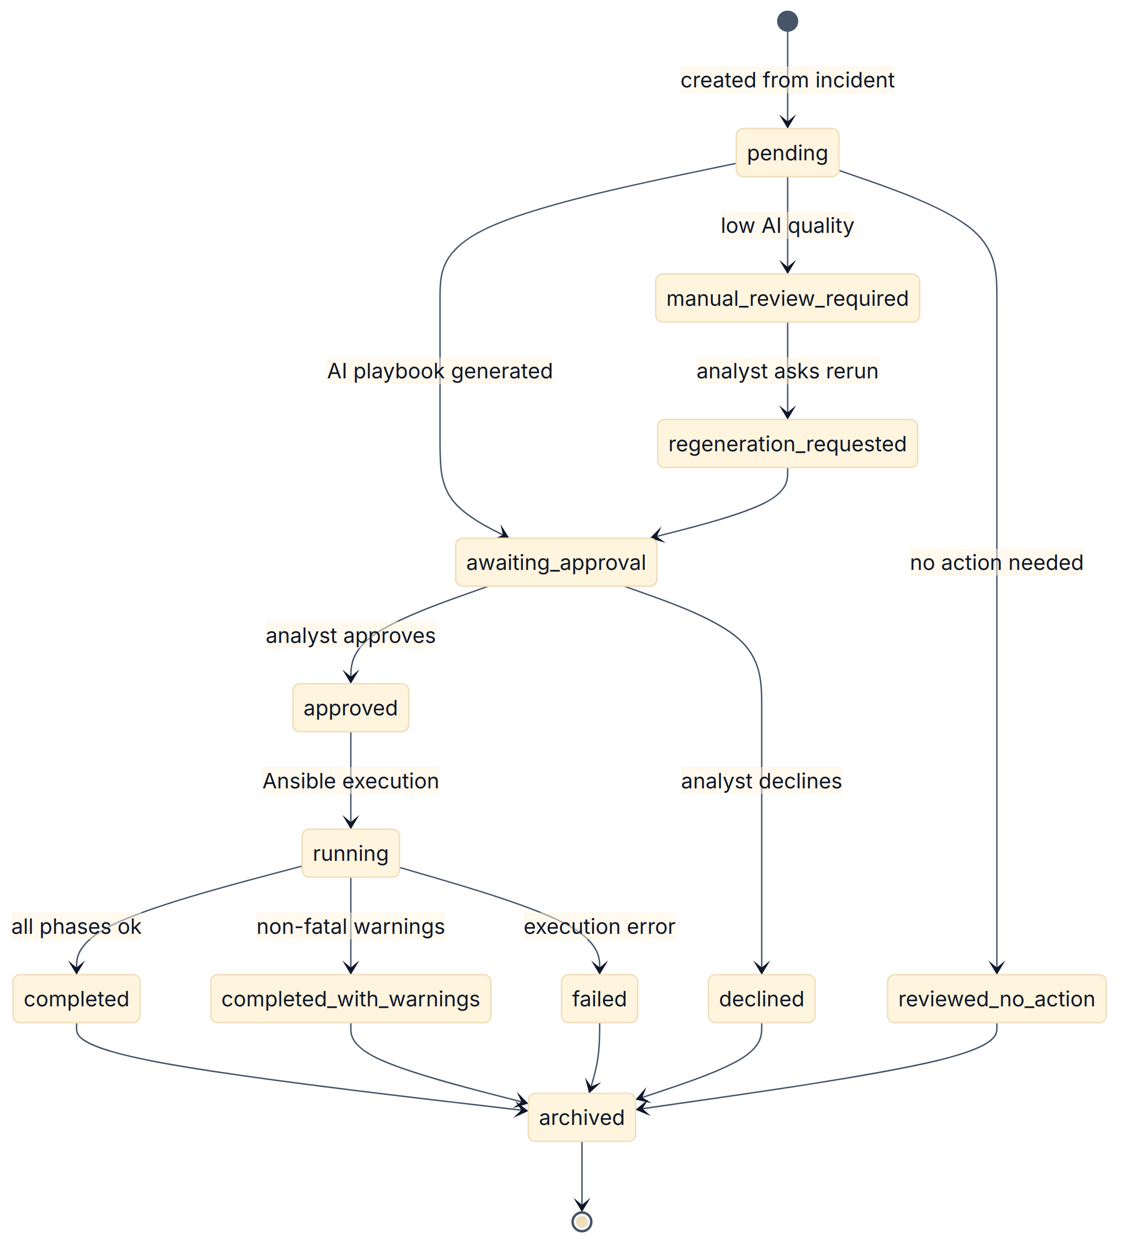
Investigation Lifecycle
Explicit State Machine
pending → awaiting_approval → approved/declined → running
↓
completed/failed → archived
Every action is derived from the current state — no ambiguous transitions.
pending → awaiting_approval → approved/declined → running ↓ completed/failed → archived

Slide 21
AI Response Engine
Context → LLM → Structured Output
• Build structured context: timeline, indicators, MITRE, host info
• Route to configured LLM (local Ollama / cloud fallback)
• Parse structured output: summary, narrative, risk, playbook YAML
• Fallback parsing + rule-based generation on malformed output

Slide 22
Approval → Execution → Verification → Archive
Human-in-the-Loop Remediation
1. AI proposes playbook
2. Safety tier + admin-secret gate
3. Analyst approves / edits / declines
4. Ansible executes on scoped asset
5. Verifier re-checks Elasticsearch / remote state
6. Case archived with full audit log

Slide 23
Performance Monitoring & Remediation
Metric-Driven Auto-Response
Metric | Critical | Auto-action
 | CPU | 90%
 | Memory | 85%
 | Disk | 90%
 | Network | 500 MB/s
30-minute cooldown per anomaly type.

Slide 24
IPS Attack Visualization
GeoIP-Enabled Situational Awareness
• Map attack sources by country / coordinates
• Per-country breakdown, statistics, filters
• Answers: “Where is this traffic coming from?”

Slide 25
AI Assistant & AI Operator
Two AI Interaction Modes
**AI Assistant** — chat-style Q&A about alerts, incidents, infrastructure
**AI Operator** — guided diagnostic / remediation actions with safety checks

Slide 26
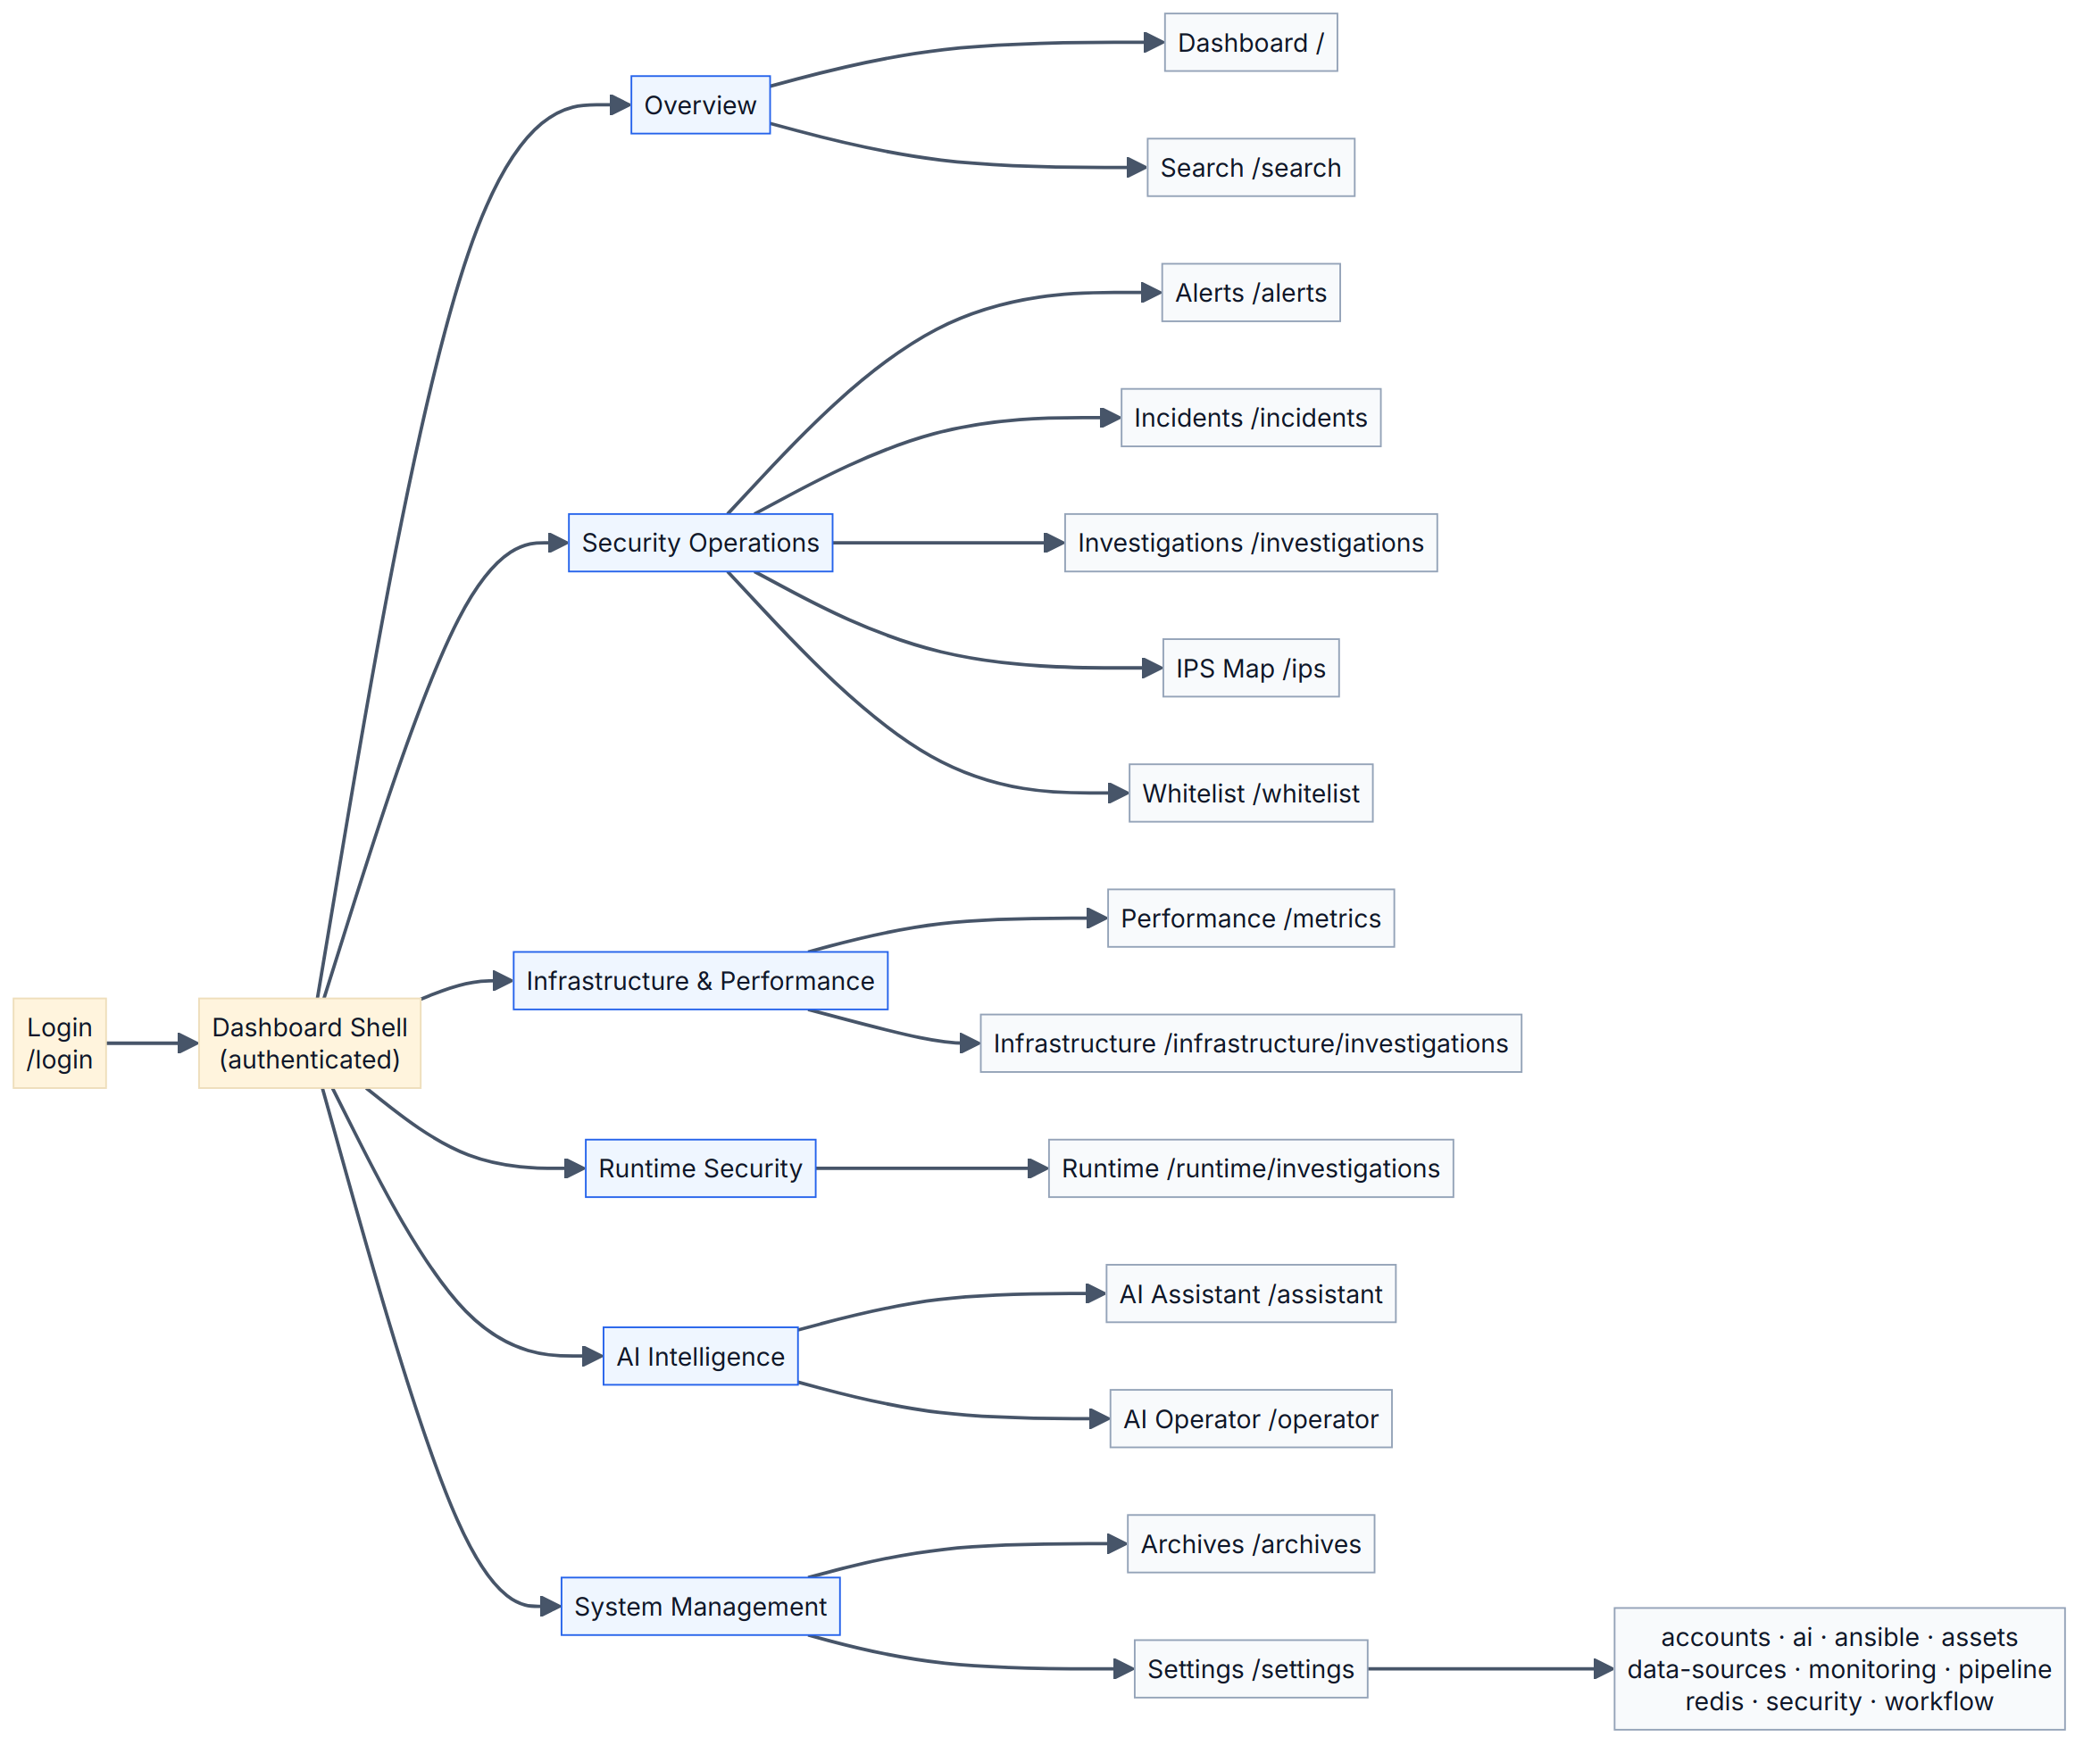
Frontend Navigation Map
Dashboard Organization
Sidebar groups:
• Overview: dashboard, search
• Security Operations: alerts, incidents, investigations, IPS map, whitelist
• Infrastructure & Performance
• Runtime Security
• AI Intelligence: assistant, operator
• System Management: archives, settings

Slide 27
Key Dashboards
Operational Interface
Representative screenshots:
• Dashboard overview
• Alerts list + detail
• Incident timeline
• Investigation AI result
• IPS world map
• Runtime security
• Infrastructure metrics
• AI assistant chat
• Settings / assets
All views respect the selected `asset_id` scope.

Slide 28
End-to-End SOC Scenario
Alert → Incident → Investigation → Remediation → Archive
Wazuh SSH brute-force alert
↓
Normalized + enriched (GeoIP, MITRE T1110)
↓
Correlated into incident
↓
AI generates summary + Ansible playbook
↓
Analyst approves (admin-secret gate)
↓
Ansible blocks source IP + hardens sshd
↓
Verifier confirms no new brute-force events
↓
Case archived with audit trail
Wazuh SSH brute-force alert ↓ Normalized + enriched (GeoIP, MITRE T1110) ↓ Correlated into incident ↓ AI generates summary + Ansible playbook ↓ Analyst approves (admin-secret gate) ↓ Ansible blocks source IP + hardens sshd ↓ Verifier confirms no new brute-force events ↓ Case archived with audit trail

Slide 29
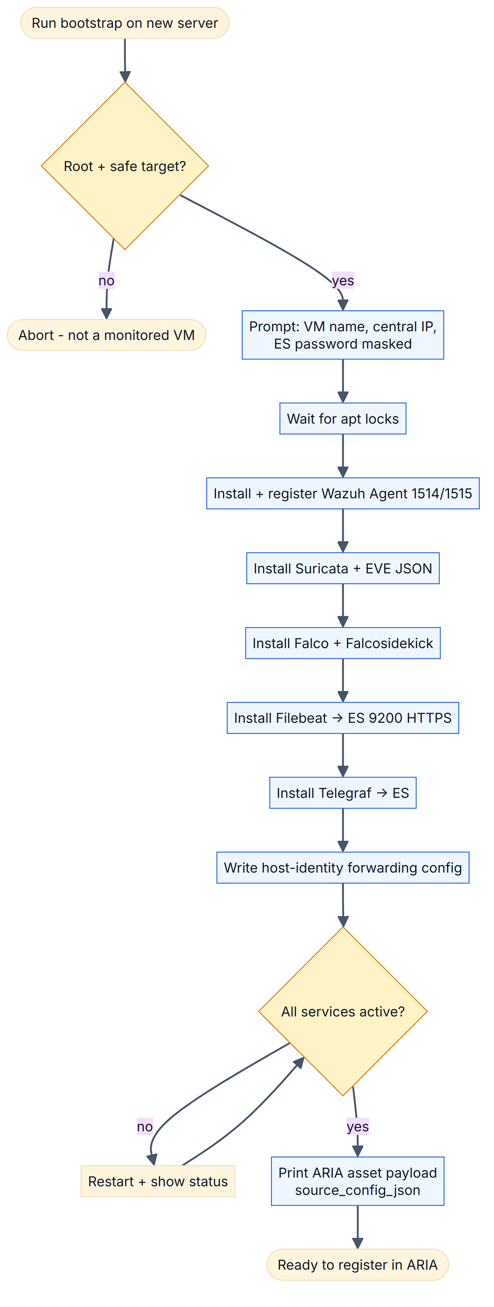
Onboarding a New Server
From Bare Metal to Scoped Asset
1. Bootstrap script installs Wazuh agent, Filebeat, Falco, Telegraf
2. Registers with central Elasticsearch
3. ARIA creates `MonitoredAsset` record
4. Source validation confirms data arrival

Slide 30
Asset Payload & Validation
What ARIA Needs to Know
{
"name": "dash-linux",
"host": "192.168.1.20",
"sources": {
"wazuh": "wazuh-alerts-4.x-*",
"suricata": "filebeat-*",
"falco": "falco-events-*",
"telegraf": "telegraf-*"
},
"ansible": {
"user": "ansible",
"ssh_key_ref": "dash-linux-key",
"become": true
}
}
Validation queries each source index and reports real document counts.
{ "name": "dash-linux", "host": "192.168.1.20", "sources": { "wazuh": "wazuh-alerts-4.x-*", "suricata": "filebeat-*", "falco": "falco-events-*", "telegraf": "telegraf-*" }, "ansible": { "user": "ansible", "ssh_key_ref": "dash-linux-key", "become": true } }

Slide 31
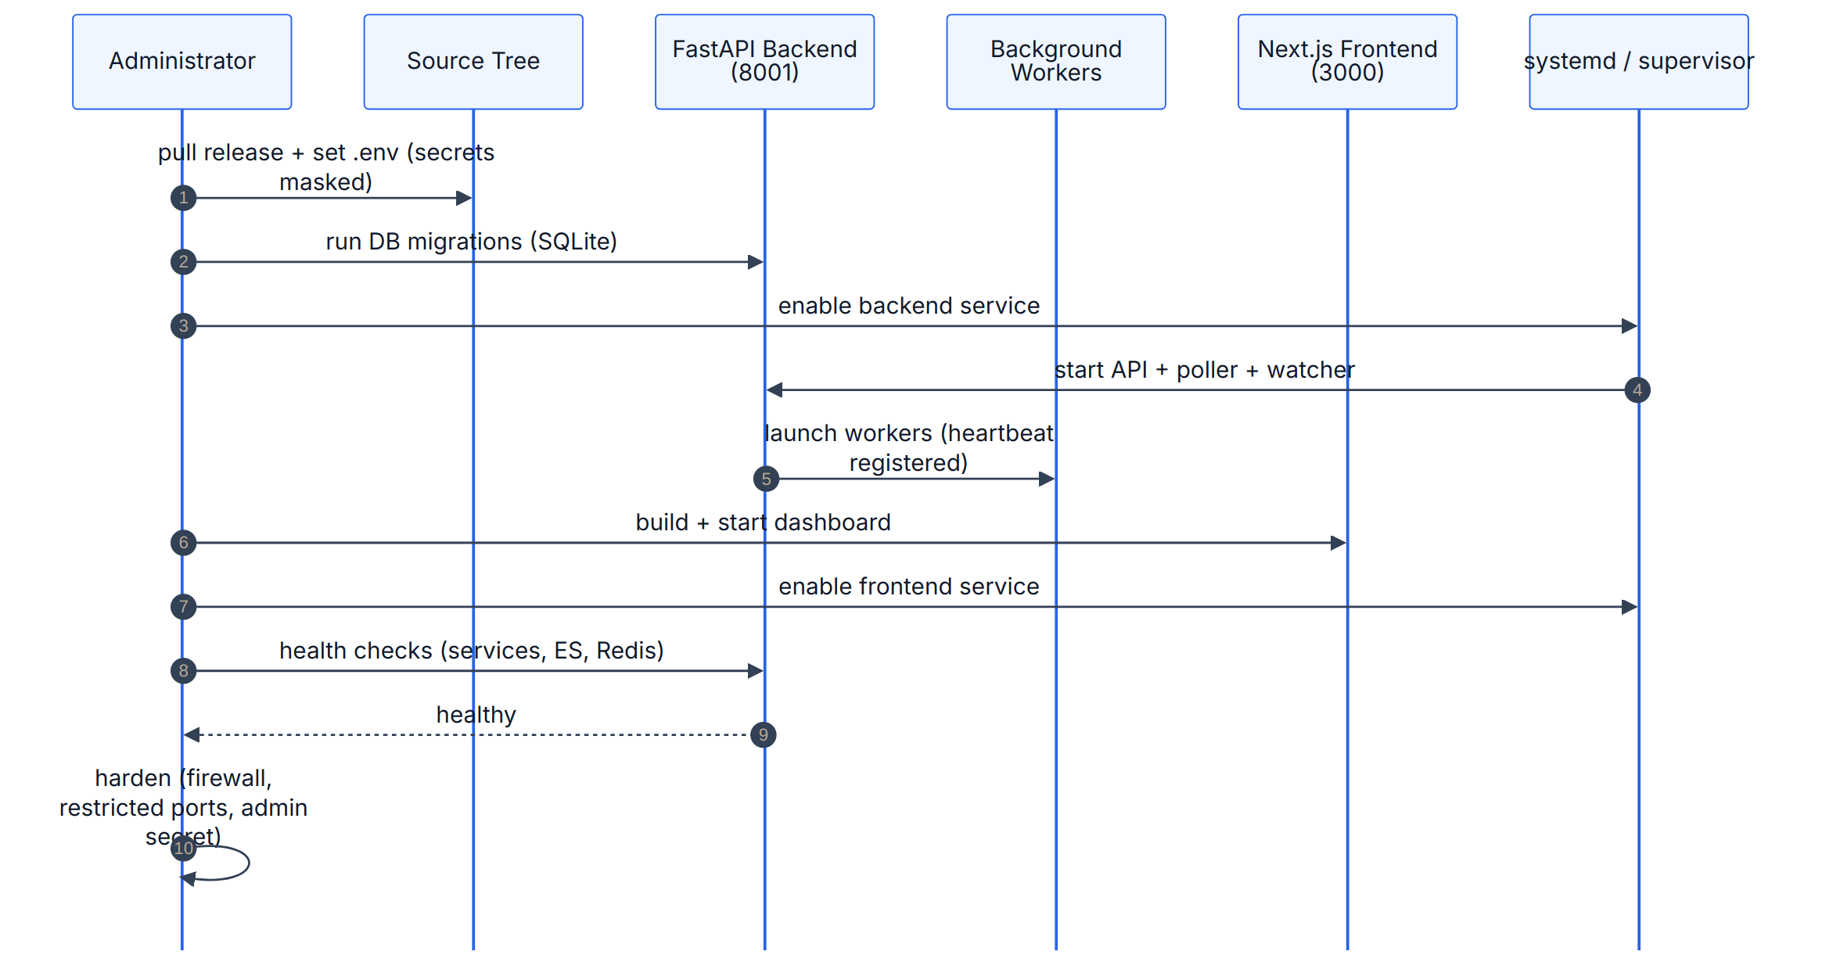
Production Deployment Workflow
Staged Rollout
1. Build frontend and backend images
2. Push to registry / copy to host
3. Deploy Redis, API, worker, frontend services
4. Run health checks and API smoke tests
5. Enable pipeline pollers
6. Validate first alert → incident → investigation flow

Slide 32
Functional Requirements
What ARIA Must Do
ID | Requirement
 | FR-01
 | FR-02
 | FR-03
 | FR-04
 | FR-05
 | FR-06
 | FR-07
 | FR-08
 | FR-09
 | FR-10

Slide 33
Non-Functional Requirements
Quality Targets
Category | Target
 | Security
 | Reliability
 | Performance
 | Scalability
 | Auditability
 | Maintainability

Slide 34
Methodology & Testing
Agile Iterative, 2-Week Sprints
• **Methodology:** phased iterative with 2-week validation sprints
• **Sprint rhythm:** plan → implement → test → demo → document
• **Test levels:**
◦ Unit tests (pytest)
◦ Integration tests (API + DB + Redis)
◦ Functional tests (end-to-end alert → archive)
◦ Security tests (admin-secret bypass attempts)
◦ Performance tests (poller throughput)

Slide 35
Results & Achievements
What Was Built
Metric | Value
 | Python backend
 | TypeScript frontend
 | API routes
 | DB models
 | Backend modules compiled
 | Automated tests passed
 | API root health check
 | Alerts ingested
 | Incidents created
 | Investigations
**Validation:** backend compiles, API root 200 OK, multi-server activation, admin-secret verification, frontend build success.

Slide 36
Thank You / Q&A
Questions?
**ARIA**
Adaptive Response Intelligence Automation
**Ghazi Mabrouki**
PFE — ESPRIT University
Huawei Technologies — Tunis, Tunisia

