Slide 1
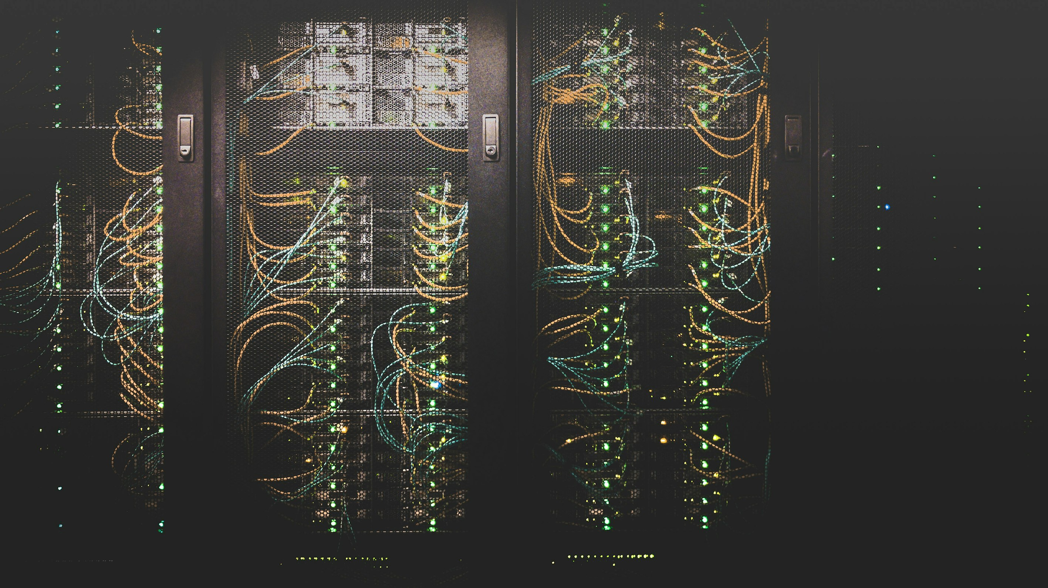
ARIA
Adaptive Response Intelligence Automation
Transform Security Events into Actionable Intelligence
Ghazi Mabrouki | AI-Assisted SOC/SOAR Platform | 2026
Notes:
<!--pageType:cover-->

Slide 2
OVERVIEW
01
02
03
The Business Problem
Introducing ARIA
How ARIA Works
Security operations are overwhelmed by alerts, disconnected tools, and manual processes
Centralize, enrich, correlate, and respond with AI-assisted security operations
From raw alerts to closed cases — the complete incident lifecycle
04
05
06
AI That Helps Teams Work Smarter
Business Impact
Why ARIA
AI accelerates decisions while keeping analysts in full control
Measurable improvements for security operations and ROI
Clear differentiators in a crowded security market
Notes:
<!--pageType:table_of_contents-->

Slide 3
01
CHAPTER ONE
The Business Problem
Security operations are overwhelmed
Notes:
<!--pageType:chapter-->

Slide 4
01 THE BUSINESS PROBLEM
Security Teams Face an Alert Crisis
SOC teams receive thousands of alerts daily from disconnected tools — each speaking its own language. Analysts waste hours switching consoles, manually connecting events, and deciding what matters.
The result: slower response, missed threats, and analyst burnout.
ALERT VOLUME
Disconnected Tools — Separate dashboards with no unified view
Manual Correlation — Analysts connect events by hand
Alert Fatigue — Critical signals buried in noise
Expert Dependency — Response quality varies by analyst
1 Analyst
Slow Response — Hours lost to repetitive triage work
10,000+
alerts per day — typical enterprise SOC (industry context)
GHAZI MABROUKI
4
Notes:
Emphasize the business impact: slower response, missed threats, analyst burnout. Use the alert volume visual to show how disconnected tools create chaos.
<!--pageType:content-->

Slide 5
01 THE BUSINESS PROBLEM
Why Traditional SOC Operations Struggle
Fragmented Tools
Alert Fatigue
No Context
Manual Processes
No Verification
Separate dashboards for Wazuh, Suricata, Falco — no unified view of the environment
Thousands of raw alerts daily — no deduplication or noise filtering
Technical alerts without GeoIP, MITRE mapping, or asset context
Expert-dependent correlation, investigation, and remediation
Fixes executed without confirmation — no audit trail
GHAZI MABROUKI
5
Notes:
<!--pageType:content-->

Slide 6
02
CHAPTER TWO
Introducing ARIA
Centralize. Enrich. Correlate. Respond.
Notes:
<!--pageType:chapter-->

Slide 7
02 INTRODUCING ARIA
What ARIA Delivers
SEE
UNDERSTAND
DECIDE
ACT
Unified Visibility
AI-Powered Analysis
Correlated Incidents
Controlled Automation
Network, host, runtime, and metrics — all in one place. No more switching between tools.
AI-generated summaries, risk scores, and attack narratives in plain language.
Related alerts grouped into meaningful incidents with full context and confidence scores.
Approval-gated playbooks with verification and full audit trail. Trust through transparency.
GHAZI MABROUKI
7
Notes:
<!--pageType:content-->

Slide 8
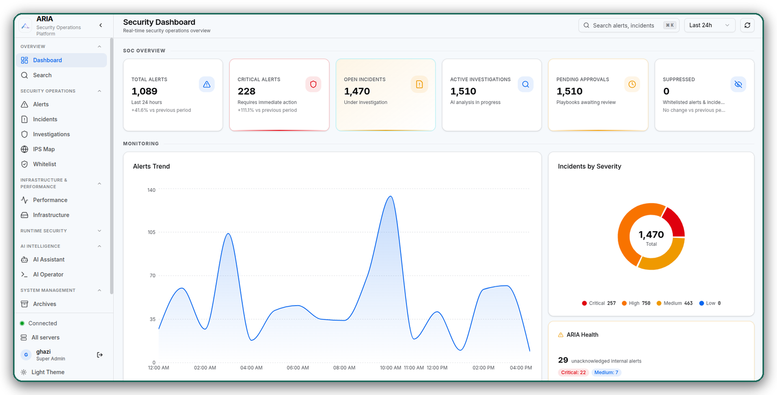
LIVE PRODUCT
See ARIA in Action
One unified dashboard — real-time security visibility from the running platform.

Slide 9
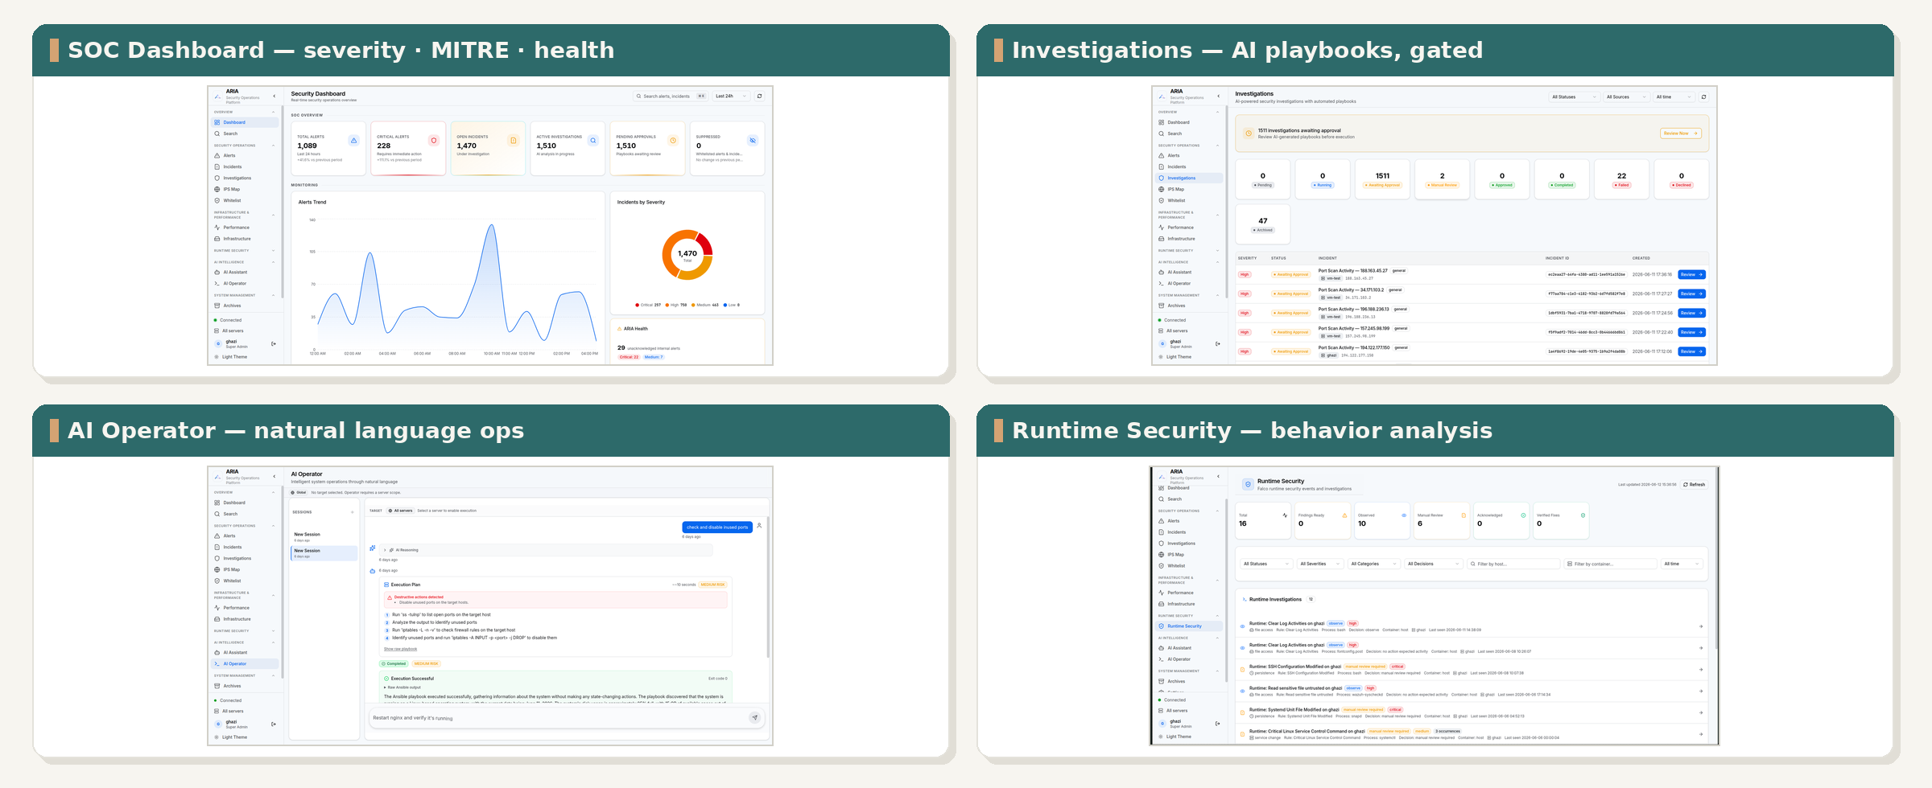
LIVE PRODUCT
See ARIA in Action — the Full Platform
Dashboard, AI-gated investigations, natural-language operator and runtime defense — one platform.
GHAZI MABROUKI
9

Slide 10
02 INTRODUCING ARIA
ARIA in One View
DATA SOURCES
ARIA INTELLIGENCE
SOC TEAM
OUTCOME
Cloud VMs & Infrastructure
Ingest & Normalize
Unified Dashboard
Faster Response
Hosts & Endpoints
Enrich with Context
Incident Review
Network Traffic
Correlate Events
One-Click Response
Smarter Decisions
Containers
AI Analysis
Audit Trail
Security Tools
Incident Prioritization
Better Detection
Metrics & Logs
Automated Response
Stronger Compliance
GHAZI MABROUKI
10
Notes:
This is the executive summary diagram. Keep it clean and simple — emphasize transformation from scattered alerts to unified operations.
<!--pageType:content-->

Slide 11
03
CHAPTER THREE
How ARIA Works
From raw alerts to closed cases
Notes:
<!--pageType:chapter-->

Slide 12
03 HOW ARIA WORKS
The Incident Lifecycle
01
02
03
04
05
COLLECT
NORMALIZE
ENRICH
FILTER
CORRELATE
Events from all layers
Context & threat intel
Group related alerts
06
07
08
09
10
ANALYZE
REVIEW
RESPOND
VERIFY
ARCHIVE
AI summary & risk score
Execute playbooks
Full audit trail
INGESTION & PROCESSING
ANALYSIS & RESPONSE
Raw alerts enter. Through enrichment, correlation, and AI analysis, closed cases exit.
Every step is tracked. Every action is verified. Every case is auditable.
GHAZI MABROUKI
12
Notes:
Walk through the 10-step lifecycle emphasizing the transformation: raw alerts enter, closed cases exit. Business language throughout.
<!--pageType:content-->

Slide 13
03 HOW ARIA WORKS
Unified Security Visibility
Cloud & Infrastructure
Network Traffic
Host & Endpoint
Runtime & Containers
VPC, virtual machines, containers, and cloud resources — all monitored in one place
IDS monitoring protocols, threats, and anomalous connections across the network
Authentication events, file integrity, and system activity on every endpoint
Abnormal processes, container escapes, and runtime threat detection
One Unified Dashboard
All security data centralized into one searchable store. One dashboard shows everything — no more switching between five different tools.
From scattered alerts to unified visibility. See your entire security posture in a single glance.
GHAZI MABROUKI
13
Notes:
Emphasize the "one dashboard" message. All data sources feed into a single unified view — no more tool switching.
<!--pageType:content-->

Slide 14
03 HOW ARIA WORKS
From Alert Overload to Clear Priorities
BEFORE ARIA
WITH ARIA
Isolated alerts — each alert stands alone with no connections
Correlated incidents — related alerts grouped with confidence scores
No context — raw technical data without enrichment
Enriched context — GeoIP, MITRE, and asset data auto-added
Manual triage — hours spent on routine investigation
AI-assisted triage — summaries and recommendations in minutes
VS
Alert fatigue — critical signals buried in noise
Smart prioritization — severity-based ranking surfaces what matters
Inconsistent response — quality depends on analyst
Standardized response — approval-gated playbooks ensure consistency
Analysts see incidents, not isolated alerts.
GHAZI MABROUKI
14
Notes:
Emphasize the dramatic transformation: from chaos to clarity. The before/after contrast should be stark and visually clear.
<!--pageType:content-->

Slide 15
04
CHAPTER 04
AI That Helps Teams Work Smarter
AI accelerates decisions. Analysts stay in control.
Notes:
<!--pageType:chapter-->

Slide 16
THE PROBLEM INTRODUCING HOW IT WORKS AI & AUTOMATION IMPACT WHY ARIA
AI-Assisted Investigation
ARIA's AI engine translates complex alerts into clear, actionable intelligence.
Investigation Summary
Attack Narrative
A clear explanation of what happened, written in plain language that any analyst can understand — no technical decoding required.
A step-by-step story of the attack chain, showing how events unfolded across time and systems — from initial entry to current status.
Risk Assessment
Recommended Playbook
Clear severity rating — Low, Medium, High, or Critical — with supporting reasoning so analysts know exactly what to prioritize.
Structured corrective actions as step-by-step instructions, ready for analyst review and one-click execution when approved.
Supports multiple AI providers: Ollama, Google Gemini, OpenRouter, NVIDIA NIM
AI never acts alone — every output is reviewed by a human analyst.
GHAZI MABROUKI
16
Notes:
When a correlated incident is created, ARIA's AI engine produces four outputs: investigation summary, attack narrative, risk assessment, and recommended playbook. These outputs support multiple AI providers (Ollama for privacy, Google Gemini, OpenRouter, NVIDIA NIM). Crucially, every AI output is reviewed by a human analyst before any action is taken — AI augments human judgment, never replaces it.
<!--pageType:content-->

Slide 17
THE PROBLEM INTRODUCING HOW IT WORKS AI & AUTOMATION IMPACT WHY ARIA
Automation with Control
Every automated action is staged, verified, and logged — trust through transparency.
APPROVAL LEVELS
Manual
Auto-approved
Blocked
Analyst examines and decides. For sensitive actions requiring human judgment.
Low-risk routine actions execute without delay. Pre-approved playbooks only.
Critical and high-risk cases require explicit override. Safety-first default.
STAGED EXECUTION
Preview
Verify
Execute
Verify Fix
Archive
Review playbook steps before execution
Check connectivity and target whitelist
Run with full logging and monitoring
Confirm the fix resolved the issue
Preserve complete audit trail
Trust through transparency — complete audit trail for every action.
Who approved, what ran, what changed, whether it worked.
GHAZI MABROUKI
17
Notes:
ARIA provides three approval levels for automation: Manual (analyst decides), Auto-approved (low-risk routine), and Blocked (critical/high-risk). Every remediation follows a staged process: Preview the playbook, Verify connectivity, Execute with logging, Verify the fix worked, then Archive. The complete audit trail records who approved, what ran, what changed, and whether it worked.
<!--pageType:content-->

Slide 18
THE PROBLEM INTRODUCING HOW IT WORKS AI & AUTOMATION IMPACT WHY ARIA
A Day with ARIA
An illustrative incident response scenario — from detection to closure.
9:00 AM
SSH brute-force detected — Wazuh flags repeated login failures on production server
9:00:15
Port scan flagged — Suricata detects network reconnaissance from same source IP
9:00:30
Unexpected shell — Falco notices abnormal process execution in container
9:01
Correlated incident created — ARIA links all three events into one case: "SSH Brute Force & Port Scan"
9:02
AI generates summary + playbook — Risk: HIGH | Recommendation: block IP + harden SSH
9:05
Analyst reviews and approves — Human verification before any action is taken
9:06
Ansible executes — Firewall rule applied, SSH config hardened automatically
9:10
Fix verified — No new brute-force events confirmed, remediation successful
9:15
Case archived — Complete timeline and audit trail preserved
What took hours now takes minutes.
From first alert to closed case in ~15 minutes (illustrative) — with full human oversight at every step.
GHAZI MABROUKI
18
Notes:
This scenario demonstrates ARIA's real-world value: a multi-stage attack (SSH brute-force, port scan, unexpected shell) is detected, correlated, analyzed, and remediated in under 15 minutes. What traditionally takes hours of manual investigation now takes minutes with AI-assisted analysis and approval-gated automation.
<!--pageType:content-->

Slide 19
05
CHAPTER 05
Business Impact
Measurable improvements for security operations
Notes:
<!--pageType:chapter-->

Slide 20
THE PROBLEM INTRODUCING HOW IT WORKS AI & AUTOMATION IMPACT WHY ARIA
Operational Benefits
Concrete improvements ARIA delivers to your security operations.
Faster Triage
Lower Operational Load
Better Detection Quality
Correlated incidents replace isolated alerts. Analysts see the full picture immediately and can act with confidence.
AI handles initial analysis and noise filtering. Deduplication collapses repeated events significantly.
Multi-source correlation catches multi-stage attacks that single tools miss. MITRE mapping adds adversary context.
Improved Consistency
Audit Readiness
Scalable Foundation
Approval-gated playbooks ensure standardized responses. No more ad-hoc fixes that vary by analyst.
Complete trail from detection to archive. Who did what, when, and whether it worked — all recorded.
Modular architecture grows with your needs. New sources via configuration, not code changes.
GHAZI MABROUKI
20
Notes:
These six operational benefits demonstrate ARIA's business value: faster triage through correlation, reduced operational load via AI analysis, better detection through multi-source correlation, consistent responses via playbooks, complete audit readiness, and a scalable modular foundation.
<!--pageType:content-->

Slide 21
THE PROBLEM INTRODUCING HOW IT WORKS AI & AUTOMATION IMPACT WHY ARIA
Scalable and Future-Ready
ARIA grows with your organization — from initial deployment to enterprise scale.
Grows with You
Scales for Size
Integrates Widely
New Data Sources
Add monitoring via configuration — no code changes needed. Wazuh, Suricata, Falco, Telegraf, and more.
New Detection Rules
Sigma rule files expand coverage. Custom rules for your environment.
Expanding AI
LLM capabilities grow as technology advances. Swap providers or add new models.
ES Clustering
Elasticsearch clusters handle growing data volumes with horizontal scaling.
PostgreSQL Migration
Upgrade from SQLite to PostgreSQL for enterprise concurrency and reliability.
Containerized Deployment
Docker containers with Ansible-managed mass onboarding across servers.
Ticketing Systems
Connect with Jira, ServiceNow, or internal ticket platforms for workflow integration.
Threat Intel Feeds
STIX/TAXII integration for real-time threat intelligence and indicator enrichment.
External SOAR
API-ready for integration with existing security orchestration platforms.
GHAZI MABROUKI
21
Notes:
ARIA's architecture is designed for growth: new data sources through configuration, new Sigma rules for detection, expanding AI capabilities, and horizontal scaling via Elasticsearch clustering and containerized deployment. Integration points include ticketing systems, threat intel feeds, and external SOAR platforms.
<!--pageType:content-->

Slide 22
06
CHAPTER 06
Why ARIA
Clear differentiators in a crowded market
Notes:
<!--pageType:chapter-->

Slide 23
THE PROBLEM INTRODUCING HOW IT WORKS AI & AUTOMATION IMPACT WHY ARIA
ARIA Differentiators
What sets ARIA apart from traditional security tools and platforms.
Centralized Intelligence
AI-Assisted Analysis
Context-Rich Correlation
One platform for network, host, runtime, and metrics — not four separate tools with four dashboards.
LLM-powered summaries and playbooks, not just rule-based alerts. AI explains what happened and why.
GeoIP locations, MITRE ATT&CK mapping, asset context, and behavioral patterns — not just timestamp matching.
Human-Centered Automation
Cloud-Native Foundation
Open & Extensible
Approval gates, verification steps, and complete audit trails — automation augments analysts, never replaces them.
Huawei Cloud deployment, Docker containers, reproducible scripts — built for modern infrastructure.
Open, standards-based stack — customizable detection rules and response playbooks, avoiding single-vendor lock-in.
GHAZI MABROUKI
23
Notes:
ARIA's six key differentiators: a single platform replacing multiple tools, LLM-powered analysis beyond rules, context-rich correlation with GeoIP and MITRE mapping, human-centered automation with approval gates, cloud-native containerized foundation, and open extensible architecture without vendor lock-in.
<!--pageType:content-->

Slide 24
THE PROBLEM INTRODUCING HOW IT WORKS AI & AUTOMATION IMPACT WHY ARIA
Implementation Approach
A phased adoption journey that builds confidence and proves value at every step.
01
02
03
Assess
Connect Sources
Configure
Evaluate current SOC tools, identify coverage gaps, and define implementation priorities.
Deploy Wazuh, Suricata, Falco, and Telegraf agents. Validate telemetry flow to Elasticsearch.
Tune Sigma rules, set severity thresholds, and define approval policies for automation.
04
05
06
Pilot
Expand
Optimize
Onboard a small server group. Validate correlation quality and refine playbooks.
Scale to full infrastructure. Add more data sources and train analysts on the platform.
Review metrics, tune detection rules, and expand automation scope based on results.
Phased approach minimizes risk — prove value at every step before expanding.
GHAZI MABROUKI
24
Notes:
ARIA's phased implementation approach minimizes risk: start with assessment, connect data sources progressively, configure detection rules, pilot with a small group, expand to full infrastructure, and continuously optimize. Each phase builds confidence and validates value before the next investment.
<!--pageType:content-->

Slide 25
ARIA
ADAPTIVE RESPONSE INTELLIGENCE AUTOMATION
Transform security events into actionable intelligence.
Smarter SOC operations start here.
Ghazi Mabrouki
Thank You
Questions & Discussion
Notes:
<!--pageType:final-->

