Slide 1



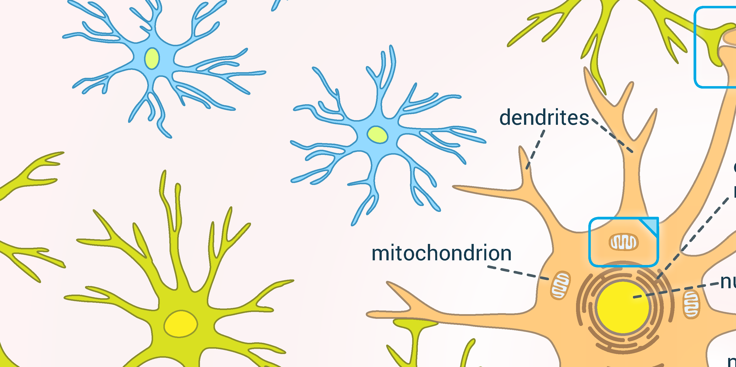
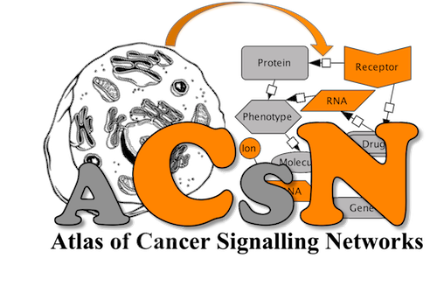
5th Disease Maps Community Meeting
12-14 November 2020
5th Disease Maps Community Meeting
12-14 November 2020
COVID-19
Resource: COVID-19 Disease Map
Contact: Marek Ostaszewski, University of Luxembourg, Belvaux, Luxembourg
OPEN PROJECT
Parkinson’s disease
Resource: Parkinson’s Disease Map
Contact: Marek Ostaszewski, University of Luxembourg, Belvaux, Luxembourg
Cancer
Resource: Atlas of Cancer Signalling Network
Contact: Inna Kuperstein, Institut Curie, Paris, France
Parkinson’s disease
Resource: Parkinson’s Disease Map
Contact: Marek Ostaszewski, University of Luxembourg, Belvaux, Luxembourg
Parkinson’s disease
Resource: Parkinson’s Disease Map
Contact: Marek Ostaszewski, University of Luxembourg, Belvaux, Luxembourg
Parkinson’s disease
Resource: Parkinson’s Disease Map
Contact: Marek Ostaszewski, University of Luxembourg, Belvaux, Luxembourg
Cancer
Resource: Atlas of Cancer Signalling Network
Contact: Inna Kuperstein, Institut Curie, Paris, France

