Slide 1
Automatic Music Genre Classification of Audio Signals
George Tzanetakis, Georg Essl & Perry Cook
Presented by:
Dave Kauchak
Department of Computer Science
University of California, San Diego
dkauchak@cs.ucsd.edu

Slide 2
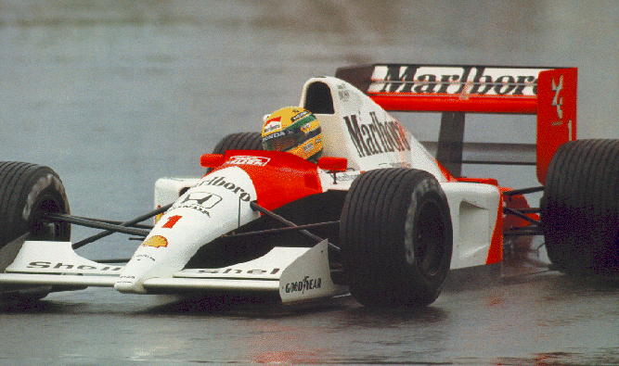
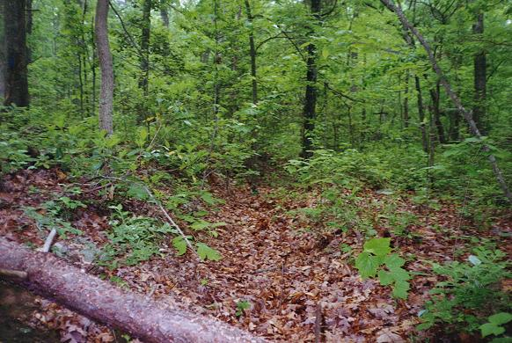


Image Classification
?
?
?

Slide 3
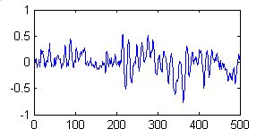
Audio Classification
?
?
?
Classical
Rock
Country

Slide 4
Hierarchy of Sound
Sound
Music
Speech
Other?
?
Jazz
Country
Sports
Announcer
Rock
Male
Classical
Disco
Hip Hop
Female
Orchestra
Choir
String
Quartet
Piano

Slide 5
Classification Procedure
Raw audio
Digitally encode
Extract features
Preprocessing
Build class models
Decide class
Raw audio
Digitally encode
Extract features
Input processing

Slide 6
Digitally Encoding
Raw Sound is simply a longitudinal compression wave traveling through some medium (often, air).
Must be digitized to be processed
  WAV
  MIDI
  MP3
  Others…

Slide 7
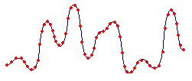
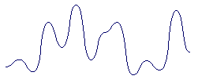
WAV
Simple encoding
Sample sound at some interval (e.g. 44 KHz).
High sound quality
Large file sizes

Slide 8
MIDI
Musical Instrument Digital Interface
MIDI is a language
Sentences describe the channel, note, loudness, etc.
16 channels (each can be though of and recorded as a separate instrument)
Common for audio retrieval an classification applications

Slide 9
MIDI Example
Music
Tempo
Melodies
Sequence of Notes
Channel
Instrument
Pitch
amplitude
Duration

Slide 10
MP3
Common compression format
3-4 MB vs. 30-40 MB for uncompressed
Perceptual noise shaping
  The human ear cannot hear certain sounds
  Some sounds are heard better than others
  The louder of two sounds will be heard

Slide 11
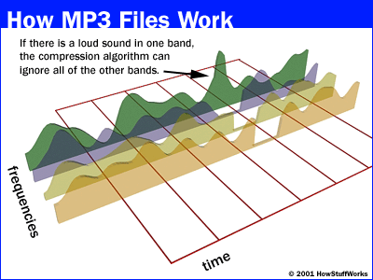
MP3 Example

Slide 12
Extract Features
Mel-scaled cepstral coefficients (MFCCs)
Musical surface features
Rhythm Features
Others…

Slide 13
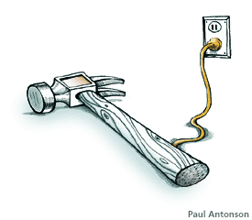
Tools for Feature Extraction
Fourier Transform (FT)
Short Term Fourier Transform (STFT)
Wavelets

Slide 14
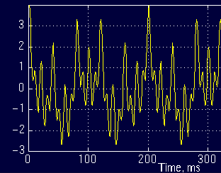
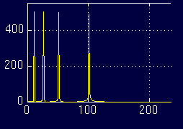
Fourier Transform (FT)
Time-domain Frequency-domain

Slide 15
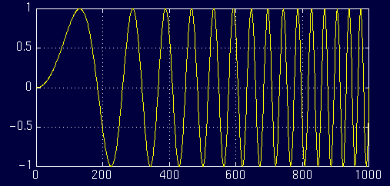
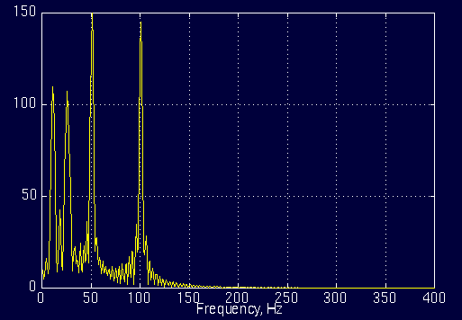
Another FT Example
Time
Frequency

Slide 16
Problem?
≈

Slide 17
Problem with FT
FT contains only frequency information
No Time information is retained
Works fine for stationary signals
Non-stationary or changing signals cause problems
  FT shows frequencies occurring at all times instead of specific times

Slide 18
Solution: STFT
How can we still use FT, but handle non-stationary signals?
How can we include time?
Idea: Break up the signal into discrete windows
Each signal within a window is a stationary signal
Take FT over each part

Slide 19
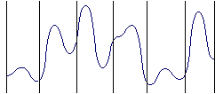
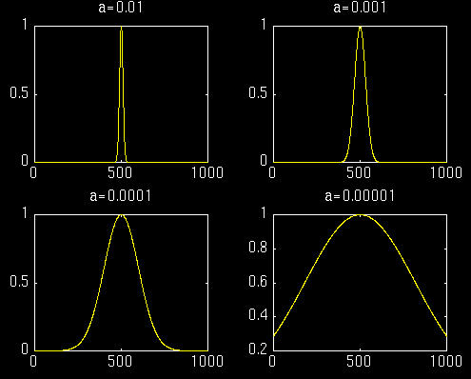
STFT Example
Window functions

Slide 20
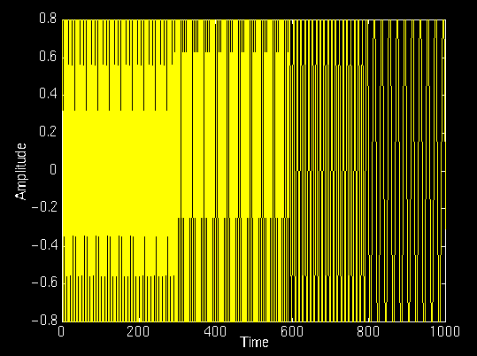
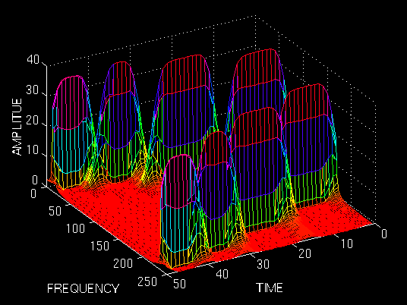
Better STFT Example

Slide 21
Problem: Resolution
We can vary time and frequency accuracy
  Narrow window: good time resolution, poor frequency resolution
  Wide window: good time resolution, poor frequency resolution
So, what’s the problem?

Slide 22
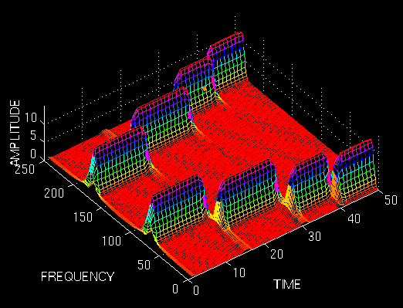
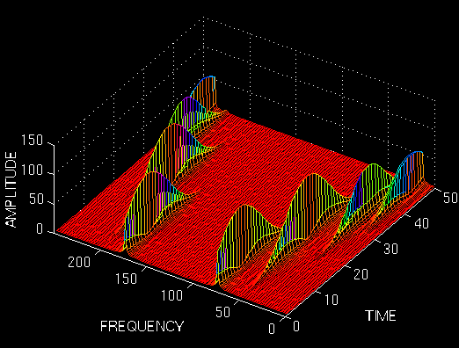
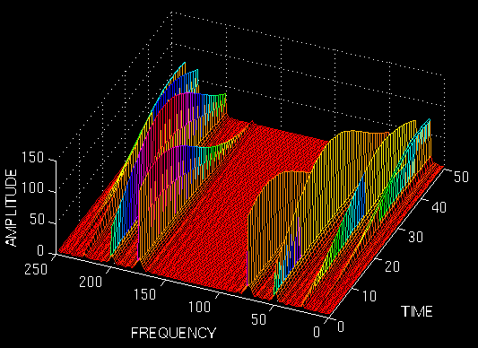
Varying the resolution

Slide 23
Where’s the problem?
How do you pick an appropriate window?
Too small = poor frequency resolution
Too large may result in violation of stationary condition
Different resolutions at different frequencies?

Slide 24
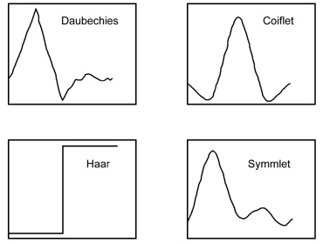
Solution: Wavelet Transform
Idea: Take a wavelet and vary scale
Check response of varying scales on signal

Slide 25
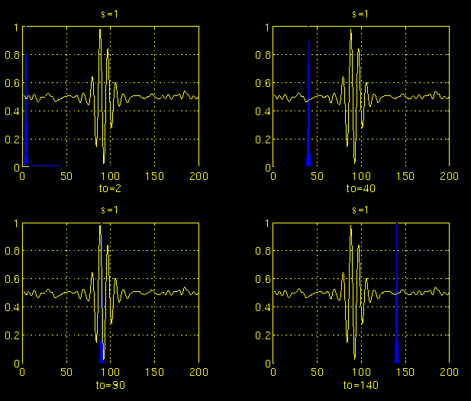
Wavelet Example: Scale 1

Slide 26
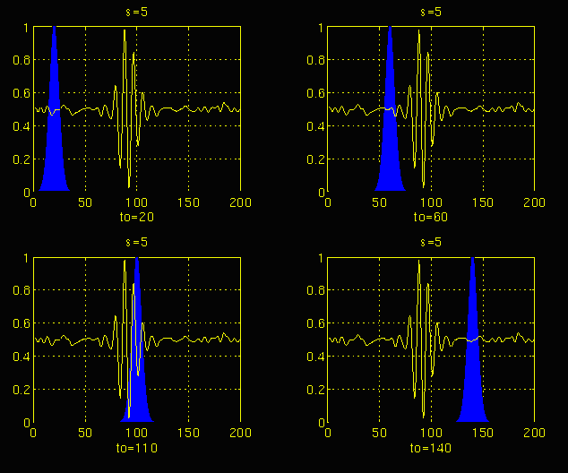
Wavelet Example: Scale 2

Slide 27
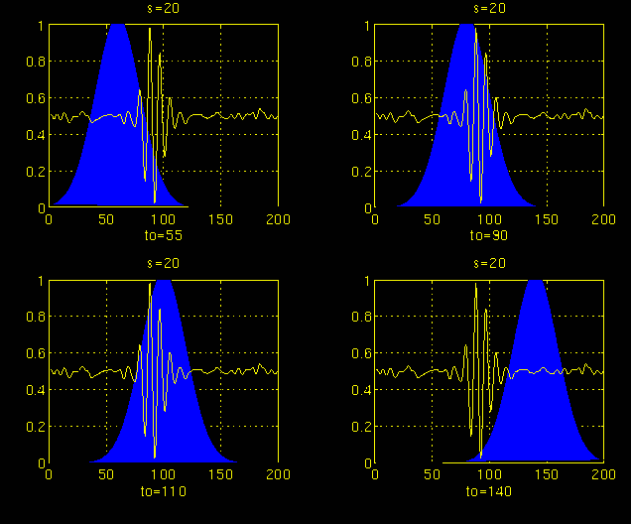
Wavelet Example: Scale 3

Slide 28
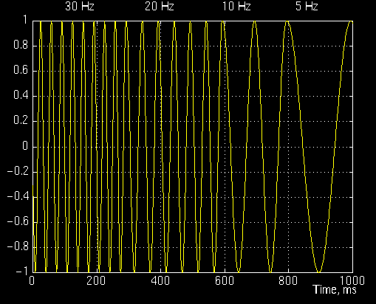
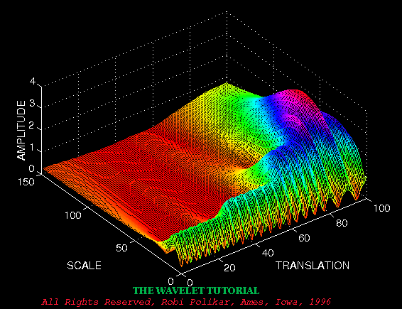
Wavelet Example
Scale = 1/frequency
Translation ≈ Time

Slide 29
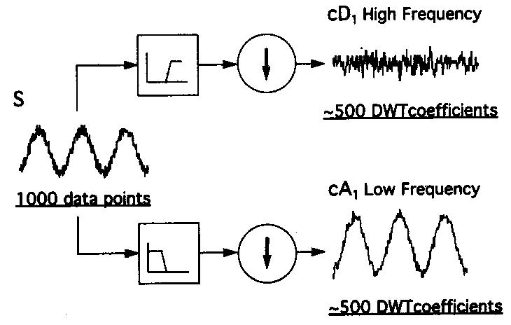
Discrete Wavelet Transform (DWT)
Wavelet comes in pairs (high pass and low pass filter)
Split signal with filter and downsample

Slide 30
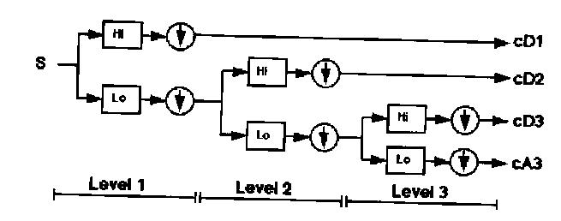
DWT cont.
Continue this process on the high frequency portion of the signal

Slide 31
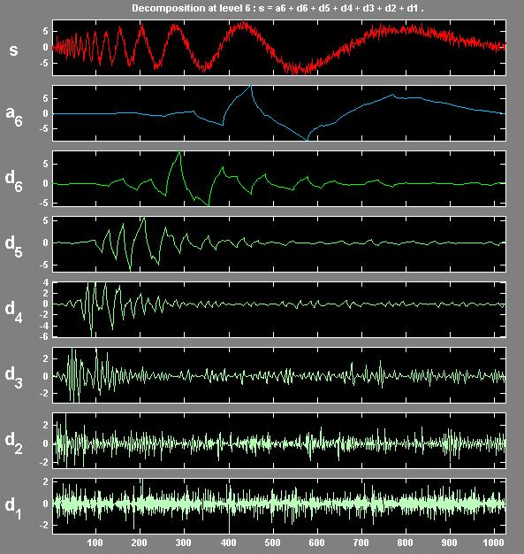
DWT Example

Slide 32
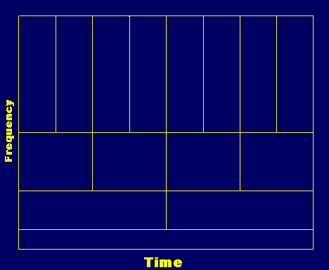
How did this solve the resolution problem?
Higher frequency resolution at high frequencies
Higher time frequency at low frequencies

Slide 33

Don’t Forget…
Why did we do we need these tools (FT, STFT & DWT)?
Features extraction:
  Mel-frequency cepstral coefficients (MFCCs)
  Musical surface features
  Rhythm Features

Slide 34
MFCC
Common for speech
Pre-Emphasis
  Filter out high frequencies to imitate ear
Window then FFT
Mel-scaling
  Run frequency signal through bandpass filters
  Filters are designed to mimic “critical bandwidths” in human hearing
Cepstral coefficients
  Normalized Cosine transform

Slide 35
Musical surface features
Represents characteristics of music
  Texture
  Timbre
  Instrumentation
Statistics over spectral distribution
  Centroid
  Rolloff
  Flux
  Zero Crossings
  Low Energy

Slide 36
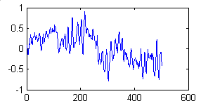
Calculating Surface Features
Divide into windows
Calculate feature for window
Calculate mean and std. dev. over windows
Signal
FFT over window
Σ…

Slide 37
Surface Features
Centroid: Measures spectral brightness
Rolloff: Spectral Shape
R such that:
M[f] = magnitude of FFT at frequency bin f over N bins

Slide 38
More surface features
Flux: Spectral change
Zero Crossings: Noise in signal
Low Energy: Percentage of windows that have energy less than average
Where, M_{p}[f] is M[f] of the previous window

Slide 39
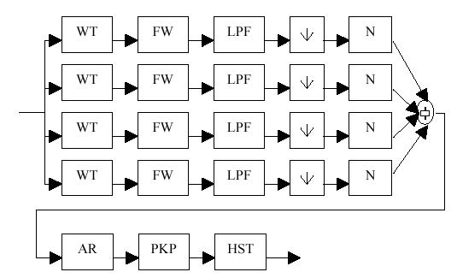
Rhythm Features
Wavelet Transform
Full Wave Rectification
Low Pass Filtering
Downsampling
Normalize

Slide 40

Rhythm Features cont.
Autocorrelation – The cross-correlation of a signal with itself (i.e. portions of a signal with it’s neighbors)
Take first 5 peaks
Histogram over windows of the signal

Slide 41
Actual Rhythm Features
Using the “beat” histogram…
  Period0 - Period in bpm of first peak
  Amplitude0 - First peak divided by sum of amplitude
  RatioPeriod1 - Ratio of periodicity of first peak to second peak
  Amplitude1- Second peak divided by sum of amplitudes
  RatioPeriod2, Amplitude2, RatioPeriod3, Amplitude3

Slide 42
Experimental Setup
Songs collected from radio, CDs and Web
50 samples for each class, 30 sec. Long
15 genres
  Music genres: Surface and rhythm features
  Classical: MFCC features
  Speech: MFCC features
Gaussian classifier
10 Fold cross validation

Slide 43
General Results
 | Music vs. Speech | Genres | Voices | Classical
Random | 50 | 16 | 33 | 25
Gaussian | 86 | 62 | 74 | 76

Slide 44
Results: Musical Genres
 | Classic | Country | Disco | Hiphop | Jazz | Rock
Classic | 86 | 2 | 0 | 4 | 18 | 1
Country | 1 | 57 | 5 | 1 | 12 | 13
Disco | 0 | 6 | 55 | 4 | 0 | 5
Hiphop | 0 | 15 | 28 | 90 | 4 | 18
Jazz | 7 | 1 | 0 | 0 | 37 | 12
Rock | 6 | 19 | 11 | 0 | 27 | 48
Pseudo-confusion matrix

Slide 45
Results: Classical
 | Choral | Orchestral | Piano | String
Choral | 99 | 10 | 16 | 12
Orchestral | 0 | 53 | 2 | 5
Piano | 1 | 20 | 75 | 3
String | 0 | 17 | 7 | 80
Confusion matrix

Slide 46
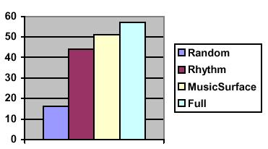
Analysis of Features

Slide 47
GUI for Audio Classification
Genre Gram
  Graphically present classification results
  Results change in real time based on confidence
  Texture mapped based on category
Genre Space
  Plots sound collections in 3-D space
  PCA to reduce dimensionality
  Rotate and interact with space

Slide 48
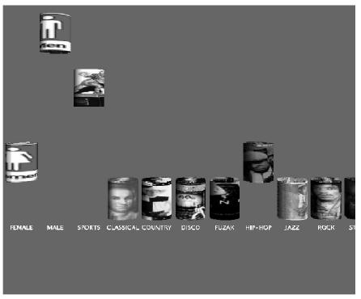
Genre Gram

Slide 49
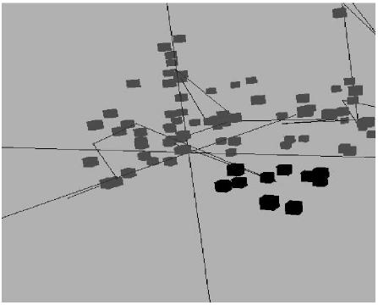
Genre Space

Slide 50
Summary
Audio retrieval is a relatively new field
Wide range of genres and types of audio
A number of digital encoding formats
Various different types of features
Tools for feature extraction
  FT
  STFT
  Wavelet Transform

Slide 51
Thanks
Robi Polikar for his tutorial (http://www.public.iastate.edu/~rpolikar/WAVELETS/WTtutorial.html)
Karlheinz Brandenburg for developing mp3 ☺

