Slide 1
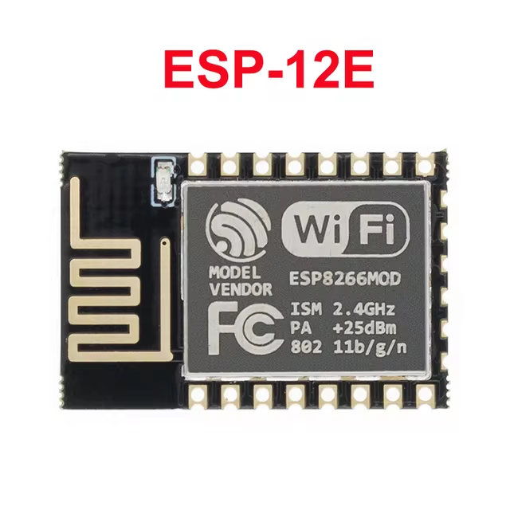
https://tilde.town/~kzimmermann/articles/alpine_linux_desktop.html ->
https://wiki.alpinelinux.org/wiki/Raspberry_Pi

