Slide 1




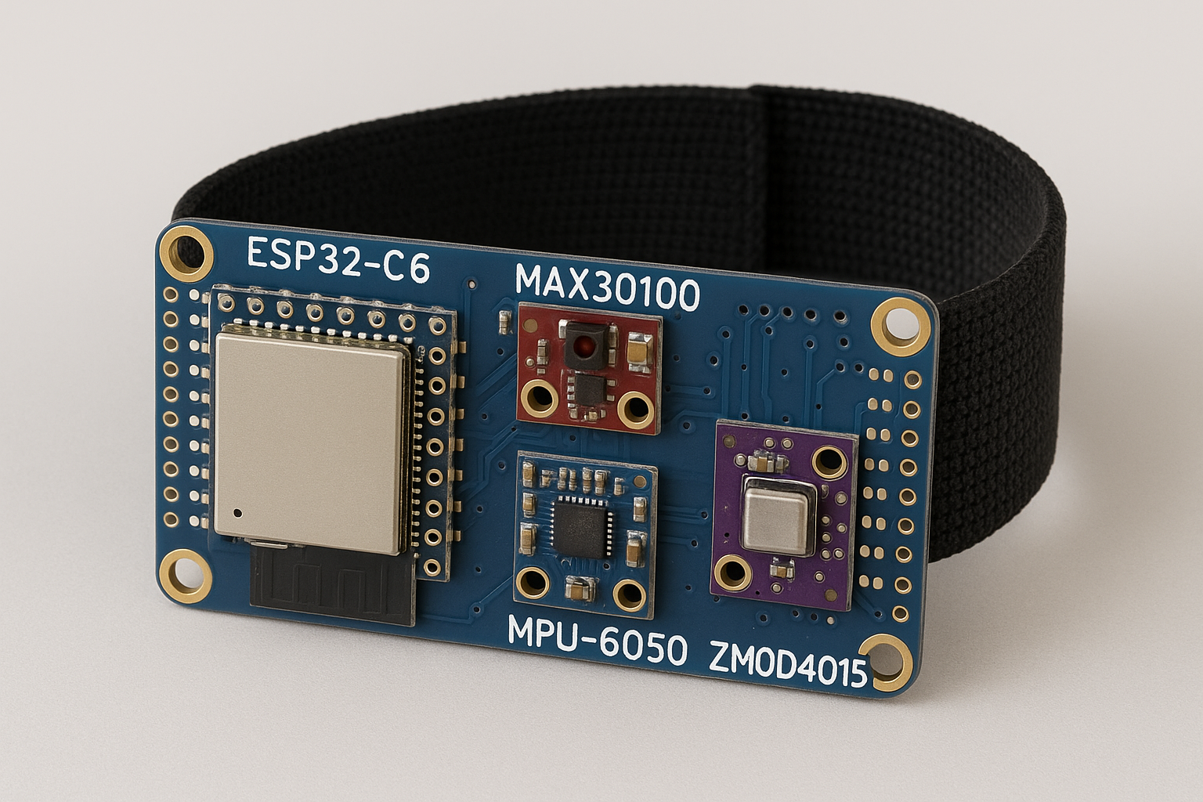



BRATARA SMART
Student: Cristian Ghervasă
Profesor: Marius – Ciprian Brânzilă

Slide 2

Why is valuable?
Healty at Risk!
Automation
Real Time
Imagine being able to know within seconds that one of your employees is in a life threatening situation
Reduce the response time. By automatically sending alerts during emergencies such as falls, toxic gas exposure, or abnormal heart rates
Monitoring of vital signs and environmental conditions. early detection of potential health issues or hazards.

Slide 3

System Components
Applications Fields
Motherboard and Sensors
01
02
High-risk Work Environments
Coal Mines, Chemical Plants
ESP32, MAX30100, ZMOD4510(VOC), MPU-6050
Communication Technologies
Algorithms
03
04
MQTT, 802.11 Wi-Fi, ThingsBoard
Neurofuzzy, FallDetection, HVR, DangerDetection

Slide 4
Communication Technologies
IoT Server Management
ThingsBoard
Real-Time Visibility
Incident Reporting
Emergency Response
Posibility to monitor each worker’s health
Validation of Algorithms
Fast and accurate localization
Scalable indefinitely through NAT.
Instant alert on Smartphone/PC
Awareness of the health problem prior to arrival
ThingsBoard Dashboard
Automatic Emergency Call
Knowledge of the victim's environment.

Slide 5
System Utility
Why do we use those components?
ESP32-C6
ZMOD4510
MAX30100
MPU-6050
Dedicated to Air Quality
Pulse Oximeter Sensor
Gyroscopic and Acceleration
VOCs Sensor Type
HVR and Stress Detection
Fall Detection, Dangerous Space Detection
Dangerous Space Detection
SpO2, Pulse and Respiratory Monitoring
Integration with MAX30100

