Slide 1

Reproducibility
Image Enhancement

Slide 2
MLFlow
Data set too big to preprocess in local machine because last time we used Colab pro
So, to test the MLFlow implementation, we used only 300 images out of 2053
The original dataset is stored in /data/raw/
Preprocess performed and monitored by MLFlow
After preprocessing Low- and high-resolution images are stored in .h5 data file in /data/processed/

Slide 3
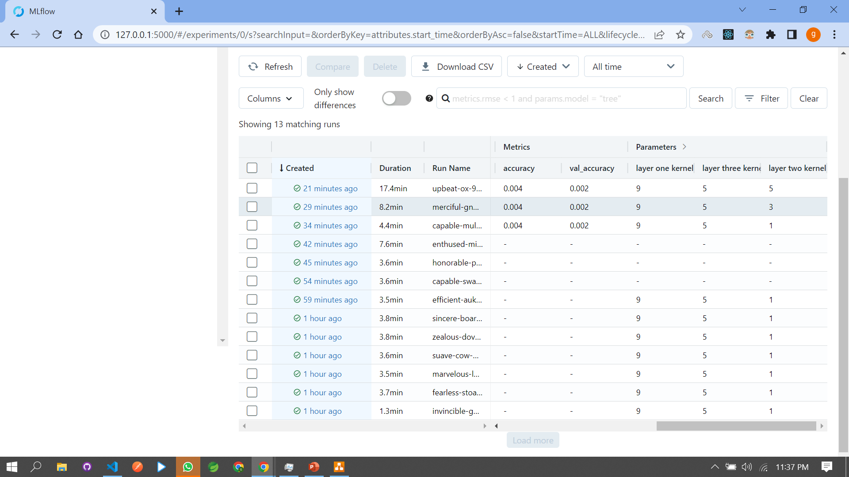
MLFlow
Experimenting the optimization of model when the kernel size increased
Parameters was on kernel sizes 9-1-5, 9-3-5, 9-5-5
Performance matrices on train loss

Slide 4
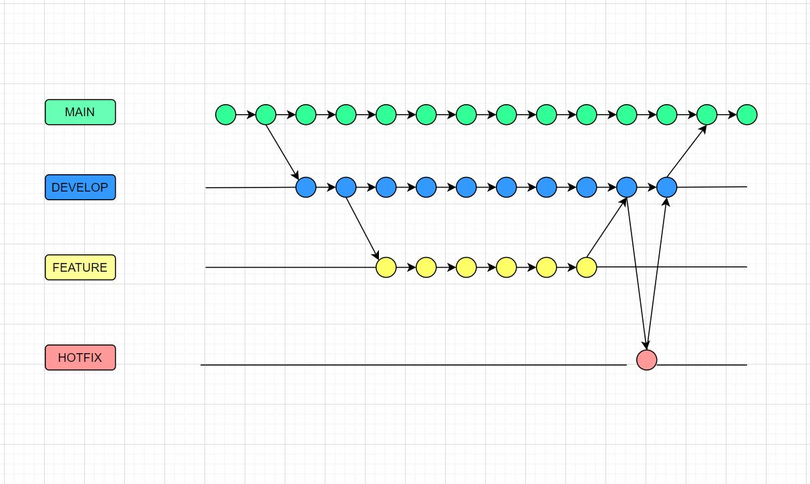
Code Versioning
Git
There are two starting branches Main and Develop
Develop is the working branch
Feature branch is created from develop for working in specific task, the name convention for feature is [task_Feature]
Hotfix branch is created when there is issue in code, the naming convention is [task_Hotfix]
Our plan is to merge to main twice before mid exam and the at final project

Slide 5
Team Rules
Before publishing we Pull current changes(if there is any) from develop and we merge. If there is any conflict, we solve it by our self
We review each others code
If we are working the same task, we specify the reviewer

Slide 6
DVC
Our first task was deciding what will be our remote storage. So, we made some research in free tier plan on
Amazon S3
Google Drive

Slide 7
Amazon S3
Amazon provides free 5 GB storage during the sign up.
20,000 GET request.
5000 put, copy, post, list request.
100 GB data transfer.

Slide 8
Google Drive
Google drive provides 15 GB free storage.
From all the remote storage providers google drive provides more storage in free tier. So, we decided to use google drive as our remote storage.

Slide 9
Setting up DVC Environment
In order to install and use DVC first we should have to install and initialize Git. We have already installed and initialized our Git repository. So, we installed our DVC and initialized it in our working directory.

Slide 10
Setting up DVC Environment
The next task was adding the files to the DVC local repository. We added our raw data, models and other large files that can not be pushed to the GitHub repository. After that we have configured our remote repository and we pushed our files to the remote storage that is Google drive. And the files are successfully uploaded.

Slide 11
Setting up DVC Environment
Finally, we created python API that will help us to integrate our data or model directly with our source code from DVC. This lets you access the data contents directly from within an application at runtime.
Our next move is, implementing dagshub as data and pipeline versioning.

Slide 12
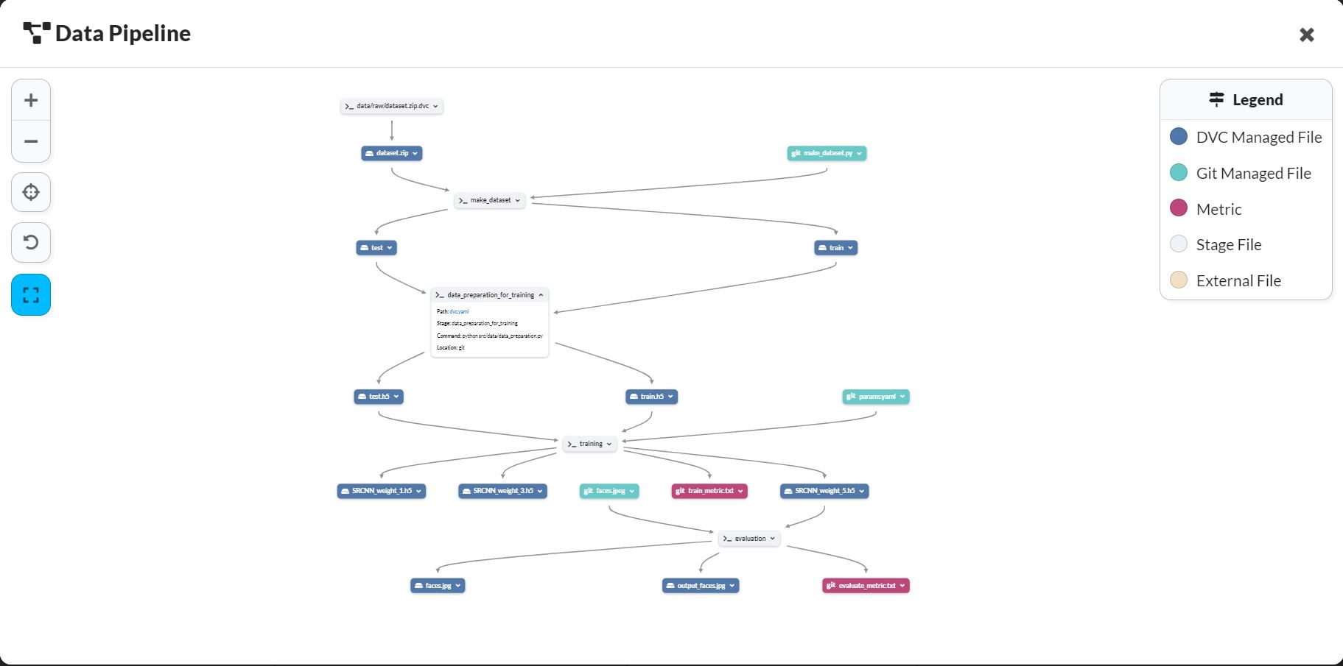
dagshub as data and pipeline versioning.

