Slide 1
Interoperable Tools for Advanced Petascale Simulations (ITAPS)
ComPASS Meeting Update
December 3, 2008
LLNL-PRES-407129

Slide 2
Outline
ITAPS data models & interfaces
ITAPS services
ANL/ITAPS activities & opportunities

Slide 3
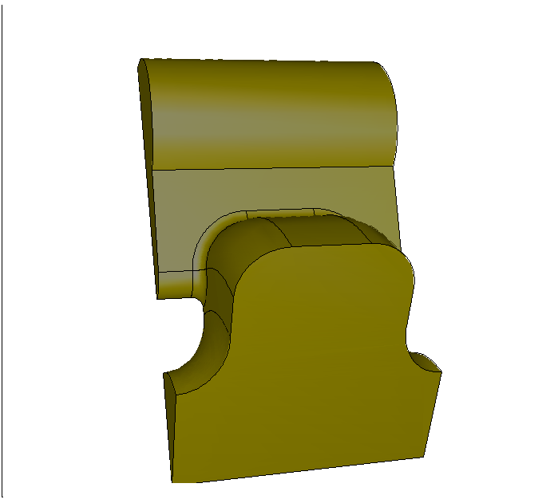
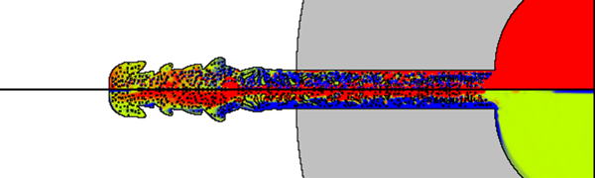
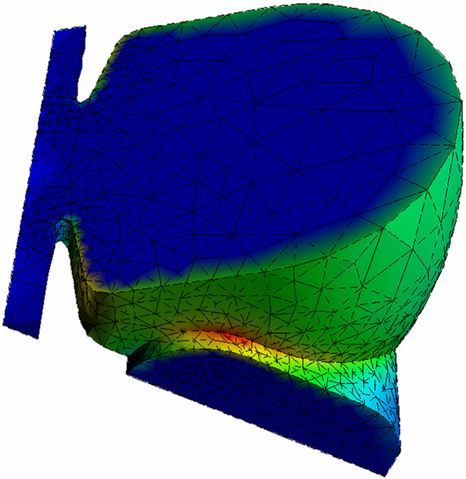
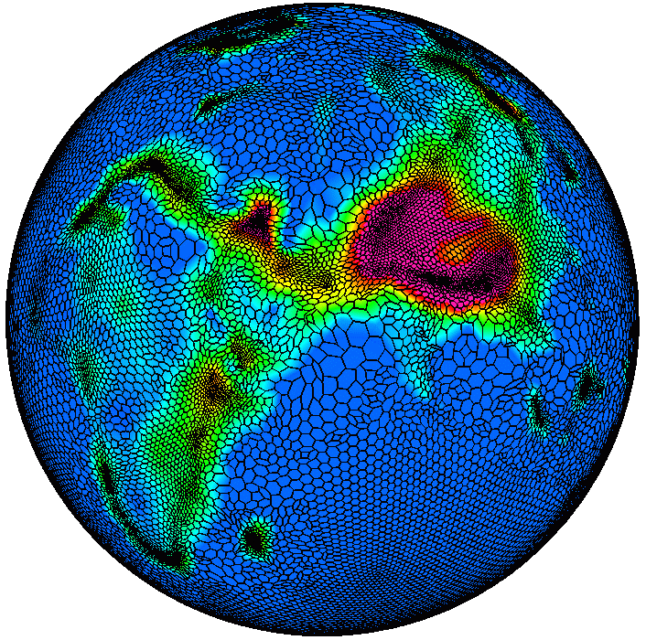
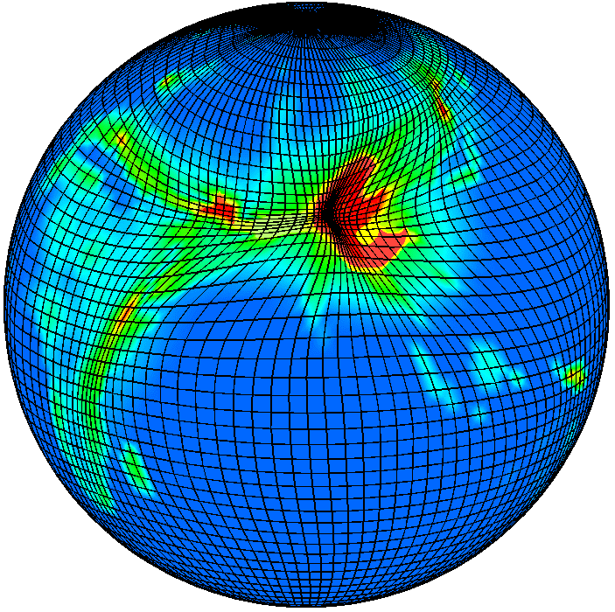
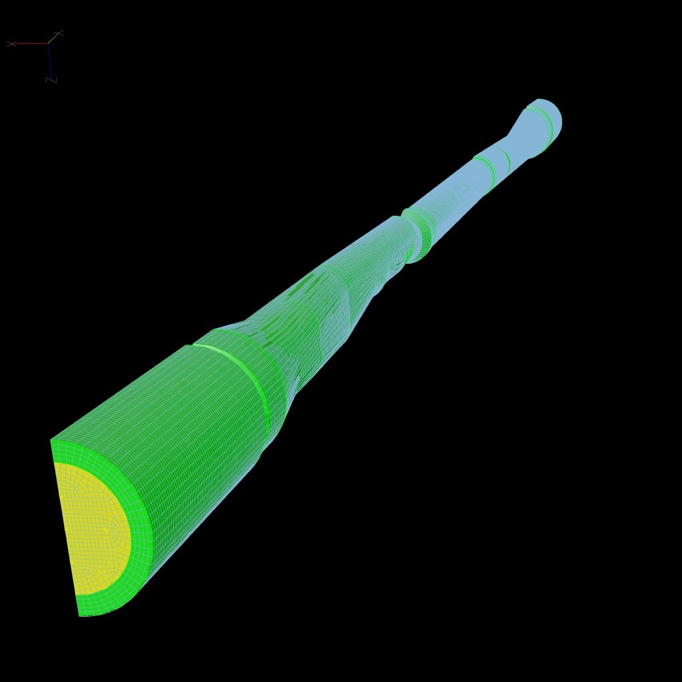
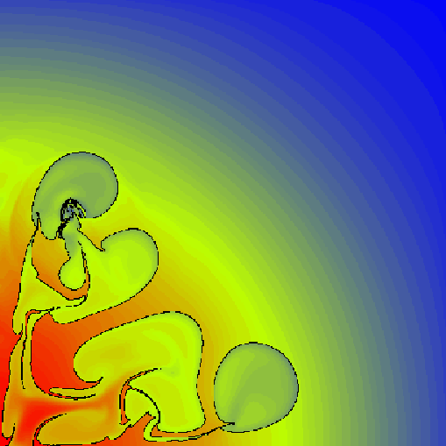
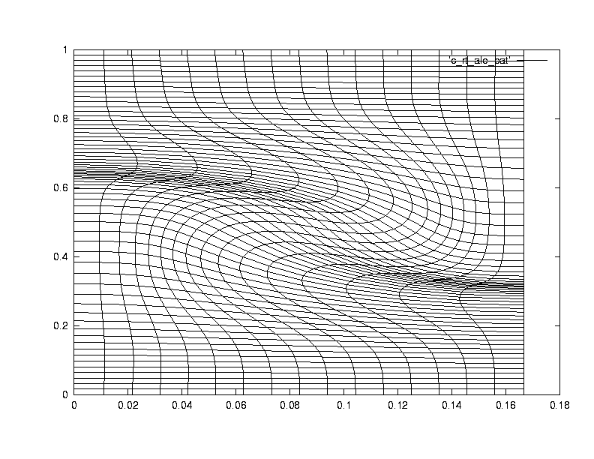
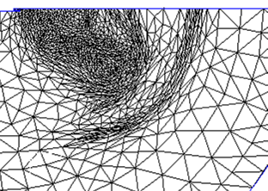
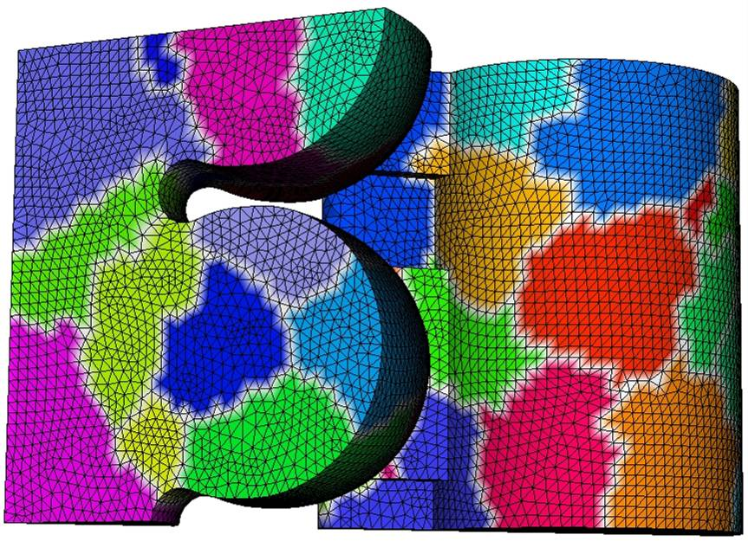
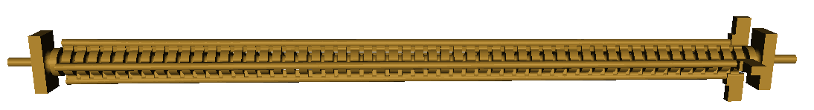
ITAPS 3-Tier Approach
Interfaces, Tools, Services
Accelerator
Fusion
Groundwater
Nuclear energy
Petascale
Integrated
Tools
Build on
AMR
Front tracking
Shape
Optimization
Solution
Adaptive
Loop
Solution
Transfer
Petascale
Mesh
Generation
β
α
α
α
α
Component
Tools
Are unified
by
Front
tracking
Mesh
Improve
Mesh
Adapt
Swapping
Interpolation
Kernels
Dynamic
Services
Geom/Mesh
Services
P
P
β
P
α
P
P
Common
Interfaces
Mesh
Geometry
Relations
Field
P
P
β
N
to…
GRUMMP
MOAB
FMDB
NWGrid
CGM
Lasso

Slide 4
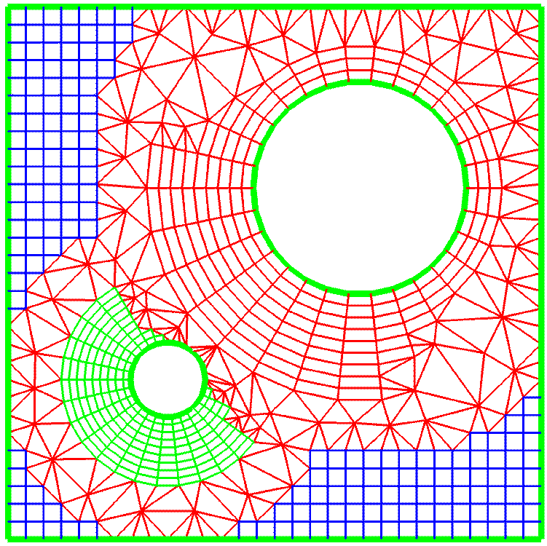
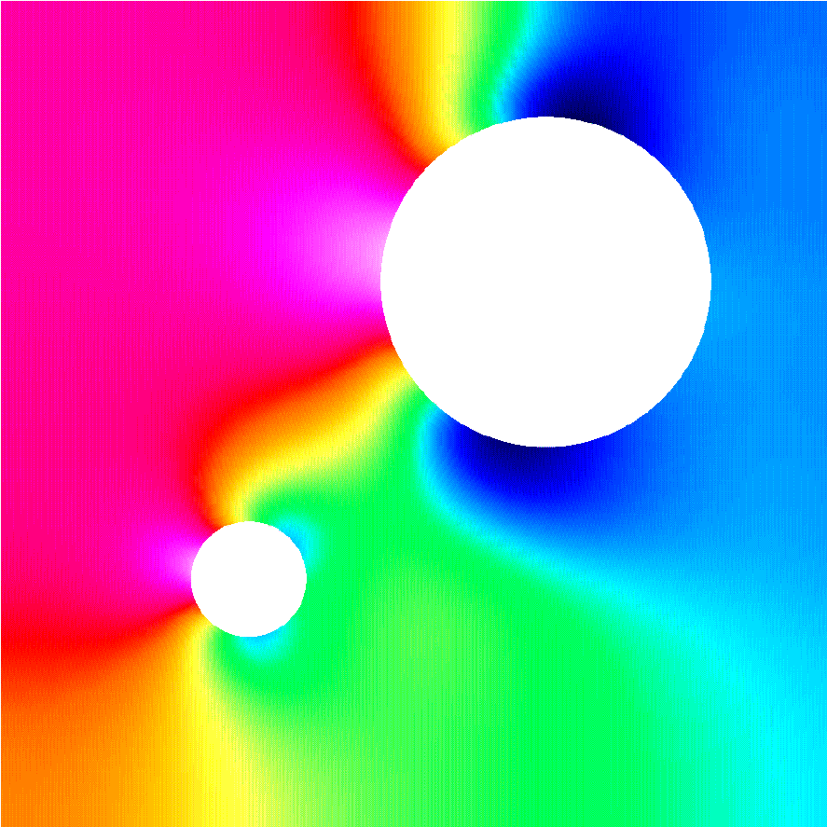
The ITAPS data model abstracts
PDE-simulation data hierarchy
Core Data Types
  Geometric Data: provides a high level description of the boundaries of the computational domain; e.g., CAD, image, or mesh data (iGeom)
  Mesh Data: provides the geometric and topological information associated with the discrete representation of the domain (iMesh)
  Field Data: provides access to time dependent physics variables associated with application solution. These can be scalars, vectors, tensors, and associated with any mesh entity. (iField)
Data Relation Managers (iRel)
  Provides control of the relationships among the core data types
  Resolves cross references between entities in different groups
  Provides functionality that depends on multiple core data types

Slide 5
The ITAPS data model has four fundamental “types”
Entity: fine-grained entities in interface (e.g., vertex, face, region)
Entity Set: arbitrary collection of entities & other sets
  Parent/child relations, for embedded graphs between sets
Interface Instance: object on which interface functions are called and through which other data are obtained
Tag: named datum annotated to Entities and Entity Sets

Slide 6
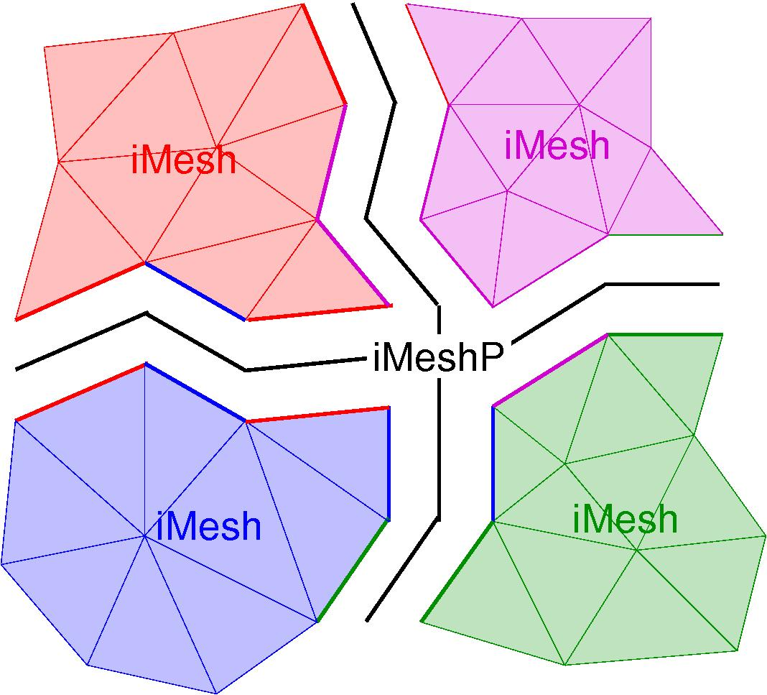
The iMeshP parallel interface defines a partition model
Process: a program executing; MPI process
  # of processes == MPI_Comm_size
  Process number == MPI_Comm_rank
iMesh instance: mesh database provided by an implementation
  One or more instances per process
Partition: describes a parallel mesh
  Maps entities to subsets called parts
  Maps parts to processes
  Has a communicator associated with it

Slide 7
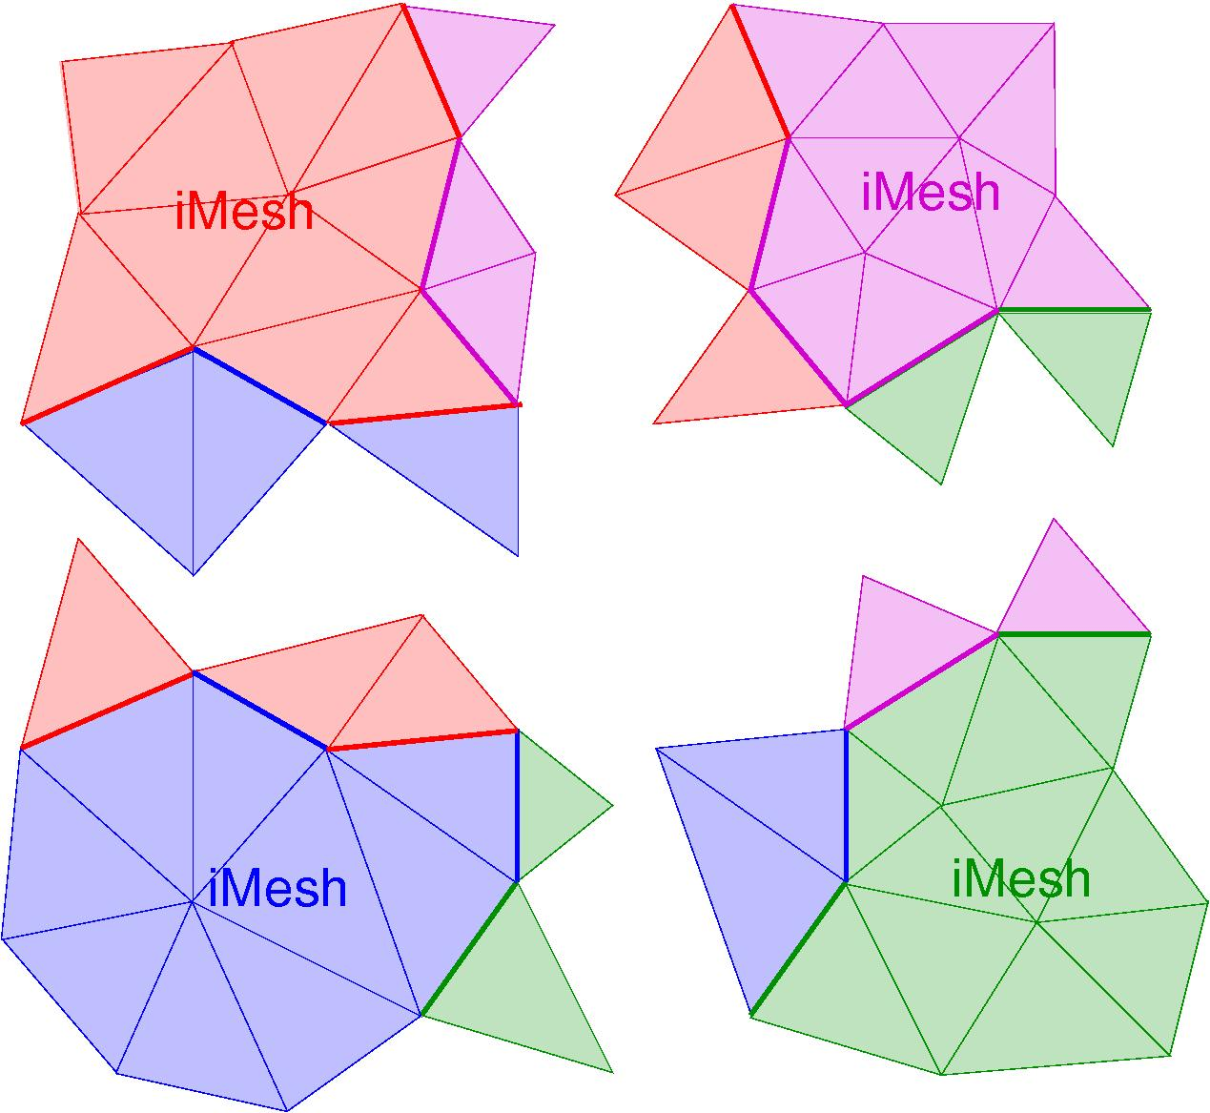
The Partition Model
Ownership: right to modify an entity
Internal entity: Owned entity not on
an interpart boundary.
  E.g., all triangles w/ same color as
  iMesh label for part
Part-Boundary entity: Entity on an
interpart boundary
  E.g., bold edges
  Shared between parts (owner indicated
  by color; other parts have copies).
Ghost entity: Non-owned, non-part-
boundary entity in a part
  E.g., triangles whose color is different from iMesh label
  Needed for adjacency and/or solution data
Copies: ghost entities + non-owned part-boundary entities.

Slide 8
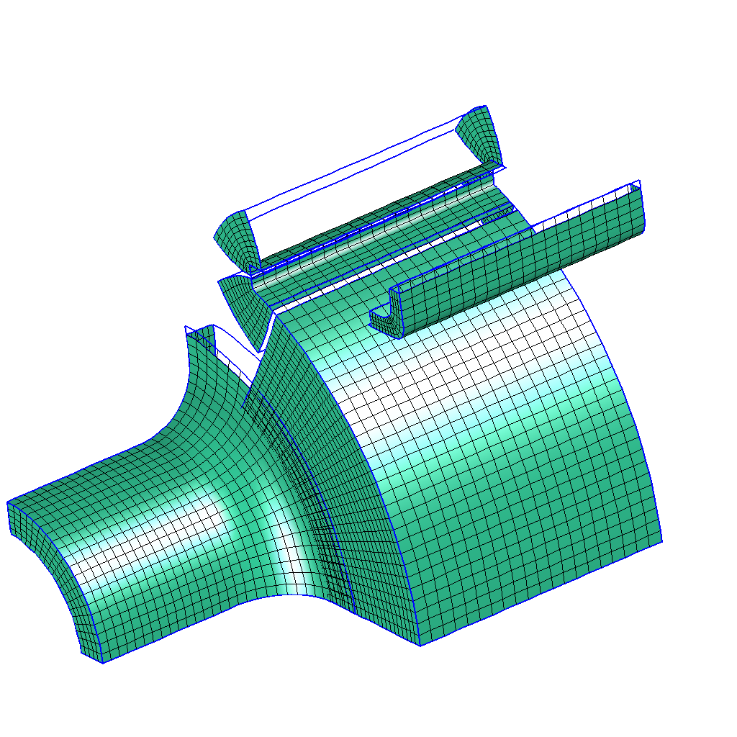
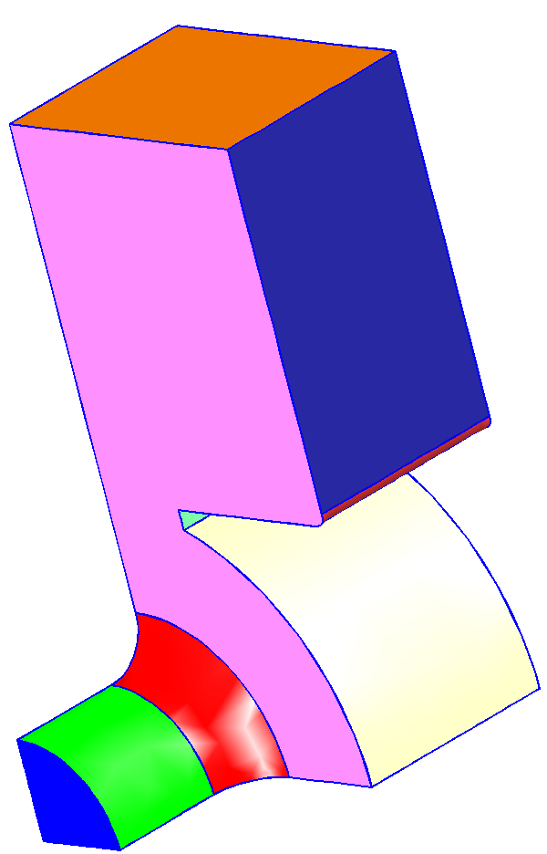
Basic and advanced functionalities are supported in the geometry interface
Model loading and initiation
Topological queries of entities and adjacencies
Pointwise geometric shape interrogation
Parametric coordinate systems
Model topology modification
Model construction (primitives, booleans, transforms, etc.)

Slide 9
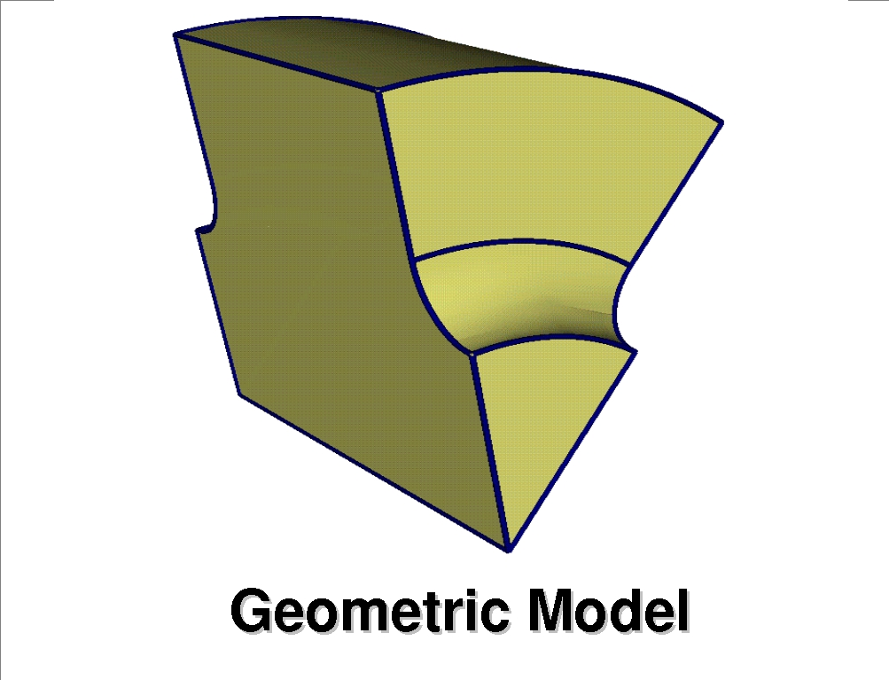
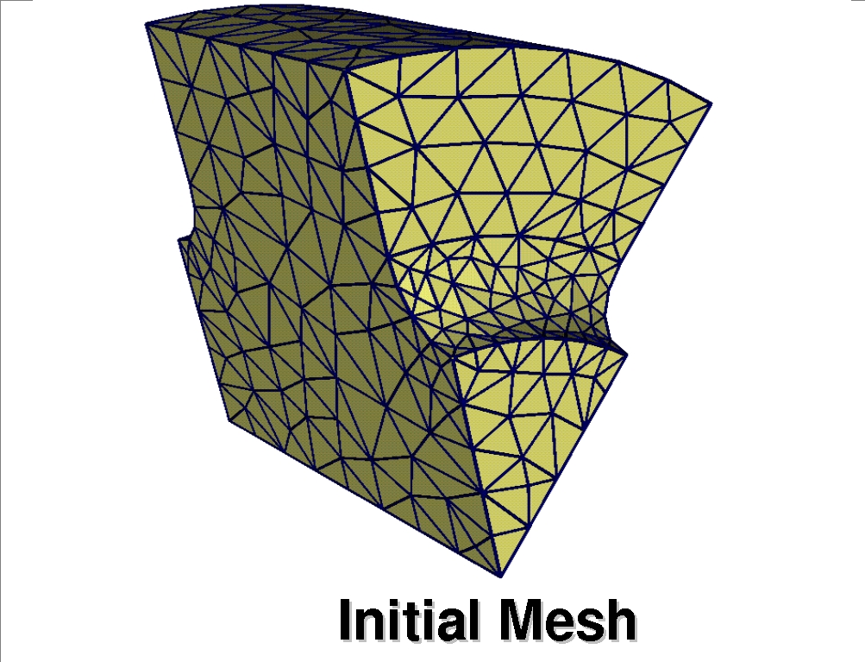
Relating mesh and geometry data is critical for advanced ITAPS services
Required for e.g., adaptive loops, mesh quality improvement
Mesh/Geometry Classification Interface
  Manages the relationship between the high level geometric description and the mesh
  Called by an application that knows about both
Capabilities
  For a given mesh entity, get the geometric entity against which it is classified
  Establish a classification relationship between a mesh entity and a geometric entity

Slide 10
ITAPS Interfaces Designed for Interoperability
app1.f77
app2.f90
app3.CC
app4.c
app1.f77
app2.py
Babel
iMesh
(C)‏
f77 client
Server
Python client
app3.java
Java client
Interoperability across language,
application, implementation
Multiple call paths to the same implementation
Efficiency preserved using
direct, C-based interface
implA.CC
implB.c
implC.f77

Slide 11
Simple Example: HELLO iMeshP
Revised 11/08
Parallel Version: HELLO iMeshP
1) Instantiates Partition
2) Reads mesh into mesh instance and Partition
3) Reports # parts in Partition
#include "iMesh.h"
#include "iMeshP.h"
#include <mpi.h>
int main(int argc, char *argv[]) {
char *options = NULL;
iMesh_Instance mesh;
iMeshP_PartitionHandle partition;
int me, dim, num, ierr, options_len=0;
iBase_EntitySetHandle root;
/* create the Mesh instance */
iMesh_newMesh(options, &mesh, &ierr, options_len);
iMesh_getRootSet(mesh, &root, &ierr);
MPI_Init(&argc, &argv);
MPI_Comm_rank(MPI_COMM_WORLD, &me);
/* Create the partition. */
iMeshP_createPartitionAll(mesh, MPI_COMM_WORLD, &partition, &ierr);
/* load the mesh */
iMeshP_loadAll(mesh, partition, root, argv[1], options, &ierr,
strlen(argv[1]), options_len);
/* Report number of Parts in Partition */
iMeshP_getNumParts(mesh, partition, &num, &ierr);
printf("%d Number of Parts = %d\n", me, num);
. . .
1
2
3

Slide 12
HELLO iMeshP Makefile
Revised 11/08
CC = mpicc -g
IMESH_DIR = /usr/local/itaps/FMDB_iMeshP
include $(IMESH_DIR)/lib/iMesh-Defs.inc
INCPATH += $(IMESH_INCLUDES)
LIBS += $(IMESH_LIBS)
hello_iMeshP: hello_iMeshP.c
$(CC) $(INCPATH) -c hello_iMeshP.c
$(CC) -o $@ hello_iMeshP.o $(LIBS)

Slide 13
ITAPS API's: Argument Handling Conventions
ITAPS API's are C-like and can be called directly from C, Fortran, C++
Arguments pass by value (in) or reference (inout, out)
  Fortran: use %VAL extension
Memory allocation for lists done in application or implementation
  If inout list comes in allocated, length must be long enough to store results of call
  By definition, allocation/deallocation done using C malloc/free; application required to free memory returned by implementation
  Fortran: Use “cray pointer” extension (equivalences to normal f77 array)‏
Handle types typedef'd to size_t (iBase_EntityHandle, iBase_EntitySetHandle, iBase_TagHandle, iMesh_Instance)
Strings: char*, with length passed by value after all other args
Enum's: values (iBase_SUCCESS, etc.) available for comparison operations, but passed as integer arguments
  Fortran: named parameters

Slide 14
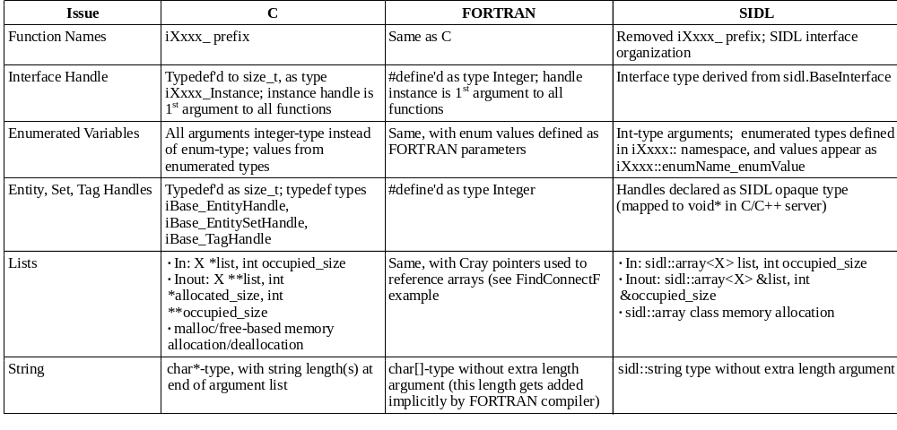
Argument Handling Conventions

Slide 15
Performance
Large applications balance memory and cpu time performance
Implementations of iMesh vary on speed vs. memory performance
  Create, v-E, E-v query, square all-hex mesh
  Entity- vs. Array-based access
Compare iMesh (C, SIDL), Native (MOAB), Native Scd (MOAB), CUBIT
  Ent-, Arr-based access
  All-hexahedral square structured mesh
CUBIT
SIDL Ent
SIDL Arr
C Arr‏
SIDL Ent
C Ent‏
C Ent‏
Native Ent
Native Arr
C Arr
Native Scd
Native Ent
Native Arr
CUBIT
Native Scd

Slide 16
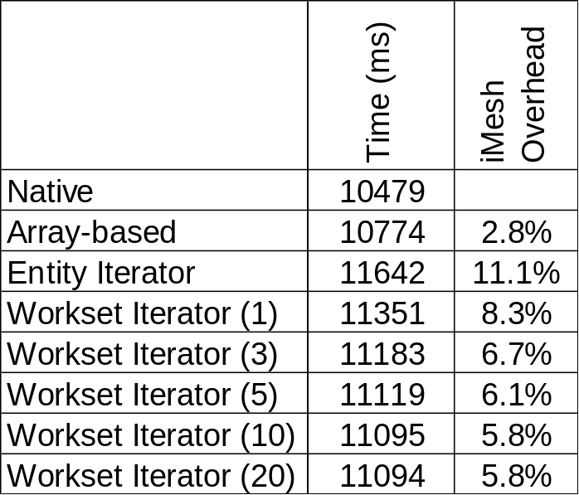
Performance in building a finite element stiffness matrix
Set up a simple stiffness matrix for a 2D diffusion equation
Examine costs of entity access via native data structures, arrays, entity iterators and workset iterators
Arrays minimize time overhead but require a data copy
Entity iterators are straightforward to program, minimize memory overhead, but maximize time cost
Entity array iterators balance time/memory tradeoffs but are the most difficult to program
∇²u = f
u(x=0)=1 u(x=1) = 1
u_{y}(x=0, x=1) = 0

Slide 17
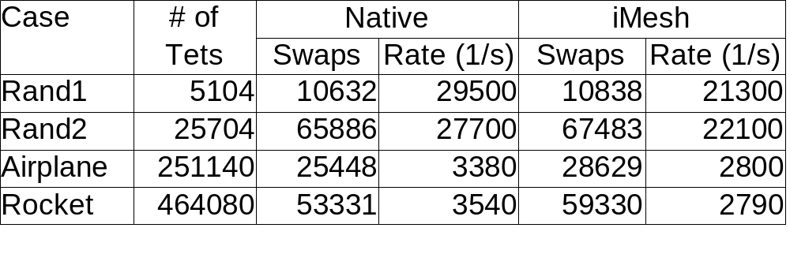
Performance of iMesh Swap for 3D Meshes
Comparing GRUMMP native implementation to service with GRUMMP iMesh implementation
Most remaining overhead is in transcribing data to return format expected by iMesh

Slide 18
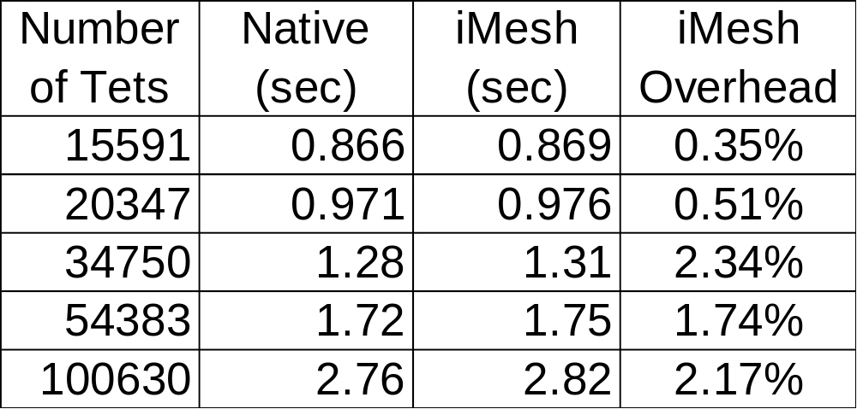
Performance of Zoltan Partitioning for 3D Meshes
Comparing MOAB native implementation linking to Zoltan partitioning service with the MOAB iMesh implementation
Using a coordinate bisection geometric partitioner on tetrahedral meshes and array-based access to the data

Slide 19
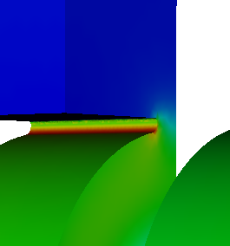
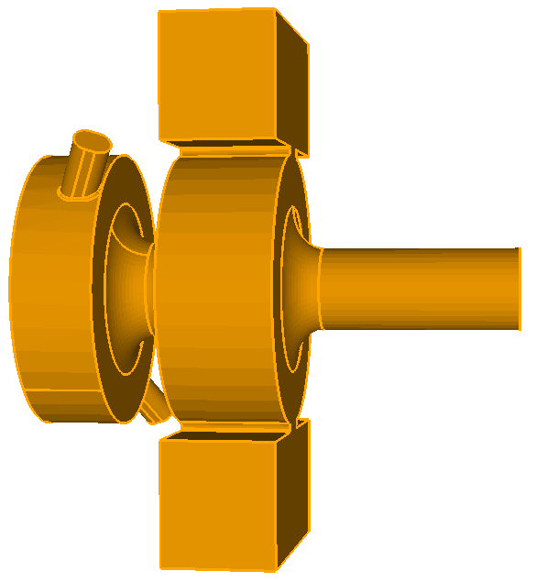
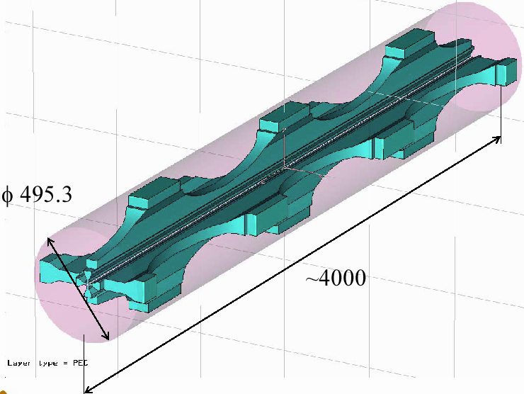

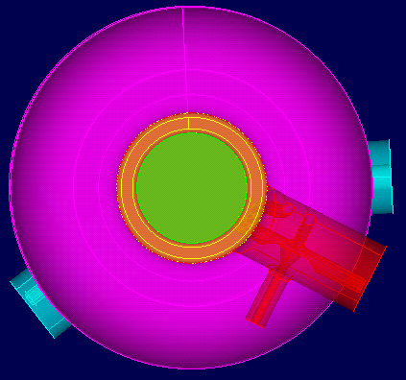
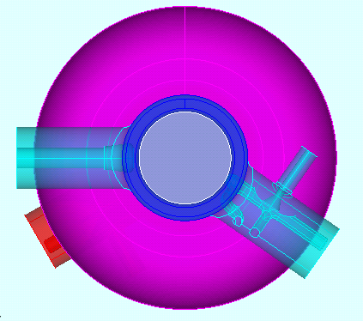

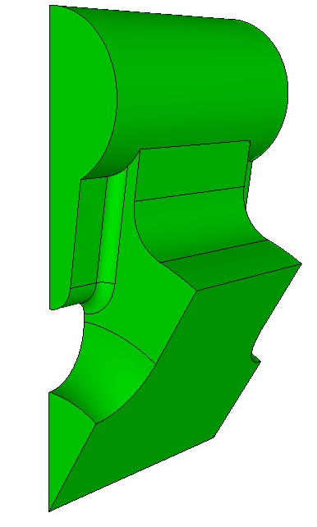
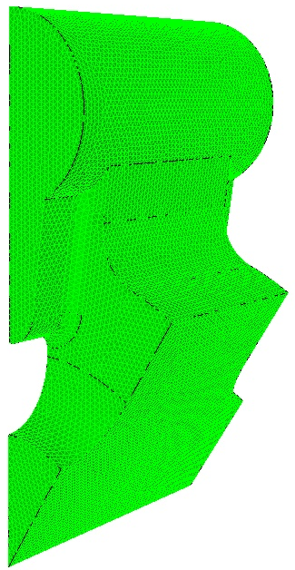
Shape Optimization for
Accelerator Cavity Design
Optimizing a cavity design is still mostly a manual process
Future accelerators employ complex cavity shapes that require optimization to improve performance
Geometry & meshing support:
LCLS
RIA
ILC
Ddriv
Iteration 0:
Omega3P,
Sensitivity,
Optimization
p₀
Ddriv
G(p₀)
CUBIT
m(p₀)
Fixed mesh topology:
Convergence
No re-meshing
Re-use factorization
Iteration 1..k:
p_{k}
Ddriv
G(p_{k})
Ddriv
m₀’
…

Slide 20
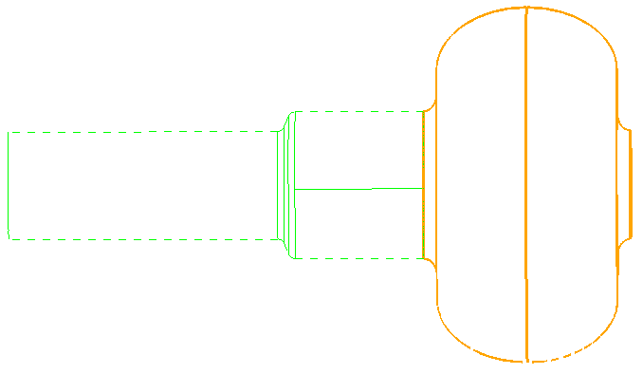
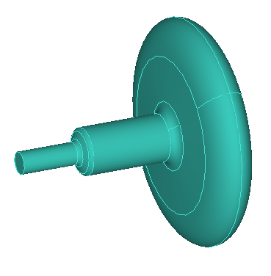
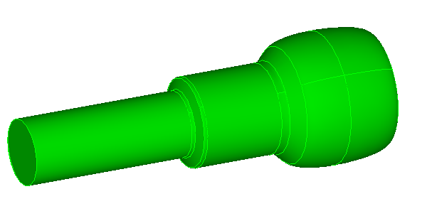
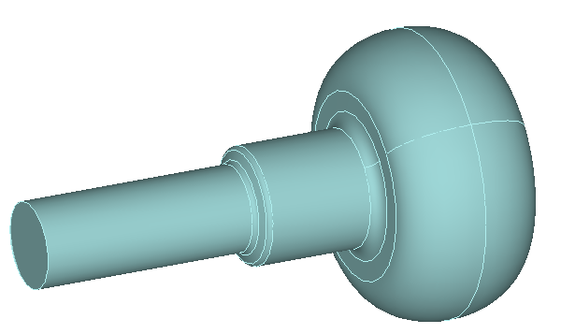
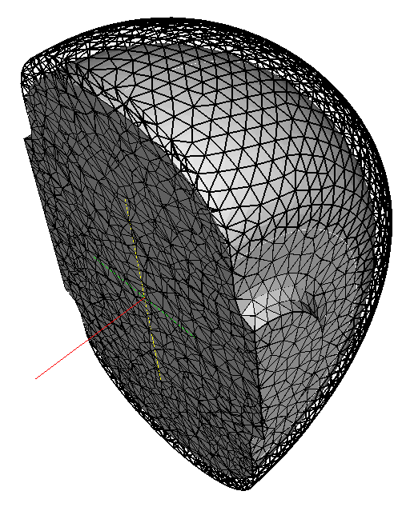
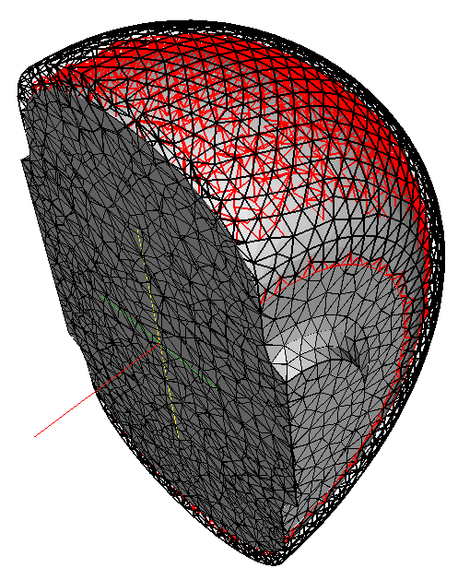
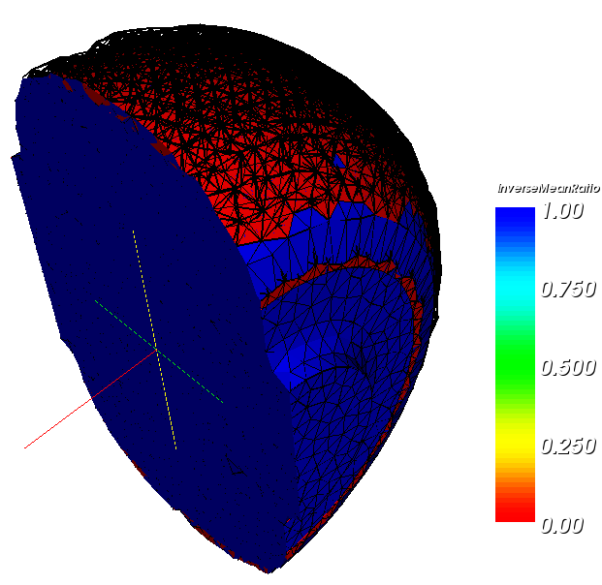

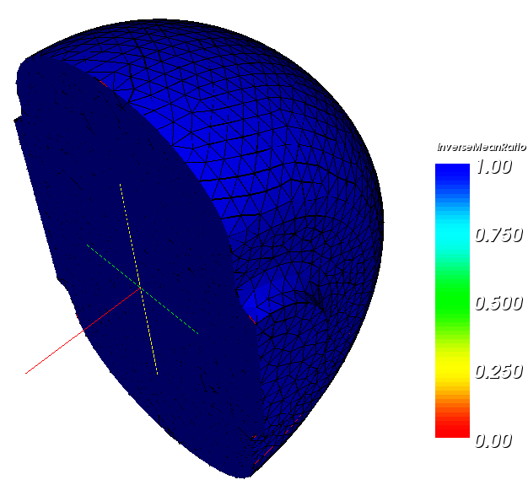
Shape Optimization for
Accelerator Cavity Design
Generate new geometric model G(p’)
given a parameter vector p’
  MkILCCell function
  DDRIV
  CGM (iGeom)
Associate old mesh m(p_{o})
to new geometry G(p’),
project to CAD
  DDRIV
  CGM (iGeom)
  MOAB (iMesh)
  LASSO (iRel)
Smooth mesh
  …
  Mesquite
b1
b
al
a1
a2
ar
bl
br
ra1
ra2
zcc
zcb
zcl
zcr
zcll
Project to CAD,
inverted elements
New geom,
old mesh
Smooth Curves
Smooth Surfaces
Smooth Volume

Slide 21
Services Provided by DDRIV
Parameterized geometric model construction
  You write function which constructs model using iGeom
  DDRIV acts as driver and handles IO
Coordination of mesh smoothing on geometric model
Re-classification of “old” mesh on “new” model
Target matrix-based smoothing of re-classified mesh
Computation of design velocities & embedding on mesh using iMesh Tags

Slide 22
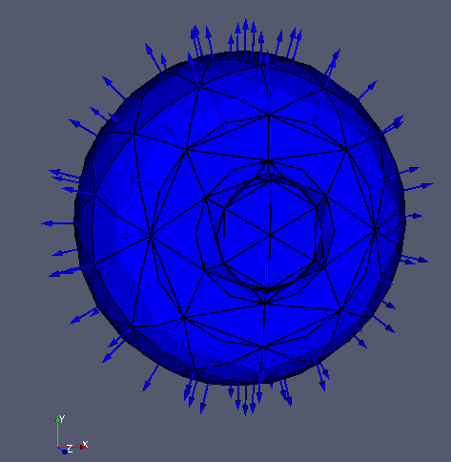
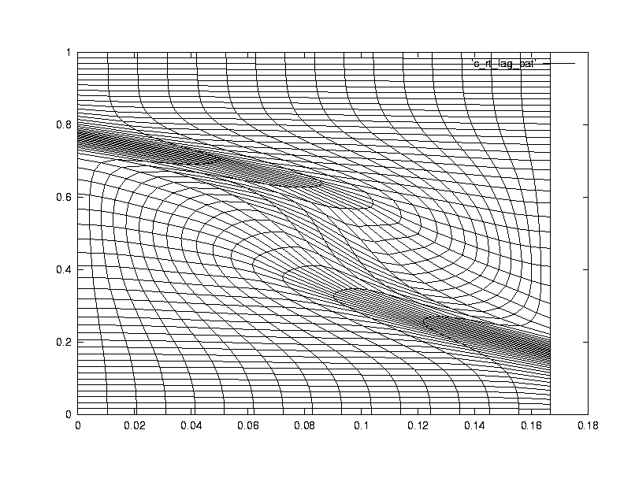
Mesquite provides advanced mesh smoothing capabilities
Mesquite is a comprehensive, stand-alone library for mesh quality improvement with the following capabilities
  Shape Quality Improvement
  Mesh Untangling
  Alignment with Scalar or Vector Fields
  R-type adaptivity to solution features or error estimates
    Maintain quality of deforming meshes
    Anisotropic smoothing
    Control skew on mesh boundaries
Uses node point repositioning schemes

Slide 23
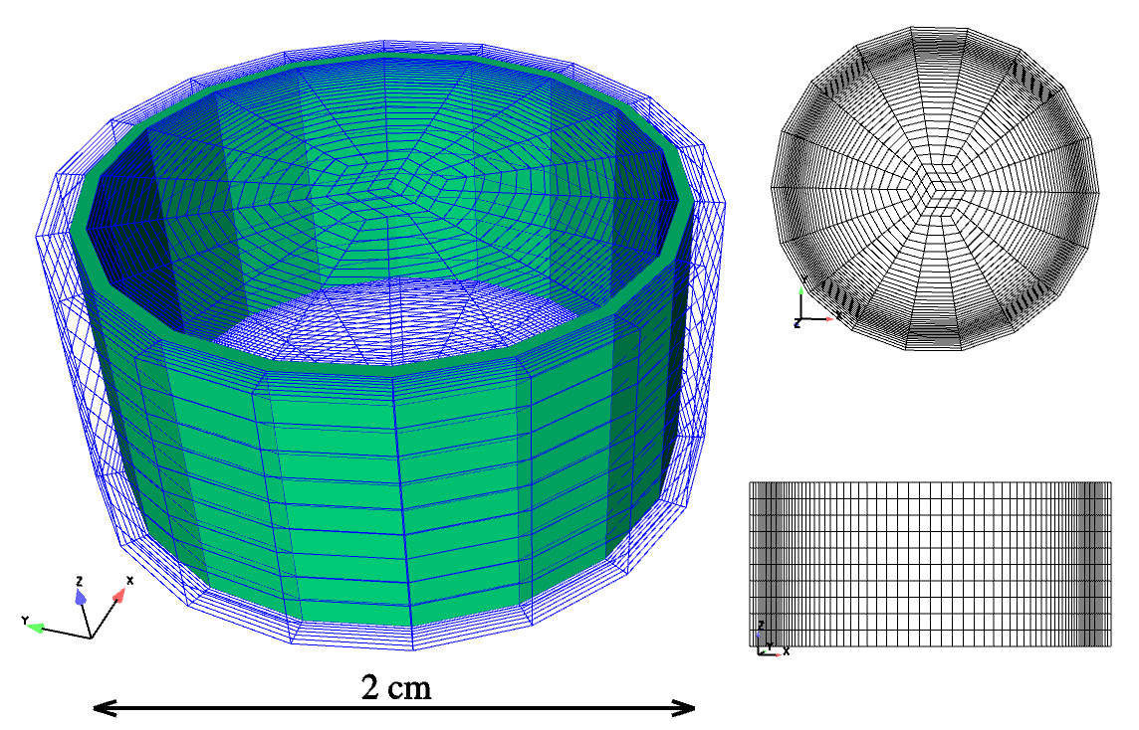
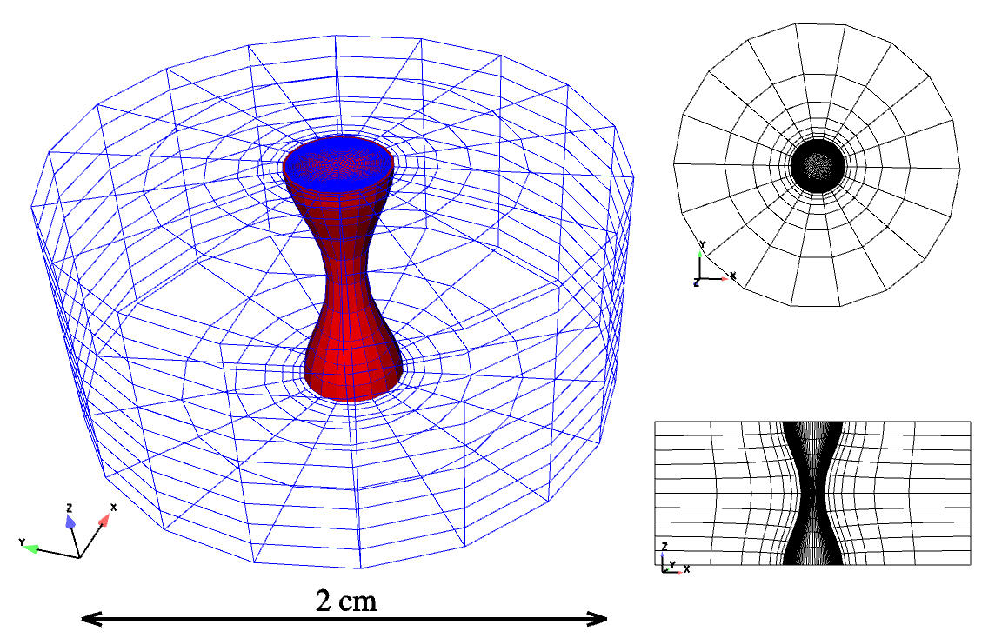
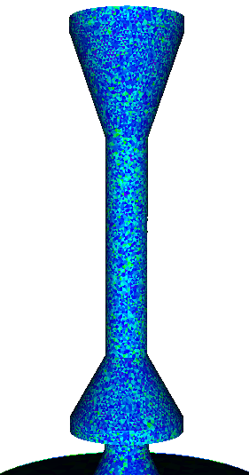
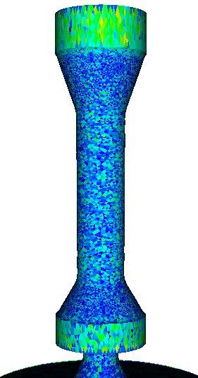
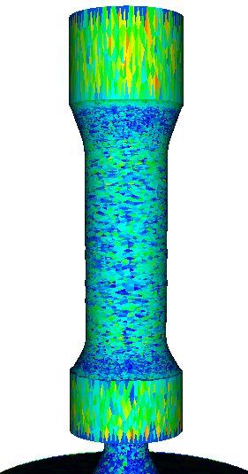
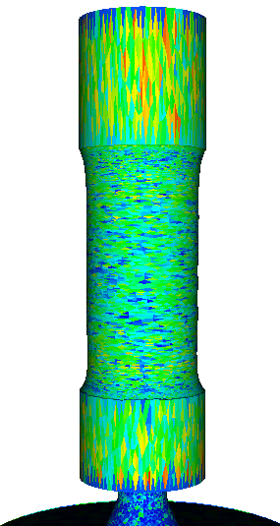
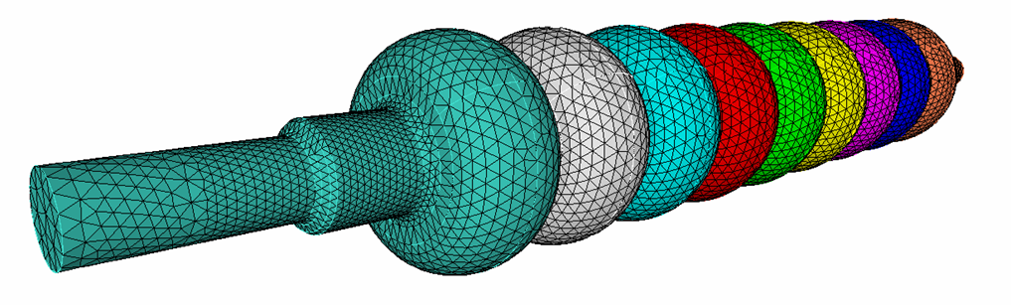
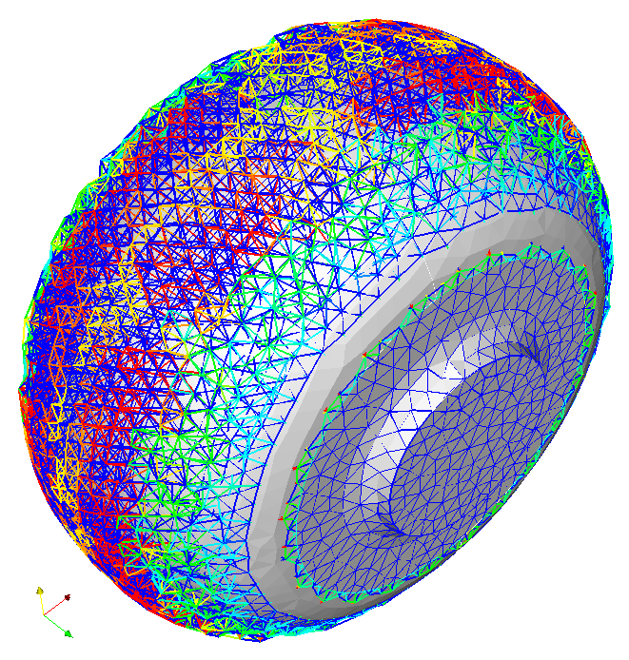

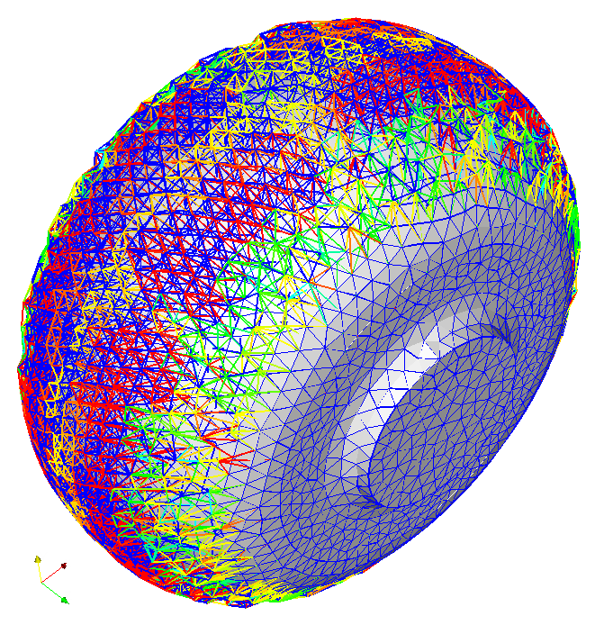
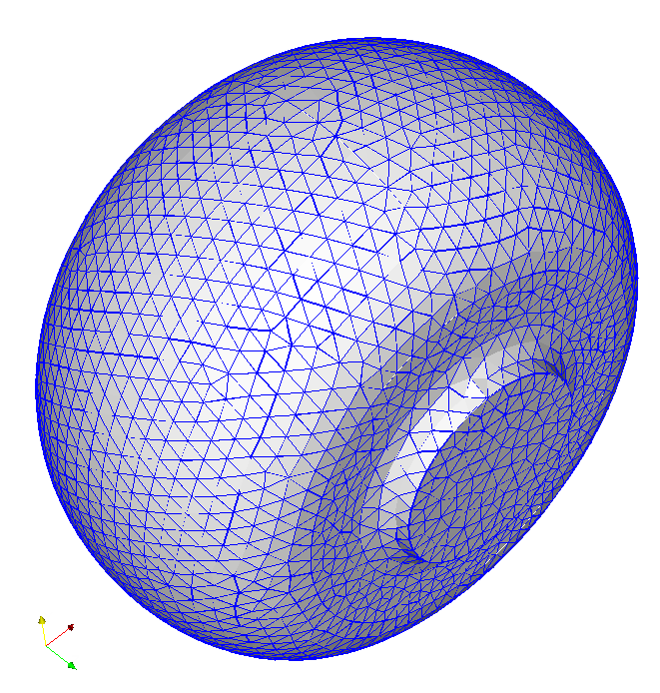
Our mesh quality improvement work has impacted many DOE applications
Application: Burn of rocket propellants in a time-deforming domain
Challenge: Maintain good tetrahedral element shape quality as domain deforms
Impact: Condition number smoother (through ShapeImprovementWrapper) enabled many burn simulations at CSAR/UIUC.
Application: Plasma implosion using ALE methods
Challenge: Maintain good mesh quality and biasing during deformation of plasma.
Impact: Prior to use of Mesquite, this calculation could not be performed by Alegra due to ineffective mesh rezoning algorithm.
Application: Shape optimization for accelerator cavities to minimize losses
Challenge: Rapidly and smoothly update the mesh to conform to trial geometries
Impact: Used the deforming mesh metric to prototype geometry & mesh update model for potential use in SLAC accelerator design studies.

Slide 24

ITAPS has been integrated with VisIt as a database plug-in
A single plug-in supports multiple ITAPS implementations
Supports all entity types
Supports subset and and tag data visualization
Future integration will use VisIt’s in-situ ‘simulation’ interface
  Will enable any ITAPS-compliant software to integrate with VisIt at run-time

Slide 25

VisIt can be used to display test data from multiple implementations
Example of VisIt displaying test data from multiple ITAPS implementations simultaneously

Slide 26






Parallel Tetrahedral Mesh Generation
Mesh volumes and surfaces in parallel
Use graph partitioning to partition work
Use of component-based mesh, geometry, partitioning
1st-generation tool developed before ITAPS parallel interface specification
  Parallel communication handled at application-level
  Need production-capable tool
Processor: 1 2 3 4

Slide 27

CAD-Based Monte Carlo Radiation Transport
Facet-based Ray Tracing
Most Monte Carlo codes use CSG-type
geometry construction
Replaced with high-fidelity CAD modeling
  Use modern geom construction tools
  Model more complex solids
Previous CAD-based MC 20-100x slower than native
  Facet-based Oriented Bounding Box (OBB) tree acceleration reduced
  slowdown to 2-5x
Component-based approach simplifies introduction into multiple MC codes
  Incorporated into ITS in < 1 week
CUBIT
MCNPX/CGM
ITS/CGM
CGM/MOAB
Ray-OBB intersection
OBB Tree
OBB
level 1
level 2
AABB
ARIES Compact Stellerator
level 3

Slide 28










CAD-Based Monte Carlo Radiation Transport
ITER Modeling & Code Comparison Effort
TF Magnet Heating
n Source
TOP
equitorial port w/
tally spheres
BOT
toroidal field magnets
n Wall Loading
divertor
O/B
I/B
Joint US/FRG/PRC effort

Slide 29


MC-Based Neutron Transport for ITER
Module 13 First Wall/Shield Design
CGM→MOAB → VTK → Visit
Heat deposition & cooling
Helium generation close to weldable components

Slide 30

Solution Coupling
Need to couple physics (TH,
neutronics, structural mechanics)
for reactor simulation
  Need to preserve standalone development capability
Assumptions:
  Each physics solved on its own mesh, optimized for that physics
  Each physics mesh distributed with its own distinct MPI communicator, independent of other mesh
  On each processor, meshes for both/all physics stored in the same MOAB instance
Coupling algorithm:
  Initialization (read mesh, initialize searching structures (kdtree) )
  Point location
  Interpolation
  Normalization

Slide 31






Solution Coupling
Results
Implemented as tool in MOAB
12k hex, 130k tet
Contrived data field
Not implemented on iMesh
  Tree-based search
  Field interpolation

Slide 32


Solution Coupling
Timing, Future Work
Future work:
  High-order (spectral) element interpolation
  Subset-based normalization
  Error norms
  Timing, scalability

Slide 33
CGM Port to Open.Cascade
CGM: provides common interface to geometry from multiple engines
  ACIS
  Catia/ProE (Sandia or weapons complex-restricted)
  Facet-based geometry
Smooths topological model variations
Porting to open-source Open.Cascade modeler
  Substantial improvements to OCC build process (autoconf-based)
  Ready for (very) friendly external users (http://trac.mcs.anl.gov/projects/ITAPS/wiki/CGM)
Methods for getting OCC-based model
  Read OCC BREP format
  Read/translate IGES/Step format
  Construct model using CSG approach
    Implemented reader for MCNP input file syntax
    Simple thing to do same for Superfish?

Slide 34


ABTR 1/6 Core Mesh Generation
CUBIT-based approach required 6 GB for ~5M elements
Different ways to generate mesh
  Start with ass’y geometry + mesh, copy/move/merge in CUBIT
  Start with ass’y mesh, copy/move/merge in external tool
    Development underway in MeshKit
    Need to handle sets carefully (material, geometric topology, BC’s)
      Copy/merge sets
  Start with cross section 2d mesh, extrude into 3d
    Will require extrude tool in MeshKit
    Need to handle sets carefully: copy/expand, but with extrusion

Slide 35



The ITAPS team has developed tools to address these needs
CAD interaction: CGM
Mesh generation: GRUMMP, NWGrid
Mesh databases: FMDB, MOAB
Mesh improvement: Mesquite, swapping tools
Parallel Adaptive loops: FMDB, NWGrid, MeshAdapt
Front tracking: Frontier
Partitioning: Zoltan

Slide 36
Opportunities for Collaboration
ANL/ITAPS received SAP funding for a post-doc starting in November, should have it filled by end of January
Near-term opportunities
  Incorporation of CAD into production shape optimization, curved boundary correction tools
  Parallel meshing
  Fast ray-tracing, EB meshing on complex CAD
Longer-term opportunities
  Common set of CAD-based cavity models
  Direct comparison of results from different codes on common mesh-based representation
  Data analysis & viz through common mesh interface
  ?

