Slide 1
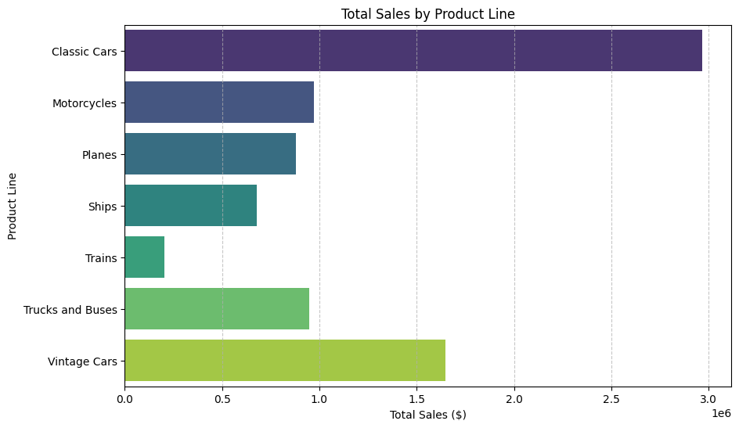
Which product lines have the highest and lowest sales?
Highest Sales: Classic Cars - $2,968,546.40
Lowest Sales : Trains - $203,804.26

Slide 2
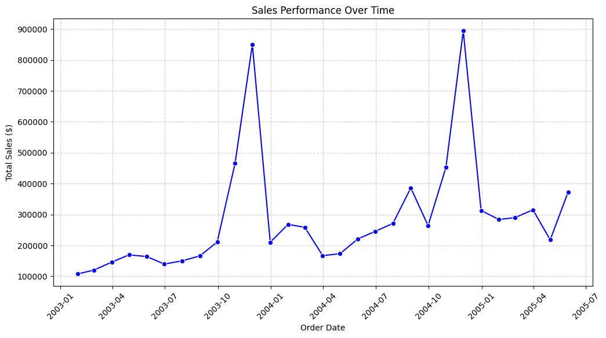
Show sales performance over time, is there any pattern?

Slide 3
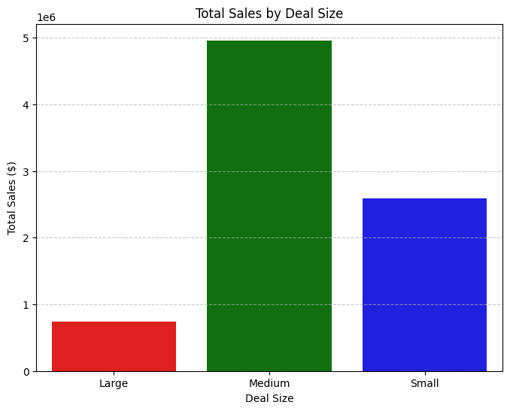
How does deal size (small, medium, large) correlate with total sales?
Total Sales by Deal Size: DEALSIZE TOTALSALES
0 Large 738757.91
1 Medium 4961736.68
2 Small 2592193.44

Slide 4
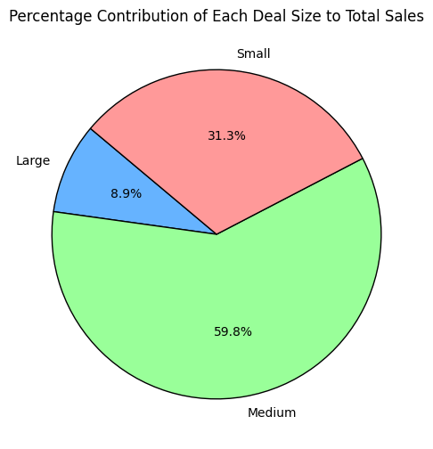
What is the percentage of contribution for each type of deal?
Percentage Contribution of Each Deal Size: DEALSIZE PERCENTAGE
0 Large 8.908546
1 Medium 59.832670
2 Small 31.258784

