Slide 1
NetFPGA Summer School MACSec
Bogdan Deac Digilent Inc.*
Tobias Rosenkranz quapona Technologies GmbH
Joern Hoffmann quapona Technologies GmbH
*Student

Slide 2
Outline
Project Description
Motivation
Implementation
Results

Slide 3
Project Description
Goal: Implement MACSec standard
Workflow: Verilog
Progress: coding and simulation

Slide 4
Why MACSec?
Encryption and authentication between two network interfaces
Secures network communication
Ideal for intermediate deep packet inspection
Ethernet layer security addition (OSI layer 2)
Can transparently applied to the network stack
No complex key distribution like in End-to-End security

Slide 5
MACSec Overview

Slide 6
Implementation Overview
The MACSec module is placed between the output port lookup and output queues.
Verilog Code
MACSec packet logic
Control and status registers
Testing
Packet generation (scapy)
NetFPGA Test code for registers and packets (nftest)

Slide 7
IEEE 801.ae MACSec Packet
Ethernet Packet
Preamble
DST MAC
SRC MAC
Eth
Type
Payload
CRC
MACSec Packet
Preamble
DST MAC
SRC MAC
Sec
TAG
Payload
ICV
CRC
Encryption possible
Integrity Check Value

Slide 8
SecTAG
2 Byte
1 Byte
1 Byte
4 Byte
8 Byte
Ethertype
0x88e5
TCI
AN
SL
PN
SCI (optional)
Sec TAG
TCI TAG Control Information
AN Association Number (Determines the used secure association)
SL Short Length (Encodes packet length if packet <= 64 Byte)
PN Packet Number (Sequential number of the packet used for stream chipher)
SCI Secure Channel Identifier (Channel ID, determied by a chiper key)

Slide 9
MACSec TAG Control Information (TCI)
1 Byte
Ethertype
0x88e5
TCI
AN
SL
PN
AN
SCI (optional)
V
ES
SC
SCB
E
C
V Version Bit (=0)
ES End Station? (Use DST MAC in addition to SCI)
SC SCI present?
SBC Secure Channel Broadcast?
E Encryption Enabled?
C Change Text? (Confidentiality or integrity)

Slide 10
Implementation - State Transition
Indicate Success
Header State
Indicate Error
Indicate Success
n
n
MAC
Sec?
y
Valid?
Valid?
y
n
y
Copy State
Calculate ICV
State
End?
n
n
End?
y
y

Slide 11
Implementation - Registers
reset_reg
Reset counters
Reset core
macsec_header_dbg
macsec_pkt_valid_reg
macsec_pkts_cnt_reg
other_pkts_cnt_reg

Slide 12
Implementation - Test Program
“run.py” file
Uses NF test suite to send packets
Set and check registers
Craft and send packets
“MACSec.py” file
Generator for MACSec Packets
Build with scapy

Slide 13
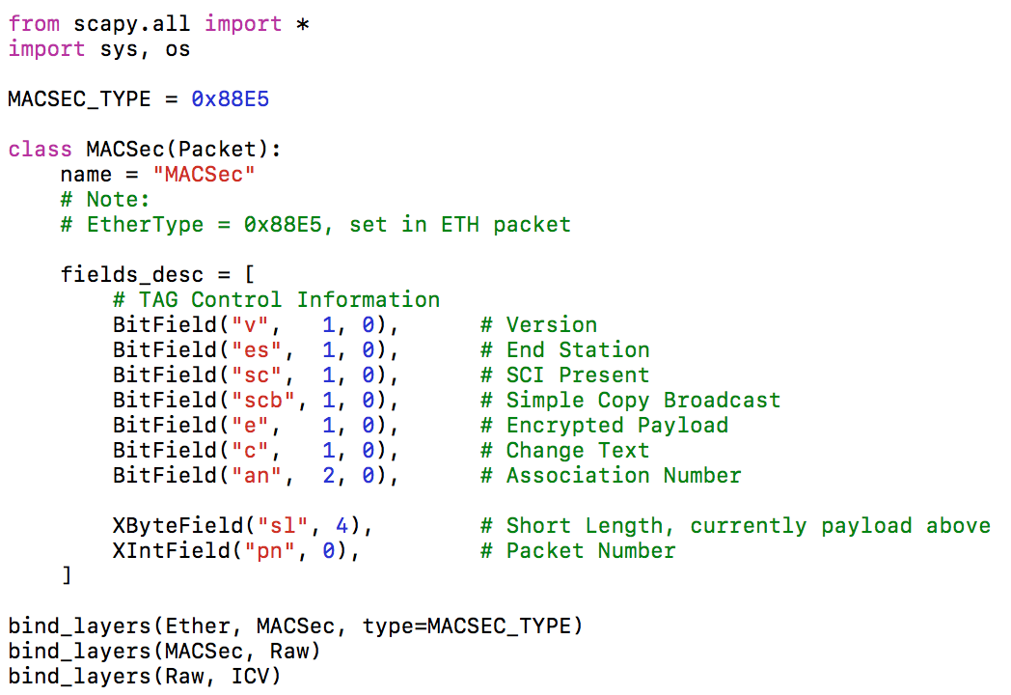
Implementation - MACSec.py

Slide 14
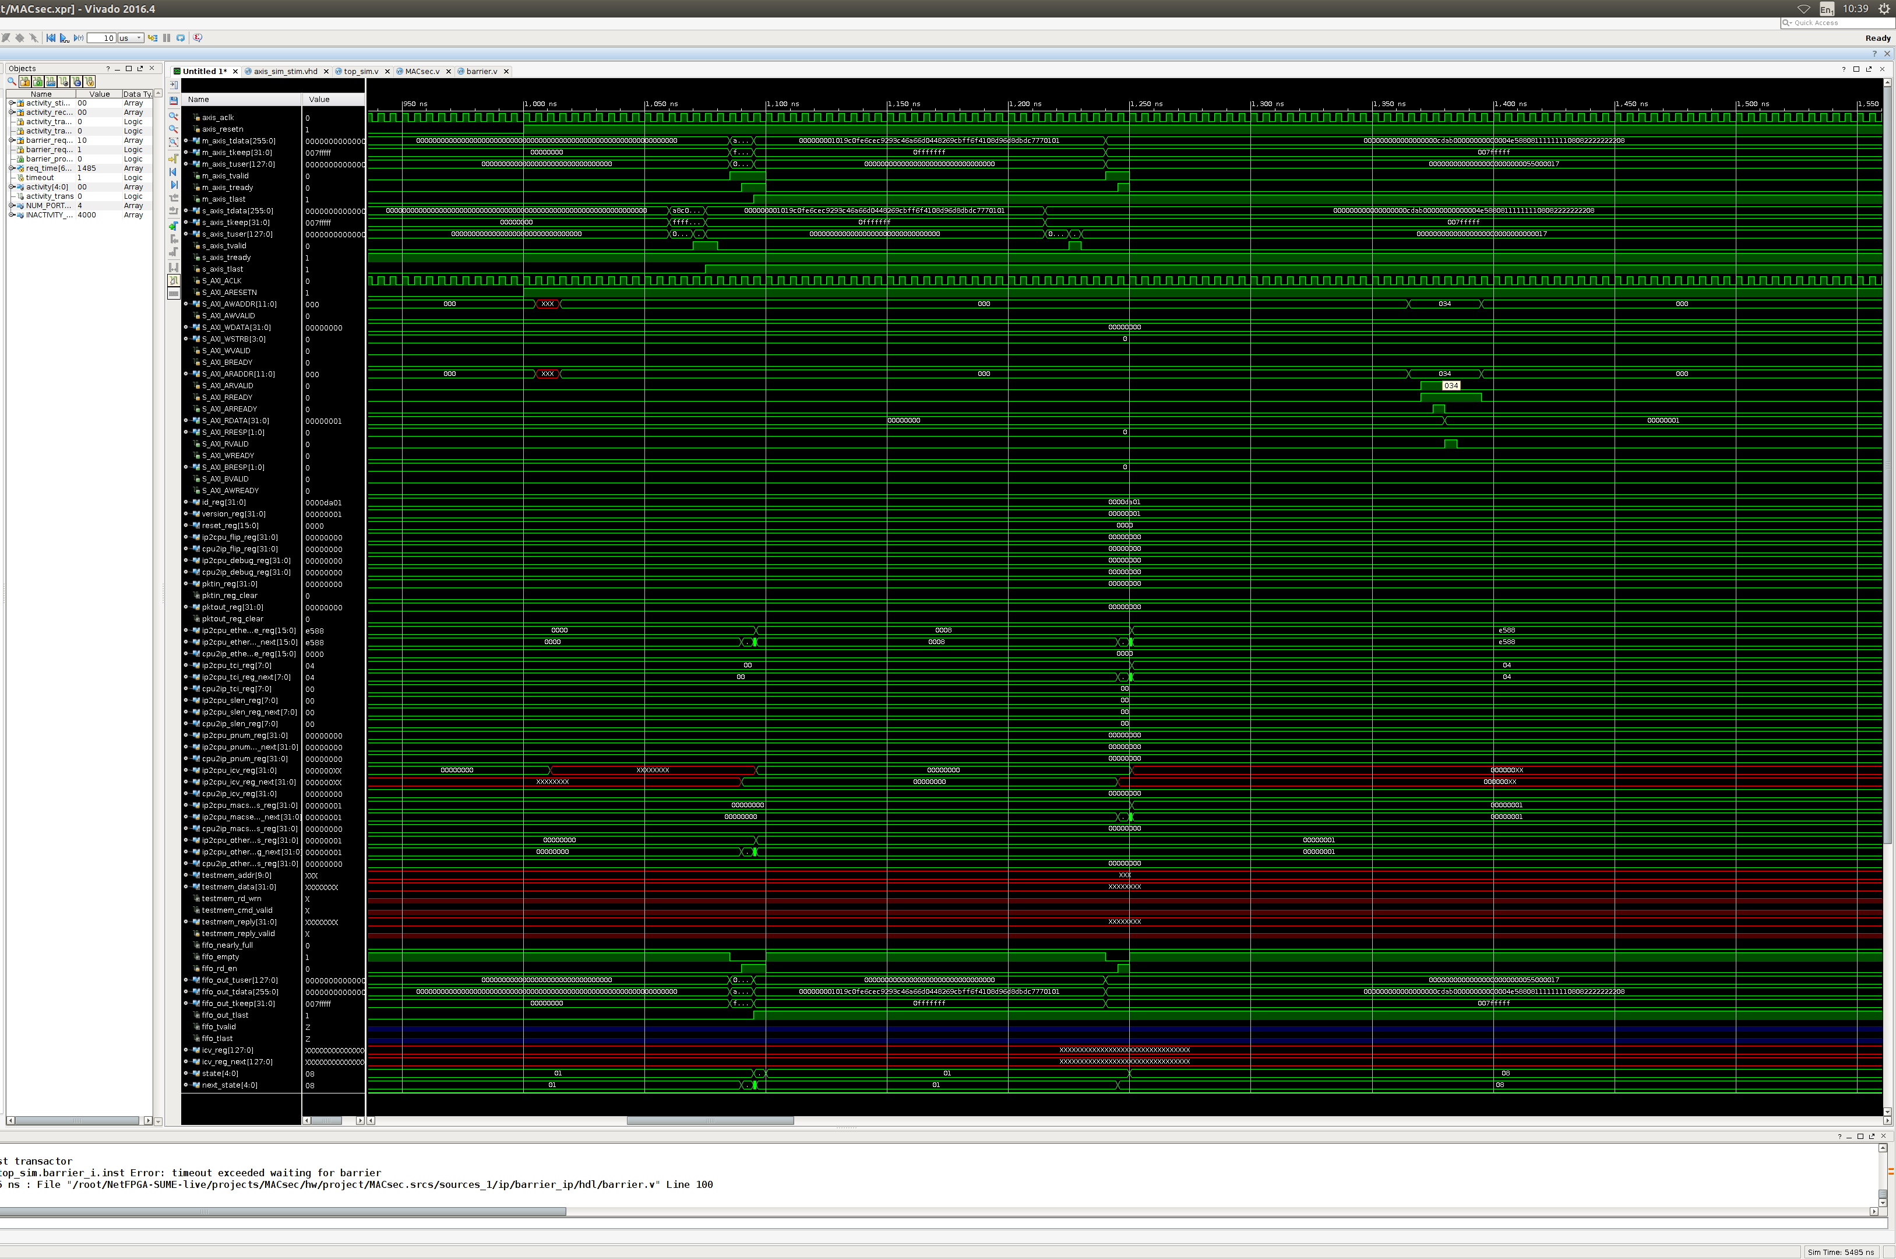
Results (1)
Get familiar with:
NetFPGA Toolchain
Register Subsystem
Debugging with Vivado
Verilog and Python
IEEE 801.ae MACSec

Slide 15
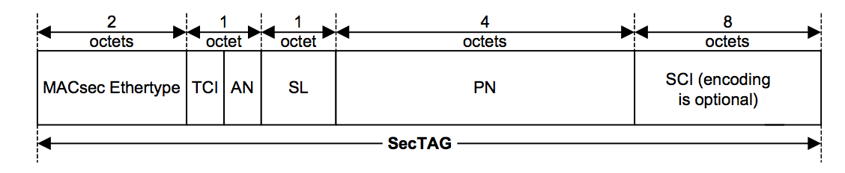
Results (2)
Implementation
Packet detection and validation logic in Verilog
MACSec layer with scapy in Python
Test cases in Python
Synthesizable and tested as simulation

Slide 16
Thank you! Questions?
Bogdan Deac bogdan.deac@digilent.ro
Tobias Rosenkranz t.rosenkranz@quapona.com
Joern Hoffmann j.hoffmann@quapona.com

